Slide 1
CFO Considerations in Joint Sounding
Date: 2025-05-09
Authors:

Slide 2
Abstract
UHR Sounding is an enabling protocol for Coordinated Beamforming.​
​
Two UHR Sounding schemes are considered in D0.2:​
Sequential Sounding​
Joint Sounding​
​
This contribution focuses on CFO in Joint Sounding.

Slide 3
UHR TB Joint NDP Sounding
Joint Sounding consists of having two APs (initiating & responding) transmitting sounding NDPs simultaneously.​
​
Carrier frequency synchronization between APs allows the STA to consider a single CFO in channel estimation (CFO correction) [1, 2]​.

Slide 4
Problem Statement​
The Doppler profile of the channel STA – AP1 (initiating AP) is different than that of STA – AP2 (responding AP).​
​
The NDP transmitted by AP1 is received at STA with a CFO different than that of the NDP transmitted by AP2 (even with perfect synchronization between APs).​
​
If a STA considers a single CFO during channel estimation, the Doppler-induced differences between both AP-STA links can result in residual carrier-frequency errors.

Slide 5
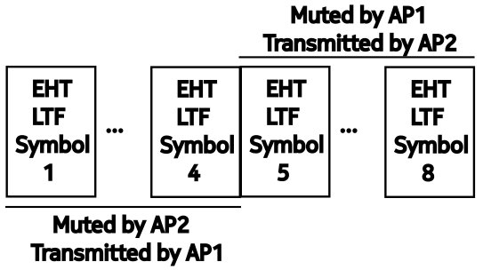
Proposal 1
Have the initiating and responding APs interchangeably mute the LTF symbols in the NDP's LTF field.​
Second STA Info field (B30-B31) may be used for instructing the responding AP how muting should be performed.

Slide 6
Proposal 2
Have initiating and responding APs transmit NDPs sequentially, separated by a SIFS.​
The First STA Info field (B11-B13) may be used to indicate NDPs separated by a SIFS.

Slide 7
Additional Remarks
Private wireless networks in factories and ports is an emerging vertical.
STAs have low-medium mobility (10 – 30 kmph).
The channel coherence time at 5GHz ranges from 9 – 4 ms. [4]
The scheduler prioritizes STAs with higher Doppler for CBF transmission after UHR Joint Sounding

Slide 8
Straw Poll 1
Do you agree that LTF symbol muting shall be included in UHR Joint Sounding ?​

Slide 9
Straw Poll 2
Do you agree that NDPs sent by APs in UHR Joint Sounding shall be sent sequentially, separated by a SIFS ?

Slide 10
References
[1] CFO Correction for COBF, Sameer Vermani et al., Qualcomm​
[2] On Determination of CoBF MAP Sync-Reference and Sync-Follower Roles, Julia Feng et al., Mediatek​
[3] IEEE P802.11bn/D0.2
[4] An Uncertainty Relation for WSS Processes and Its Applications to WSSUS Systems, B. H. Fleury, IEEE Transactions on Communications

