Slide 1
Technical Amendments for Consideration within the Scope of TGbr
Date: 2025-05-12
Authors:

Slide 2
Abstract
May 2025
This contribution aims to kickstart the technical discussion on several of the technical topics that are part of the TGbr PAR. In particular, the topics discussed here are those of wavelength channel separation in the 400 nm – 600 nm window, the supported types of operation in WDM, the localization capability that should be supported by LiFi, and last but not least, better integration between the light antennae and 802.11 compliant DSPs.

Slide 3
Outline
May 2025
Blue-Green Spectrum Operation
Multi-Wavelength Operation
Localization Capability
Integration of the IEEE Std. 802.11 Baseband with Optical Frontends

Slide 4
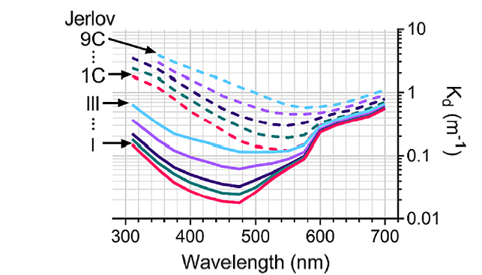
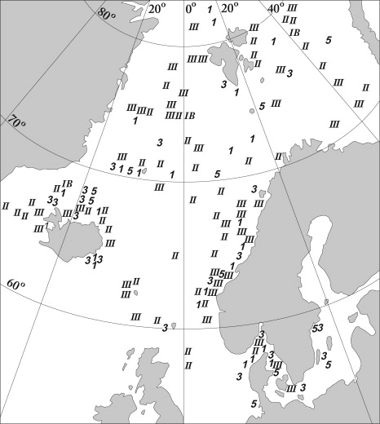
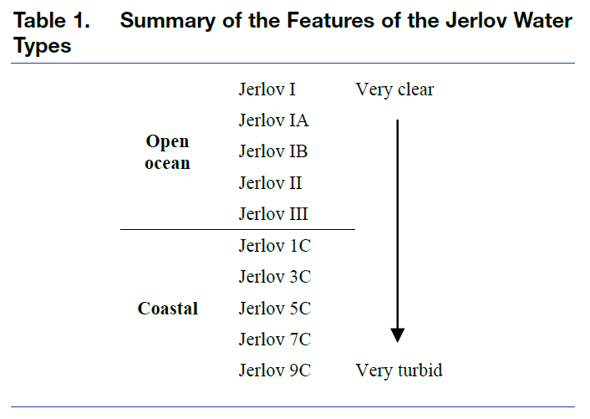
Blue-Green Spectrum Operation
May 2025
400 nm – 600 nm spectrum use required for optimum results in underwater deployments
Defined wavelength ranges should be dictated by pairing the most common environments with the optimum wavelengths in the proposed band
Two ranges (400 nm – 500 nm and 500 nm – 600 nm for Open Ocean and Coastal respectively) may be sufficient; this is in line with how 802.11bb defined wavelength ranges of operation

Slide 5
Multi-Wavelength Operation
May 2025
802.11bb defines the following options as far as use of WDM goes:
  SU-MIMO
  MU-MIMO
802.11bb defines the maximum number of WDM streams as 2 (should we increase to 3?)
Multi-Wavelength Operation can enhance data rates (as above) and through MLO but can also provide physical network separation which can be beneficial in certain use cases
Simultaneous operation of an AP in a manner similar to 2.4 GHz vs 5 GHz vs 6 GHz with separate SSIDs but across different wavelengths would be beneficial to achieve the above objective
Operation where uplink and downlink communication is done on separate wavelengths could also be beneficial in certain use cases and should also be considered

Slide 6
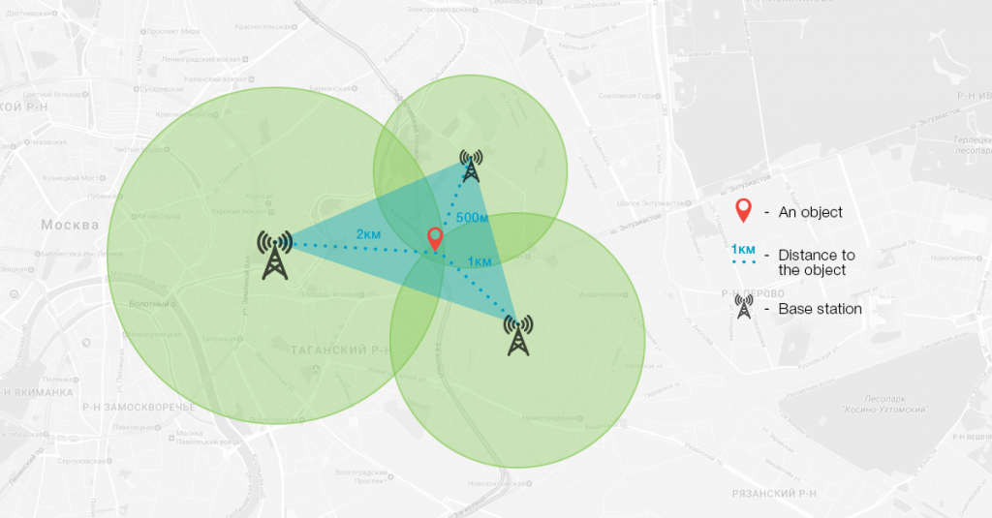
Localization Capability
May 2025
Combining data transmission with localization capability can be a great value add in certain use cases
For maximum accuracy we would require a trilateration type technique
This necessitates ranging capability even when not connected to AP i.e., based on beacon signaling or a trigger request similar to the WiFi Round Trip Time approach introduced by TGmc

Slide 7
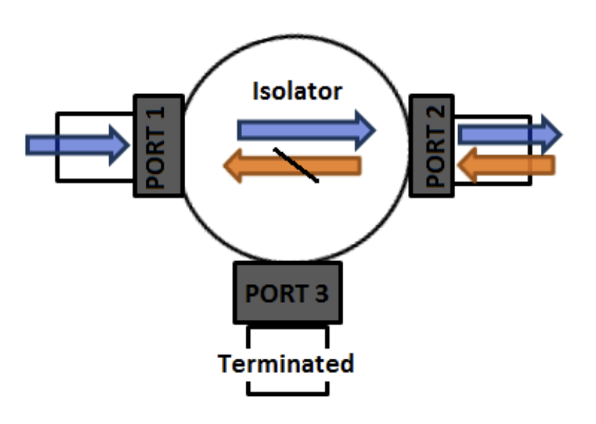
Integration of the IEEE Std. 802.11 Baseband with Optical Frontends
May 2025
New carrier frequency support – (40+delta) MHz, (80+delta) MHz, (160+delta) MHz (also 5 MHz and 10 MHz for backwards compatibility?)
  Eliminates need for external up and down conversion
Exposed dedicated RX pins or alternatively expose digital signaling to reduce external component count for TX and RX antenna separation
  We want to eliminate the need for external components required for antenna connection i.e., circulators, switches and isolators

Slide 8
Straw Poll 1
Propose to include two operational wavelength ranges – 400 nm to 500 nm and 500 nm to 600 nm into the baseline TGbr draft.

Slide 9
Straw Poll 2
Propose to include the ability to do uplink and downlink communication on two separate and different wavelengths/wavelength ranges into the baseline TGbr draft.

Slide 10
Straw Poll 3
Propose to include new carrier frequencies that allow for baseband signals to be output from WiFi DSP chipsets that support LiFi communication into the baseline TGbr draft.

Slide 11
References
May 2025
[1] Slide 4, images from C. Williamson and R. Hollins, "Measured IOPs of Jerlov water types," Appl. Opt. 61, 9951-9961 (2022).
[2] Slide 4, images from Eyvind Aas, Niels Kristian Højerslev, Jo Høkedal, Kai Sørensen, Optical water types of the Nordic Seas and adjacent areas, Oceanologia, Volume 55, Issue 2, 2013, Pages 471-482, ISSN 0078-3234, https://doi.org/10.5697/oc.55-2.471. (https://www.sciencedirect.com/science/article/pii/S0078323413500261)
[3] Slide 6, image from https://www.loccate.com/blog/identify-location-without-gps/
[4] Slide 7, image from https://encrypted-tbn0.gstatic.com/images?q=tbn:ANd9GcQnqC1sSGBjEYy9Ua_kRD-yJ0MnhjUjLTfiPg&s https://valvo.com/wp-content/uploads/2017/12/ISOLATOR.pdf

