Slide 1
Improvement on Link Adaptation Feedback
Date: 2025-05-08
Authors:
Name | Affiliation | Address | Phone | Email
Ning Gao | OPPO |  |  | gaoning1@oppo.com
Chaoming Luo
Liuming Lu
Weijie Xu
Liangxiao Xin
Huixuan Zhou

Slide 2
Introduction
The HE link adaptation (HLA) Control and EHT link adaptation (ELA) Control are defined to enable fast link adaptation mechanism for HE and EHT respectively.
However, both HLA Control and ELA Control are variants of an A-Control subfield, which only present in Data frames and Management frames.
Apart from Data frames and Management frames, a TXOP responder also transmits BlockAck/Ack Control frames to a TXOP holder in a TXOP.
Therefore, it makes sense to include the link adaptation feedback in the BlockAck frames to help the TXOP holder obtain feedbacks more frequently.
In this contribution, we propose to improve the link adaptation mechanism by including link adaptation feedback in Multi-STA BlockAck frames.

Slide 3
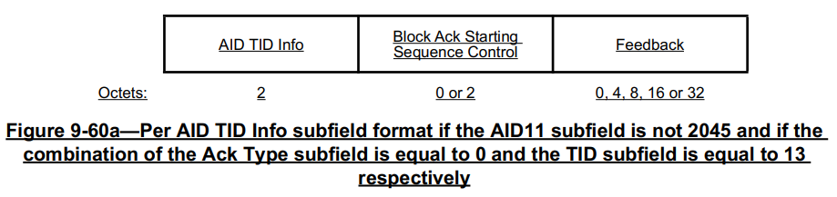
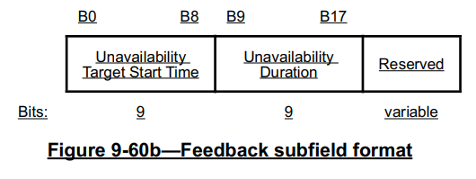
Recap
The Multi-STA BlockAck (M-BA) frame with Dynamic Unavailability Operation (DUO) feedback
  In 802.11bn Draft 0.2, a Per AID TID Info subfield is used to carry DUO feedback if the AID11 subfield is not 2045 and if the combination of the Ack Type subfield is equal to 0 and the TID subfield is equal to 13 respectively. ^{[1]}

Slide 4
Proposed Method
Similar to the DUO feedback, we can use the M-BA frame to carry UHR link adaptation (ULA) feedback and differentiate it from the DUO feedback by a Feedback Type field which is proposed in [2, 3].
The ULA feedback are used to provide recommended parameters for the TXOP holder, such as
  UHR-MCS
  NSS
  BW
  RU Allocation
  PPDU format
  Coding Type
  Tx beamforming
  RRU/DRU
  ….
This method can improve the link adaptation mechanism and further improve the throughput and reliability performance of the UHR.

Slide 5
Summary
A Multi-STA BlockAck frame with ULA feedback is proposed in this contribution to improve the link adaptation mechanism.
The position of this ULA feedback is similar to the DUO feedback.
The ULA feedback is differentiated from the DUO feedback by a Feedback Type field.
The format and parameters of this ULA feedback is TBD.

Slide 6
SP 1
Do you agree to use the Multi-STA BlockAck frame to carry a UHR link adaptation (ULA) feedback and differentiate it from the DUO feedback by a Feedback Type field?
  Yes/No/Abstain

Slide 7
References
[1] Draft P802.11bn_D0.2
[2] 11-24-0414-01-00bn-improving-acknowledgment-mechanisms, Sherief Helwa (Qualcomm)
[3] 11-25-0430-01-00bn-in-device-coexistence-signaling-details, Sherief Helwa (Qualcomm)

