Slide 1
AMP Bi-static Backscatter in 2.4GHz
Date: 2025-05-10
Authors:
Name | Affiliation | Address | Email
Panpan Li | Huawei | Singapore | lipanpan25@huawei.com
Lei Huang |  | Singapore
Bin Qian |  | Shenzhen, China
Lumin Liu |  | Singapore

Slide 2
Background
Motion 15: 11bp defines at least one mode of MAC/PHY that supports bi-static backscattering communication in 2.4 GHz.
[1] investigated UL coverage of bi-static backscatter. UL range of about 2 meter, may still be achieved when direct leakage is present for an DR of 50 dB with EH power levels that are relatively sufficient
This contribution intends to revisit the link budget analysis and answer following questions for both DL and UL
Can bi-static reuse mono-static receivers?
Can bi-static reuse mono-static Sync sequence?
AMP Energizer
Carrier
leakage
AMP AP
AMP STA
Backscatter signal

Slide 3
DL Link budget (AP → STA)
Pr_STA (>=Rx sensitivity) = Pt_AP – PL(d)
Consider coverage 2m and STA Rx sensitivity -45dBm, AP Tx power need to be >=3.2dBm.
2.4GHz
Pt_AP (dBm) | 0 | 3.2 | 10
STA Rx sensitivity (dBm) | -45 | -45 | -45
DL distance(Friis channel) (m) | 1.8 | 2.6 | 5.6
DL distance (channel D) (m) | 1.4 | 2 | 4.4

Slide 4
DL Assumptions
For mono-static backscatter, SNR at STA: -20-(-95)-10-9=56dB
For bi-static backscatter, SNR at STA: -36-(-95)-10-9=40dB
 |  | Mono-static | Bi-static
Coverage |  | 10-20cm | 2m
Tx power | Tx power | AP: 0dBm | AP: 10dBm
Receive signal modelling | Backscatter signal | 10cm PL: 20dB → -20dBm | 2m PL: 46dB → -36dBm
 | Rx noise | 80MHz thermal noise: -95dBm STA NF: 10 dB [2] Sensitivity of ~9dB for 100k ppm [2]
DL receiver | Detector | Non-coherent
 | Rx bandwidth | 80MHz
 | Rx sensitivity | -45dBm

Slide 5
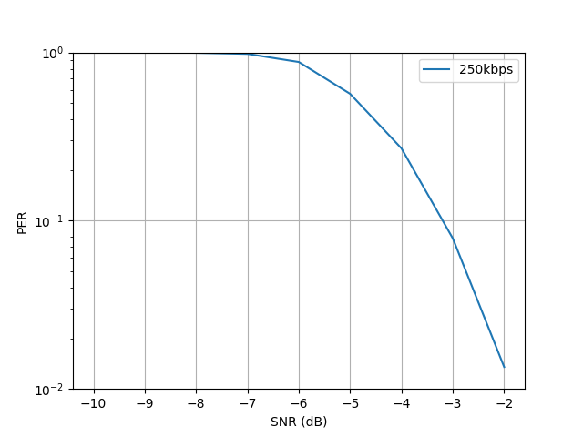
DL Assumptions
Mono-static SNR at STA: 56dB
Bi-static SNR at STA: 40dB
Bi-static backscatter may reuse mono-static backscatter DL receiver and Sync sequence.
May need to increase Tx power to achieve 2m coverage.
Data PER 10% @-3.3dB, PacketLen=80bits, ideal sync, 0ppm, L-LTF, Rx 2MHz

Slide 6
UL Link budget (Energizer → STA)
Pr_STA (EH sensitivity) = Pt_E– PL(d)
The STA EH sensitivity limits the coverage from Energizer to STA
Consider coverage 2m, STA EH sensitivity need to be <=-28dBm.
2.4GHz
Pt_energizer (dBm) | 20
STA EH sensitivity | -20 | -25 | -28 | -30
$d_{ES}$ (Friis channel) (m) | 0.99 | 1.77 | 2.5 | 3.15
$d_{ES}$ (channel D) (m) | 0.79 | 1.41 | 2 | 2.50

Slide 7
UL Link budget (STA→AP)
Energizer
Leakage: $P_{r}^{E→A}$
$$P_{t}^{E}$$
$$d_{AE}$$
$$d_{ES}$$
Dynamic range: ~50dB
Signal: $P_{r}^{S→A}$
$$P_{r}^{E→A}$$
$$∂_{ESA}$$
AP
$$P_{r}^{S→A}$$
$$d_{AS}$$
STA
SNR
Noise
SNR = DR - (P_leakage - P_signal)
Pt_energizer (dBm) | 20
backscatter loss (dB) | 5
$d_{AS}$ (m) | 2
$d_{ES}$ (m) | 1 |  |  |  |  | 2
$$∂_{ESA}$$ | 60 | 90 | 120 | 150 | 180 | 60 | 90 | 120 | 150 | 180
SNR (dB) | 3.7 | 5.9 | 7.3 | 8.2 | 8.5 | -1.0 | 1.9 | 3.7 | 4.6 | 5.0

Slide 8
UL Assumptions
UL Performance for mono-static backscatter [4]
Bi-static backscatter may need a longer Sync than mono-static backscatter.
Bi-static backscatter may need better leakage removal.
Suggest keep clock restriction of bi-static backscattering same with mono-static: 100k ppm.
RxNF | Data rate | Clock accuracy | Rx power @10% SYNC+Data PER | SNR (dB)
-35dBr | 250kbps | 0ppm | -33 dBr | 2
 |  | 100kppm | -31.5 dBr | 3.5
 | 1Mbps | 0ppm | -26 dBr | 9
 |  | 100kppm | -22 dBr | 13

Slide 9
Summary
For DL, bi-static backscatter may reuse mono-static backscatter receiver and Sync sequence.
For UL, bi-static backscatter may need a longer Sync than mono-static backscatter. Also, bi-static backscatter may need better leakage removal.

Slide 10
Reference
[1] 11-25-0030-00-00bp-amp-ul-bi-static-leakage-and-dynamic-range-implications
[2] 11-24-1797-00-00bp-design-considerations-of-dl-data-rate-and-sync
[3] 11-24-1798-00-00bp-backscattering-ul-data-rate-and-modulation
[4] 11-25-0306-00-00bp-amp-backscattering-ppdu-and-sync-design

