Slide 1
AMP Security – follow up
Date: 11 May 2025
Name | Affiliation | Address | Phone | Email
Rojan Chitrakar | Huawei | Singapore |  | rojan.chitrakar@huawei.com
Lei Huang
Ian Bajaj
Notes:
Jul 12, 2010
Page 1

Slide 2
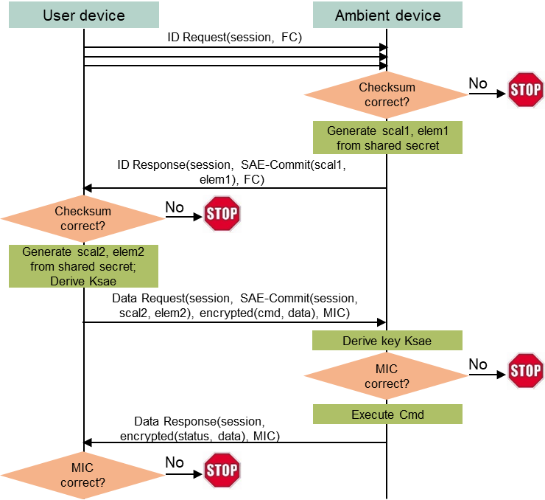
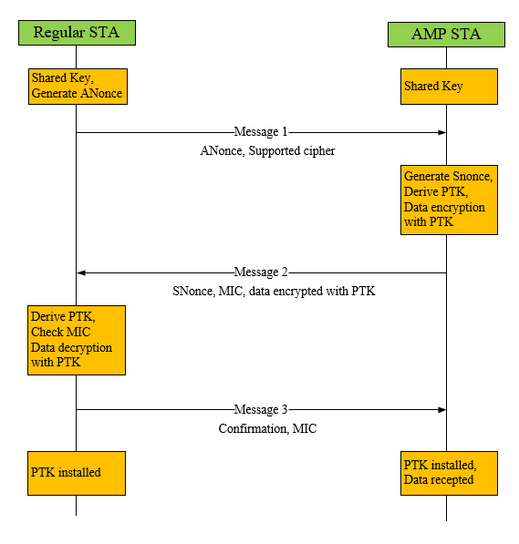
Recap (1/2)
Authentication and Key generation for AMP STAs were discussed in [1], [2], [3], [4].
[1] proposes using the SAE during AMP message exchanges to generate the security keys to be used in AMP communication.
[2] proposes to generate the security keys to be used in AMP communications using pre-shared keys.

Slide 3
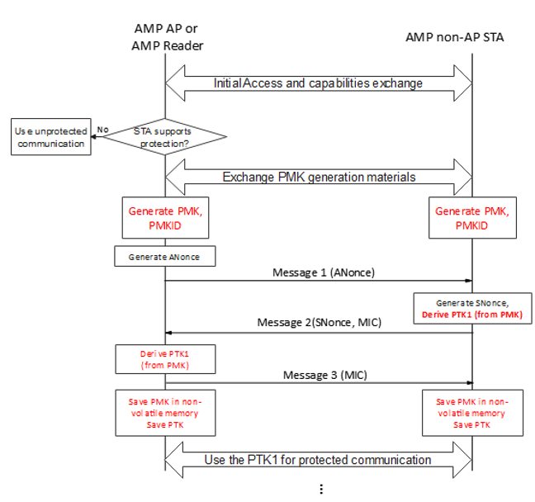
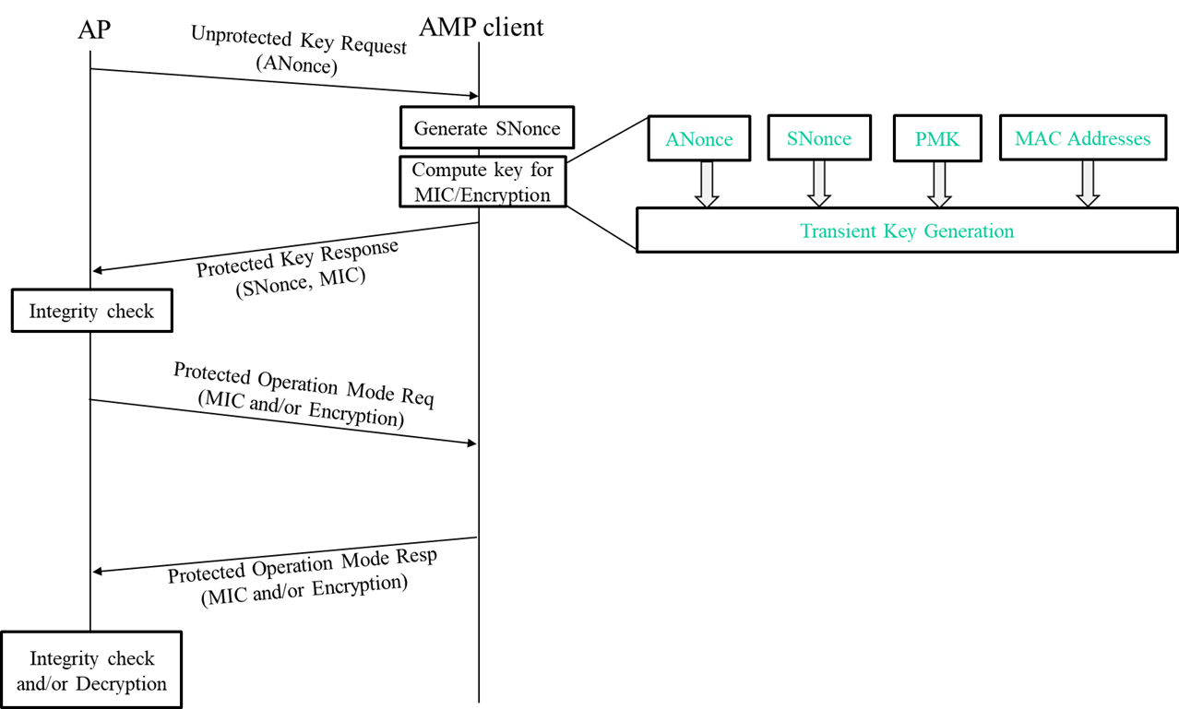
Recap (2/2)
[3] proposes generating PMK infrequently/only when needed. PTK is derived from the PMK to be used in AMP communication.
[4] proposes using PMK generated during offline onboarding to derive PTK to be used in AMP communication

Slide 4
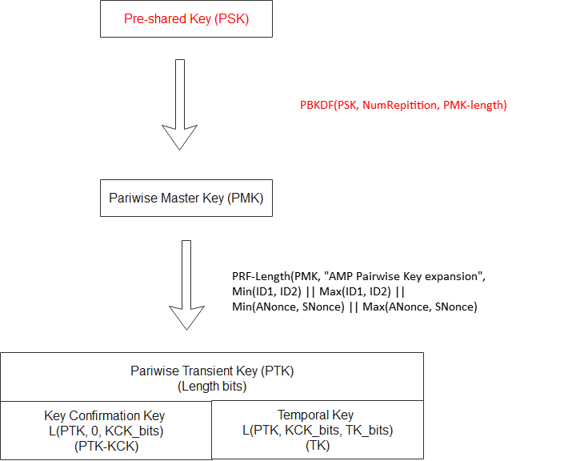
Key Generation - 1
Many non-AP AMP STAs (e.g., Active Tx non-AP AMP STA) can be expected to be in operation for long time (years). For such STAs, it is desirable that the PMK can be replaced in-band as needed (instead of out-of-band during onboarding etc.).
Simpler methods of deriving PMK from pre-installed Pre-shared Key (PSK) can be used, e.g., Password-Based Key Derivation Function (PBKDF).
Assumption: A Pre-shared key (e.g., 256 bits) is pre-programmed on both AMP AP and non-AP AMP STA.
Using a Password-Based Key Derivation Function (PBKDF), “Hash-String || transmitter's ID || receiver's ID” are hashed 2^{NumRepetition} times using the PSK, to produce a PMK-length bits Pairwise Master Key (PMK) .

Slide 5
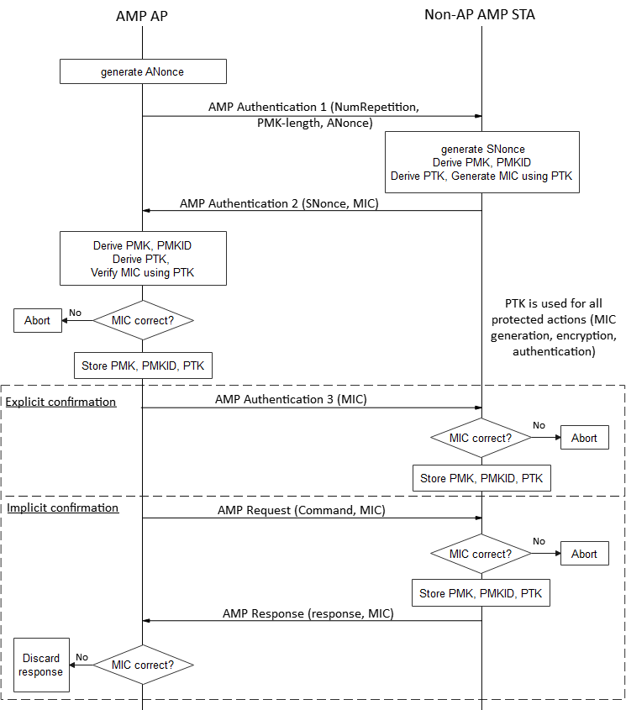
Key Generation - 2
PMK Generation (first time or for update):
In Message 1, AMP AP provides:
Info required for PMK generation:
  NumRepetition: Number of hash repetition to be performed
  PMK-Length: Length of the PMK (e.g.,0: 128-bits, 1: 256-bits)
Anonce for PTK generation (from the PMK)
2) Non-AP AMP STA generates PMK (based on Message 1) and derives PTK from it and sends Message 2 carrying a SNonce and a MIC generated using the PTK.
3) Upon receiving Message 2, AMP AP generates PMK and derives PTK from it and verifies the MIC in Message 2 using the PTK. If the MIC verification succeeds, it saves the PMK and PMKID and sends a frame to confirm the keys:
Either explicitly using Message 3 carrying a MIC
Or, implicitly by including a MIC in a protected AMP frame.
4) If the MIC in the received AMP frame is verified correctly using the PTK, the non-AP AMP STA saves the PMK and PMKID.
Example:
PMK = 2^{NumRepetition} times (SHA-128(PSK, Hash-string || Min(ID1, ID2) || Max(ID1, ID2))
Here,
Hash-string = “AMP PMK Generation”
ID1 = AMP AP’s MAC Address, ID2 = non-AP AMP STA’s MAC Address

Slide 6
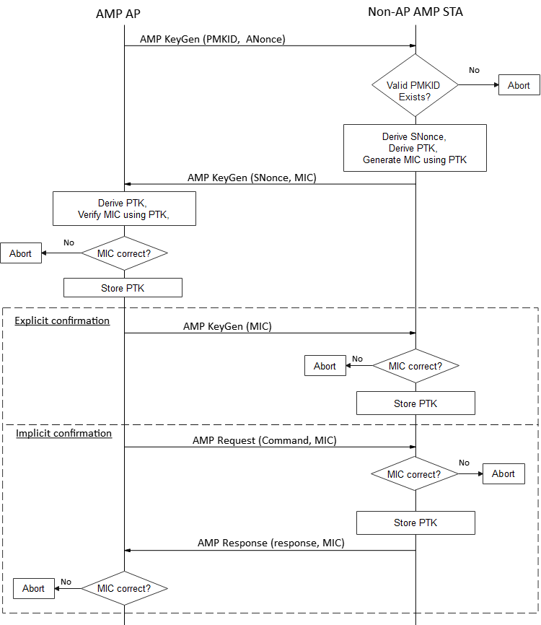
Key Generation - 3
PTK Generation (from an existing PMK):
In Message 1, AMP AP provides:
PMKID corresponding to a PMK
Anonce for PTK generation
2) Upon receiving Message 1, Non-AP AMP STA retrieves the PMK (based on PMKID) and derives PTK from it and sends Message 2 carrying a SNonce and a MIC generated using the PTK.
3) Upon receiving Message 2, AMP AP derives PTK from PMK and verifies the MIC in Message 2 using the PTK. If the MIC verification succeeds, it saves the PTK and sends a frame to confirm the PTK:
Either explicitly using Message 3 carrying a MIC
Or, implicitly by including a MIC in a protected AMP frame.
4) If the MIC in the received AMP frame is verified correctly using the PTK, the non-AP AMP STA saves the PTK.
Example:
PTK = HMAC-SHA-1 (PMK, "AMP Pairwise Key expansion", Min(ID1, ID2) || Max(ID1, ID2) || Min(ANonce, SNonce) || Max(ANonce, SNonce))

Slide 7
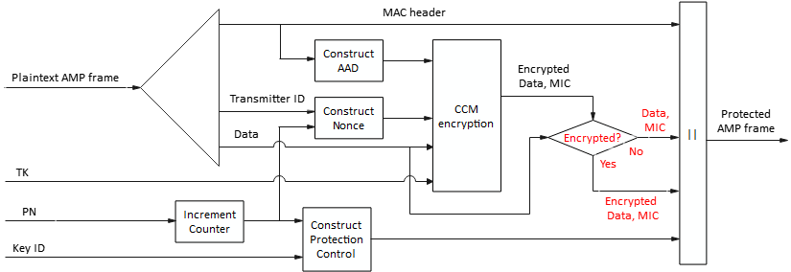
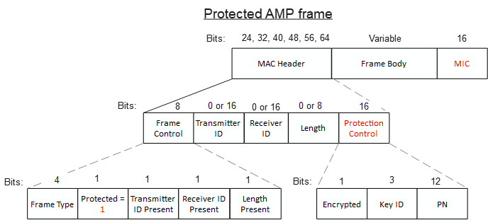
Cryptographic protocol
Due to its simplicity and wide use in 802.11, we propose that CCMP is used both* for encryption and authentication of AMP frames.
  For authenticated AMP frame, the FCS field carries the MIC but the frame body is not encrypted.
If Encrypted = 1, content of Frame Body is encrypted, else it is in plain text.
FCS field carries the MIC
Indicates protected AMP frame
0: Authenticated
1: Encrypted
Notes:
In baseline (802.11REVme)D7), CCMP is only used for encryption

Slide 8
Conclusion
In this contribution we shared our thoughts regarding AMP Security:
A new PMK is generated using the same frame exchange used for PTK generation. Once verified, the new PMK is used for PTK derivation.
The same cryptographic protocol (e.g., CCMP) is used both for authentication and encryption of AMP frames.

Slide 9
SP 1
Do you agree to add the following text to TGbp SFD?
802.11bp defines a mechanism to generate a Pairwise Master Key (PMK) and a Pairwise Transient Key (PTK) at a non-AP AMP STA to support secure communication, where:
  An AMP AP transmits a first downlink AMP frame containing NumRepetition, PMK-Length and an ANonce.
  After receiving the first downlink AMP frame from the AMP AP, the non-AP AMP STA generates a PMK, a PMKID and an SNonce.
  The non-AP AMP STA generates a Pairwise Transient Key (PTK) using the ANonce, the SNonce, and the PMK.

Slide 10
SP 2
Do you agree to add the following text to TGbp SFD?
802.11bp defines a mechanism to generate a Pairwise Master Key (PMK) and a Pairwise Transient Key (PTK) at a non-AP AMP STA to support secure communication, where:
  After generating a PMK and a PTK in response to the first downlink AMP frame carrying an ANonce, the non-AP AMP STA generates a first MIC using the PTK and transmits an uplink AMP frame carrying the SNonce and the first MIC.
  After receiving the uplink AMP frame from the non-AP AMP STA, the AMP AP generates a PMK, and a PMKID.
  The AMP AP generates a Pairwise Transient Key (PTK) using the ANonce, the SNonce, and the PMK and verifies the first MIC using the PTK.
  If the first MIC is verified, the AMP AP saves the PMK and PMKID, generates a second MIC and transmits a second downlink AMP frame carrying the second MIC to the non-AP AMP STA.

Slide 11
SP 3
Do you agree to add the following text to TGbp SFD?
802.11bp defines a mechanism to generate a Pairwise Master Key (PMK) and a Pairwise Transient Key (PTK) at a non-AP AMP STA to support secure communication, where:
  After receiving the second downlink AMP frame carrying the second MIC, the non-AP AMP STA verifies the second MIC using the PTK.
  If the second MIC is verified, the non-AP AMP STA saves the PMK and PMKID.

Slide 12
SP 4
Do you agree to add the following text to TGbp SFD?
CTR with CBC-MAC protocol (CCMP) is used both for data confidentiality (i.e., encryption) and authentication of AMP frames.

Slide 13
References
[1] IEEE 802.11-24/178r0, Security considerations in ambient power communications, Hui Luo
[2] IEEE 802.11-24/1203r0, Authentication and Security transaction for AMP, Chuanfeng He
[3] IEEE 802.11-24/1548r2, Thoughts on security for AMP , Rojan Chitrakar
[4] IEEE 802.11/24/2112r0, Secure E2E Operation for AMP, Sanket Kalamkar

