Slide 1
Feasibility Study of Mono-static Backscatter in Sub-1 GHz
Date: 2025-05-10
Authors:
Name | Affiliation | Address | Email
Panpan Li | Huawei | Singapore | lipanpan25@huawei.com
Lei Huang |  | Singapore
Lumin Liu |  | Singapore

Slide 2
Background
This contribution intends to discuss the feasibility of mono-static backscattering communication in sub-1 GHz
  Use cases
  AMP S1G tag reading
  Prior arts of self-jammer cancellation
  Link budget analysis
  Operating bands, bandwidth
  PHY design principle
  Coexistence issues

Slide 3
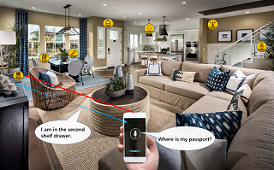
Use cases
According to AMP technical report, some mobile device related use cases like item tracking and smart home require coverage up to 10 meters [2].
Mobile device related mono-static backscattering use cases in 2.4 GHz discussed in [3] has coverage 10~20cm.
Mono-static backscattering communication in sub-1GHz is expected to achieve >5m coverage.

Slide 4
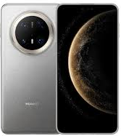
AMP S1G Tag reading
Digital Logic
Rx
RF carrier cancellation
Directional coupler/Circulator
Carrier
ADC
RF Harvesting & Power Management
Baseband leakage removal
Rx
OOK signal
Tx
Tx
AMP AP
Single antenna
Leakage removal modules
  RF carrier cancellation (including directional coupler/circulator)
  Baseband leakage removal
AMP tag
Similar simple tag as 2.4G

Slide 5
Prior Arts of self-jammer cancellation
Typical RF carrier cancellation in UHF RFID achieve 50-70dB [5]
Baseband algorithm can bring >60dB (up to 80dB) suppression [6, 7]
RFID chips [8-11] achieve [-103, -77]dBm Rx sensitivity
  10dBm self-jammer at Rx port is usually assumed
  Assume backscatter signal -90dBm, >100 dB self jammer cancellation are achieved
 | Tx power (dBm) | Rx sensitivity (dBm)
[8] | 33, 11 | -103, -98, -93, -84
[9,11] | 30, 17.5 | -80, -77
[10] | 33, 27, 11 | -88, -82, -75

Slide 6
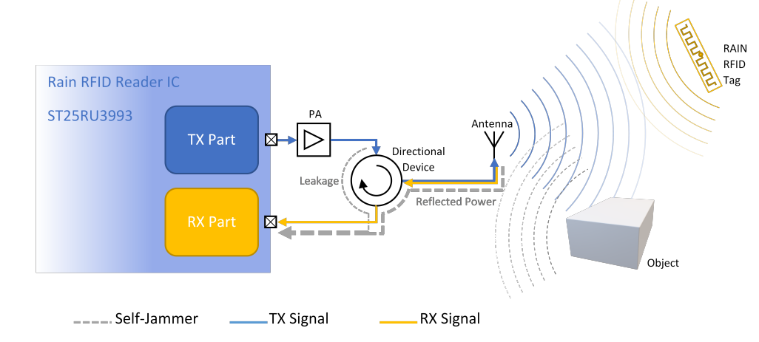
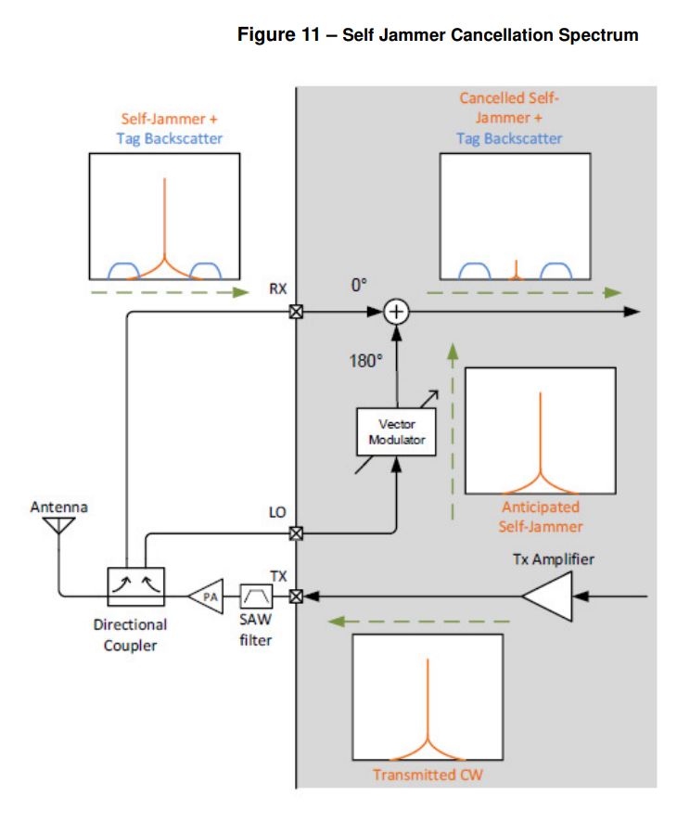
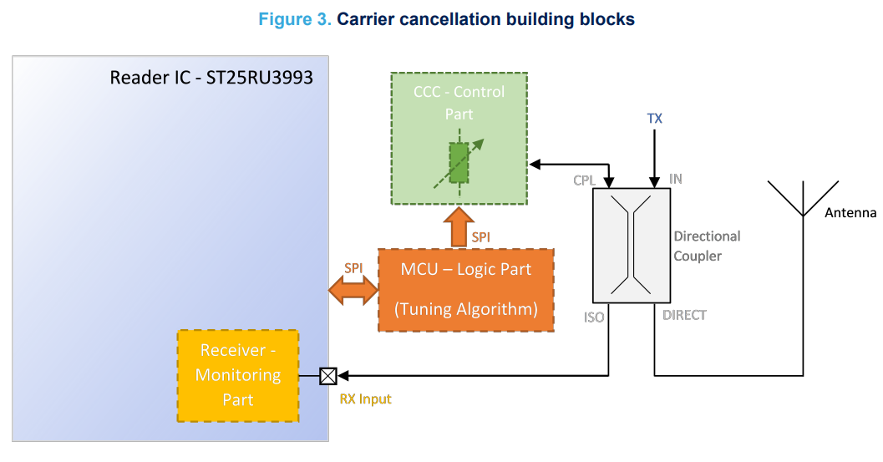
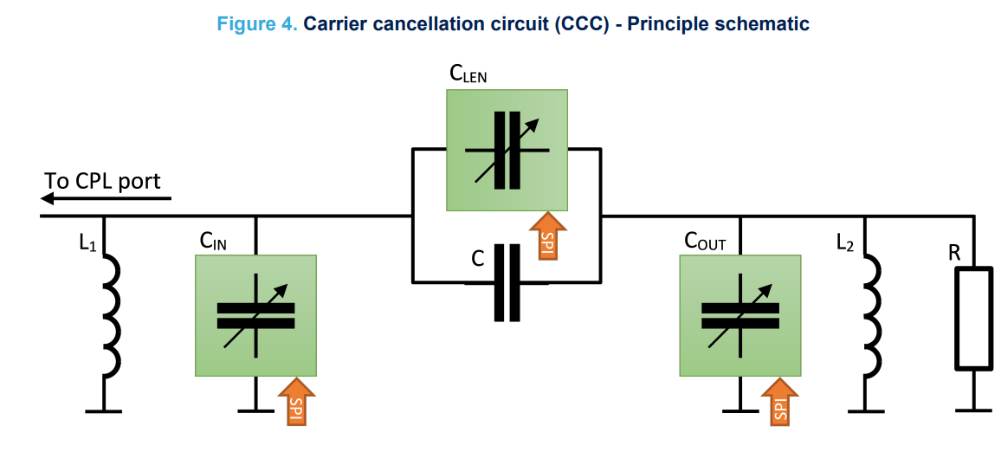
RF carrier cancellation circuit examples in [8-11]

Slide 7
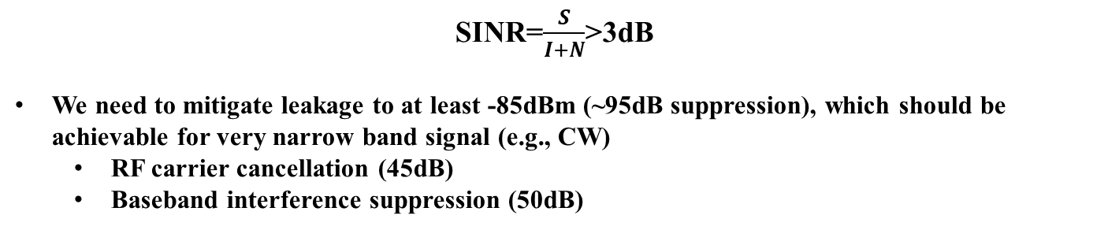
Link budget analysis
Pt_AP=35dBm
Antenna loss: -5dB
Return loss: 15dB
5m PL: -45.7dB
Backscatter loss: -5dB
Coupling: -10dB
5m PL: -45.7dB
Leakage before removal: 10dBm
Antenna loss: -5dB
Backscatter signal: -81.4dBm
Coupling: -10dB
95dB
Leakage after removal: -85dBm
Thermal noise: -114dBm (1MHz)
SINR=$\frac{S}{I+N}$>3dB
We need to mitigate leakage to at least -85dBm (~95dB suppression), which should be achievable for very narrow band signal (e.g., CW)
  RF carrier cancellation (45dB)
  Baseband interference suppression (50dB)

Slide 8
Operating bands, bandwidth
To achieve >5m coverage in sub-1GHz, AMP may seek operating bands with higher Tx power.
Possible AMP operating bands in sub-1GHz [Appendix A]:
  For US, comply with FCC
  For China, RFID bands
  For EU: maybe RFID bands
  For other areas, choose operating bands with higher Tx power limitation
Possible AMP BW in sub-1GHz:
  200 kHz , 400 kHz, 250 kHz, 500 kHz,...

Slide 9
PHY design general principle
AMP-S1G PHY should be consistent with 2.4 GHz as much as possible
  Device type: mono-static backscatter, bi-static backscatter, active transmission
  PPDU format: overall formats remain same with 2.4G, details maybe different
  Modulation: OOK is baseline
  Coding: start with Manchester, open to other choices
Focus on difference of AMP PHY operating on sub-1 GHz and 2.4G
  Operating class, bandwidth, channelization
  Data rates: limited by BW
  Waveform: start with CW, since narrow BWs make DSSS/OFDM/MC-OOK not suitable

Slide 10
AMP-S1G PPDUs
AMP-S1G DL PPDU
  Backscatter:
    (S1G preamble) + Excitation + AMP-Sync + (AMP-SIG) + AMP-Data + Excitation
    The existence of S1G preamble depends on regions
    S1G preamble can be changed based on S1G_1M PPDU (11ah)
    could exist repetitions of “AMP-Sync + (AMP-SIG) + AMP-Data + Excitation”
  Non-backscatter:
    (S1G preamble) + AMP-Sync + (AMP-SIG) + AMP-Data
AMP-S1G UL PPDU
  AMP-Sync + AMP-Data
S1G preamble | Excitation | AMP-Sync | AMP-SIG | AMP-Data | Excitation | ….
AMP-Sync | AMP-SIG | AMP-Data
DL PPDU
UL PPDU

Slide 11
Coexistence
Level 1: 802.11 & non 802.11 [2]
  Energy detection, LBT,…
Level 2: 11bp & 11ah
  11ah devices are expected to recognize AMP-S1G PPDUs
  S1G preamble in AMP-S1G PPDUs can be constructed based on 11ah preamble
Level 3: AMP data communication in sub-1 GHz & AMP WPT
  First need to decide whether WPT PPDU should be designed and distinguished
Also, interference from 2.4 GHz may be considered.
Data communication
AMP
802.11
WPT
Coex issues
11ah
Energy detection, LBT
Non 802.11: RFID, etc

Slide 12
Summary
In this contribution, we investigated the feasibility of mono-static backscattering communication in sub-1 GHz. According to the evaluations, it is feasible to achieve >5 meter coverage with
  High Tx power
  RF and baseband self-jammer cancellation

Slide 13
Reference
[1] 11-25-0338-00-00bp-amp-data-communication-in-sub-1-ghz
[2] 111-23-2203-01-0amp-updated-technical-report-on-support-of-amp-iot-devices-in-wlan
[3] 11-23-2038-01-0amp-close-range-amp-backscattering-in-2-4ghz
[4] https://www.digikey.com/en/products/filter/rf-circulators-and-isolators/1010
[5] https://ieeexplore.ieee.org/stamp/stamp.jsp?tp=&arnumber=9418696
[6] https://ieeexplore.ieee.org/stamp/stamp.jsp?tp=&arnumber=9380725
[7] Q. Guo et al., “A novel adaptive leakage suppression method for UHF RFID reader,” in Proc. IEEE Int. Conf. RFID (RFID), May 2017, pp. 187–192.
[8] https://support.impinj.com/hc/article_attachments/40267970973459
[9] https://www.st.com/resource/en/data_brief/st25ru3993-hpev.pdf
[10]https://www.cisper.com/datasheets/MTI%20Micro%20Electronics/MTI_Micro_Electronics_MSx10_RFID_Reader_SiP_Datasheet_v1.2a.pdf
[11] https://www.st.com/resource/en/application_note/an5532-carrier-cancellation-for-rain-rfid-readers-with-st25ru3993-stmicroelectronics.pdf

Slide 14
SP 1
Do you agree to add the following text to TG bp SFD?
  11bp defines at least one mode of MAC/PHY that supports mono-static backscattering communication in sub-1 GHz.
  Yes
  No
  Abstain

Slide 15
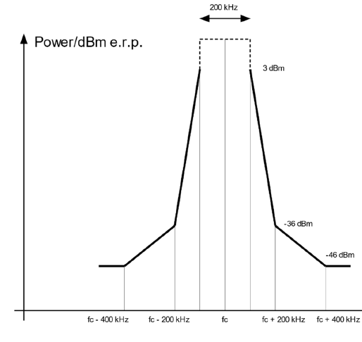
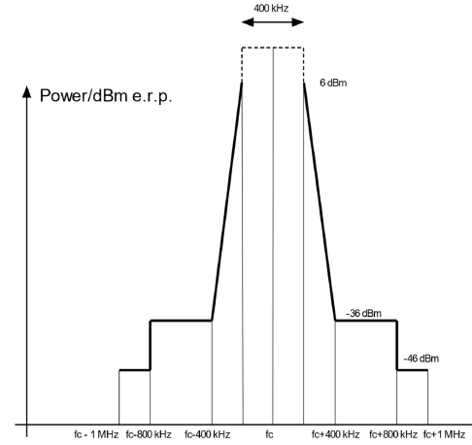
Appendix
Except the table below, other regulations [iv] may also be considered.
 | China [i] | Europe [ii] |  | US [iii]
 | RFID | RFID |  | Frequency hopping spread spectrum | Digital modulated systems
Bands (MHz) | 840-845, 920-925 | 865-868 | 915-921 | 902-928
Bandwidth | 250 kHz | 200 kHz | 400 kHz
TX power | 2W (ERP) | 2W (ERP) | 4W (ERP) | >=50 channel: 36 dBm (EIRP) <50 channel: 30 dBm (EIRP) | 36 dBm (EIRP); <=8 dBm in any 3 kHz
Transmit mask | Adjacent Channel Power Ratio (ACPR): 40dB (first adjacent channel), 60 dB (second adjacent channel) |  |  | Channel<250kHz, at least 50 channels; Channel>250kHz, at least 25 channels; Maximum allowed 20dB bandwidth is 500kHz | minimum 6 dB bandwidth shall be at least 500 kHz
[i] 关于发布800/900MHz 频段射频识别（RFID）技术应用试行规定的通知.
[ii] https://www.etsi.org/deliver/etsi_en/302200_302299/302208/03.04.01_60/en_302208v030401p.pdf.
[iii] https://www.law.cornell.edu/cfr/text/47/15.247.
[iv] https://www.itu.int/dms_pubrec/itu-r/rec/sm/R-REC-SM.2151-0-202209-I!!PDF-E.pdf

Slide 16
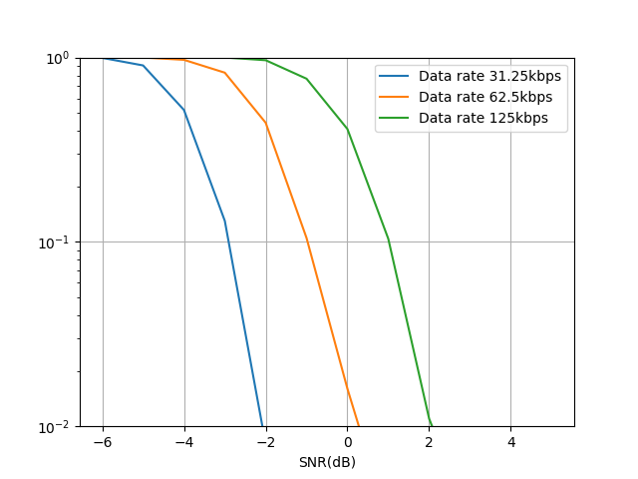
Appendix : Simulation results
DL PER of data field
Simulation setting:
TX
  Payload: 100 bits
  Encoding: Manchester
  Modulation: OOK
  Waveform: CW
  No Tx filter
Channel
  AWGN channel
RX
  No Rx filter
  Non-coherent detector
Notes:
Rx: 2M, Mono-static: SNR ​ = P_AP_Tx​ − backscatter loss​ - 2*Path loss - P_noise
P_noise=-70, Pt=35
80MHz thermal noise: -95dBm

Slide 17
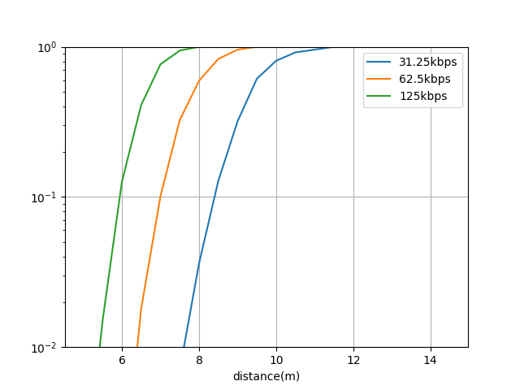
Appendix : Simulation results
UL PER of data field
Leakage
AP
STA
d
Simulation setting:
AP side:
  Packet size = 100 bits
  Manchester encoding
  EIRP: 35dBm (0dBr)
  Leakage : modeled in Rx noise
  Rx noise: -55dBm (-90dBr)
  No filter
  Coherent detector
STA side:
  Modulation noise: -20dBr
  Backscatter loss: 5dB
  No filter

