Slide 1
UL access mechanisms for Active Tx AMP STAs
May 2025
Doc.: IEEE 802.11-25/0815r0
Date: 2025-05-02
Authors:
Name | Affiliation | Address | Phone | Email
Chuanfeng He | OPPO |  |  | hechuanfeng@oppo.com
Weijie Xu |  |  |  | xuweijie@oppo.com
Yinan Qi |  |  |  | v-qiyinan@oppo.com

Slide 2
Background
Doc.: IEEE 802.11-25/0815r0
The motions about UL access mechanisms for Active Tx non-AP AMP STAs were agreed.[1][2]
MM-10: 802.11bp supports a time-slot based random access mechanism for Active Tx non-AP AMP STAs:
AMP AP transmits an AMP frame that indicates one or more time-slots.
Further details (e.g., frame formats, how a STA chooses a random access time-slot etc.) are TBD.
MM-11: 802.11bp supports a time-slot based scheduled access mechanism for Active Tx non-AP AMP STAs:
AMP AP transmits an AMP frame to assign one or more transmission time-slots.
Further details (e.g., frame formats, how the time-slots are assigned etc.) are TBD.
Chuanfeng He (OPPO)

Slide 3
May 2025
Doc.: IEEE 802.11-25/0815r0
Time-slot based random access mechanism
AMP AP transmits an AMP frame that indicates one or more time-slots for potential UL PPDU Tx without the request from AMP STAs.
Random access mechanism is applicable to logistics like use cases
AP has no knowledge of AMP STA’ ID.
Small data is solicited by AP for AMP STA identification.
Low latency is expected for fast AMP STA identification.
Association is not required for one shot UL PPDU Tx from AMP STAs.
Collision may happen in a time-slot with random access mechanism.
Slide 3
Chuanfeng He (OPPO)

Slide 4
May 2025
Doc.: IEEE 802.11-25/0815r0
Time-slot based scheduled access mechanism
AMP AP transmits an AMP frame to assign one or more transmission time-slots for specific AMP STAs.
Scheduled access mechanism is applicable to sensor like use cases
Long term online and frequent UL data transmission.
Association may be required, in which case AMP STA has AID for AP to assign time-slot.
Collision can be avoided with scheduled access mechanism.
Slide 4
Chuanfeng He (OPPO)

Slide 5
May 2025
Doc.: IEEE 802.11-25/0815r0
Two phases time-slot based access mechanism
Joint two phases access mechanism
Random access phase: A AMP STA chooses one slot indicated by AMP trigger for random access (RA) signal transmission.
Scheduled access phase: AP performs contention resolution based on the identified RA signals, and schedules slots for specific AMP STAs to perform data transmission.
The RA signal is identified as temporary ID for AMP AP to assign time-slot for the AMP STA. The RA signal can be, for example:
Random number, e.g. RN16
CDM code, if CDM is supported for random access.
Slide 5
Chuanfeng He (OPPO)

Slide 6
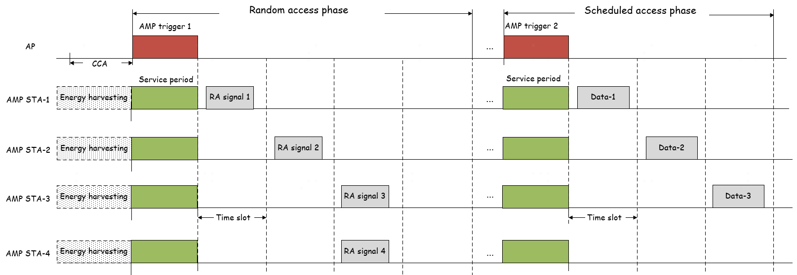
May 2025
Doc.: IEEE 802.11-25/0815r0
Two phases time-slot based access mechanism
Two phases access mechanism does not require the AID of AMP STA through association.
Two phases access mechanism can avoid collision among UL data transmission during scheduled access phase, since temporary ID is identified during random access phase.
Collison happens between AMP STA 3 and 4 during random access phase.
Contention resolution by AP during scheduled access phase.
Slide 6
Chuanfeng He (OPPO)

Slide 7
May 2025
Doc.: IEEE 802.11-25/0815r0
One and two phases time-slot based access mechanism
Standalone one phase access mechanism
Time-slot based random access mechanism
Random access for one shot and small data Tx.
Do not require association.
Typically for logistics like use cases.
Time-slot based scheduled access mechanism
Long term and frequent data Tx.
Require AID through association.
Typically for sensor like use cases.
Joint two phases access mechanism
Do not require association for AID.
Random access for larger data Tx
For collision sensitive access, e.g. access for larger data Tx, or heavy load access scenario.
Slide 7
Chuanfeng He (OPPO)

Slide 8
May 2025
Doc.: IEEE 802.11-25/0815r0
Proposal
11bp supports standalone time-slot based random access mechanism and scheduled access mechanism.
11bp supports joint two phases access mechanism, which includes random access phase and scheduled access phase.
AMP AP transmits an AMP trigger frame that indicates the solicited type of access mechanism, and further the phase of two phases access mechanism.
Slide 8
Chuanfeng He (OPPO)

Slide 9
May 2025
Doc.: IEEE 802.11-25/0815r0
Straw Poll #1
Do you agree with the following text:
802.11bp supports a time-slot based two phases access mechanism for Active Tx non-AP AMP STAs, which include:
Random access phase: An AMP STA transmits random access signal through time-slot based random access mechanism.
Scheduled access phase: An AMP STA transmits data through time-slot based scheduled access mechanism.
Further details (e.g., random access signal, how a AMP STA chooses a access mechanism etc.) are TBD.
Yes
No
Abstain
Slide 9
Chuanfeng He (OPPO)

Slide 10
Reference
May 2025
Doc.: IEEE 802.11-25/0815r0
IEEE 802.11-24/1613r7, Specification framework for tgbp
IEEE 802.11-25/0334r1, Channel access for Active Tx non-AP AMP STAs – follow up, Huawei

