Slide 1
Consideration on 60GHz mmWave Sensing and IMMW Coexistence
Date: 2025-05-15
Authors:
Name | Affiliations | Address | Phone | Email
Zisheng Wang | ZTE | Nanjing, China |  | wang.zisheng@zte.com.cn
Qisheng Huang
Bo Cao
Yurong Qian
Chun Huang
Yun Li
Chaofan Ji | ChinaMobile | Hangzhou, China
Yihua Xu

Slide 2
Introduction
Recently, 60GHz mmWave radar/sensing devices have appeared or been deployed, providing high-resolution detection, tracking or other types of sensing abilities. Typical applications include:
  Smart home: person detection, security monitoring.
  Medical purposes: Heart rate or respiratory monitoring.
The impact of 60GHz radar and communication has been discussed in Coex SC [1].
  radar suffers round-way path loss which leading to a much weaker signal energy compared with IMMW.
It is hard for IMMW to sense the presence of radar because
  radar signal is too weak for IMMW energy detector
  radar beam might not aim at IMMW antenna.
With the help of Sub7G MLO defined in IMMW, we can resolve this co-existence problem easier.

Slide 3
mmWave Regulation Review
Similar to Coex SC [1], we review the latest progress of regulation at 2025.
For radar,
  57-64GHz is opened for radio location in most countries*.
  77GHz is opened for vehicular radar.
As for 802.11
  11ad/ay defined operation on 57-74GHz
Therefore, mmWave radar and IMMW may use overlapped bands and thus cause coexistence problem.
* Detailed regulations for each country are provided in the Appendix A

Slide 4
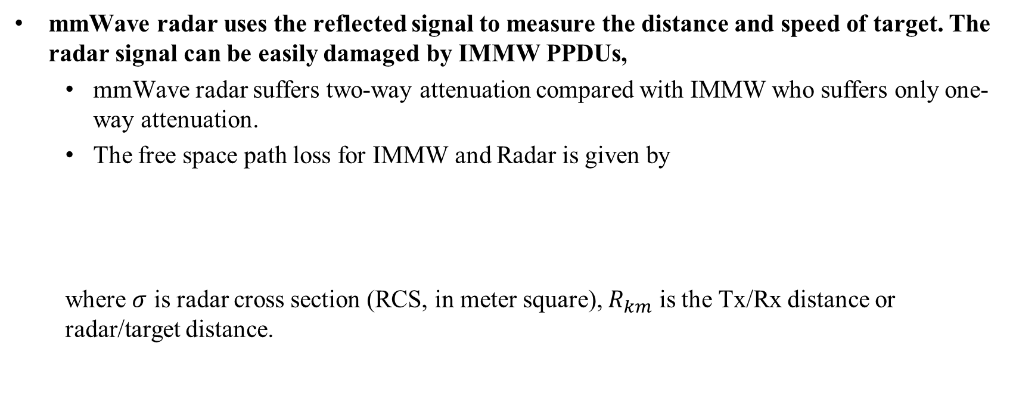
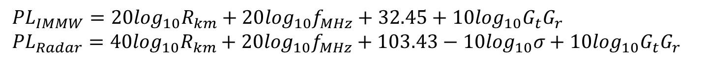
Impact of IMMW on mmWave Radar #1
mmWave radar uses the reflected signal to measure the distance and speed of target. The radar signal can be easily damaged by IMMW PPDUs,
  mmWave radar suffers two-way attenuation compared with IMMW who suffers only one-way attenuation.
  The free space path loss for IMMW and Radar is given by
  where $σ$ is radar cross section (RCS, in meter square), $R_{km}$ is the Tx/Rx distance or radar/target distance.
$${PL}_{IMMW}=20\log_{10}R_{km}+20\log_{10}f_{MHz}+32.45+10\log_{10}G_{t}G_{r}$$
$${PL}_{Radar}=40\log_{10}R_{km}+20\log_{10}f_{MHz}+103.43−10\log_{10}σ+10\log_{10}G_{t}G_{r}$$

Slide 5
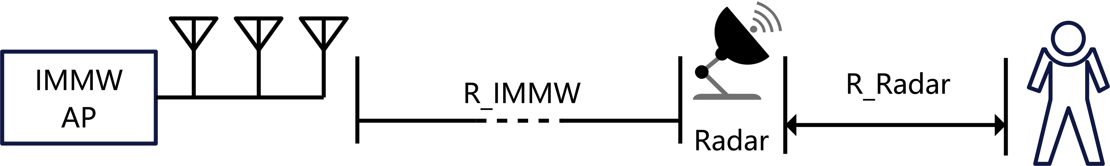
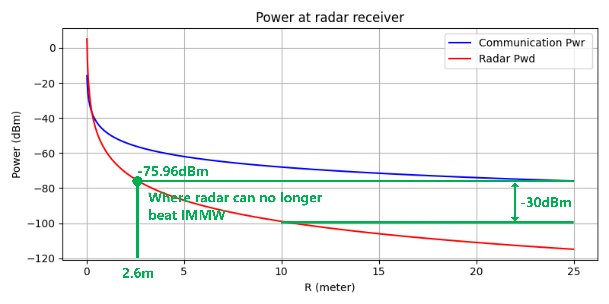
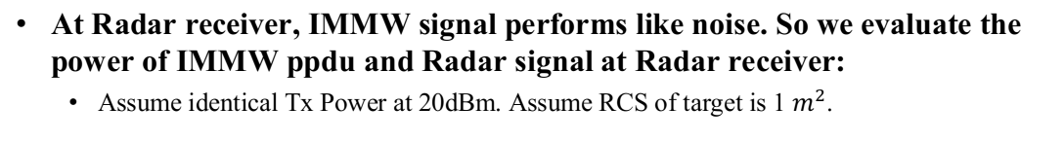
Impact of IMMW on mmWave Radar #2
At Radar receiver, IMMW signal performs like noise. So we evaluate the power of IMMW ppdu and Radar signal at Radar receiver:
  Assume identical Tx Power at 20dBm. Assume RCS of target is 1 $m^{2}$.
  Using path loss equ, the curves of IMMW pwr and radar pwr at radar receiver is plotted.
  At the same distance, IMMW power is usually 20dB larger than radar.
  If the radar receiver want to amplify the radar signal to a measurable level, the receiver already saturated due to the much larger IMMW PPDUs
Thus, IMMW do has a big influence on existing mmWave Radar

Slide 6
Solutions to Radar/IMMW Coexistence #1
It is hard for IMMW/Radar to detect the energy from each other because
  mmWave radar uses directional antenna, it may not point at IMMW Rx.
  Reflected signal is very weak which is much lower than IMMW energy detection threshold.
The non-standalone operation of IMMW provides an easier solution.
  mmWave radar devices usually equip 802.11n/ac/ax modules transmitting radar results.
  So radar can talk with IMMW on Sub7G.
mmWave radar can send a frame at Sub7G indicating up-coming radar signal.
IMMW AP/STA can backoff up-coming radar signal at mmWave bands based on the frame elements.

Slide 7
Solutions to Radar/IMMW Coexistence #2
Radar signal uses a different frequency band definition compared with IMMW. Therefore, this frame should contain radar signal information so that IMMW STA/AP can decide its behavior.
  such as, radar signal channels, power or sectors.
  radar signal duration.
Defining a frame indicating the up-coming radar signal helps both sides:
  Radar with 802.11 module can get rid of IMMW interference.
  IMMW can backoff radar signal or schedule data transmission considering up-coming radar signal reducing inter-ference at both side.

Slide 8
Conclusion
At 60GHz, Radar and IMMW coexistence is a problem. IMMW can cause huge impact on Radar operation.
Radar can send a frame at Sub7G including key radar signal information.
IMMW can perform backoff or schedule data transmission accordingly; Radar and IMMW both benefit from this frame and the operation.

Slide 9
Appendix A
Detailed Regulations
USA
  57-71GHz: Short range with fixed installation at low power
  61-61.5GHz: Fixed installation at high power
Europe
  57-64GHz: With power limited
  61-65GHz: With reduced limitation on power
China
  59-64GHz: Open for radar
Korea:
  57-66GHz: With low output power
Japan
  60-61GHz: low power radar

Slide 10
References
[1] IMMW proposed PAR, https://mentor.ieee.org/802.11/dcn/24/11-24-0116-07-immw-immw-draft-proposed-par.docx
[1] Coexistence between radars and communications systems in the 60GHz band - U.S. Update, https://mentor.ieee.org/802.11/dcn/21/11-21-1089-00-coex-coexistence-between-radars-and-communication-systems-in-the-60ghz-band-u-s-update.pptx

