Slide 1
Downlink Receiver Performance
Date: 2025-05-12
Authors:
Name | Affiliation | Address | Phone | Email
Nelson Costa | HaiLa Technologies | Suite 403, 460 Saint-Catharine St. W. Montreal, QC. Canada |  | nelson@haila.io
Kamran Nishat |  |  |  | kamran@haila.io
Vytas Kezys |  |  |  | vytas@haila.io
Patricia Bower |  |  |  | pbower@haila.io

Slide 2
Abstract
In the following, we present a basic analysis of the receiver performance at an AMP STA.
We compare the receiver performance using the four different downlink waveforms analyzed in [1].
The goal is to move toward some commonality in an AMP STA receiver model, so that we can compare different waveforms under a common framework.

Slide 3
Background
In [1] we presented a spectral analysis of four proposed downlink waveforms.
  [2-3] proposed two different spreading sequences to create a DSSS modulated base sequence.
  [4] proposed an OFDM symbol based-waveform.
  The group has also discussed using the L-LTF as a base waveform.
In general, that analysis showed
  The DSSS base waveforms did not meet the ETSI power spectral density limit of 10dBm/1MHz.
  The OFDM base waveforms exhibited notably high Peak-to-Average Power ratios.
None of the proposed waveforms were compatible with PSK backscatter.

Slide 4
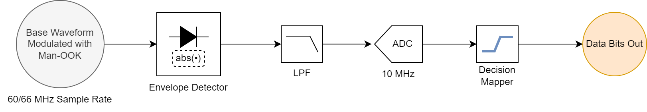
AMP STA Receiver Model
Inputs are the filtered and normalized waveforms from [1].
  “Sim” sample rate of 60/66 MHz for OFDM/DSSS waveforms.
10 MHz ADC
Perfect timing sync assumed.

Slide 5
AMP STA Receiver Model: Things Missing
LPF design greatly affects receiver performance.
  [5] Analyzes BER versus LPF type and parameters.
Noise Figure.
  Front-end bandwidth.
ADC quantization.
Sync sequence and timing recovery for the data sequence.
How many models? (Active Tx, Close range monostatic, bistatic)

Slide 6
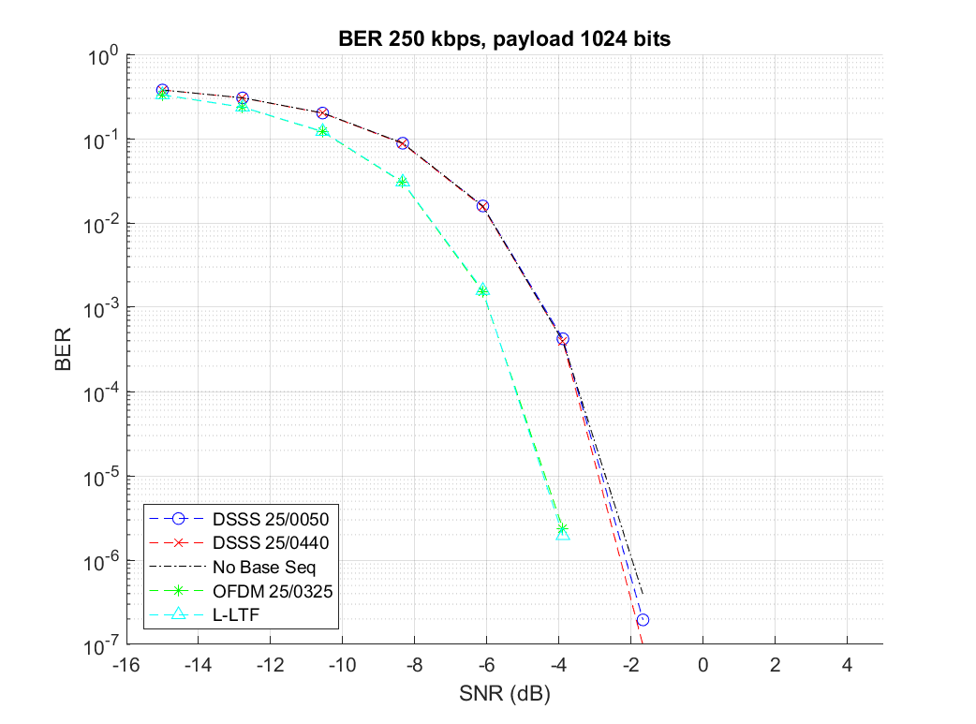
BER Performance: 250 kbps
All the DSSS based waveforms perform equally as well as regular Manchester encoded OOK with no base waveform.
The OFDM based waveforms show about a 2 dB improvement at 1% BER.

Slide 7
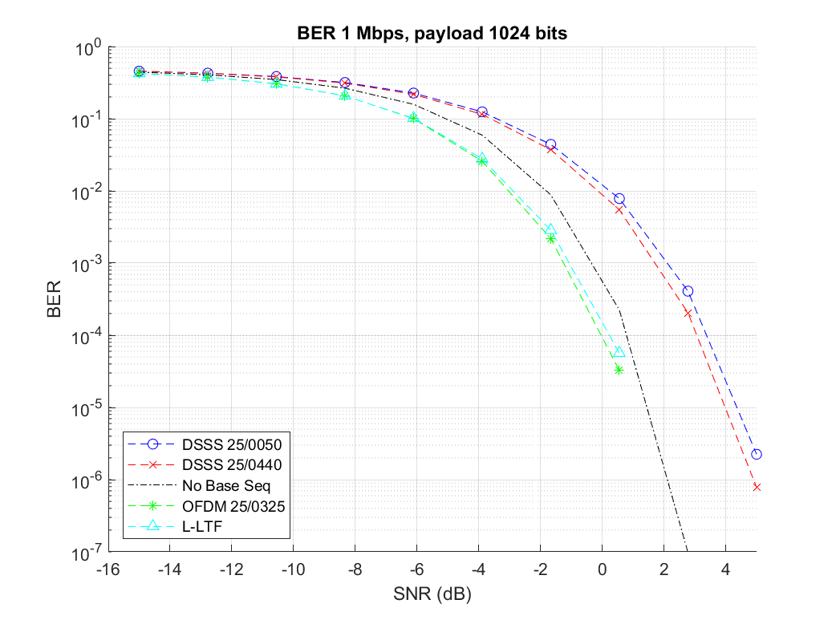
BER Performance: 1 Mbps
All the DSSS based waveforms perform about 2 dB worse than Manchester encoded OOK with no base waveform at 1 % BER.
The OFDM based waveforms show about a 3 dB improvement over DSSS based waveforms.
The OFDM based waveforms show about a 1 dB improvement over Manchester encoded OOK with no base waveform at 1% BER.

Slide 8
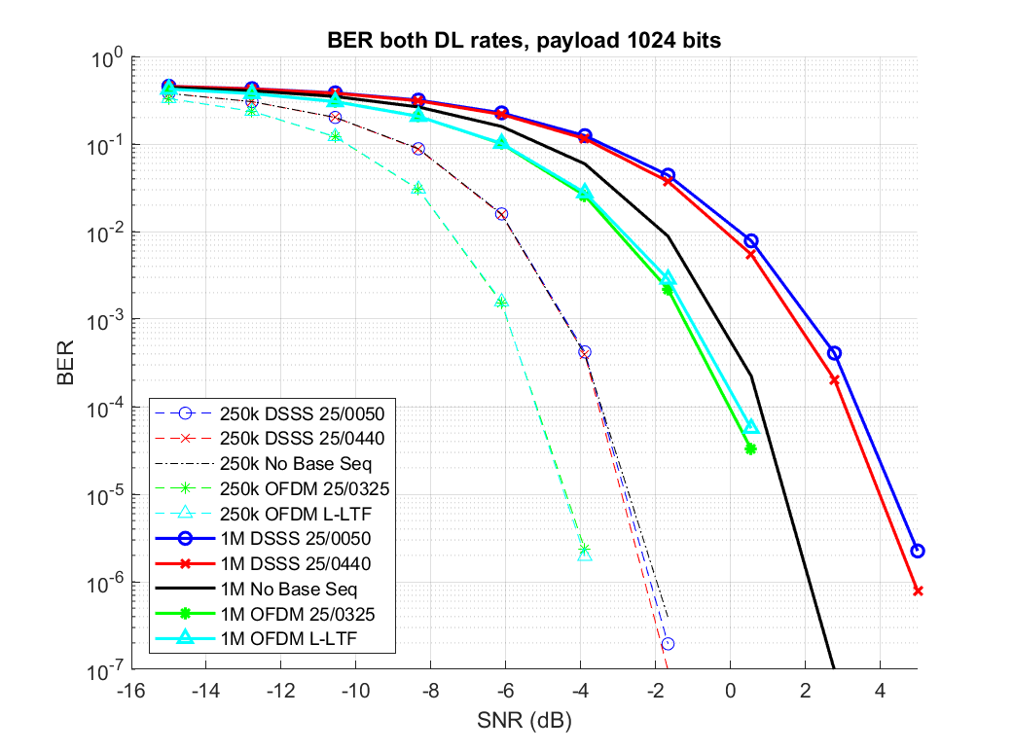
BER Performance: Receiver Sensitivity
At 1% BER, shifting from 250 kbps to 1 Mbps means degrading receive sensitivity by
  About 4-5 dB for the OFDM base waveforms.
  About 6 dB for DSSS based waveforms.
  About 4 dB for Man-OOK with no base waveform.
1 Mbps
250 kbps

Slide 9
Conclusion
Here, we presented an analysis of DL receiver performance.
We also proposed that we should standardize on a few receiver models in order to make a fair comparison between proposals.
  Prefer three models, 1) active Tx, 2) close range monostatic backscatter, 3) bistatic backscatter.
We created a common framework for simulating BER performance across three proposed downlink waveforms.
Overall receiver performance with proposed waveforms,
  At 250 kbps, the OFDM-based waveforms had about a 2 dB advantage over the DSSS waveforms.
  At 1 Mbps, the OFDM-based waveform had about a 3 dB advantage over the DSSS waveforms.
  Moving from 250 kbps to 1 Mbps degrades receiver sensitivity by about 4 – 6 dB

Slide 10
Straw Poll 1
Do you agree that 11bp should define at least one standard receiver model?

Slide 11
Straw Poll 2
Do you agree that 11bp should define at least three receiver models for the following topologies.
  Active Transmit
  Close-Range Monostatic Backscatter
  Bistatic Backscatter.

Slide 12
References
[1] Costa et al., Downlink Waveform Analysis, 11-25/0771, May 2025.
[2] Li et al., AMP DL Wideband OOK Generation, 11-24/0050, January 2025.
[3] Wang et al., Follow-up on AMP DL OOK generation, 11-25/0440, March 2025.
[4] Shellhammer et al., AMP Downlink Bandwidth Control using OFDM Spreading Waveform, 11-25/0325, March 2025.
[5] Wilhelmsson et al., Discussion of a Wake-Up Receiver Front-End Model, 11-17/0093, January 2017.

