Slide 1
LDPC Codes new matrix for N=3888
Date: 2025-05-DD
Authors:

Slide 2
Abstract
This contribution proposes a new matrix for LDPC codes with a code rate R=1/2 and N= 3888 to be considered in the PDT IEEE 802.11-24/1992r3.
This new matrix optimizes the first part, the parity matrix, by ensuring a more consistent number of row and column connections. This new matrix structure keeps the redundancy design, without changing the whole LDPC structure.
Link level simulation results highlight gains @FER 10-4, up to 1 dB.
This structure allows a reduction of the number of iterations at the decoder side, improving the complexity and potentially the latency.
Complementary results are given with a matrix dedicated to R=2/3, limiting the connection numbers.

Slide 3
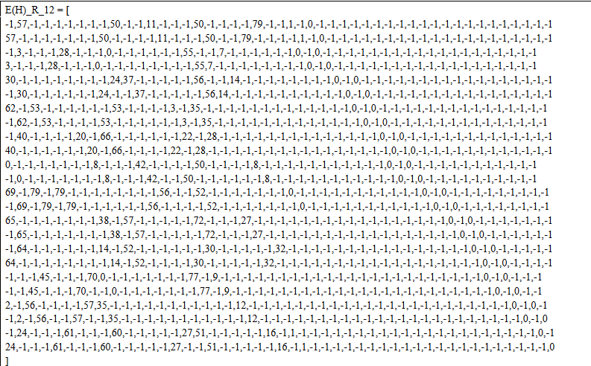
Motivation
It is more relevant to ensure a more consistent number of row and column connections within the parity matrix, especially to reduce the number of iterations at the decoder side.
Starting from the LDPC matrix R=1/2 proposed in doc.: IEEE 802.11-24/1992r3

Slide 4
Structure of the matrix N=3888, number of connections per row and column
doc.: IEEE 802.11-24/1992r3
Number of connections per row
Number of connections per column

Slide 5
Structure of the new matrix N=3888, number of connections per row and column
doc.: IEEE 802.11-25/805r0
The number of connections is more homogenous in two dimensions
Number of connections per row
Number of connections per column <-> equivalence in terms of connections
number vs initial matrix in “1992r3 »

Slide 6
Simulation results
Simulation settings
Modulation: BPSK, QPSK and 16QAM
Coding rate: R=1/2
Additional coding rate R= 2/3
AWGN channel
Frame size : N=3888
Layered Normalized Min-Sum (Alpha = 0.75) decoder with 5 and 10 iterations

Slide 7
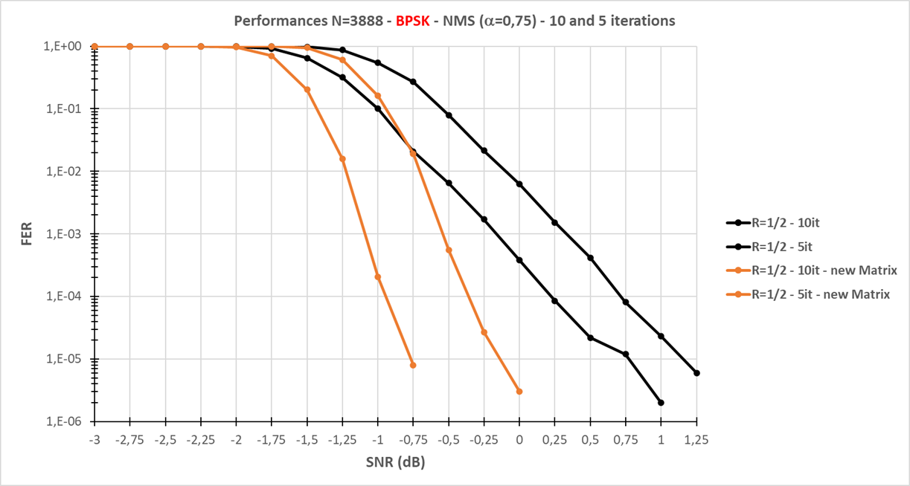
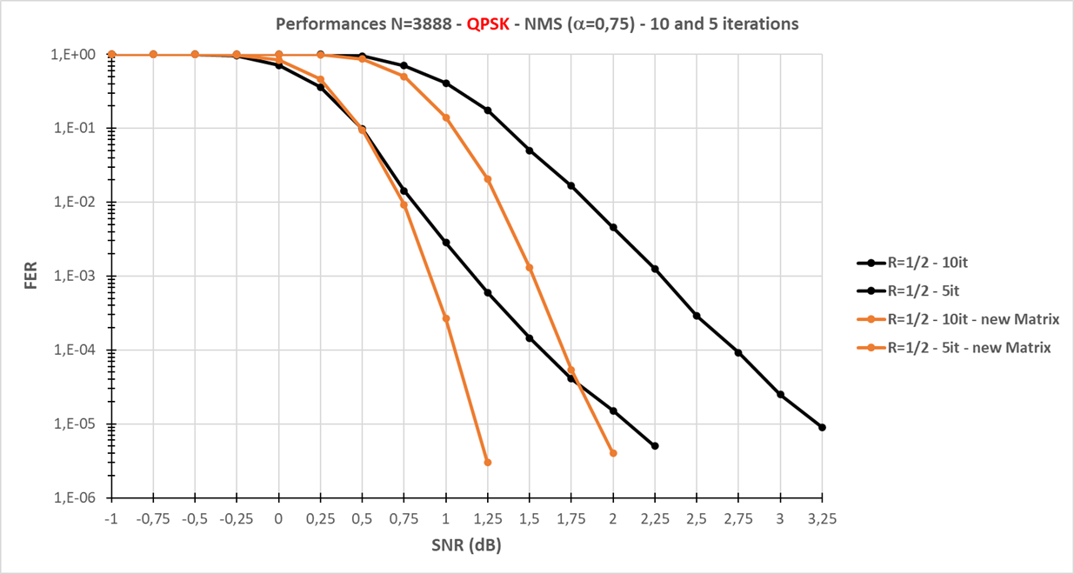
Performance comparison R=1/2 (1)

Slide 8
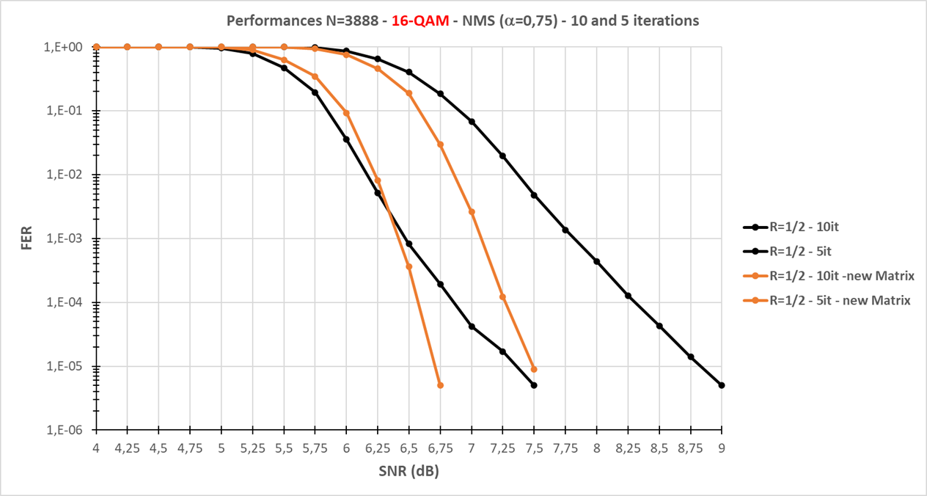
Performance comparison R=1/2 (2)

Slide 9
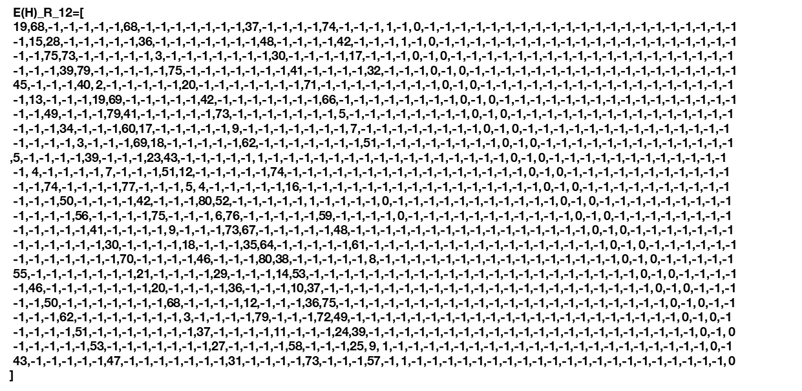

Proposed Modifications R=1/2
Update the matrix as follow

Slide 10
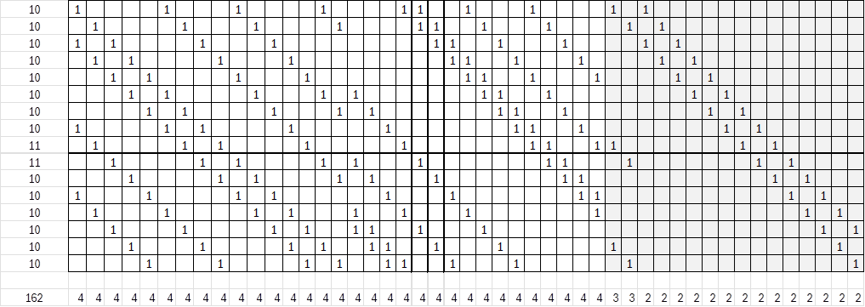
Structure of the new matrix N=3888, number of connections per row and column, R=2/3
doc.: IEEE 802.11-25/805r0
The number of connections is reduced
Number of connections per row
Number of connections per column <-> equivalence in terms of connections
number vs initial matrix in “1992r3 »

Slide 11
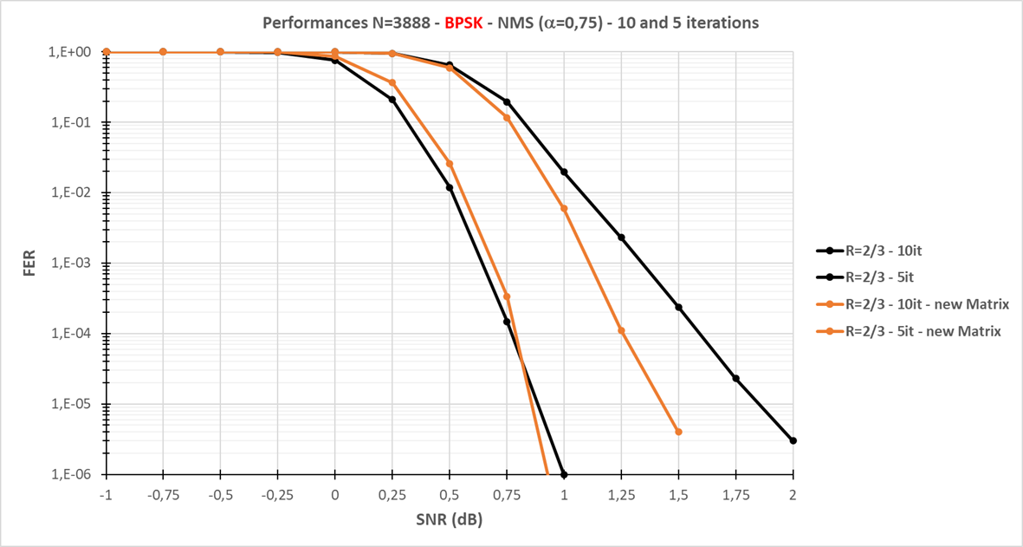
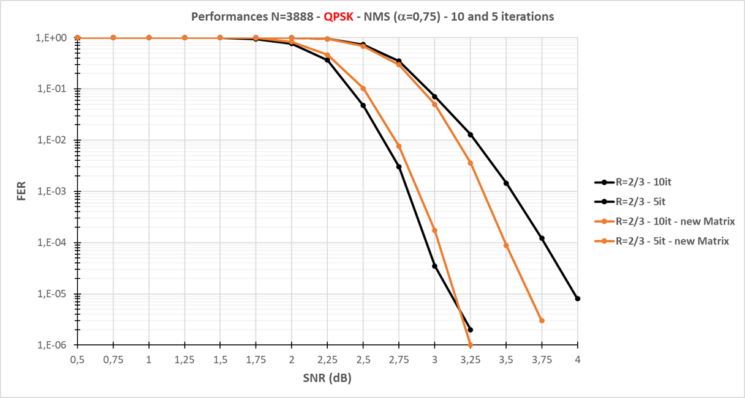
Performance comparison R=2/3 (1)

Slide 12
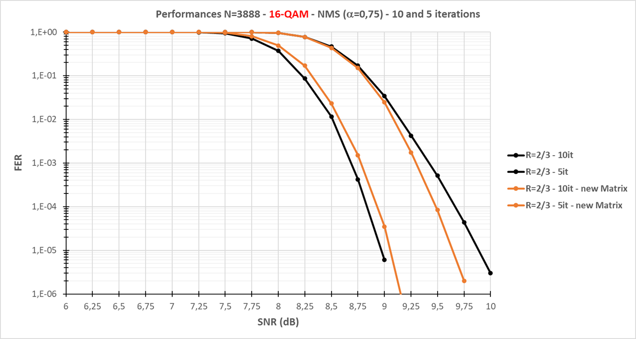
Performance comparison R=2/3 (2)

Slide 13
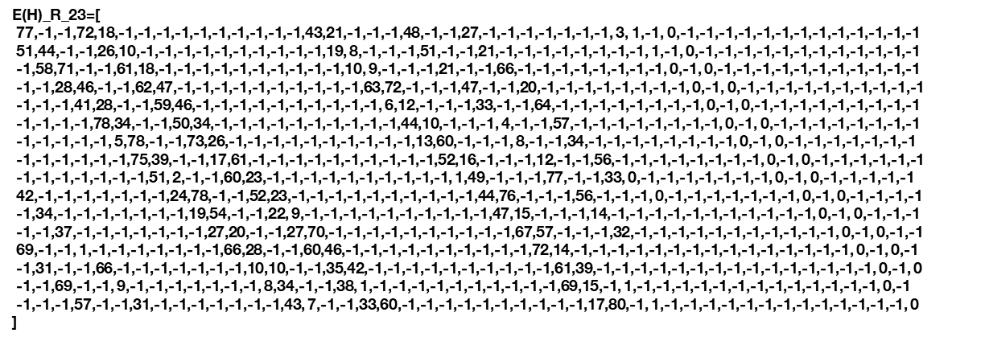
Proposed Modifications R=2/3
Update the matrix as follow

Slide 14
Summary and perspectives
We propose a new LDPC matrix for N=3888, Simulation results highlight significant gains specifically for R=1/2, (@FER 10-4, up to 1 dB)
Another LDPC matrixes with N={648, 1296, 1944} for the coding rate R=1/2 shall be designed and assessed. Gains shall be expected following 2D homogenous connection numbers
Higher codes rates should be addressed, incorporating UEQM processing. Work is under progress
Presentation of the UEQM proposal keeping unchanged MCS shall be further proposed.

Slide 15
Straw Pol
SP1
Do you agree to replace the N=3888 LDPC R=1/2 matrix with the proposed matrix in the PDT IEEE 802.11-24/1992r3?
SP2
Do you agree to replace the N=3888 LDPC R=2/3 matrix with the proposed matrix in the PDT IEEE 802.11-24/1992r3?
  Yes/No/Abstain

Slide 16
References
11-24-1992-03-00bn-pdt-phy-longer-ldpc-coding

