Slide 1
OOK generation for AMP
May 2025
Doc.: IEEE 802.11-25/0802r0
Date: 2025-05-09
Authors:
Name | Affiliation | Address | Phone | Email
Ke Wang | OPPO |  |  | wangke6@oppo.com
WeiJie Xu | OPPO |  |  | xuweijie@oppo.com

Slide 2
Abstract
Doc.: IEEE 802.11-25/0802r0
In [1], we discussed and proposed DL OOK generation with DSSS.
In [2], DL OOK generation with OFDM was discussed and the main idea is to use a BPSK sequence to generate a sufficiently wide bandwidth OFDM signal.
In this submission, we further discussed the required bandwidth of DL OOK and proposed a BPSK sequence to fulfill the requirement for OFDM based OOK.

Slide 3
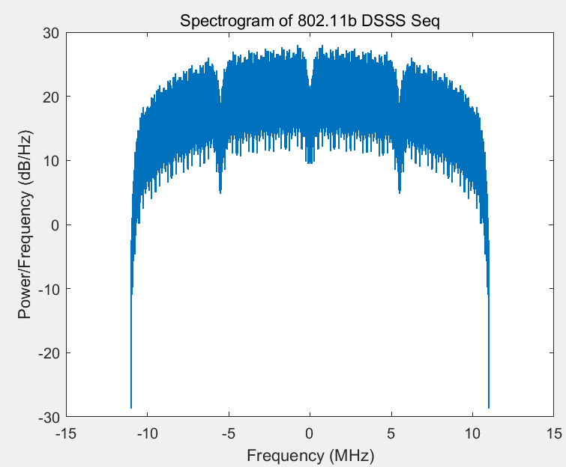
Recap :OOK generation with DSSS for DL(1)
May 2025
Doc.: IEEE 802.11-25/0802r0
  In 802.11b, Barker code (1,-1,1,1,-1,+1,+1,+1,-1,-1,-1) is used to spread information bits to a wideband DSSS signal with 22MHz spectrum.

Slide 4
Recap: OOK generation with DSSS for DL(2)
May 2025
Doc.: IEEE 802.11-25/0802r0
  In order to generate a narrow bandwidth DSSS signal, one way is to replace Barker code with another spreading code.
    Less randomization than Barker code, one example is [1 1 1 1 -1 -1 -1 -1 -1 -1 -1]
      about 3 times spectrum spreading via About 4 times repetition of 1 or -1
  The new output DSSS signal is OOK modulated (may has Manchester coding), as shown in the following.

Slide 5
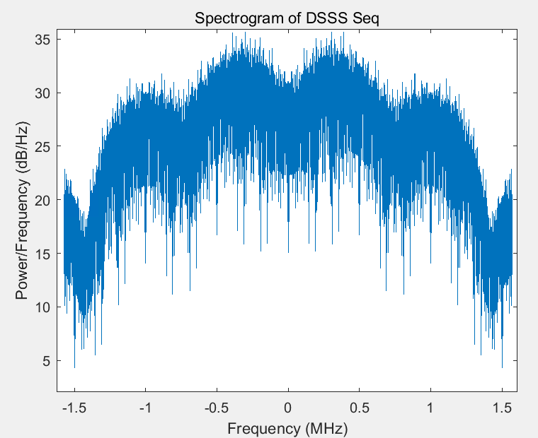
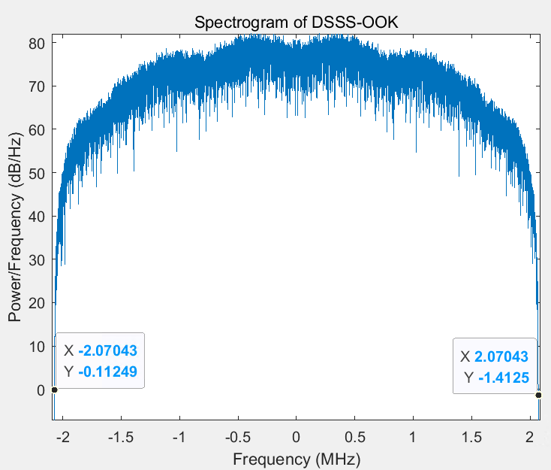
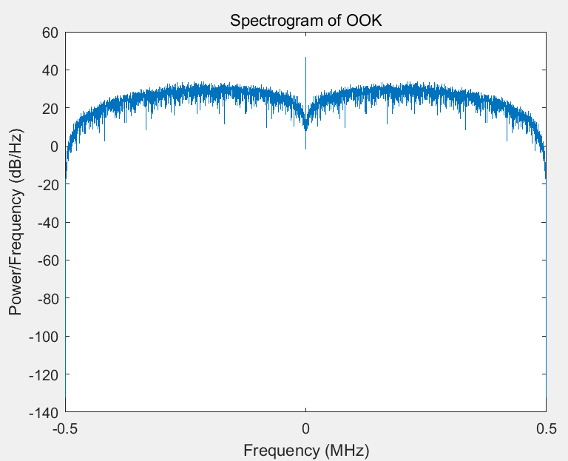
Recap: OOK generation with DSSS for DL(3)
May 2025
Doc.: IEEE 802.11-25/0802r0
  The new DSSS signal is OOK modulated, the BW of the output DSSS OOK = BW of DSSS + BW of OOK envelope.

Slide 6
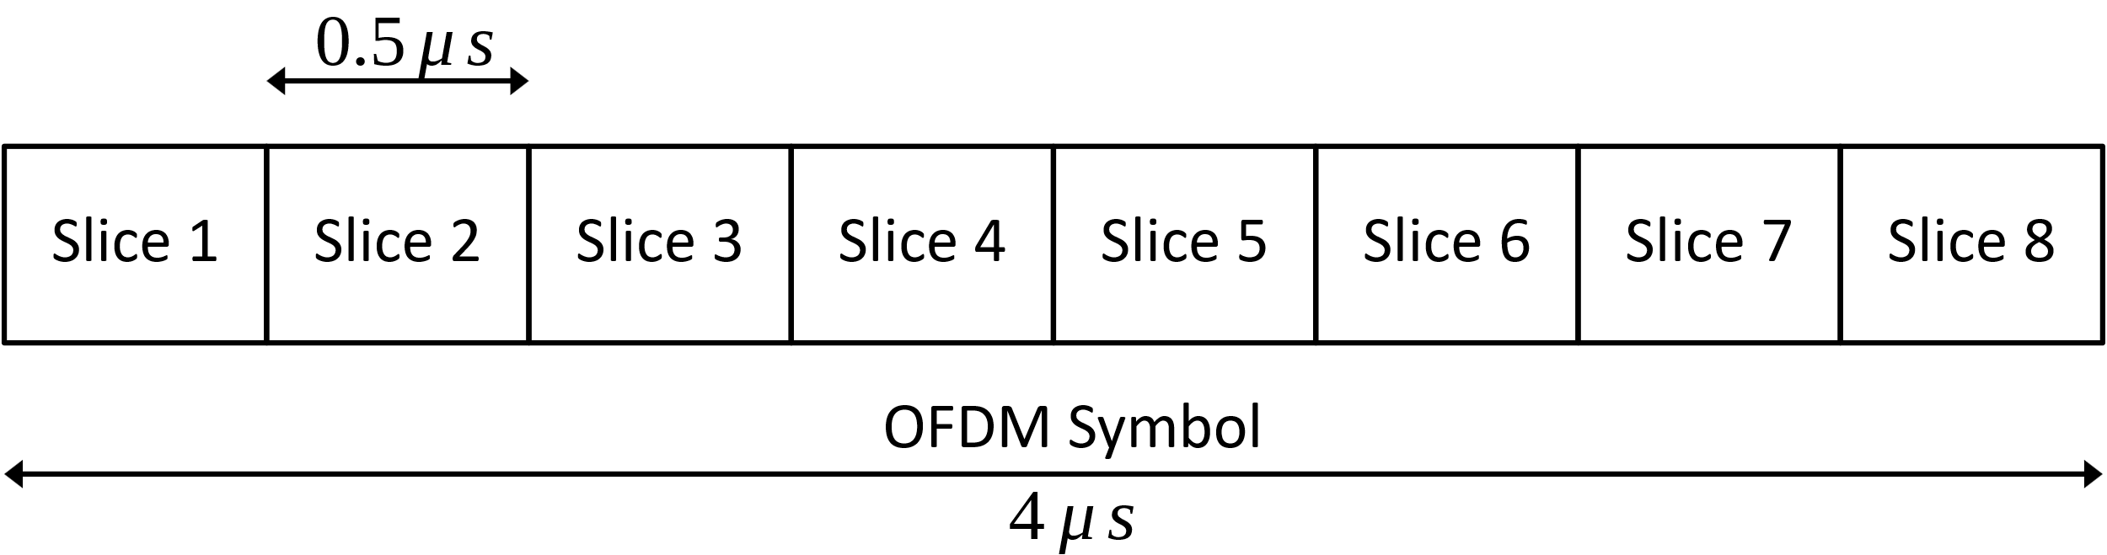
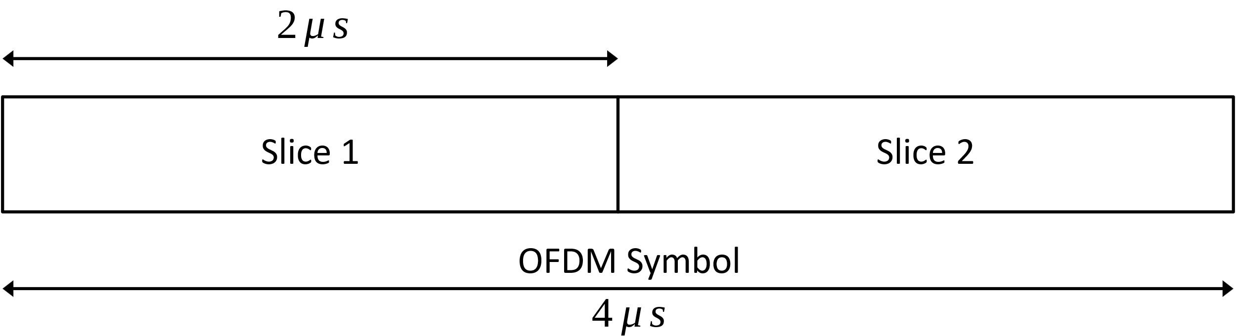
Recap: OOK generation with OFDM for DL(1)
May 2025
Doc.: IEEE 802.11-25/0802r0
  In [2], one method using OFDM waveform to generate DL OOK is proposed. In order to support higher symbol rate for OOK than that of OFDM symbol, one OFDM symbol is divided into several slices for further OOK modulation. The key task is to find a proper BPSK sequence mapped in the OFDMed subcarriers such that it can realize relatively average power among these slices.

Slide 7
Further thoughts on OOK for AMP DL[1]
May 2025
Doc.: IEEE 802.11-25/0802r0
  For a AMP DL PPDU, what is the proper bandwidth?
    In order to support large coverage, it shall be able to support a maximum power of 20dBm.
      Considering the regulation requirement in regions and the PSD limitation, it shall be no less than 10MHz.
    It needs to ease the implementation for the AMP STA.
      For AMP STA receiver using envelope detector[3], it makes no big difference for different DL PPDU bandwidth since the receiver will open a very wide receiving bandwidth.
      However, design of AMP shall also consider to support different implementation. For an advanced AMP receiver, i.e., IF (Intermediate Frequency) receiver[3], it will be useful for use cases requiring larger coverage[4].
        Sufficient guard band on both side can ease the filtering implementation for this kind of receiver.
          E.g. as for 11ba, the BW of WUR portion is 4MHz and it leaves guard band of 8 MHz on each side.

Slide 8
Further thoughts on OOK for AMP DL[2]
May 2025
Doc.: IEEE 802.11-25/0802r0
  For the excitation portion, we see similar requirement of the BW
    Considering the regulation requirement and the PSD limitation, it shall be no less than 10MHz in order to support a maximum power of 20dBm.
    On the other hand, it shall have empty band on both side in order to avoid the power leakage from the backscattering signal to adjacent channel.
      e.g. if the BW of the excitation portion is 20MHz, an AMP UL PPDU of 250kbps modulated on top of it will have a bandwidth of (20+1) MHz . It will affect the neighboring node operating on the adjacent channel.

Slide 9
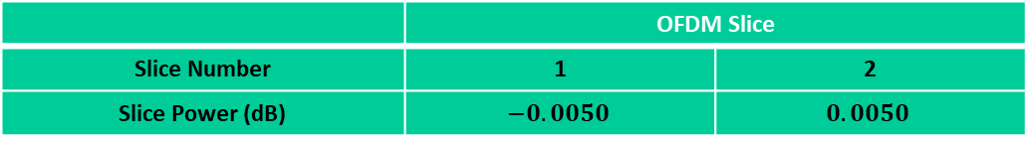
DL OOK generation with OFDM (1)
May 2025
Doc.: IEEE 802.11-25/0802r0
  Based on the discussion, we propose a bandwidth of ~10MHz for AMP DL PPDU (applicable for the sync filed, control field and excitation field).
    One BPSK sequence identified is: [0,0,0,0,0,0,0,0,0,0,0,0,0,0,0,0,-1,1,1,1,-1,1,-1,1,1,-1,1,-1,-1,-1,1,1,0,1,1,1,-1,1,1,1,1,1,-1,-1,1,1,1,-1,1,0,0,0,0,0,0,0,0,0,0,0,0,0,0,0];
    The output PPDU Bandwidth is 10.3125MHz.
  For DL rates of 250kbps and 1Mbps, the power fluctuation among different slices is evaluated. Very good signal power stability can be seen for the identified sequence.
 | OFDM Slice
Slice Number | 1 | 2 | 3 | 4 | 5 | 6 | 7 | 8
Slice Power (dB) | 0.0948 | 0.2078 | -0.1487 | -0.1865 | -0.0655 | 0.0689 | 0.0045 | 0.0111
Table: Power distribution for sliced OOK symbols within one OFDM symbol (1Mbps in Top table and 250kbps in right table)
 | OFDM Slice
Slice Number | 1 | 2
Slice Power (dB) | $$−0.0050$$ | $$0.0050$$

Slide 10
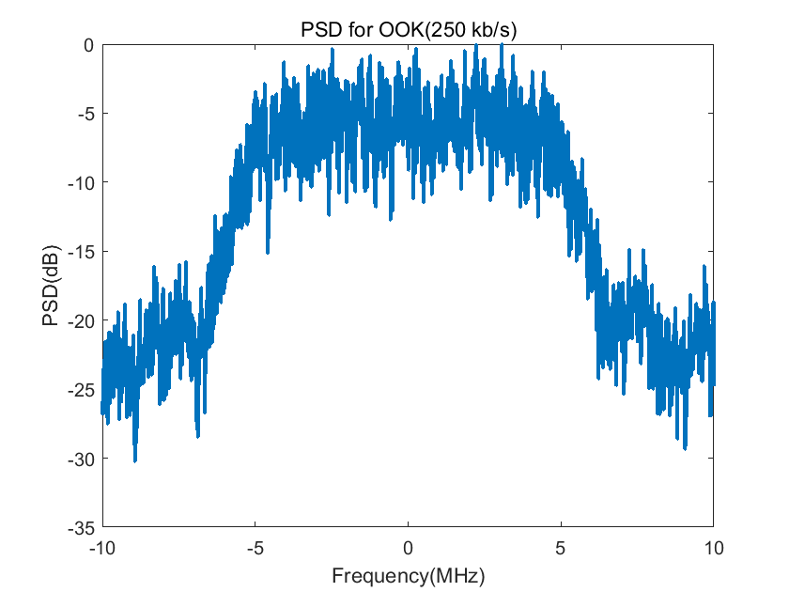
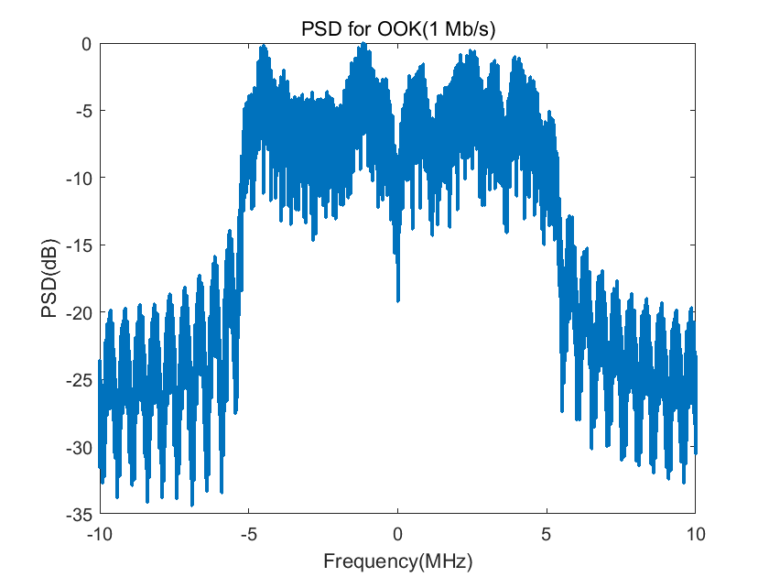
DL OOK generation with OFDM (2)
May 2025
Doc.: IEEE 802.11-25/0802r0
  For OOK symbols generated with the identified BPSK sequence, the PSD is also evaluated as show in the following Figures. Good spectrum property is observed.

Slide 11
Summary
May 2025
Doc.: IEEE 802.11-25/0802r0
  In this submission, on top of OOK generation with DSSS, we further discussed DL OOK generation with OFDM, including bandwidth requirement, impact on receiver complexity etc. Based on the discussion and evaluation, we propose the following BPSK sequence.
    [0,0,0,0,0,0,0,0,0,0,0,0,0,0,0,0,-1,1,1,1,-1,1,-1,1,1,-1,1,-1,-1,-1,1,1,0,1,1,1,-1,1,1,1,1,1,-1,-1,1,1,1,-1,1,0,0,0,0,0,0,0,0,0,0,0,0,0,0,0];

Slide 12
May 2025
Doc.: IEEE 802.11-25/0802r0
Straw Poll(1)
Do you agree with the following text:
  DSSS based OOK is supported for AMP DL.
Yes
No
Abstain
Slide 12
Wang ke (OPPO)

Slide 13
May 2025
Doc.: IEEE 802.11-25/0802r0
Straw Poll(2)
Do you agree with the following text:
  For DL OOK generation with OFDM, the following BPSK sequence is recommend.
    [0,0,0,0,0,0,0,0,0,0,0,0,0,0,0,0,-1,1,1,1,-1,1,-1,1,1,-1,1,-1,-1,-1,1,1,0,1,1,1,-1,1,1,1,1,1,-1,-1,1,1,1,-1,1,0,0,0,0,0,0,0,0,0,0,0,0,0,0,0];
Yes
No
Abstain
Slide 13
Wang ke (OPPO)

Slide 14
Reference
May 2025
Doc.: IEEE 802.11-25/0802r0
IEEE 802.11-25/0440r0 Follow-up on AMP DL OOK generation
IEEE 802.11-24/1322r7 TGbp Motion Dock
IEEE 802.11-24/0853r0, Design target and device capabilities for AMP IoT
IEEE 11-23/2203r1, Updated technical report on support of AMP IoT devices in WLAN

