Slide 1
High Level Thoughts on AMP SYNC Field Design
Date: 2025-05-11
Authors:
Name | Affiliations | Address | Phone | Email
Shengquan Hu | Mediatek | 2840 Junction Ave. San Jose, CA, 95134 |  | Shengquan.hu@mediatek.com
You-Wei Chen |  |  |  | You-Wei.chen@mediatek.com
Jianhan Liu
Thomas Pare

Slide 2
Introduction
SYNC field design has been widely studied & discussed [1-5]; the SYNC fields are considered to use for:
  Differentiate non-backscatter & backscatter STA type for DL;
  Indicate the data rate for DL
  Use as a UL/DL indicator
  For UL, it could also be benefit to different backscatter & non-backscatter
In this contribution, we will share some thoughts for SYNC field design and the basic simulation setting for performance comparison.

Slide 3
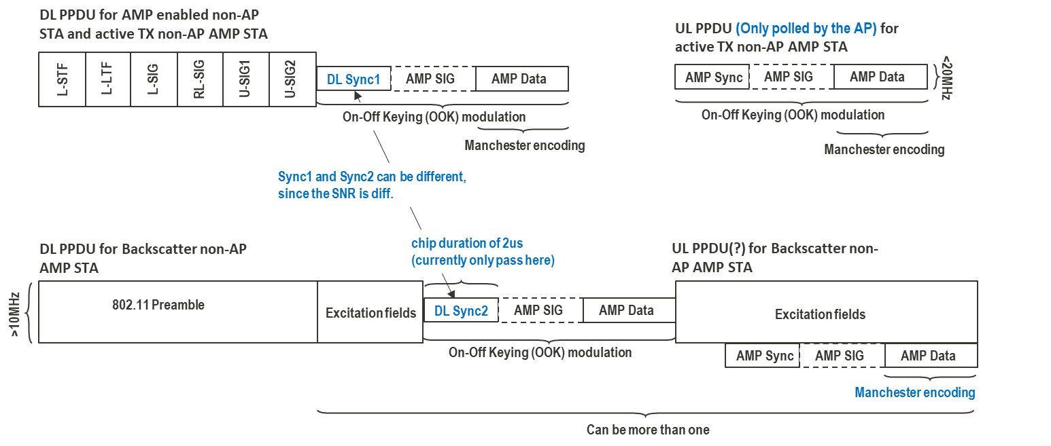
Recap: AMP PHY Design [5]
Data Rate:
(2.4GHz) | DL | UL
Backscatter | 250kbps | 250kbps, 1Mbps
Non-backscatter | 250kbps, 1Mbps | 250kbps, 1Mbps, 4Mbps (Mandatory or optional is TBD )
2 sequences to indicate data rate
AMP PPDU Format:
Different sequences to separate backscatter & non-backscatter, and used as DL/UL indicator

Slide 4
SYNC Field Design
Option1:
  DL: 3 different SYNC sequences to differentiate non-backscatter & backscatter and to indicate data rate;
  UL: 2 different SYNC sequences to differentiate DL&UL, non-backscatter & backscatter; no need to indicate data rate;
 | DL PPDU for non-AP STAs |  | UL PPDU from non-AP STAs
 | non-Backscatter | Backscatter | non-Backscatter | Backscatter
250kbps | S₂ | S₃ | S₄ | S₅
1Mbps | S₁ | N/A
4Mbps | N/A | N/A |  | N/A
5 base sequences
NOTE: the detailed SYNC sequences are TBD
Option2:
  DL: 3 different SYNC sequences, two sequences are constructed from same base sequence S₁;
  UL: 2 different SYNC sequences to differentiate DL & UL, non-backscatter & backscatter; no need to indicate data rate;
 | DL PPDU for non-AP STAs |  | UL PPDU from non-AP STAs
 | non-Backscatter | Backscatter | non-Backscatter | Backscatter
250kbps | S₂= f(S₁) | S₃ | S₄ | S₅
1Mbps | S₁ | N/A
4Mbps | N/A | N/A |  | N/A
4 base sequences
NOTE: the detailed SYNC sequences are TBD; S₂= f(S₁) denotes that S₂ may be constructed from base sequence S₁

Slide 5
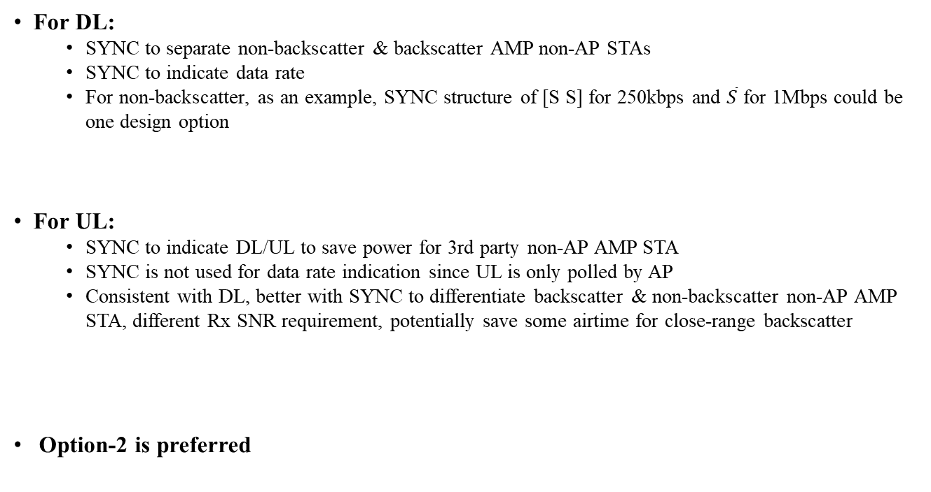
Discussions on SYNC Field Design
For DL:
  SYNC to separate non-backscatter & backscatter AMP non-AP STAs
  SYNC to indicate data rate
  For non-backscatter, as an example, SYNC structure of [S S] for 250kbps and $\overline{S}$ for 1Mbps could be one design option
For UL:
  SYNC to indicate DL/UL to save power for 3rd party non-AP AMP STA
  SYNC is not used for data rate indication since UL is only polled by AP
  Consistent with DL, better with SYNC to differentiate backscatter & non-backscatter non-AP AMP STA, different Rx SNR requirement, potentially save some airtime for close-range backscatter
  Option-2 is preferred

Slide 6
Simulation Settings for DL
It is hard to finalize the SYNC field designs, if the TX/RX baseline are not aligned.
SNR is calculated with the ratio of average Tx signal power over noise power (noise is with 80MHz BW)
Parameter settings are open for more discussion.
 |  | DL (Backscatter and non-Backscatter)
TX | Transmit Bandwidth (MHz) | 20
 | Transmit Waveform | OFDM
 | Chip Duration (us) | 2 & 0.5
 | Transmitter Clock Accuracy (ppm) | 0
 | Data Field Size (Byte) | 10
Channel | Channel | AWGN & D-LOS
RX | Receiver Bandwidth (MHz) | 80
 | Sampling Frequency (MHz) | 8
 | Receiver Clock Accuracy (ppm) | 0
 | RX LPF | off
 | Receiver Type | non-coherent

Slide 7
PER performance of Data Only
All the simulation results assume ideal SYNC.
About 2dB degradation for D-LOS vs AWGN for 1Mbps. This may because 4-samples per-chip for 0.5us chip duration with 8MHz sampling rate.
AWGN
D-LOS

Slide 8
Reference
[1] 11-25-0306-00-00bp-amp-backscattering-ppdu-and-sync-design, by NXP
[2] 11-25-0315-01-00bp-further-discussion-on-downlink-sync-field-design, by Huawei
[3] 11-25-0042-00-00bp-amp-downlink-sync-field-study, by QCOM
[4] 11-25-0321-00-00bp-follow-up-on-sync-field-for-amp-ppdu, by OPPO
[5] 11-25-0400-00-00bp-sync-field-design-considerations, by MTK

Slide 9
SP#1
Do you support that total 4 base sequences are used for AMP DL/UL SYNC field design in 2.4GHz frequency band?
  Detailed SYNC sequence designs are TBD
  Bi-static backscattering UL SYNC field design is TBD

