Slide 1
Initial Thoughts on AMP Downlink Sync Field Design
Date: 2025-05-10
Authors:
Name | Affiliations | email
Steve Shellhammer | Qualcomm | shellhammer@ieee.org
Bin Tian |  | btian@qti.qualcomm.com
Pooria Pakrooh |  | ppakrooh@qti.qualcomm.com
Manideep Dunna |  | mdunna@qti.qualcomm.com
Alice Chen |  | alicel@qti.qualcomm.com

Slide 2
Introduction
Here we introduce some high-level thoughts on the design for the AMP Downlink Sync field for transmission to non-Backscatter STAs
We provide our thoughts on the requirements
Description of our Proposed Design Concept
We give Data field simulation results to understand the SNR requirements for the Sync field detection
We provide some Sync field detection simulation results

Slide 3
Requirement for Downlink PPDU Sync Field
The non-Backscatter receivers need to decode both the 1 Mb/s and the 250 kb/s PPDUs
It is beneficial if the Sync field can indicate the downlink data rate
The Sync field should be more robust than the Data field
The Sync field should support both a higher power/performance Sync detector and lower power/performance Sync field detector
The Sync field should provide timing alignment for the Data field decoding
The Sync field detector should work with clock error of TBD PPM
Task Group has not yet specified the receiver clock error for non-Backscatter STAs
Some people have suggested $±10,000$ PPM

Slide 4
Downlink Sync Field High-Level Thoughts
We propose to use a chip duration of 2 µs, which will be more robust to multipath channels than 0.5 µs chip duration
We propose to use a sequence $W$ for the 250 kb/s PPDU
We propose to use a sequence $\overline{W}$ for the 1 Mb/s PPDU
$\overline{W}$ indicates the logical complement of $W$
$W$ is selected to meet the following requirements:
Has good autocorrelation properties
We need to have a discussion on if we use Manchester encoding in the Sync Field
The Test Statistic for the W Sync field detector can easily be converted to the Test Statistic for the $\overline{W}$ Sync field detector by a simple change of the sign
Hence the complexity is reduced essentially to a single Sync field detector

Slide 5
Simulation Parameters
Parameter | Value | Comment
Transmit Bandwidth | < 20 MHz | Fit within 20 MHz Channel
Transmit Waveform | Either OFDM or Simple OOK is fine
Receiver Bandwidth | 80 MHz | No RF Filter
SNR Definition | RX Signal Power (in dB) minus Noise Power over 80 MHz (in dB). Using the 80 MHz receive waveform. | If zero padding is done before and after the signal, that portion is not included in the RX Signal Power
Receiver Clock Accuracy | TBD PPM | SFD specifies Active TX Uplink Clock Accuracy of $±1000$ PPM but does specify the RX Clock Accuracy. Some people have indicated interest in supporting $±10,000$ PPM for RX.
Receiver Architecture | Envelope Detector (Non-Coherent) | Details of Envelop Detector model need to be clarified
Sync Detection False Alarm Rate Definition Interval | 5 ms | Tag has poor clock accuracy and needs to wake-up early and listen for Sync Field
Data Field Size | 10 Octets | Size in Octets for Data Field. Downlink is expected to be smaller than uplink

Slide 6
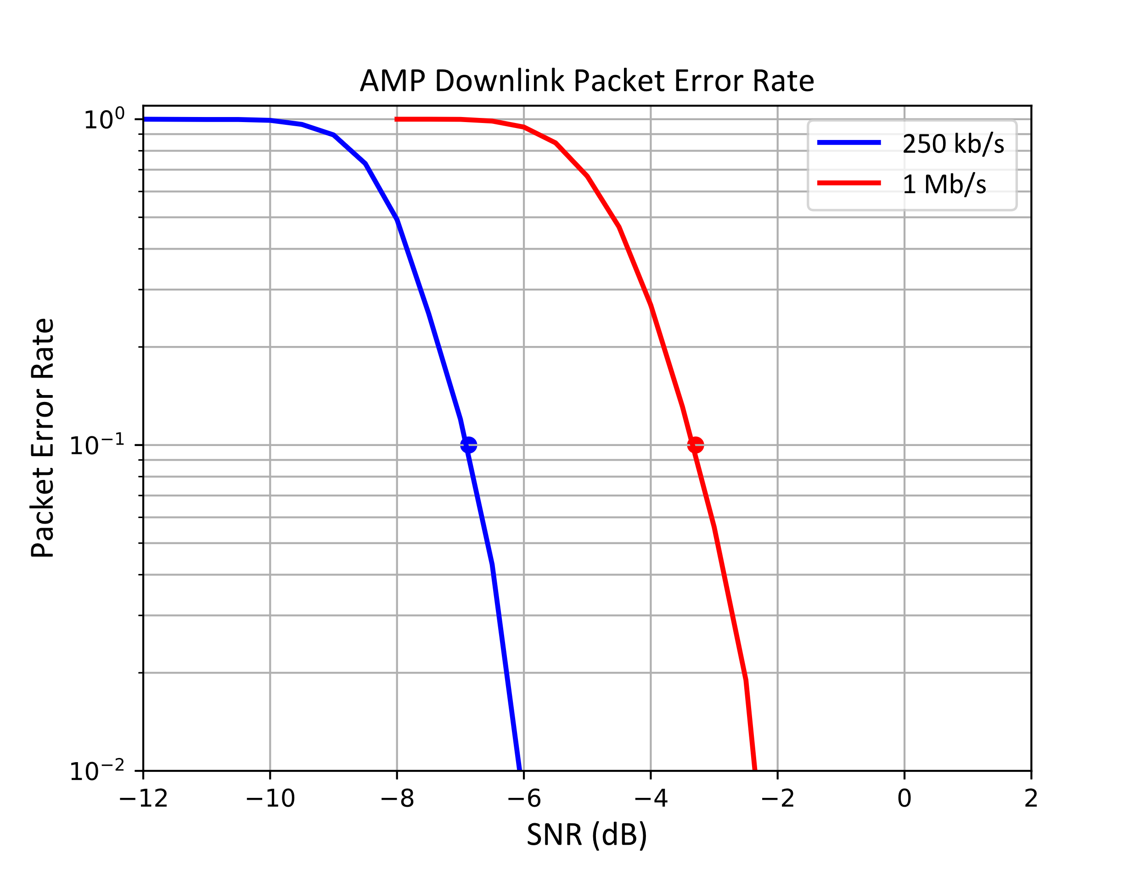
Data Field Simulation (For Reference)
At a 10% PER the 250 kb/s Downlink has an SNR of around $−6.9$dB
The SNR for the 1 Mb/s Downlink has an SNR of around $−3.3$dB
We want the Sync field Detector to work a few dB lower than $−6.9$dB

Slide 7
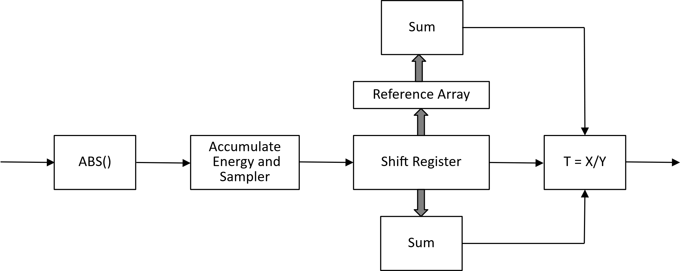
Correlation-based Sync Field Detector
Sampler runs at 8 MHz
Reference Array is $R = \left(2W – 1\right),$sampled at 8 MHz
The Test Statistic is X/Y
Y normalizes for different receive power levels
Division is easily converted to a multiplication in an implementation

Slide 8
Example Sync Field Length Simulations
Simulated several length Sync Fields
Lengths Simulated: 16, 24, and 32 Chips
Chip Duration = 2 µs
Set Detector Threshold to meet a False Alarm Rate of $10^{−4}$ with 5 ms of Noise Input
Plotted Sync Detection Failure Rate
Tabulated SNR for 10% Sync Detection Failure Rate
Calculated Margin compared to 250 kb/s Data Field

Slide 9
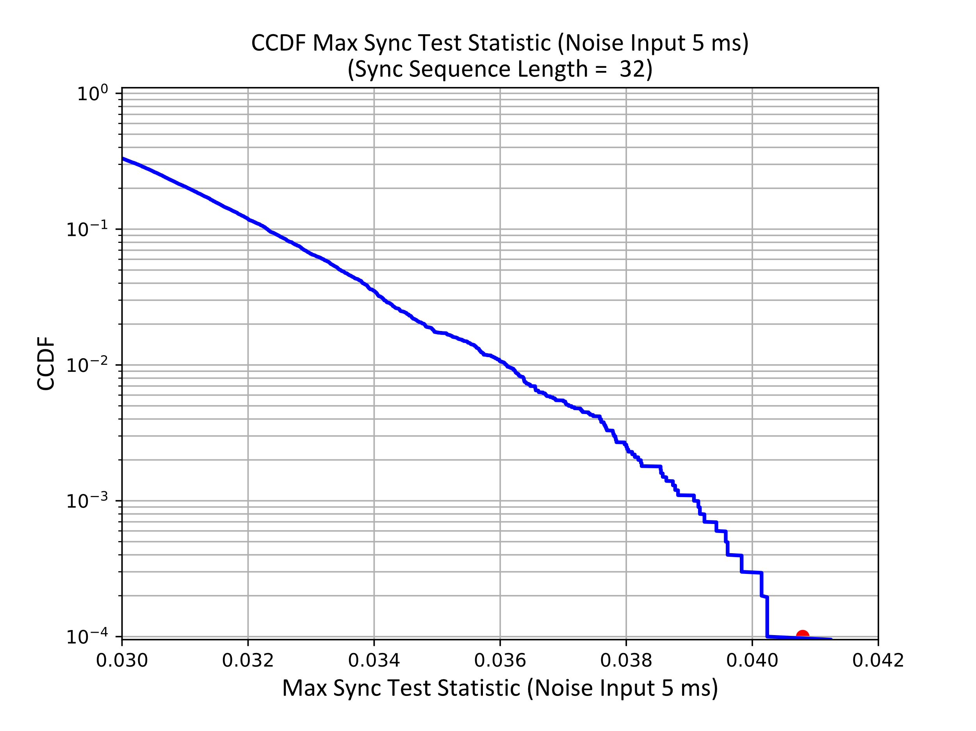
Noise Only Simulation Example Sync Sequence Length = 32 Chips
5 ms of AWGN
Plot the CCDF of the Test Statistic
Set the False Alarm rate at ${10}^{−4}$
Select Test Statistic value to meet the target False Alarm Rate
Selected Threshold Value show in Red Dot

Slide 10
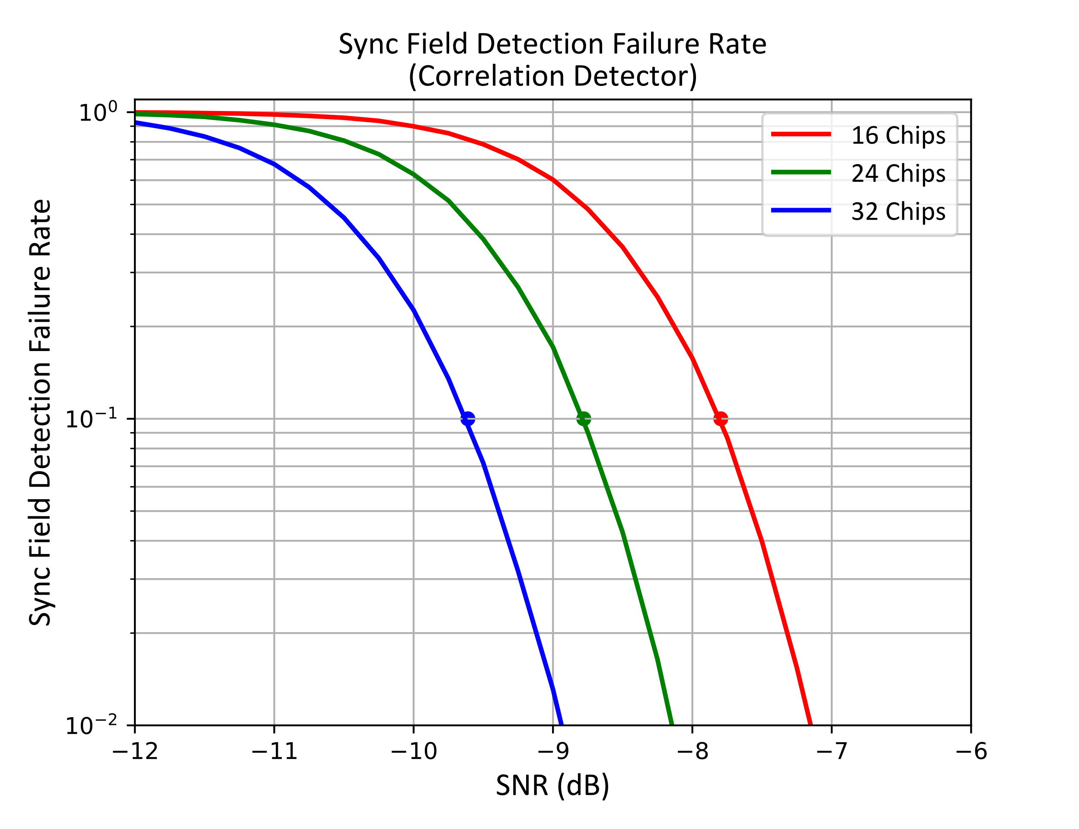
Sync Field Detector Failure Rate versus SNR
Three Sync Lengths
16, 24, and 32 Chips
Chip Duration = 2 µs

Slide 11
Sync Field Detection Required SNR
Sync Field Length (Chips) | Required SNR for 10% Sync Detection Failure Rate (dB) | 250 kb/s Data Field Required SNR for 10% BER (dB) | Margin (dB)
16 | $$−7.8$$ | $$−6.9$$ | $$0.9$$
24 | $$−8.8$$ | $$−6.9$$ | $$1.9$$
32 | $$−9.6$$ | $$−6.9$$ | $$2.7$$

Slide 12
Summary
Proposed using 2 µs chip duration for Downlink Sync field transmitted to non-Backscatter STAs
Proposed using Sync Field sequence $W$ for 250 kb/s PPDUs and $\overline{W}$ for 1 Mb/s PPDUs
Enables simple Sync field detector which can use a positive Sync field threshold for 250 kb/s PPDU and a negative threshold for 1 Mb/s PPDU
$W$ is selected to have good autocorrelation properties
Provided simulation results for the Correlation-based Detector
Simulated three Sync Field Lengths: 16, 24, and 32 Chips

