Slide 1
Spatial Re-Use and Spatial Nulling
Interference Cancellation Requirements
Date: 05-May-25

Slide 2
Introduction
Current Status
  Good progress on CoBF sounding [1], clock synchronization and data frame format [2]
  Little progress and CoSR and the relation between CoBF and CoSR
This contribution
  The understanding of CoBF and CoSR vs. the frame format definition
  Partial nulling and the need for clarification of the interference cancellation depth
  This is related to CID 369

Slide 3
Coordinated Spatial Re-Use vs Coordinated Beamforming
Coordinated spatial re-use
  Initially [3, 4, 5], referred to OBSS interference mitigation by transmit power control.
  Mostly for one STA per AP, but not limited to that (e.g., [5, 7])
Coordinated beamforming
  Initially referred to the use of spatial nulling to mitigate OBSS interference (e.g. [6, 7])
  Considered for 1 STA per AP [6], but also for multiple STAs [7]
Current motions [8] and draft text [9]
  Motion 206 [8]: CoBF for MU-MIMO transmission, CoSR for SU transmission
  CoBF and CoSR are used in downlink, only
➔ There is no requirement for interference control (a CoSR transmission may use spatial nulling and a CoBF transmission may use power control, only)

Slide 4


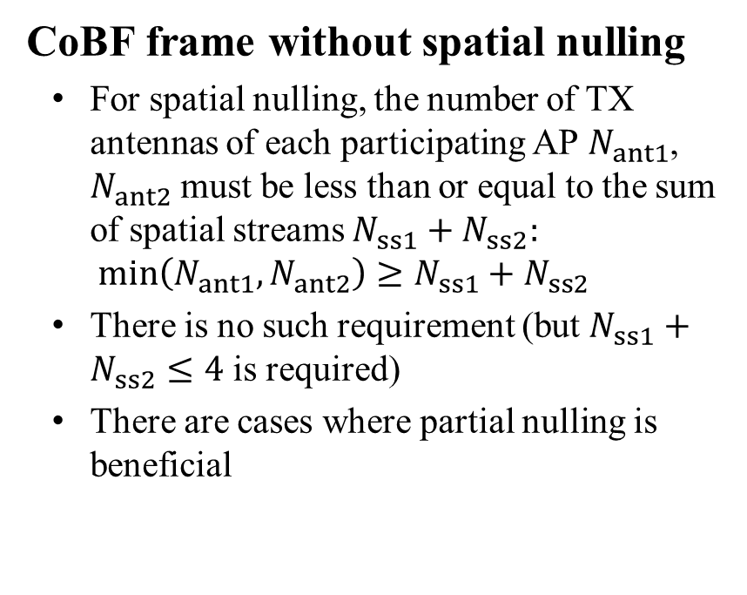
Is spatial nulling in a CoBF frame mandatory?
CoBF frame without spatial nulling
  For spatial nulling, the number of TX antennas of each participating AP $N_{ant1}$, $N_{ant2}$ must be less than or equal to the sum of spatial streams $N_{ss1}+N_{ss2}:$
  $$\min\left(N_{ant1},N_{ant2}\right)≥N_{ss1}+N_{ss2}$$
  There is no such requirement (but $N_{ss1}+N_{ss2}≤4$ is required)
  There are cases where partial nulling is beneficial
Low interference,
Reduce power
High interference, spatial null

Slide 5
Is spatial nulling in a CoSR frame possible?
CoSR frame with spatial nulling
  An AP may create spatial nulls for a CoSR frame, if the sounding feedback is available
data
data
spatial
nulling

Slide 6

Is a specific level of interference reduction required?
AP 1
AP 2
The level of OBSS interference can be controlled
  The current spec doesn’t mandate a certain level of interference suppression
  Perfect nulling is not the optimal case (see figure)
  With knowledge about the acceptable OBSS interference level, spatial nulling can be improved
null
null
data
data
STA 1
STA 2
Partial nulling
Perfect nulling
No nulling
Interference cancellation depth parameter

Slide 7
Discussion
The current CoBF and CoSR agreements, provide flexibility in the use of spatial nulling
  This flexibility is beneficial and allows for partial nulling
There are no requirements on the interference cancellation depth
  Without knowledge about the acceptable interference in the other BSS, the behavior of CoBF and CoSR is unclear
  An agreement on the acceptable level of interference will provide more reliable and more efficient CoBF/CoSR operation
  There are different possible ways to specify the allowed OBSS interference
    Fix a value in the specification
    Exchange the requirements during the CoBF/CoSR setup

Slide 8
References
[1] Sameer Vermani et.al., “Sounding Schemes for Coordinated Beamforming”, IEEE 802.11-24/1542 September 2024
[2] Sameer Vermani et.al., “COBF Design for UHR”, IEEE 802.11-24/1822r1, November 2024
[3] Kanke Wu et.al., “Performance of Coordinated Spatial Reuse”, IEEE 802.11-23/1037r0, June 2023
[4] Kosuke Aio et.al., “Evaluation of Coordinated Spatial Reuse - Follow Up”, IEEE 802.11-23/1972r0, November 2023
[5] Rainer Strobel et.al.,“Coordinated spatial re-use for UHR”, IEEE 802.11-23/1975r0, November 2023
[6] Kosuke Aio et.al.,“System Level Simulation of Co-BF and Joint Tx”, IEEE 802.11-22/1821r0, November 2022
[7] Ron Porat et.al.,“Performance of C-BF and C-SR”, IEEE 802.11-23/776r1, June 2023
[8] Alfred Asterjadhi ,“TGbn Motions List – Part 2”, IEEE 802.11-25/14r8, February 2025
[9] IEEE ,“IEEE P802.11bnTM/D0.2”, IEEE, March 2025
[3] Rainer Strobel et.al, “Coordinated Spatial Re-Use and Coordinated Spatial Nulling Follow-Up”, , IEEE 802.11-25/0635r0 March 2024

