Slide 1
Follow up on Correspondence between Energizers and AMP non-AP STAs
May 2025
Doc.: IEEE 802.11-25/0792r0
Date: 2025-05-12
Authors:
Name | Affiliation | Address | Phone | Email
Yinan Qi | OPPO |  |  | v-qiyinan@oppo.com
Weijie Xu

Slide 2
Abstract
Doc.: IEEE 802.11-25/0792r0
In this contribution, we discuss further details for the correspondence between energizer and AMP non-AP STAs needed for WPT and excitation signals.

Slide 3
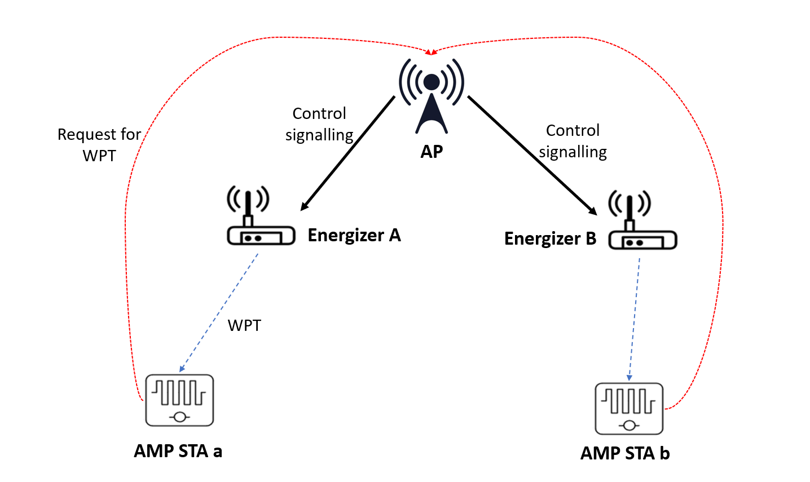
May 2025
Doc.: IEEE 802.11-25/0792r0
Recap of Correspondence
A correspondence table can be established between energizers and AMP non-AP STAs.
How to establish such correspondence table?
Energizer initiated
AP initiated
Sounding between energizer and AMP devices + CSI feedback
Position reporting from energizer and AMP devices
 | Energizer A | Energizer B
AMP a | √ | X
AMP b | X | √
Slide 3
Yinan Qi (OPPO)

Slide 4
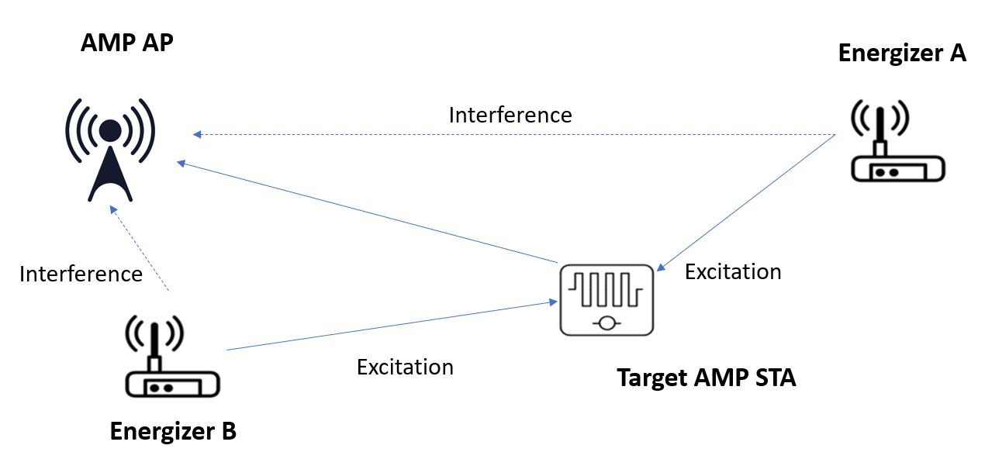
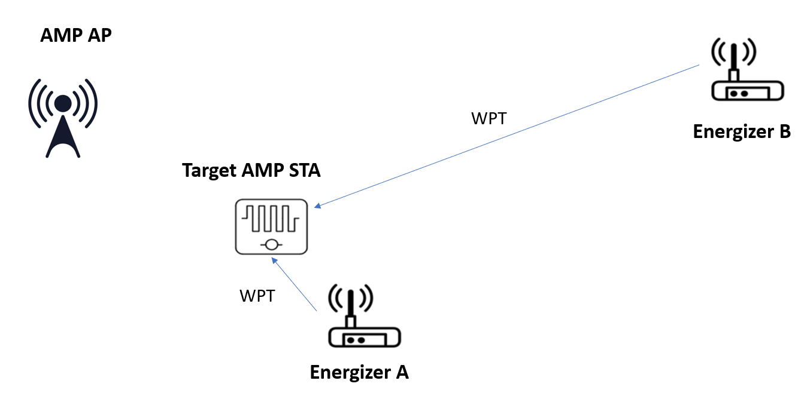
May 2025
Doc.: IEEE 802.11-25/0792r0
Consequences without Correspondence
Multiple energizers are activated to transmit excitation/WPT signals for a target AMP non-AP STAs
Low efficiency
AMP non-AP STA may not be able to process multiple excitation signal
Even with only one energizer activated, without good correspondence higher interference may happen
Energizer B is activated instead of energizer A
Direct link between AMP AP and energizer B cause heavy interference.
A far away energizer may be activated thus energy harvesting is with low efficiency or even not successful.
Energizer B is activated even it is far away from target AMP non-AP STA
Slide 4
Yinan Qi (OPPO)

Slide 5
May 2025
Doc.: IEEE 802.11-25/0792r0
How to Establish the Correspondence Table?
Position reporting based method
Limited by complexity and power consumption
High accuracy positioning method normally requires Tx/Rx positioning signals and high processing capability
AMP AP and energizer can be located with relatively good accuracy
AMP non-AP STA may not due to low complexity not supporting high accuracy positioning method
Highly depend on positioning accuracy
In [1], it shows that the range for bi-static backscattering AMP devices can be only a couple of meters without enhancement.
Considering 1m positioning accuracy, error can be up to 50% of total range.
Without good positioning accuracy, a wrong energizer might be activated and it may not be able to sufficiently charge the target AMP devices.
Channel measurement based method
Essentially distance/position based method
Limited by measurement capability of AMP devices.
Slide 5
Yinan Qi (OPPO)

Slide 6
May 2025
Doc.: IEEE 802.11-25/0792r0
Energizer ID based Method
Exchange of energizer ID is more feasible
Energize sends WPT/excitation signal together with the energizer ID when instructed by the AMP AP
AMP non-AP STA then reports such ID
Two issues:
How does the AP instruct the energizer?
How does the energizer transmit is own ID.
Solution to these issues can be different for WPT signal and excitation signal.
Slide 6
Yinan Qi (OPPO)

Slide 7
May 2025
Doc.: IEEE 802.11-25/0792r0
How to Signal the ID?
WPT signal
AP includes an indication bit in the control information sent from AP to the energizer.
Energizer can send its ID in 2.4GHz separately from WPT signal in S1GHz.
Energizer should establish a link between its ID and particular WPT signal
Energizer can send its ID in S1GHz together with WPT signal
WPT PPDU
AMP PPDU if S1GHz communication is specified.
Excitation signal
When energizer transmits excitation signals, it is always in 2.4GHz.
AMP AP can transmit energizer’s ID in the AMP DL PPDU to the target AMP non-AP STA, e.g., MAC header.
Slide 7
Yinan Qi (OPPO)

Slide 8
May 2025
Doc.: IEEE 802.11-25/0792r0
Without Correspondence
Correspondence availability
Correspondence is not available at the very beginning before transmission of any WPT/excitation/communication signal.
Once correspondence is established gradually with WPT/excitation/communication signal transmission, such correspondence table can be used to optimize the following WPT/excitation signal.
Without correspondence
AP broadcasts to activate all energizer.
Interference for excitation signals
For WPT signal, it will block channel as long as there is energizer deployed
AMP non-AP STA cannot decode ID of energizers
Slide 8
Yinan Qi (OPPO)

Slide 9
May 2025
Doc.: IEEE 802.11-25/0792r0
Without Correspondence
AMP AP can activate the energizer group by group or one by one until the target AMP non-AP STA is activated or charged.
For example, AMP AP sets periodic time slot 1-4, within which energizer or energizer group can be activated to transmit WPT/excitation signals.
Each energizer or energizer group can then choose one of the slots to transmit its own signal based on AP configuration.
Slot 1
Slot 2
Slot 3
Slot 4
t
Energizer 1/group 1
Energizer 1/group 2
Energizer 1/group 3
Energizer 1/group 4
Slide 9
Yinan Qi (OPPO)

Slide 10
May 2025
Doc.: IEEE 802.11-25/0792r0
Summary
In this contribution, we discussed further details on how to establish correspondence table between energizers and AMP non-AP STAs.
Slide 10
Yinan Qi (OPPO)

Slide 11
Reference
May 2025
Doc.: IEEE 802.11-25/0792r0
[1] “UL Monostatic and Bistatic Range Extension Considerations,” IEEE 802.11-25/0307r0, Mar. 2025

Slide 12
May 2025
Doc.: IEEE 802.11-25/0792r0
SP1
Do you agree to capture the following text to TGbp SFD?
The correspondence between energizer and AMP devices that determines which energizer to activate to charge target AMP devices should be supported
Slide 12
Yinan Qi (OPPO)

