Slide 1
Remaining Issues of WPT
May 2025
Doc.: IEEE 802.11-25/0791r0
Date: 2025-05-12
Authors:
Name | Affiliation | Address | Phone | Email
Yinan Qi | OPPO |  |  | v-qiyinan@oppo.com
Weijie Xu

Slide 2
Abstract
Doc.: IEEE 802.11-25/0791r0
In this contribution, we discuss the following remaining issues of WPT:
  Waveform of WPT signal
  Co-existence of WPT
  WPT protocols

Slide 3
May 2025
Doc.: IEEE 802.11-25/0029r0
WPT Waveform
  WPT waveform can be up to implementation but recommendation can be included in the specification
    Possibility of reuse legacy design or devices, e.g., 802.11ah
    Better co-existence performance
  Legacy waveforms are preferred because they are easy to implement thus with minimal specification/implementation efforts
  Candidate waveforms
    OFDM: high PAPR, reuse legacy design/device
    DSSS: scaled design for 2.4GHz
    Single tone/carrier: simplicity
  OFDM can be baseline WPT waveform
Slide 3
Yinan Qi (OPPO)

Slide 4
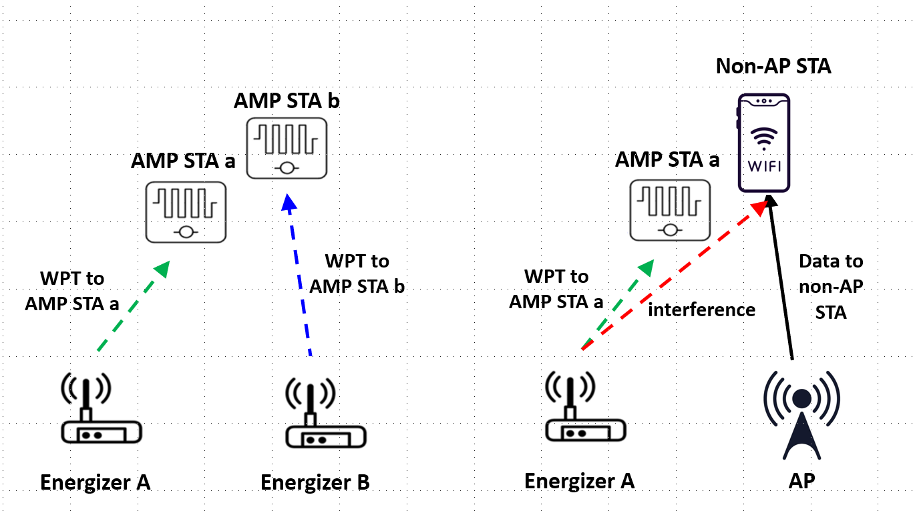
March 2025
Doc.: IEEE 802.11-25/0320r0
WPT PPDU: Co-existence Issue
  Agreement: WPT signals from two or more transmitters in S1GHz are allowed to occupy the same channel simultaneously [1].
  Co-existence between WPT signals and other 802.11 systems on S1G, e.g., 802.11ah, or even non-WiFi S1G systems.
  Two options
    Option 1: only consider co-existence with 802.11ah in S1G
      Energizer needs to be able to detect legacy 802.11ah preamble
    Option 2: consider co-existence with 802.11ah and non-WiFi systems in S1G
      WPT signal has a field that can be recognized by TGbp energizers
Slide 4
Yinan Qi (OPPO)

Slide 5
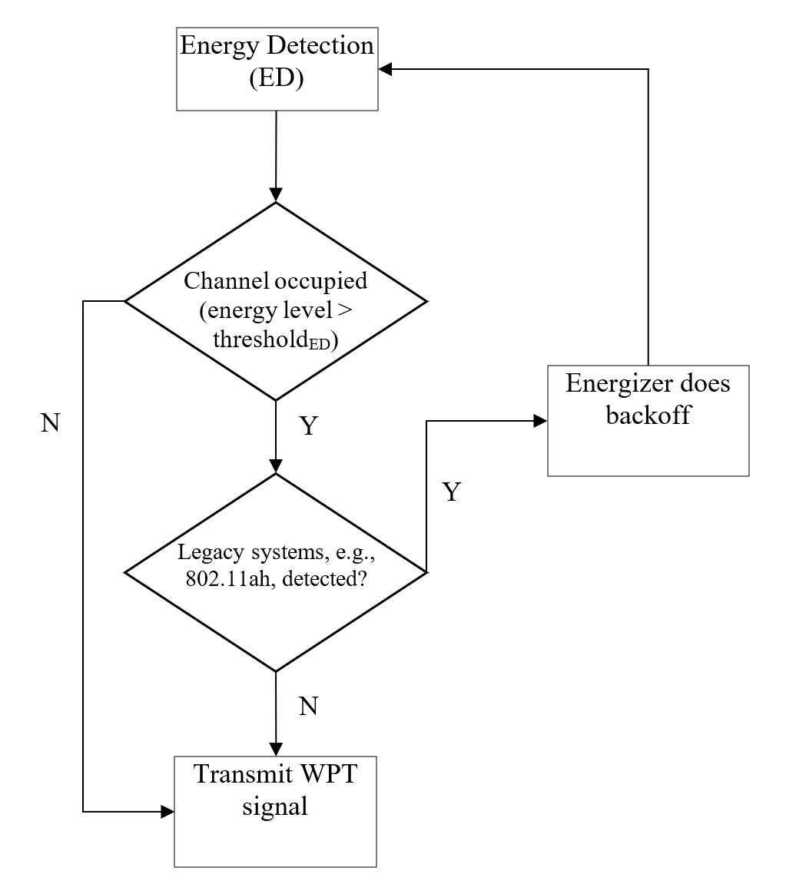
March 2025
Doc.: IEEE 802.11-25/0320r0
WPT LBT Option 1
  The energizer does ED first.
  In the case of collision, the energizer needs to keep listening to the channel. If 802.11ah PPDU is detected, the energizer does backoff.
  Otherwise, if no 802.11ah PPDU is detected, the energizer assumes the signal in the air is WPT signals and transmit its own WPT signal.
  Pros: No interference to 802.11ah, more systems can be included if the energizer can detect their PPDUs
  Cons: interference to other S1G systems.
Slide 5
Yinan Qi (OPPO)

Slide 6
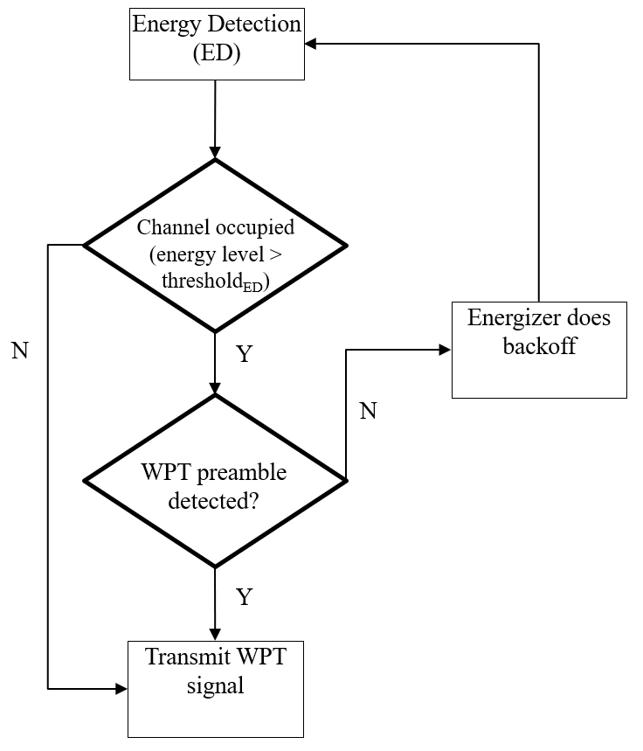
March 2025
Doc.: IEEE 802.11-25/0320r0
WPT Option 2
  The energizer can do ED first.
  In the case of collision, the energizer needs to keep listening to the channel. If a preamble is detected, the energizer knows the signal is WPT signal and it can transmit its own WPT signal.
  Otherwise, it no preamble is detected, the energizer assumes the signal in the air is communication signal and does backoff.
  Pros: No interference to not only to 802.11ah but also other S1G systems.
Slide 6
Yinan Qi (OPPO)

Slide 7

May 2025
Doc.: IEEE 802.11-25/0029r0
WPT PPDU
  Design WPT signal that can be fully or partially understood by the energizer.
  New design: the WPT preamble can be very simple and contain only essential information such as ID of the energizer, a sync sequence for capturing the WPT PPDU, etc.
    Other legacy systems do not need to understand WPT preamble
  Legacy design, e.g., 802.11ah: use 802.11ah preamble as a starting point but modify the SIG field to indicate WPT PPDU
    Unsupported MCS level → legacy 802.11ah nodes will give up processing the WPT PPDU
Slide 7
Yinan Qi (OPPO)

Slide 8
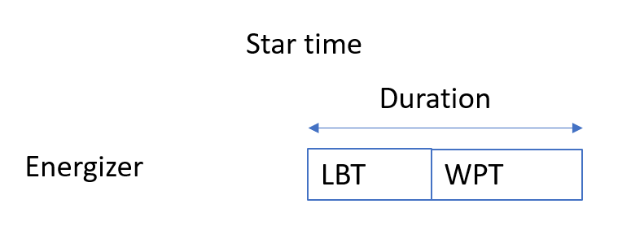
May 2025
Doc.: IEEE 802.11-25/0791r0
Additional Energizer Control Signalling Parameters
  Agreed parameters: Start Time, Duration, Interval, Transmit Power, and frequency related parameters
  However, energizer may not be able to transmit WPT from start time due to co-existence issue, e.g., channel already occupied
  Timing parameters for WPT transmission only define a window and energizer should do LBT within that window.
  Additional parameters:
    LBT parameters, e.g., detection Threshold, Contention Window, etc.
Slide 8
Yinan Qi (OPPO)

Slide 9
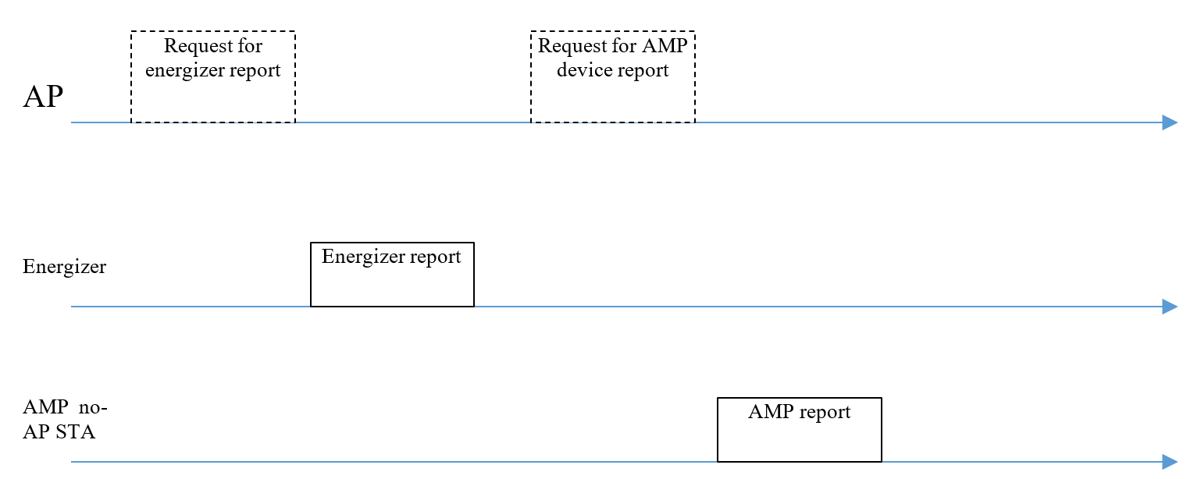
May 2025
Doc.: IEEE 802.11-25/0320r1
WPT Protocol: AMP non-AP STA Reporting
  AMP non-AP STA reporting may consume additional energy
  One time reporting of long-term energy related condition does not consume energy consistently but can provide essential information.
  For example, power sources for AMP are not limited to RF and different sources can lead to different energy usage pattern.
    Solar or vibration power source can be intermittent but with high energy harvesting efficiency.
    RF energy source can be continuous but with low energy harvesting efficiency.
  Additionally, different AMP non-AP STAs may support different WPT frequencies and such information should be known to the AMP AP and energizer
Slide 9
Yinan Qi (OPPO)

Slide 10
May 2025
Doc.: IEEE 802.11-25/0791r0
Energizer Capability Signalling: Parameters
  Agreement: Energizer should report its WPT and excitation related capability to the AMP AP. The parameters to be reported are TBD
  Parameters to be reported:
    Whether or not support S1G WPT
    Which frequencies are supported, bandwidth for each frequency, maximum Tx power for each frequency for WPT.
    Whether or not support 2.4G excitation transmission
    Maximum Tx power and whether or not the Tx power is adjustable
    ID(s) of associated AMP devices that can be wirelessly charged
Slide 10
Yinan Qi (OPPO)

Slide 11
May 2025
Doc.: IEEE 802.11-25/0791r0
Summary
  In this contribution, we discussed the remaining issues on WPT.
Slide 11
Yinan Qi (OPPO)

Slide 12
Reference
May 2025
Doc.: IEEE 802.11-25/0791r0
[1] “IEEE 802.11 TGbp Motion Dock,” IEEE 802.11-24/1322r7, Mar. 2025

Slide 13
May 2025
Doc.: IEEE 802.11-25/0791r0
SP1
  IEEE 802.11bp will recommend OFDM as the baseline waveform for WPT in S1G.
Slide 13
Yinan Qi (OPPO)

Slide 14
May 2025
Doc.: IEEE 802.11-25/0791r0
SP2
  Energizer should perform LBT before transmitting WPT signals in S1G. The details of LBT are TBD.
Slide 14
Yinan Qi (OPPO)

Slide 15
May 2025
Doc.: IEEE 802.11-25/0791r0
SP3
  IEEE 802.11bp will specify, in S1GHz, PPDU format for WPT signal including at least preamble field and power transfer field.
Slide 15
Yinan Qi (OPPO)

Slide 16
May 2025
Doc.: IEEE 802.11-25/0791r0
SP4
  The LBT related parameters, detection threshold, contention window, for energizer can be considered additionally as control information that is sent from the AMP AP to the AMP Energizer relating to the WPT waveform
Slide 16
Yinan Qi (OPPO)

Slide 17
May 2025
Doc.: IEEE 802.11-25/0791r0
SP5
  The parameters that are included in the energy harvesting and power related information report should include at least.
    Power source(s)
    Supported RF energy harvesting operation frequency
Slide 17
Yinan Qi (OPPO)

Slide 18
May 2025
Doc.: IEEE 802.11-25/0791r0
SP6
  The capability parameters to be reported by the energizer to the AMP AP at least include the following parameters.
    Whether or not support S1G WPT
    Which frequencies are supported, bandwidth for each frequency, maximum Tx power for each frequency for WPT.
    Whether or not support 2.4G excitation transmission
    Maximum Tx power and whether or not the Tx power is adjustable
    ID(s) of associated AMP devices that can be wirelessly charged
Slide 18
Yinan Qi (OPPO)

