Slide 1
Remaining Issues of AMP PPDU Design
May 2025
Doc.: IEEE 802.11-25/0790r0
Date: 2025-05-12
Authors:
Name | Affiliation | Address | Phone | Email
Yinan Qi | OPPO |  |  | v-qiyinan@oppo.com
Weijie Xu
Chuanfeng He
Ke Wang
Shengjiang Cui
Zhisong Zuo

Slide 2
Abstract
Doc.: IEEE 802.11-25/0790r0
In this contribution, we discuss the remaining open issues in AMP PPDU design covering issues such as non-AMP preamble configuration, synchronization, SIG and data fields, DL/UL waveform generation, PPDU format and UL transmission configuration.

Slide 3
May 2025
Doc.: IEEE 802.11-25/0790r0
Non-AMP DL Preamble Format
Non-AMP legacy preamble includes L-STF, L-LTF, L-SIG, RL-SIG, and U-SIGs for Active Tx and AMP enabled devices
For backscattering AMP device, additional preamble format, e.g., 802.11b like preamble can be used
Single carrier DSSS
Depending on the waveform of the following AMP portion
Convergence is possible when AMP portion waveform is decided.
Slide 3
Yinan Qi (OPPO)

Slide 4
May 2025
Doc.: IEEE 802.11-25/0790r0
Non-AMP DL Preamble Configuration
Configuration of L-SIG
Rate: configured as an unsupported rate
Differentiate from WUR where rate is always configured as MCS0
Other legacy devices can stop reception once detecting unsupported rate
Length: configured as entire DL PPDU including excitation field(s)
UL transmission parameters, e.g., payload size, rate, MCS, etc., are all configured by the AMP AP
Configuration of RL-SIG
Instead of repetition of L-SIG, may consider other options, e.g., complement of L-SIG, to differentiate 802.11bp PPDU from legacy PPDU
Slide 4
Yinan Qi (OPPO)

Slide 5
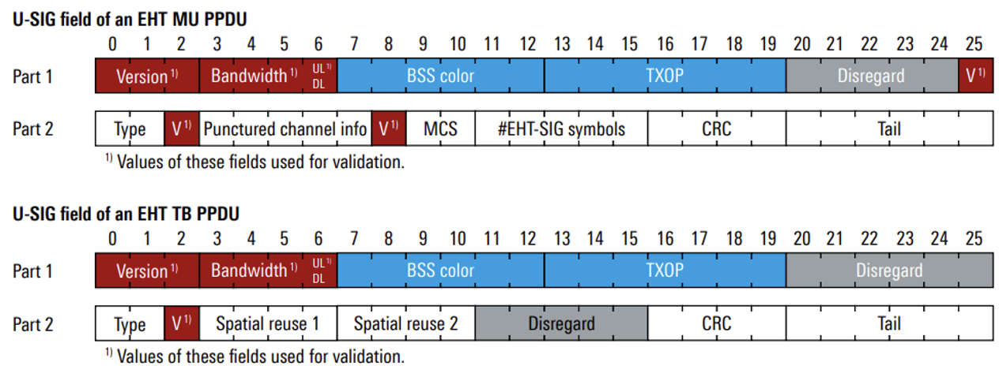
May 2025
Doc.: IEEE 802.11-25/0790r0
Non-AMP DL Preamble Configuration
Configuration of individual fields in U-SIG
Two U-SIG formats available but need to choose only one for 802.11bp
EHT MU PPDU can be chosen
How to differentiate 802.11bp PPDU from 802.11be and 802.11bn PPDU?
Validation fields, e.g., version
For example, version field can be configured different from 802.11be and 802.11bn
UL/DL: configured as DL if there is no excitation field and UL otherwise
Txop can be configured as maximum value, so it actually does not indicate Txop duration.
Slide 5
Yinan Qi (OPPO)

Slide 6
May 2025
Doc.: IEEE 802.11-25/0790r0
AMP Synchronization
Asymmetric synchronization design for UL and DL
Different sync sequences in terms of pattern and/or length for DL/UL to differentiate UL and DL
DL synchronization design
In our companion contribution [1], it is shown that DL synchronization performance depends on sequence length, chip duration, sampling rate, etc.
Sequence length: 16 and/or 32
Sampling rate: 2MHz or 8MHz
Chip duration: same chip duration for 1Mbps and 250kbps for reduced complexity at AMP non-AP STA side: 0.5, 1 and 2 microsecond can be considered
Main findings: cross-correlation with data portion may cause severe sync inaccuracy
UL synchronization design
A single synchronization sequence can be used for multiple data rates
Chip rate can scale with data rate and short chip duration is used for higher rate with higher SNR to reduce signalling overhead
AP does not need to do blind detection trying various chip duration with knowledge of UL transmission configuration.
Slide 6
Yinan Qi (OPPO)

Slide 7
May 2025
Doc.: IEEE 802.11-25/0790r0
SIG Field and Payload Size
DL SIG fields: length and/or payload size, backscatter indication, UL configuration to configure the following UL transmission in followed excitation field, CRC
Alternatively, these information can also be conveyed in MAC header
If in SIG, these basic information can always be transmitted with low rate for better link budget.
Flexible payload size configuration for DL and UL
Multiple frame formats need to be supported in DL including data, management and control frames
For data frame, 802.11ba can still be a starting point
Frame body is m*n
m is the size of AMP non-AP STA ID, e.g., AID or compressed AID
n is the number of AMP non-AP STAs to be addressed
For UL, some fixed payload size can be defined to reduce signalling overhead and padding can be applied if needed.
Slide 7
Yinan Qi (OPPO)

Slide 8
May 2025
Doc.: IEEE 802.11-25/0790r0
DL/UL waveform generation
Agreement: The carrier waveform for AMP Downlink PPDU is constructed by repeating one predefined base waveform of TBD micro-second, we suggest having a bandwidth of 10M.
DSSS
Replace Barker code with another spreading code, which can generate a narrow bandwidth DSSS signal
BW flexibly depends on the spreading code
OFDM
OFDM BPSK sequence to generate a narrow bandwidth OFDM signal as the predefined base waveform for around 10MHz.
BW 10MHz leave sufficient guard band for various implementations [2].
Slide 8
Yinan Qi (OPPO)

Slide 9
May 2025
Doc.: IEEE 802.11-25/0790r0
DL PPDU: Flexible BW and Waveform
DL PPDU
Different BW and waveforms can be considered for different fields including preamble, excitation, data, etc., to achieve optimized performance.
Active Tx
Preamble: 20MHz with OFDM waveform
AMP part: no less than 10 MHz but can be DSSS waveform
Backscattering
Preamble: OFDM or DSSS
AMP part
All transmitted by the same node for mono-static case → unified design
Different fields can be transmitted by separated nodes for bi-static case → different design for data portion and excitation
Slide 9
Yinan Qi (OPPO)

Slide 10
May 2025
Doc.: IEEE 802.11-25/0790r0
PPDU Format
New DL PPDU format
Legacy nodes, e.g., existing legacy APs, mobile phones, as energizers could be without AMP protocol support
AMP AP configures energizer and AMP non-AP STA with DL PPDU
Energizer then transmits excitation to be used for AMP non-AP STA backscattering. Due to co-existence requirement, a legacy non-AMP preamble needs to be transmitted before the excitation field. Thus, a new PPDU format is needed.
Decouple DL and UL for backscattering AMP non-AP STAs
Notes:
Preamble + Sync + excitation

Slide 11
May 2025
Doc.: IEEE 802.11-25/0790r0
UL Configuration
Chip duration can scale with data rate and FEC coding
For example, 2us for 250kbps without FEC coding and 1us with FEC coding.
UL BW, e.g., BW of the main lobe, can also scale with data rate.
Narrower BW for lower data rates.
UL BW can also scale with data rate.
FDM may be applied at least for low data rate
Slide 11
Yinan Qi (OPPO)

Slide 12
May 2025
Doc.: IEEE 802.11-25/0790r0
UL Configuration: MCS
FEC coding, e.g., convolutional coding with coding rate 1/2, can be supported for UL with 2.5dB coding gain [3]
A baseline MCS table can be as follows.
Rate has been decided with or without FEC coding
Chip duration will change with FEC coding rate.
MCS Index | Device Type | FEC Coding Rate | Data Rate
0 | Backscattering AMP device and Active AMP device | 1/2 | 250 kbps
1 | Backscattering AMP device and Active AMP device | 1 | 250 kbps
2 | Backscattering AMP device and Active AMP device | ½ | 1 Mbps
3 | Backscattering AMP device and Active AMP device | 1 | 1 Mbps
4 | Active AMP device | ½ | 4 Mbps
5 | Active AMP device | 1 | 4 Mbps
Slide 12
Yinan Qi (OPPO)

Slide 13
May 2025
Doc.: IEEE 802.11-25/0790r0
Summary
The following issues are discussed and analysed in this contribution
Preamble design
Synchronization design for both DL and UL
DL/UL SIG and payload size
DL/UL waveform generation
DL PPDU format
UL configuration, e.g., MCS

Slide 14
Reference
May 2025
Doc.: IEEE 802.11-25/0790r0
[1] “Sync field for AMP PPDU,” IEEE 802.11-25/0801r0, May 2025
[2] “OOK generation for AMP,” IEEE 802.11-25/0802r0, May 2025
[3] “AMP UL Transmission,” IEEE 802.11-25/0317r0, Mar. 2025

Slide 15
SP 1
May 2025
Doc.: IEEE 802.11-25/0790r0
The preamble of an AMP DL PPDU for AMP enabled non-AP STA and active TX non-AP AMP STA should be configured as follow,
L-SIG
Rate - configured as an unsupported MCS level
U-SIG
Version field - configured different from 802.11be and 802.11bn
UL/DL - configured as DL if there is no excitation field and UL otherwise
Other fields are TBD

Slide 16
SP 2
May 2025
Doc.: IEEE 802.11-25/0790r0
IEEE 802.11bp will specify, in 2.4 GHz, DL synchronization sequence with the same chip duration for all data rates for non-backscatter case.

Slide 17
SP 3
May 2025
Doc.: IEEE 802.11-25/0790r0
IEEE 802.11bp will specify, in 2.4 GHz, a single UL synchronization sequence for all data rates for non-backscatter case.

Slide 18
SP 4
May 2025
Doc.: IEEE 802.11-25/0790r0
IEEE 802.11bp will specify additionally, in 2.4 GHz, an AMP PPDU format containing an 802.11 preamble field and an excitation field for bi-static use case. This PPDU is transmitted by the energizer to the backscatter non-AP AMP STA.

Slide 19
SP 5
May 2025
Doc.: IEEE 802.11-25/0790r0
For DL PPDU and UL PPDU for non backscattering case:
For AMP Manchester encoded OOK of rate 250kbps, each data bit is encoded based on the chip duration of 2us.
For AMP Manchester encoded OOK of rate 1Mbps, each data bit is encoded based on the chip duration of 0.5us.
For AMP Manchester encoded OOK of rate 4Mbps, each data bit is encoded based on the chip duration of 0.125us.

Slide 20
SP 6
May 2025
Doc.: IEEE 802.11-25/0790r0
IEEE 802.11bp will specify, in 2.4 GHz, convolutional coding with coding rate ½ for UL transmission. The details of encoder is TBD.

