Slide 1
AMP Operation Status Reporting
Date: 12 May 2025
Name | Affiliation | Address | Phone | Email
Ian Bajaj | Huawei | Singapore |  | ian.bajaj@huawei.com
Lei Huang
Rojan Chitrakar
Yaron Ben-Arie |  | Israel
Notes:
Jul 12, 2010
Page 1

Slide 2
Introduction
Motion WM-2 [1] states “IEEE 802.11bp defines a mechanism that allows an AMP non-AP STA to report its energy harvesting and power related information to AMP AP STA. The parameters that are included in the report and how to report such information is TBD.”
Several contributions have discussed potential parameters that are included in the report and reporting methods [2-4].
The use case for AMP STA reporting has been discussed [3] as beneficial in optimizing the energizing provided by WPT/excitation, and particularly beneficial for AMP AP resource scheduling [4]
In this contribution, we wish to highlight:
A new Operation Status report parameter that is effective in indicating to the AMP AP, the energy signature of the AMP STAs in its BSS.
The possible encoding methods, and communication overhead for such an Operation Status report

Slide 3
AMP Operation Status – Motivation
Motivation:
A lot of the reported parameters maybe tag specific (minimum operational voltage, power consumption for various modes of operation, capacitor size, charging/discharging rate, etc.)
All the AMP AP cares about is how much time is remaining for a specific mode of operation on the tag, namely,
Does the AMP STA have enough stored energy to receive a DL PPDU?
Does the AMP STA have enough stored energy to respond with an UL PPDU?
Can the AMP STA remain charged (not die) till the next WPT/excitation signal transmission?
Proposal:
The time the AMP STA can remain in a mode of operation is reported to the AP

Slide 4
AMP STA Modes of Operation
There may be three modes of operation of an AMP STA, that may be of relevance to the AP: Transmission, Reception, Idle.
The Idle mode of operation refers to any operation that does not involve RF-related activity, i.e. modulation, encoding, transmission, demodulation, decoding, reception. It may include a host of other low-power operations such as memory (state, buffer) and clock operations.
The essence of idle mode is to determine the duty cycle nature of charging required for the AMP STA when no transmission or reception is occurring, and therefore representative of its discharging rate with no RF activity.
Each of these modes of operation will consume significantly different power, and require different minimum operating voltage.
Reporting a time in a mode of operation, therefore provides the AP an AMP STA-specific energy signature that is useful in determining the duration and time for WPT/excitation signal transmission or its control thereof, as well as scheduling or prioritizing AMP STAs for channel access.

Slide 5
AMP Operation Status – Computation
The AMP STA can determine its energy as, $E=\frac{1}{2}C\left(V_{current}^{2}−V_{min}^{2}\right),$where $C$ is the capacitor value of the AMP STA, $V_{current}$ is the current voltage level measured on chip, and $V_{min}$ is the minimum voltage level that can support a mode of operation.
The time that the AMP STA can remain in each mode of operation can then be given by,
$t_{MODE}=\frac{E}{P_{MODE}}$, where $P_{MODE}$ is the power consumption for the specific mode of operation, assuming a default date rate of 1 Mbps.
$V_{min}$ and $P_{MODE}$ for each mode of operation, may be measured by the vendor during production testing or simulation for each AMP tag.
Given the passed motion PM-2 [1], that a non-AP AMP STA UL will be triggered by the AP, transmission of an UL PPDU is dependent on reception of the AP’s DL Trigger frame. Consequently, the AMP AP may only care if the non-AP AMP STA has enough energy for 1 RX + 1 TX operation.
The time in the non-AP AMP STA can remain in the TX mode of operation, may then be computed as, $t_{TX}=\frac{E}{P_{TX}+P_{RX}}$. This may be determined as minimum information needed by the AMP AP to determine if charging is needed prior to transmitting the DL PPDU.

Slide 6
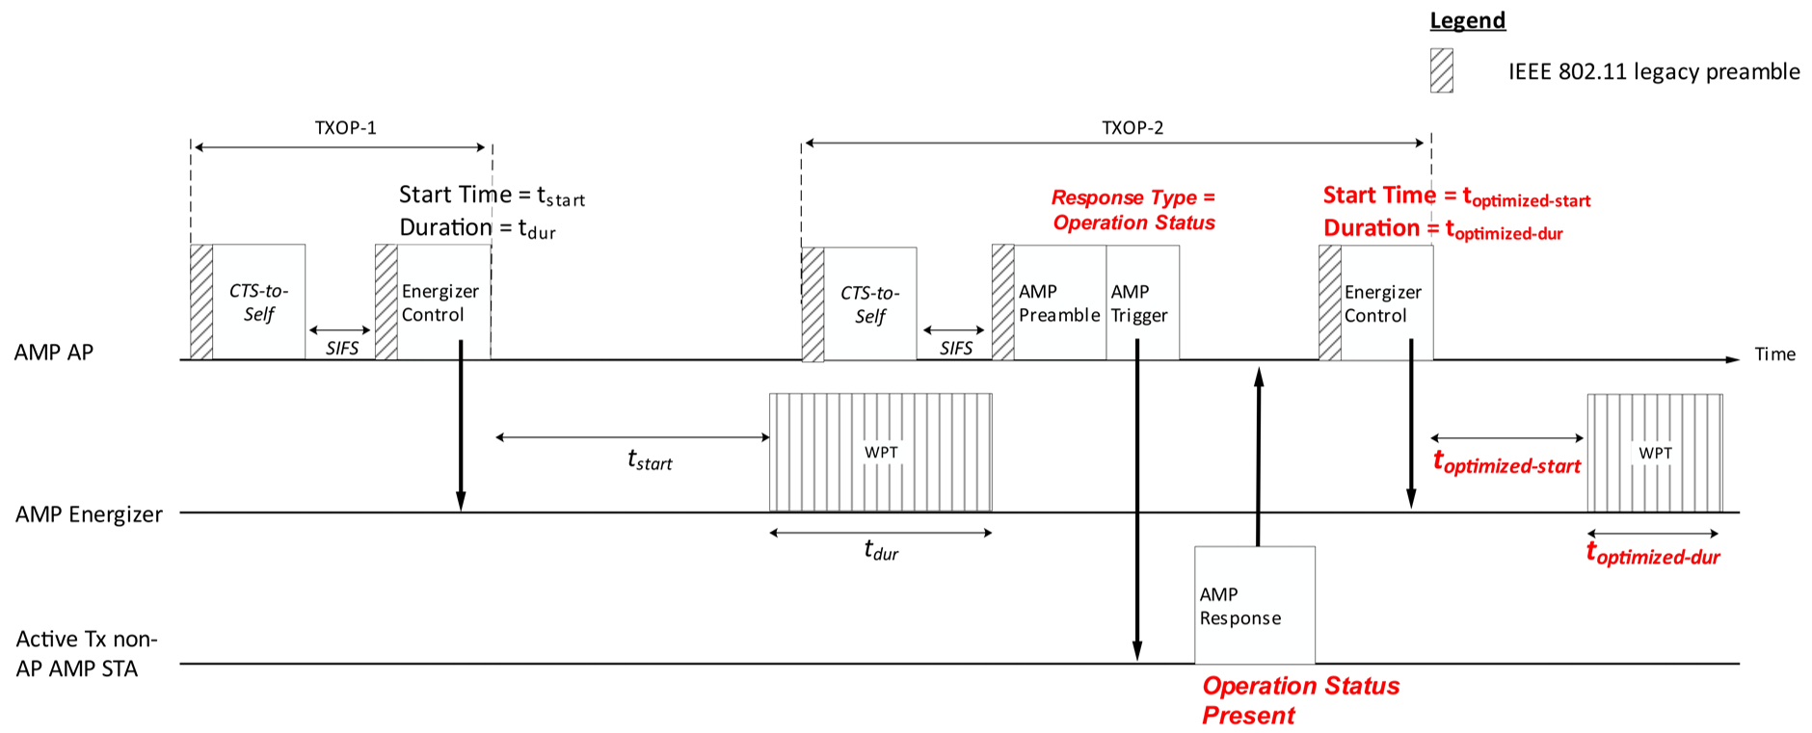
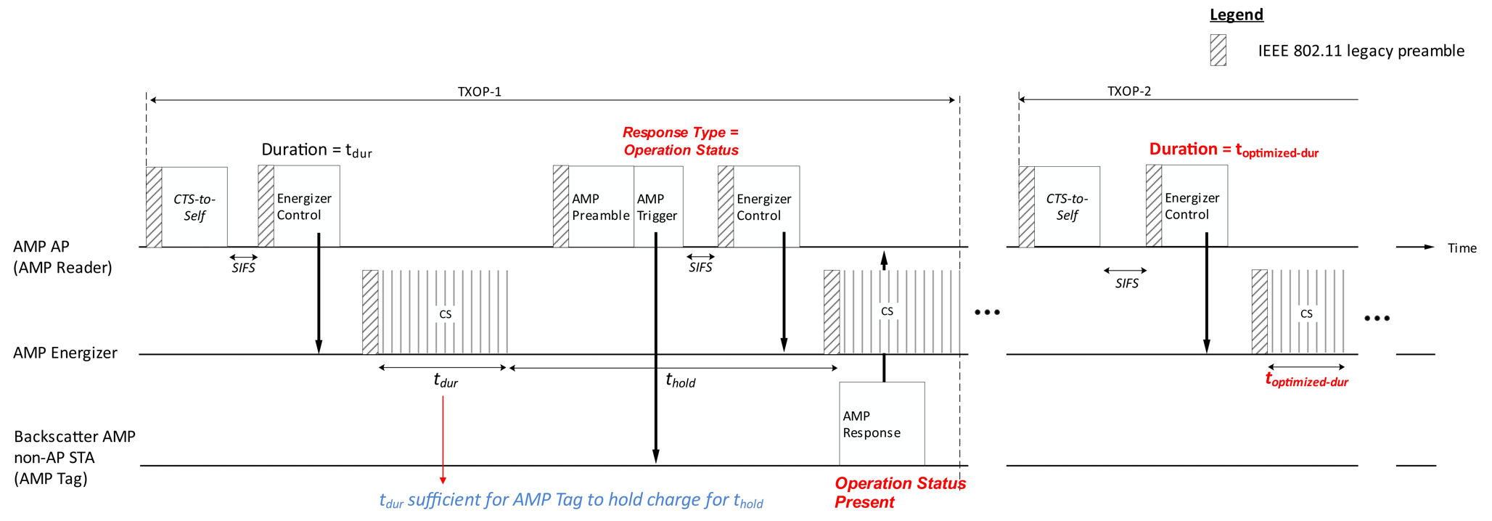
Operation Status Reporting Example
We see an example here, of how future rounds of WPT may be optimized by determining a duration and start time based on an Operation Status report from an Active Tx non-AP AMP STA.
Similarly, the AMP AP can trigger the Backscatter non-AP AMP STA to respond with the Operation Status to determine the duration of the excitation signal for future rounds of charging and backscattering.

Slide 7
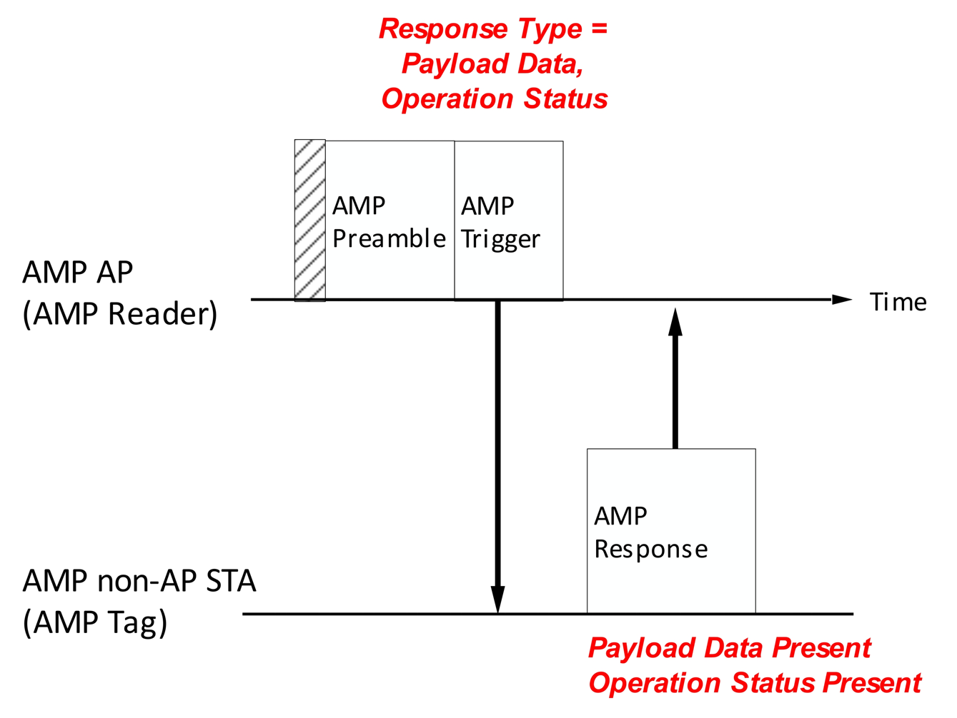
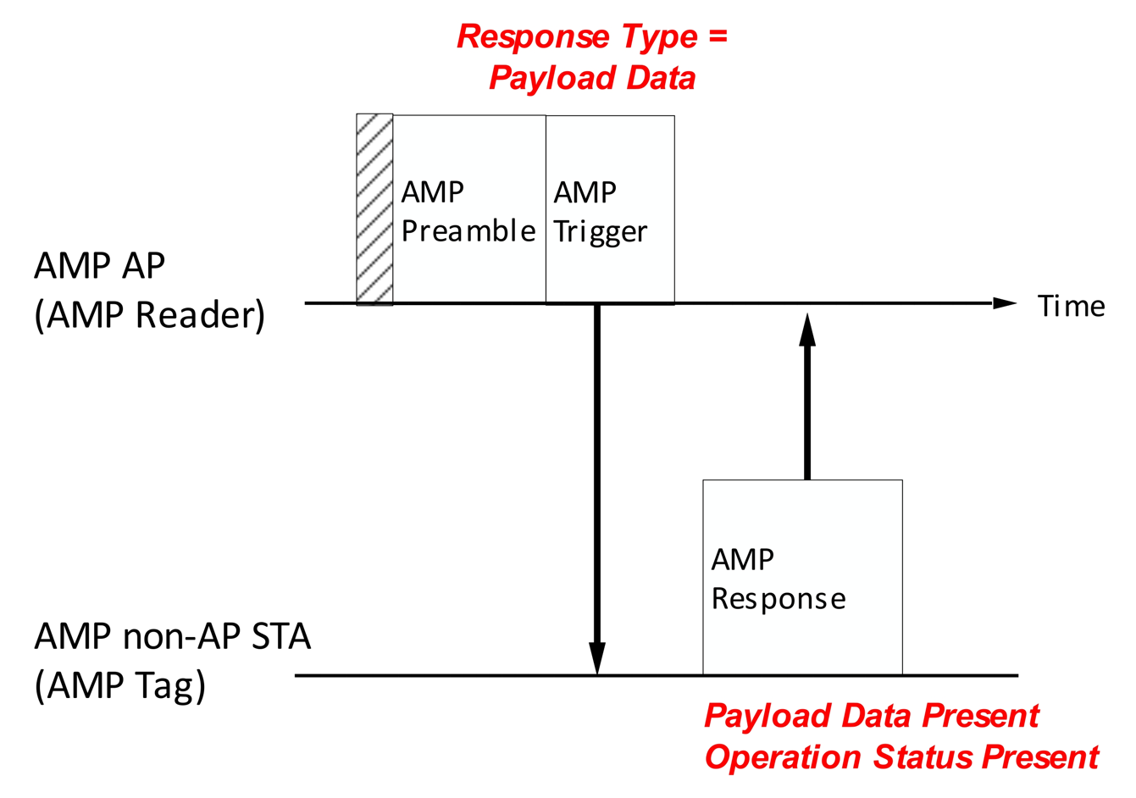
Operation Status Signaling
A possible encoding method for the time in each mode of operation, may be determined based on standard development, and cover the range of capacitor and power consumptions values for non-AP AMP STAs.
The Operation Status may be carried in an AMP Response frame (when solicited by the AMP AP Trigger Frame), corresponding to each mode of operation:
Operation Status (5 bits) – Time unit (2 bits) expressed in us, Time Value (3 bits) expressed as a multiple of the Time unit.
To reduce the communication overhead, the non-AP AMP STA may alternatively report a fixed multiplicative factor to account for the difference in RX and idle operation times relative to the transmission time, expressed as, $RX_{multiple}=t_{TX}/t_{RX}$, and $IDLE_{multiple}=t_{TX}/t_{IDLE}$, respectively.
The Operation Status may be piggybacked with Payload Data with/without explicitly being solicited by the AMP AP.

Slide 8
Summary
A new Operation Status report was introduced to provide the AP the time an non-AP AMP STA can remain in a mode of operation, namely, transmission, reception and idle.
This gives the AP, an AMP STA-specific energy signature, which can be useful in determining:
The duration and time for WPT/excitation signal transmission (or its control)
Scheduling or prioritizing of non-AP AMP STAs for channel access
A means to determine the time in a mode of operation at the non-AP AMP STA was discussed.
Possible encoding of the Operation Status, with an option to reduce the communication overhead, by indicating the reception time and idle time as a fixed multiple of the transmission time was also proposed.

Slide 9
SP
Do you agree to add the following text to TGbp SFD?
IEEE 802.11bp allows a non-AP AMP STA to optionally report the time it can remain in a mode of operation. The mode of operation may refer to at least transmission, reception or idle mode. How the non-AP AMP STA may determine the time is TBD.
Note:
Time the AMP STA can remain in transmission mode, already considers the energy consumed from receiving an AMP Trigger frame.
Idle mode refers to a mode of operation with no RF activity, i.e. the non-AP AMP STA cannot transmit or receive any frames in this mode.
[Reference: 11-25/0788r0]

Slide 10
References
[1] 11-24/1613r7, Specification Framework for TGbp
[2] 11-24/1769r0, Further Discussion on the AMP WPT Protocol
[3] 11-25/0038r0, Use Case for AMP STA Reporting
[4] 11-24/1539r0, Energy-Level Status Reporting for AMP Devices

