Slide 1
AMP Bi-Static Backscatter Control
Date: 12 May 2025
Name | Affiliation | Address | Phone | Email
Ian Bajaj | Huawei | Singapore |  | ian.bajaj@huawei.com
Lei Huang
Rojan Chitrakar
Notes:
Jul 12, 2010
Page 1

Slide 2
Introduction
The following agreed motions in 11bp [1] give us an idea on the current notion of bi-static backscatter control for AMP:
  Motion PM-4 defines MAC/PHY support for bi-static backscattering
  Motion PM-5 discusses the AMP Downlink PPDU containing at least an 802.11 preamble field, an AMP-Sync field and an AMP-Data field... Additionally, for transmission to backscatter STAs there will be one or more Excitation fields.
    Related contributions clarify how the excitation field may be used for charging the non-AP AMP STA to receive the AMP DL PPDU from the AMP AP, and for subsequent backscattering of the UL data.
  Motion AM-3 defines the AMP Energizer as capable of transmitting the excitation waveform for backscattering operation in sub1-GHz or 2.4GHz, while WM-1 allows the AMP AP to send control information to the AMP Energizer.
In this contribution, we wish to put the pieces together to present the entire picture of bi-static backscattering thus far, and highlight the timing critical aspects of bi-static backscatter control, and discuss the parameters required for the control signaling.

Slide 3
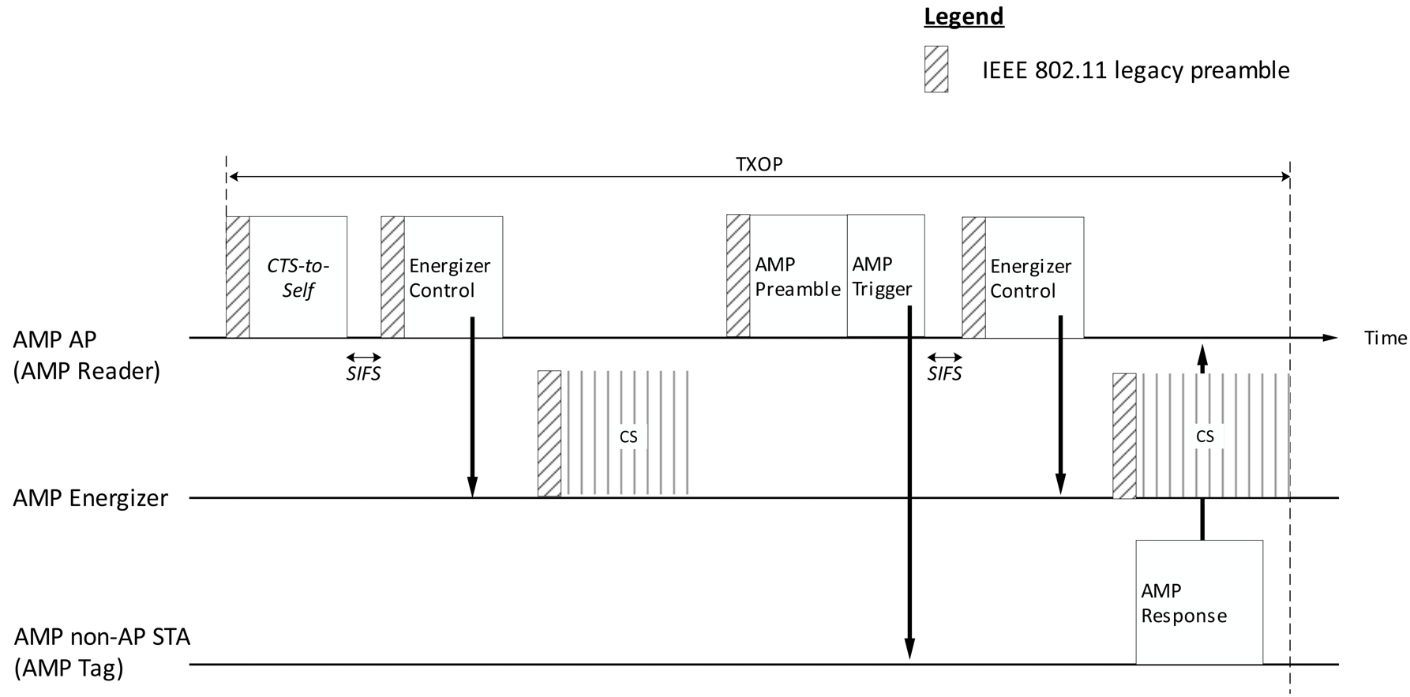
AMP bi-static backscattering flow
A bi-static backscattering setup would typically involve the following steps (“instructions”):
AMP AP to AMP Energizer control (“Send excitation signal for charging”)
AMP Energizer to AMP STA/tag excitation signal (“charging”)
AMP AP to AMP STA/tag AMP DL control (“Send response based on AMP DL control”)
AMP AP to AMP Energizer control (“Send excitation signal for backscattering”)
AMP Energizer to AMP STA/tag excitation signal (“backscattering”)

Slide 4
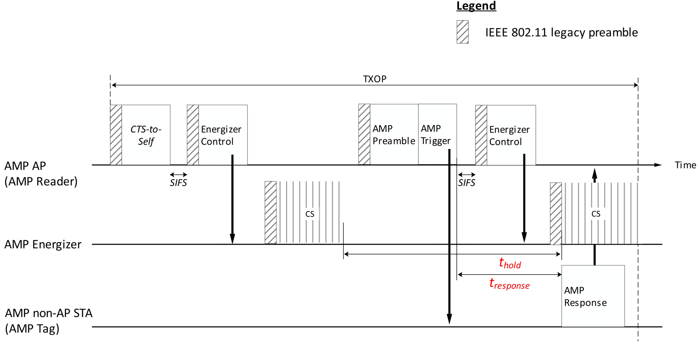
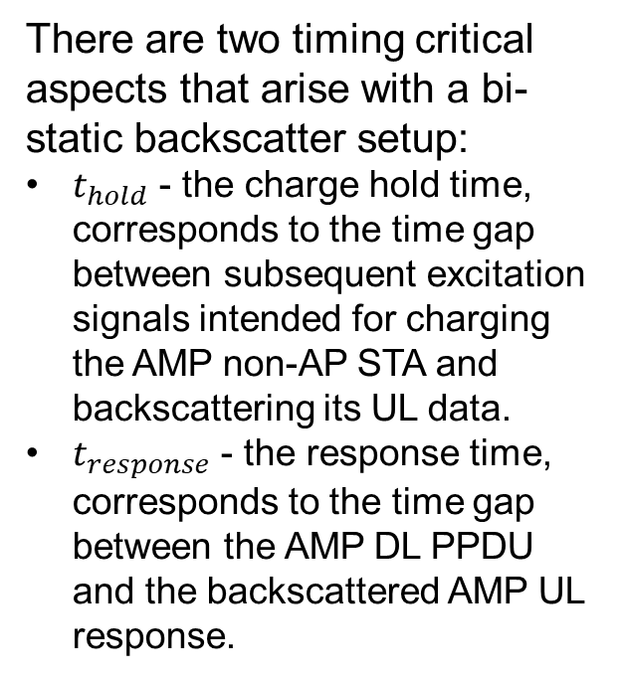
Timing Critical Implication for a Bi-static setup (1/2)
There are two timing critical aspects that arise with a bi-static backscatter setup:
$t_{hold}$ - the charge hold time, corresponds to the time gap between subsequent excitation signals intended for charging the AMP non-AP STA and backscattering its UL data.
$t_{response}$ - the response time, corresponds to the time gap between the AMP DL PPDU and the backscattered AMP UL response.

Slide 5
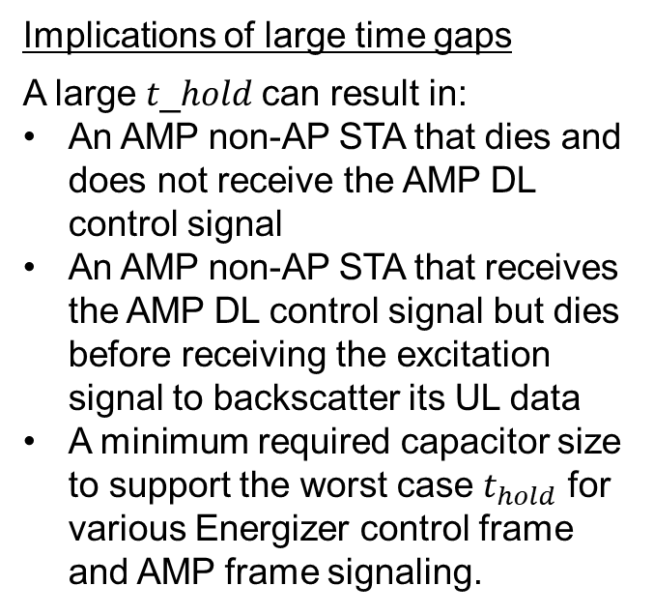
Timing Critical Implication for a Bi-static setup (2/2)
Implications of large time gaps
A large 𝑡_ℎ𝑜𝑙𝑑 can result in:
An AMP non-AP STA that dies and does not receive the AMP DL control signal
An AMP non-AP STA that receives the AMP DL control signal but dies before receiving the excitation signal to backscatter its UL data
A minimum required capacitor size to support the worst case $t_{hold}$ for various Energizer control frame and AMP frame signaling.
A large 𝑡_𝑟𝑒𝑠𝑝𝑜𝑛𝑠𝑒 can result in:
A larger expected tag response timeout, that needs to be accounted for when considering dual-mode tags (AMP + RFID)
Larger slot times for slotted response or worse channel resource utilization

Slide 6
Energizer Control Signaling
The Energizer Control frame can carry the following fields:
Start Time (12 bits) – indicates the time to transmit the excitation signal in us. Start Time field can be expressed as the LSB of the AP’s TSF. Depending on the type of MAC frame, this field could be optional for immediate excitation signal transmission, but may still be used for future scheduling of channel resources for backscattering.
Duration (4 bits) – indicates the transmission duration of the excitation signal in us.
Transmit power (6 bits) – indicates the transmit power of the excitation signal, expressed in dBm.
Other frequency related parameters – central frequency (1 bit), bandwidth (2 bits), etc.

Slide 7
Summary
The signaling flow for bi-static backscattering was presented.
Two timing critical aspects for bi-static backscattering control were highlighted, specifically, the charge hold time, and the UL response time of the non-AP AMP STA. The corresponding implications that they may have on the tag’s capacitor size and channel resource utilization were also discussed.
Finally, some of the parameters that are relevant for bi-static backscatter control from the AMP AP to AMP Energizer were discussed.

Slide 8
SP
Do you agree to add the following text to TGbp SFD?
Control information that is sent from the AMP AP to the AMP Energizer relating to the excitation signal includes one or more of the following: Start Time, Duration, Transmit Power and frequency related parameters.
The frequency related parameters may include central frequency information, bandwidth information, etc.
[Reference: 11-25/0037r0, 11-25/0786r0]

Slide 9
References
[1] 11-24/1613r7, Specification Framework for TGbp

