Slide 1
AMP Spatial “Hidden Tag” Deployment Scenario
Date: 2025-05-xx
Authors:

Slide 2
Abstract
This discussion reviews potential spatial scenarios for active and bistatic BS AMP tags that may not be functional under potential AP-Energizer/Exciter deployment locations/orientations.

Slide 3
Background: AMP Tag Range Recap
AMP tag harvesting & communicating are limited in terms of range
Active tags support longer ranges, enabled by S1G wireless power transfer (WPT) and integrated high power transmitters.
  The AMP energizer may transmit from a different location/direction than the AP/receiver. The energizer signal and the AP signal arrive from different directions
In [1], we proposed that AMP BS range can be extended utilizing tag gain, whereas WPT tag charging at S1G can support an adequate extended harvesting range as with active tags
  In bi-static BS the tag is excited from one direction and backscatters towards a different direction

Slide 4

Background: Antenna Gains
Gain of antennas should be considered in AMP
Antennas can be designed with directional gain that indicates how well they focus the signal in a specific direction, effectively achieving gain, as compared to an isotropic antenna that radiate/receive equally in all directions.
Antenna gain is measured in decibels as compared with an isotropic antenna (dBi)
Antenna gain is typically maximized in a direction perpendicular to the antenna surface. It is dependent on the spatial deviation angle, from this perpendicular line.
+ 6 dB
+ 3 dB
0 dB
- 3 dB
φ
Antenna with Gain
X
0 dBi
Z
Y
Antenna with Gain
$$G=f({\text{φ}}_{XY})$$
Isotropic Antenna

Slide 5
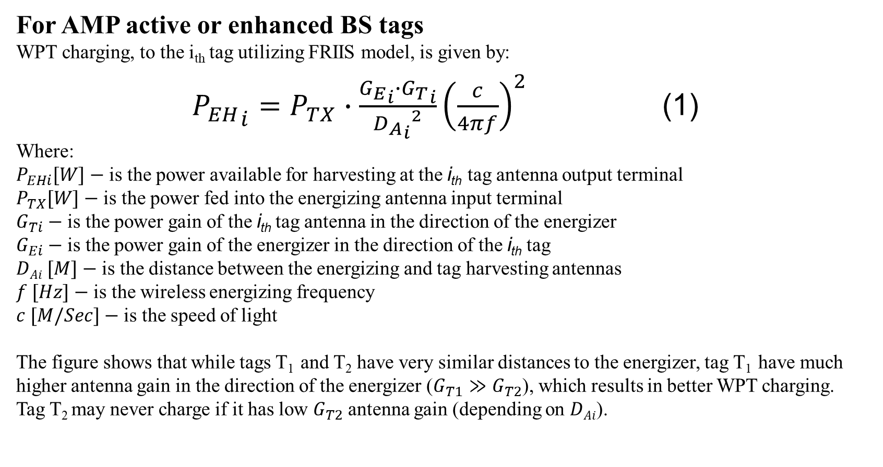

AMP Spatial Charging Deployment Scenario
For AMP active or enhanced BS tags
WPT charging, to the i_{th} tag utilizing FRIIS model, is given by:
${P_{EH}}_{i}=P_{TX}∙\frac{{G_{E}}_{i}∙{G_{T}}_{i}}{{{D_{A}}_{i}}^{2}}{\left(\frac{c}{4πf}\right)}^{2}$ (1)
Where:
$P_{EHi}[W]−$ is the power available for harvesting at the i_{th} tag antenna output terminal
$P_{TX}[W]−$ is the power fed into the energizing antenna input terminal
$G_{Ti}−$ is the power gain of the i_{th} tag antenna in the direction of the energizer
$G_{Ei}−$ is the power gain of the energizer in the direction of the i_{th} tag
$DAi [M]−$ is the distance between the energizing and tag harvesting antennas
$f [Hz]−$ is the wireless energizing frequency
$c [M/Sec]−$ is the speed of light
The figure shows that while tags T₁ and T₂ have very similar distances to the energizer, tag T₁ have much higher antenna gain in the direction of the energizer ($G_{T1}≫G_{T2}$), which results in better WPT charging.
Tag T₂ may never charge if it has low $G_{T2}$ antenna gain (depending on $DAi$).
Object Sensed
with AMP Tags
T₁
T₂
Energizer
P_{TX}
$$DAi$$

Slide 6
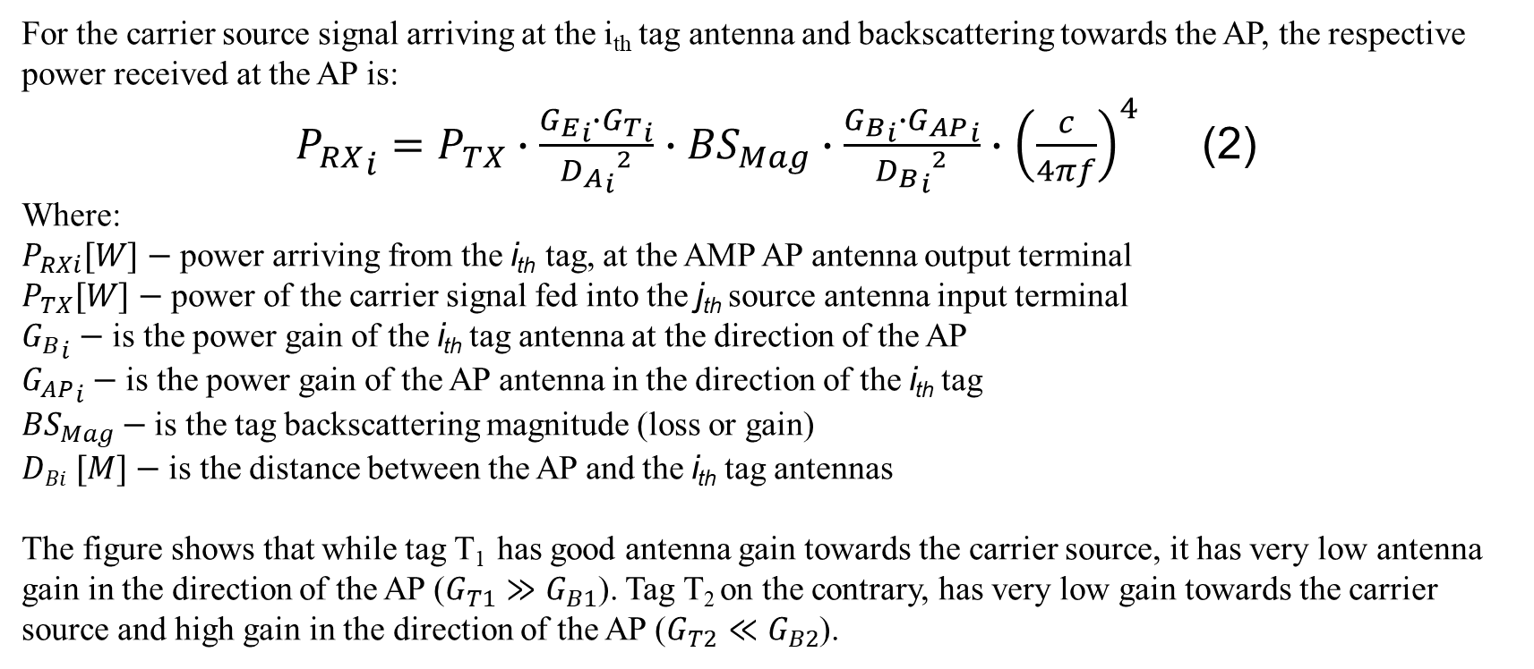



AMP Bi-Static Backscattering Deployment Scenario
For the carrier source signal arriving at the i_{th} tag antenna and backscattering towards the AP, the respective power received at the AP is:
${P_{RX}}_{i}=P_{TX}∙\frac{{G_{E}}_{i}∙{G_{T}}_{i}}{{{D_{A}}_{i}}^{2}}∙{BS}_{Mag}∙\frac{{G_{B}}_{i}∙{G_{AP}}_{i}}{{{D_{B}}_{i}}^{2}}∙{\left(\frac{c}{4πf}\right)}^{4}$ (2)
Where:
$P_{RXi}[W]−$ power arriving from the i_{th} tag, at the AMP AP antenna output terminal
$P_{TX}[W]−$ power of the carrier signal fed into the j_{th} source antenna input terminal
${G_{B}}_{i}−$ is the power gain of the i_{th} tag antenna at the direction of the AP
${G_{AP}}_{i}−$ is the power gain of the AP antenna in the direction of the i_{th} tag
${BS}_{Mag}−$ is the tag backscattering magnitude (loss or gain)
$DBi [M]−$ is the distance between the AP and the i_{th} tag antennas
The figure shows that while tag T₁ has good antenna gain towards the carrier source, it has very low antenna gain in the direction of the AP ($G_{T1}≫G_{B1}$). Tag T₂ on the contrary, has very low gain towards the carrier source and high gain in the direction of the AP ($G_{T2}≪G_{B2}$).
AP
Object Sensed
T₁
T₂
Carrier Source
$$DLeakage$$
P_{TX}
$$DBi$$
$$DAi$$

Slide 7
AMP Spatial “Hidden Tag” Deployment Scenario
Assume an enhanced BS or active tag:
AP
Tag T₁ can possibly be charged by the energizer but may not be able to communicate with the AP
Tag T₂ can communicate with the AP, yet cannot be charged/excited
Therefore, both T₁ and T₂ can be viewed as inactive “hidden tags”
Adding more energizers/exciters may activate T₂ but T₁ may always be inactive
Positioning (location & orientation) of the AP may dictate hidden tag positions
Object Sensed
T₁
T₂
Energizer& Carrier Source

Slide 8
Hidden Active vs. Bistatic BS Tag Comparison
We proposed to consider an enhanced extended range semi-active AMP tag
with BS gain and WPT at S1G [1] as in active tags.
Antenna gain in BS tags operating in a bi-static mode as well as in active tags, can enable extended EH range as well as communication range, yet likely create a trade-off between the two different ranges, since they have different gains and paths.
Active tags are dependent on the exciters only for charging, but require longer charging durations to enable their higher power consumption
AMP Tag Type | Range | UL | UL power Consumption | Power Storage / Capacitor | Antenna Frequency | Harvesting
Active | 10-50 M | 2.4 GHz modulated oscillator | ~ 150 uW | 2-5∙C pF | S1G & 2.4 GHz | S1G (*)
Enhanced BS | ~ 10 M | BS Semi-Active / Switch & Amplify | < 30-75 uW | C pF | S1G & 2.4 GHz | S1G (*)
* S1G is preferred for extended range/shorter duration EH. Harvesting at 2.4 GHz,
may be used for backup

Slide 9


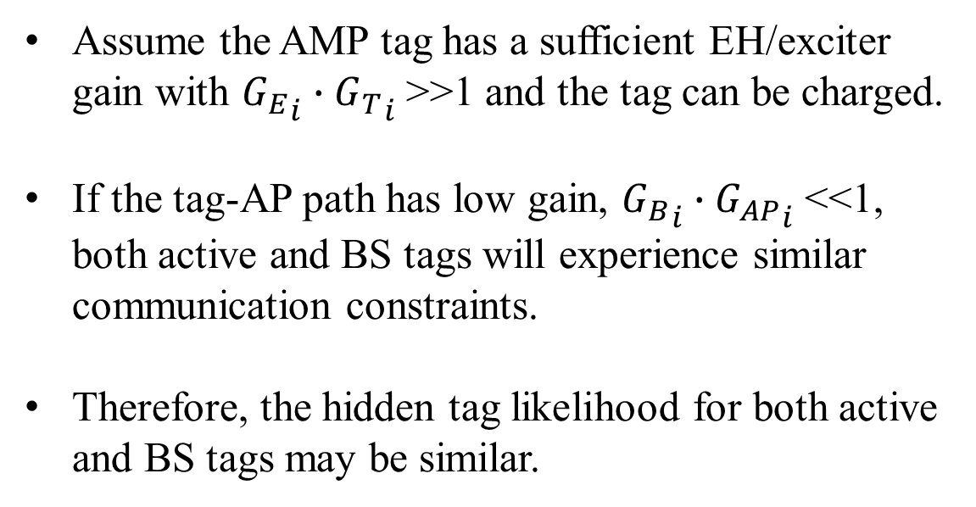




Hidden Active vs. Bistatic BS Tag Further Comparison
Energizer / Carrier Source
AMP
Tag
i
$$DAi$$
$${G_{E}}_{i}$$
$${G_{T}}_{i}$$
$${G_{B}}_{i}$$
Assume the AMP tag has a sufficient EH/exciter gain with ${G_{E}}_{i}∙{G_{T}}_{i}$>>1 and the tag can be charged.
If the tag-AP path has low gain, ${G_{B}}_{i}∙{G_{AP}}_{i}$<<1, both active and BS tags will experience similar communication constraints.
Therefore, the hidden tag likelihood for both active and BS tags may be similar.
$$DBi$$
$${G_{AP}}_{i}$$
AP

Slide 10
Hidden Tags Discussion:
Most earlier discussions overlooked AP, energizer/exciter and especially tag antenna directivity effects
Assuming a single AP, in a non-monostatic deployment, it is likely that some AMP tags will not be functional, especially when considering extended range scenarios.
The likelihood to have hidden tags can be reduced by deployments of multiple energizer/exciter devices, yet it can not be eliminated
Slide 10

Slide 11
Summary
AMP tags, except monostatic BS, can be hidden from the AP, the energizer/exciter or even both.
The likelihood to result in such dormant tags depends on the space scenario, EH and communication operation ranges considered and the directivity and orientation of the respective antennas.
Such “AMP hidden tags” should be considered
Future work will focus on approaches for reducing the likelihood of AMP hidden tags
Slide 11

Slide 12
References
11-25-0307r0 “UL Monostatic and Bistatic Range Extension Considerations”; Dror Regev (Huawei)
Slide 12

