Slide 1
Signal Design for Wideband Single-Carrier OOK
Date: 2025-05-11
Authors:

Slide 2
Abstract
It has been agreed that the (3dB) bandwidth of the AMP DL PPDU in 2.4 GHz is at least 10 MHz for backscattering communication. The transmit spectrum mask is TBD.
Two different approaches for achieving a large bandwidth for low data rates OOK were described in [1] and [2].
In [1], the design was using multi-carrier transmission.
In [2], it was proposed to use single carrier.
In this contribution, a similar approach as was taken in [1] is used to find a good signal design based on single carrier transmission.

Slide 3
Outline
Recap of desired signal properties
Some illustrations
Methods for obtaining the desired signal properties
Some examples obtained by numerical search
Conclusions

Slide 4
Recap of desired signal properties - Frequency
Wideband signals are desirable to benefit from frequency diversity and to allow for high TX power in PSD limited regions
We use the term maximum allowable power (MAP) to refer to the maximum transmission power allowed under a PSD limit of 10 dBm/MHz
A signal that achieves higher MAP will also allows for better frequency diversity
When comparing two signal alternatives, the one that allows for larger MAP is considered the better one

Slide 5
Recap of desired signal properties - Time
The signal should have as low PAPR as possible
When comparing two signal alternatives, the one with the smallest PAPR is considered the better one
Note: To measure PAPR, we must consider the signal after the LPF needed to fulfill the TX spectrum mask

Slide 6
Some illustrations
Suppose the OOK data rate is 250 kb/s and a random spreading sequence (+-1) of 11chips/s is used to increase the bandwidth
  The spreading sequence has good PAPR
However, since the generated signal after spreading does not fulfil the TX mask it needs to be filtered by a suitable LPF
  The signal after the LPF may be very far from constant envelope
On the following page some illustrations are provided to illustrate the problem

Slide 7
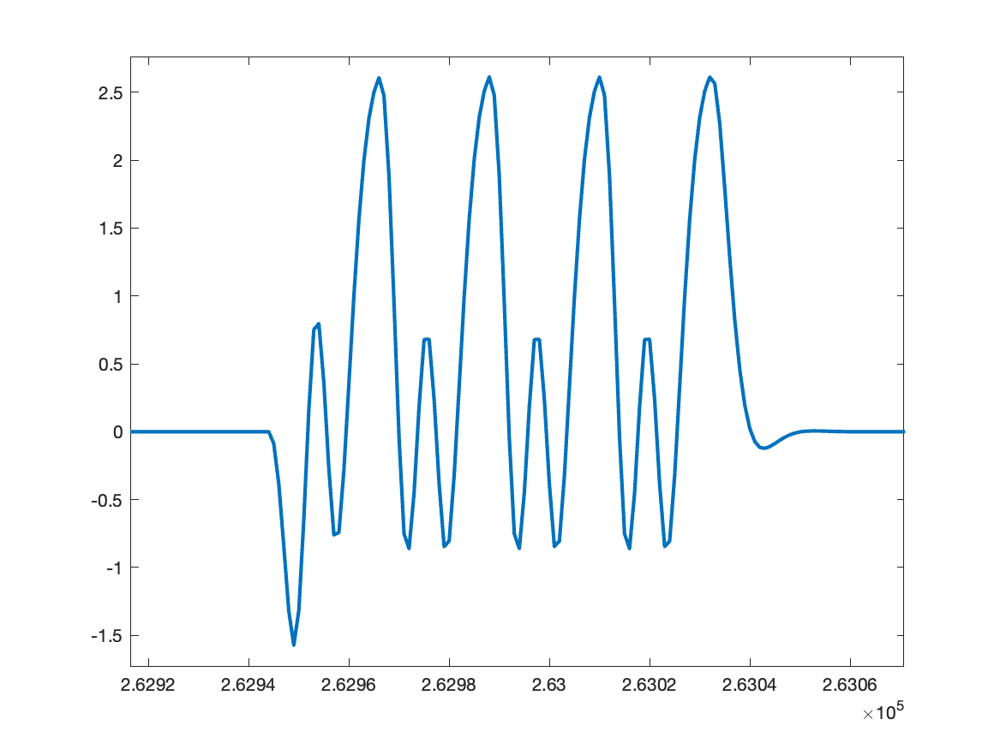
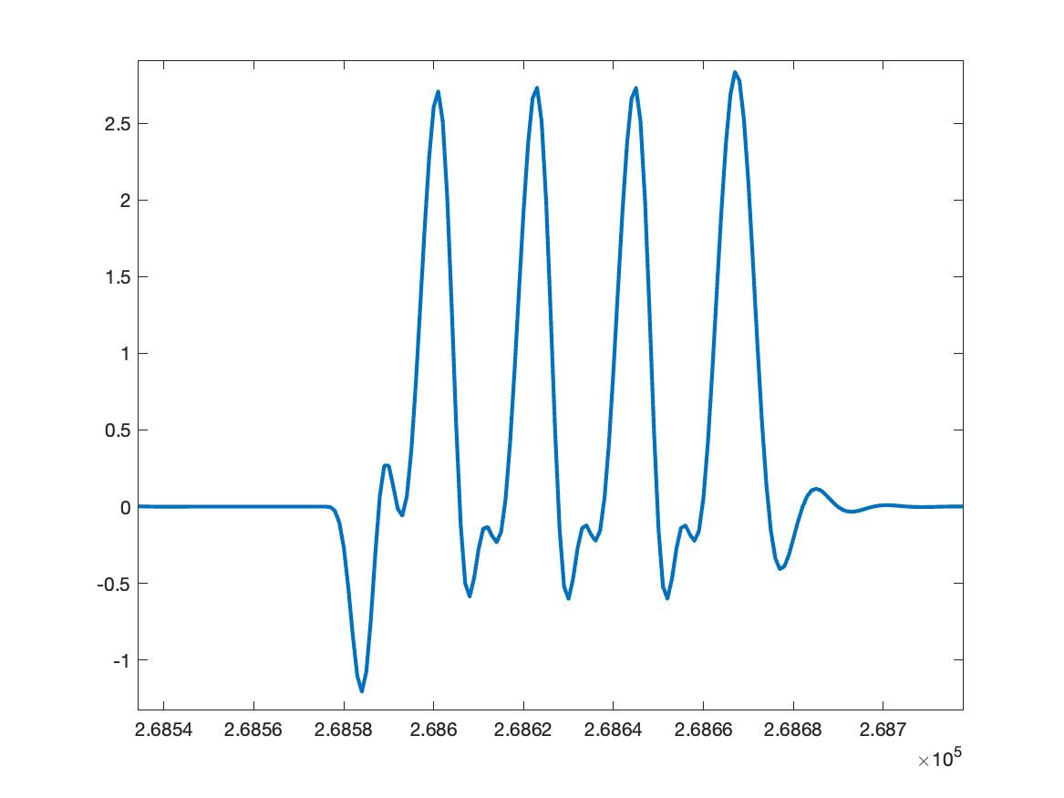
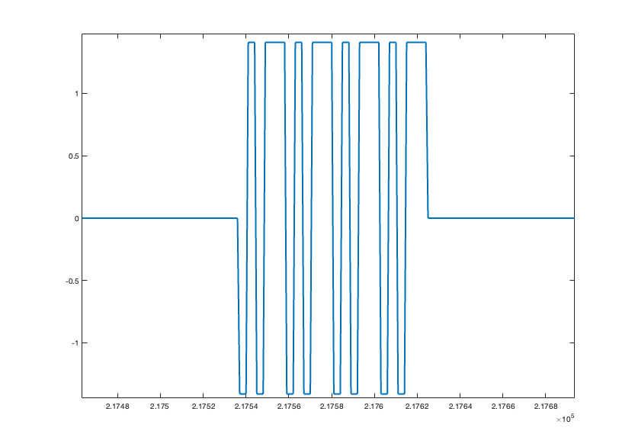
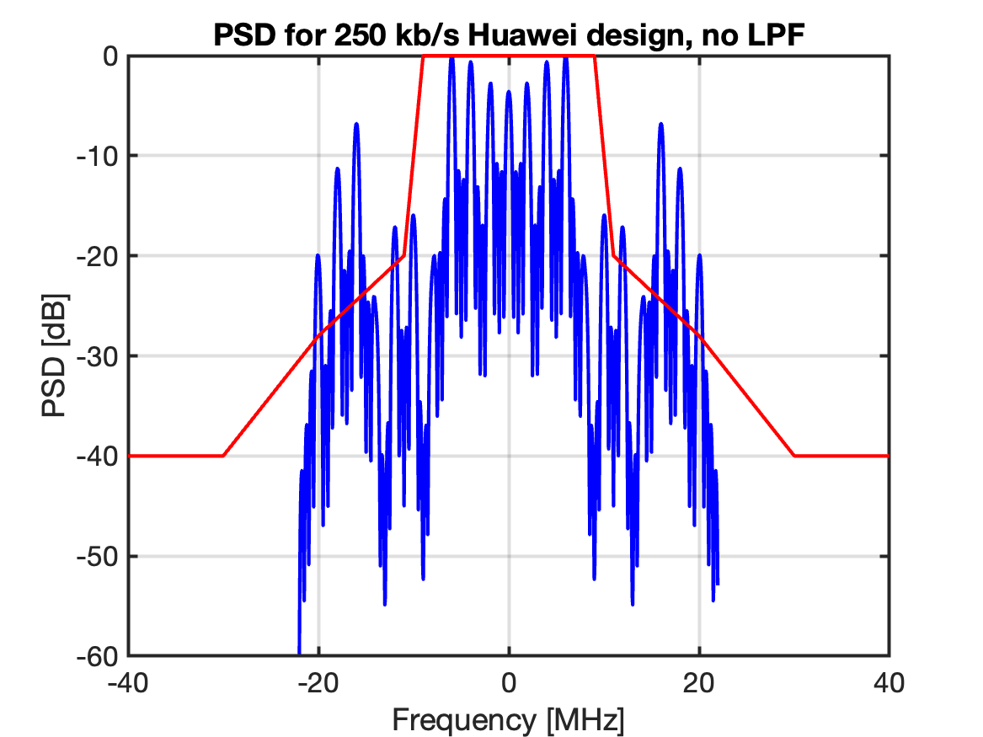
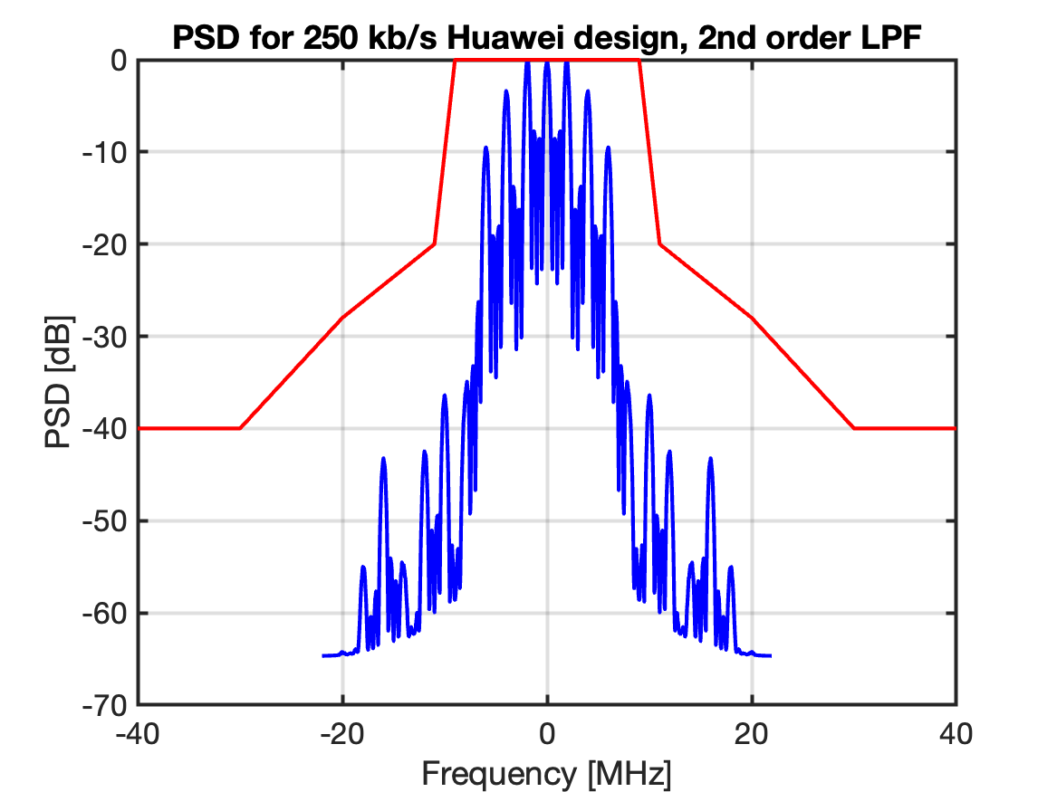
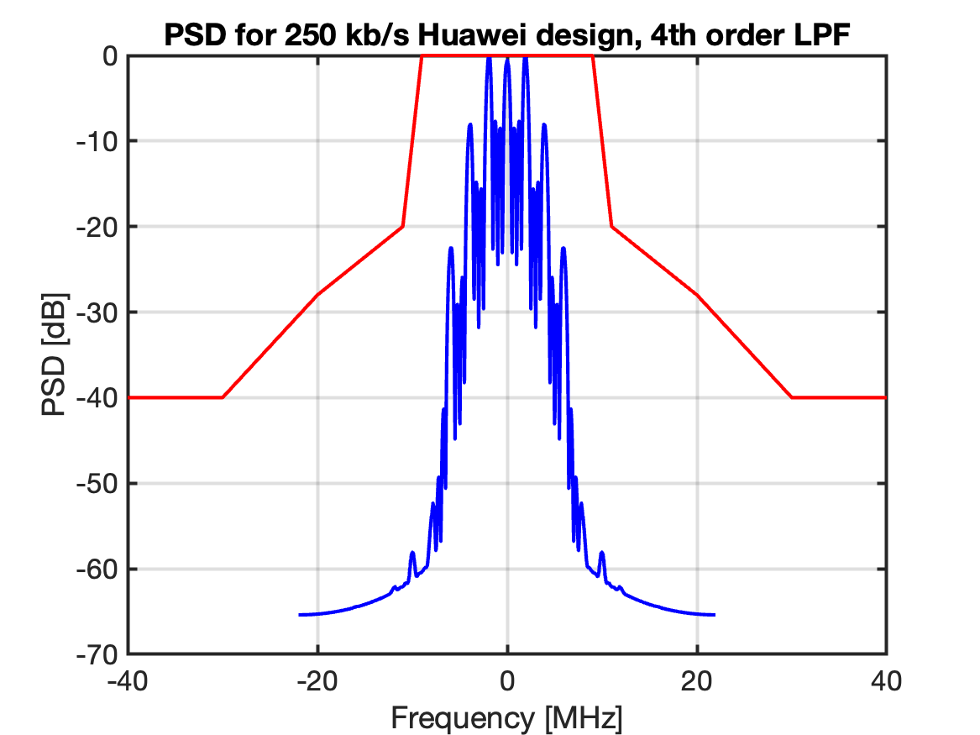
Some illustrations
PAPR 3 (0) dB
PAPR 8.45 (5.45) dB
PAPR 9.7 (6.7) dB

Slide 8
Methods for obtaining the desired signal properties
Try to generate/find a binary spreading sequence
  that is reasonbly flat in the passband (to achieve high MAP)
  that falls off reasonably fast outside of the passband, so that not too much filtering is needed to fulfill the spectrum mask as filtering impacts the PAPR
Reasonably good spectrum here means
  3dB BW > 10 MHz as this is a requirement
  Preferably as flat as possible within the 22 MHz channel, to be described later
  No large sideloobs outside of the 22 MHz channel

Slide 9
Method for obtaining the desired signal properties
A random spreading sequence at 11 Mchips/s is generated
This signal is the ON part in the Manchester coded OOK symbol
The Manchester coded OOK signal is filtered by a LPF to fulfill the TX spectrum
The simulations are done a 4x oversampling to study the spectrum outside of the 22 MHz channel

Slide 10
Search for a suitable ON signal
The selected signal should have the following properties (TX mask assumed met)
  The TX power shoud have as high MAP as possible
  The PAPR should be as small as possible
In the search, the following “Frequency-time” metric is used
  FT_metric = MAP (dBm) – PAPR (dB)
  A sequence is considered better if the FT_metric is higher
Note: If a sequence with a good FT_metric is found, but the TX mask is not met (with sufficient margin), this may be easily fixed by (i.e., no need for new search)
  Slightly decreasing the BW of the LPF assumed present to meet the TX spectrum mask

Slide 11
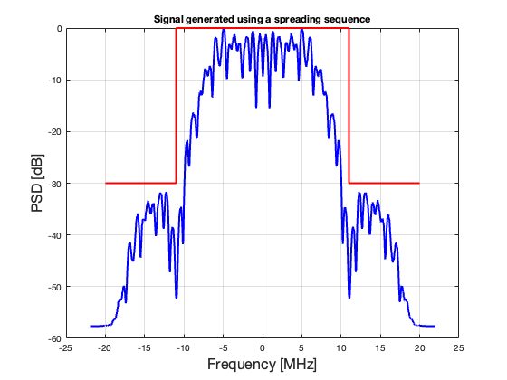
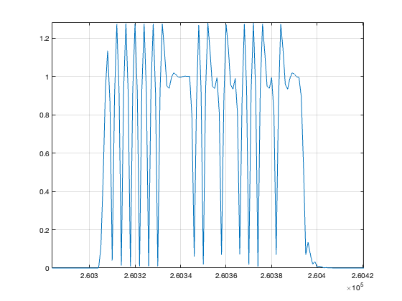
Performance 250kb/s
The best ON-signal according to the ad-hoc metric is shown to the right
Sequence =
[-1 1 -1 1 -1 1 -1 -1 -1 -1 1 -1 -1 1 1 -1 1 -1 -1 1 1 1]
The MAP is 20.6 dBm and the PAPR is 5.7 dB for the entire signal part (around 3 dB less for ON part)
Note: The sequence is randomized for different symbols by adding a random phase (0,2pi]

Slide 12
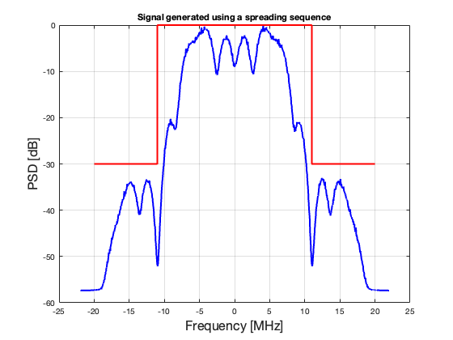
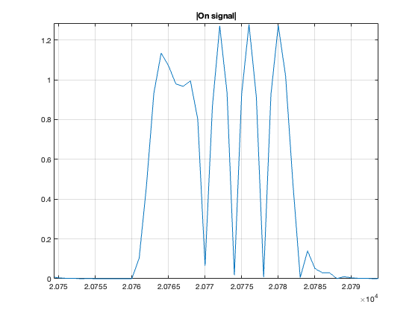
Performance 1Mb/s
The best ON-signal according to the ad-hoc metric is shown to the right
Sequence = [-1 -1 1 -1 1]
The MAP is 19.04 dBm and the PAPR is 5.7 dB for the entire signal part (around 3 dB less for ON part)
Note: The ON part is 5 chips and the OFF part is 6 chips. Due to the LPF, the ON part becomes slightly longer

Slide 13
Conclusions
It is possible to design a single-carrier OOK signal which has both good frequency and time properties for both 250 kb/s and 1 Mb/s using a single-carrier approach
Compared to the design reported in [1], the found signal has (slightly) worse properties if the Maximum Allowed Power and PAPR are considered
Somewhat surprising, the PAPR is superior when the design is based on a multi-carrier signal

Slide 14
References
L. Wilhelmsson et al., “Signal Design for Wideband Multi-Carrier OOK”, IEEE 802.11-25/0369r1.
P. Li et al., “DL Wideband OOK Generation”, IEEE 802.11-25/0050r1.

