Slide 1
E2E Operation of AMP-enabled Non-AP STAs
Date: 2025-03-03
Authors:
Name | Affiliations | Address | Phone | email
Sanket Kalamkar | Qualcomm Technologies Inc. |  |  | sankal@qti.qualcomm.com
George Cherian
Alfred Asterjadhi

Slide 2
Introduction
11bp to have a mode for AMP STAs that allows them to connect with existing WLAN network and infrastructure
  [Motion #7] 11bp supports a mode to enable AMP devices to operate in legacy WLAN network by defining AMP DL and required control/signaling
This contribution provides E2E details for the above mode

Slide 3
AMP-enabled STA
AMP Enabled non-AP STA
  [Motion #29] A non-AP STA (e.g., non-HT, HT, or HE STA) that is also capable of receiving AMP Downlink PPDUs
  Supports AMP wake-up/control signaling to reduce power consumption
  Supports existing 802.11 standards
  RF energy harvesting (S1G or 2.4 GHz)
  Optimized Tx/Rx power consumption
AMP AP + Energizer
  Ability to transmit ‘Energizer signal’ in S1G or 2.4 GHz band
  Ability to transmit AMP wake-up/control signals to AMP-enabled non-AP STA (2.4GHz)
  Relays data between the AMP-enabled non-AP STA and a legacy 802.11 AP
    May be colocated with a legacy 802.11 AP

Slide 4
AMP-enabled Non-AP STA
Capable of receiving AMP frames
  E.g., An AMP wake-up/Control signal in an AMP PPDU
Has persistent memory
  Retains information across multiple sessions even when the power is lost
    E.g., power loss caused by insufficient harvested energy
Clock error requirement in AMP power state is the same as that of an Active Tx non-AP AMP STA

Slide 5
Authentication & Association
Authentication relies on baseline protocols
  Additional temporal key (TK) is generated to protect individually and group addressed AMP frames
    Similar to WUR temporal key and WUR integrity group temporal key
  The authentication key is maintained across sessions due to persistent memory
Association relies on baseline protocols
  AID or temporary ID to the non-AP STA is assigned during the association
  The non-AP STA can retain the AID or the temporary ID across sessions due to persistent memory
Association signaling can be extended to include AMP mode setup
  AMP capabilities are exchanged during an AMP mode setup
  AMP mode setup/updates can also be performed post-association

Slide 6
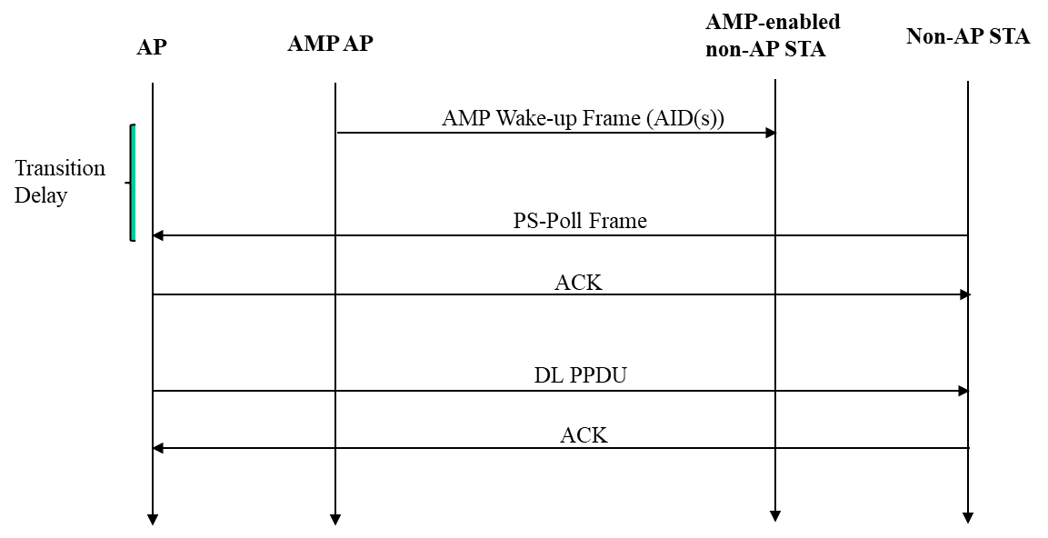
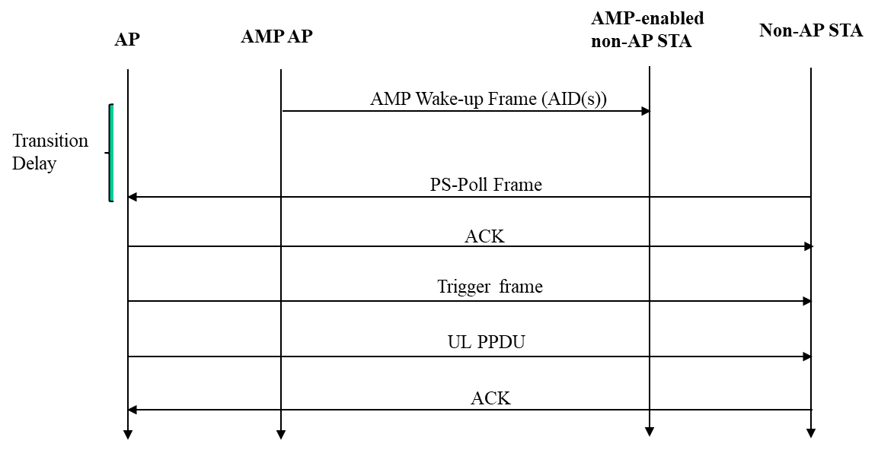
AMP Wake-Up
An AMP AP transmits an AMP Wake-Up frame to AMP-enabled non-AP STA(s) to indicate that the AP intends to exchange non-AMP frames with non-AP STA(s)
  For example, when the AP has DL data buffered for the non-AP STA or to fetch scheduled UL data (if per-client schedule is negotiated)
The AMP Wake-Up frame can be:
  Unicast: Contains the AID of the specific AMP-enabled non-AP STA to be awakened
  Multicast: Broadcast frame with a list of AIDs for multiple AMP-enabled non-AP STAs
Upon receiving an AMP Wake-Up frame from the associated AP, after a transition delay, the non-AP STA transmits a PS-Poll/UL frame to the associated AP
  The transition delay corresponds to the time needed by the non-AP STA to wake up to exchange frames after the AMP-enabled non-AP STA receives an AMP Wake-Up frame from the associated AMP AP
DL call flow
UL call flow

Slide 7
State Machine for Power States
The AMP-enabled non-AP STA to have a state machine for power states—similar to the WUR state machine
  AMP duty cycle operation for AMP-enable non-AP STA, i.e., switching between
    Awake state: Able to receive AMP Wake-Up frame
    Doze state: Unable to receive AMP Wake-Up frame
AMP duty cycle operation can be negotiated between AMP AP and AMP-enabled non-AP STA during the AMP mode setup
AMP duty cycle operation also allows an AMP AP to schedule an AMP-enabled non-AP STA to receive AMP Wake-Up frame
State transition diagram of power state of an AMP-enabled non-AP STA

Slide 8
Summary
This contribution provided E2E details for the AMP-enabled non-AP STA to operate in legacy WLAN network
  Use much of the protocol and signaling similar to WUR, with modifications specific to the AMP characteristics of the AMP-enabled non-AP STA

Slide 9
SP1
Do you agree that 802.11bp defines an AMP Wake-Up frame, which an AMP AP transmits to AMP-enabled non-AP STA(s) to indicate that the AP intends to exchange non-AMP frames with the non-AP STA?
  The expectation is to reuse WUR frame format for the AMP Wake-Up frame and to carry it in an AMP PPDU

Slide 10
SP2
Do you agree that 802.11bp defines an AMP duty cycle operation for an AMP-enabled non-AP STA, which follows the state transition diagram shown in the figure?
  AMP duty cycle operation follows the negotiation procedure defined for WUR in the baseline

Slide 11
SP3
Do you agree that if an AMP-enabled non-AP STA successfully receives an AMP Wake-Up frame from the associated AMP AP, the non-AP STA should transition to the Awake State and transmit a PS-Poll/UL frame to the AP to indicate that it is in the Awake State (PS/Active mode)?

Slide 12
SP4
Do you agree that if the non-AP STA transmits a frame with PM = 1 to the associated AP, then the non-AP may transition to the Doze state, and the AMP-enable non-AP STA shall enter the AMP mode?

Slide 13
SP5
Do you agree that 802.11bp defines:
  AMP temporal key (ATK) to protect individually addressed AMP frames
  AMP integrity group temporal key (AIGTK) to protect group addressed AMP frames

Slide 14
SP6
Do you agree that 802.11bp uses the baseline authentication procedure to generate AMP temporal key(s) to protect individually and group addressed AMP frames?

Slide 15
SP7
Do you agree that an AMP-enabled non-AP STA and the associated AMP AP use AMP mode setup to exchange AMP capabilities?
  AMP mode setup may occur during the association procedure or post-association

Slide 16
SP8
Do you agree that the clock error requirement of an AMP-enabled non-AP STA in AMP power state is the same as that of an Active Tx non-AP AMP STA?

