Slide 1
Bi-static Backscatter Protection Mechanisms – follow up
Date: 2025-05-11
Authors:

Slide 2
Abstract
Follow up on our presentation 11-25/0264 Bi-static Backscatter Protection Mechanisms
How do we reserve medium use on two channels?

Slide 3
Review: Two-channel Backscatter Operations [1]
Effective method for reducing self-jamming and increasing range for bistatic backscatter operations.
With this method, the link margin is related directly to
  The receiver’s ability to reject adjacent channel interference.
  The receiver’s ability to decode signals in the presence of in-band interferers.
  The transmitter’s emissions mask.

Slide 4
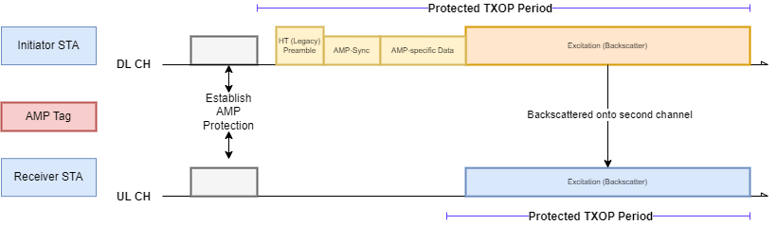
Recap: Medium Usage on Two-Channels[2]
Requirements
  The transmission needs to protect a TXOP on both channels. (the excitation signal and the backscattered signal).
  The TXOP protection mechanism needs to work for legacy 802.11 STAs.
  TXOP on the UL channel can be shorter than TXOP on the DL channel due to channel conditions.
Notes:
Some main requirements for the protection mechanism are as follows:

Slide 5
Medium Usage on Multiple Channels
The AMP-enabled STA (Initiator) can include an energizer, and the AMP-enabled STA (Receiver) can be an AMP-enabled AP.
Initially, the initiator and the receiver will operate on the same channel.
The Initiator STA sends a control frame on the excitation channel to initiate the process.
Receiver STA changes its operating channel to the backscatter channel to receive the backscattered PPDU.
Upon completion of the TXOP, the receiver STA reverts to the excitation channel and transmits a control frame to the initiator, acknowledging receipt of the backscattered PPDU.

Slide 6
Concerns addressed in this submission
It is difficult to synchronize CTS-to-Self on Channel A and B.
Two channels are used for one transmission.
How often are both channels available at the same time in the real world?

Slide 7
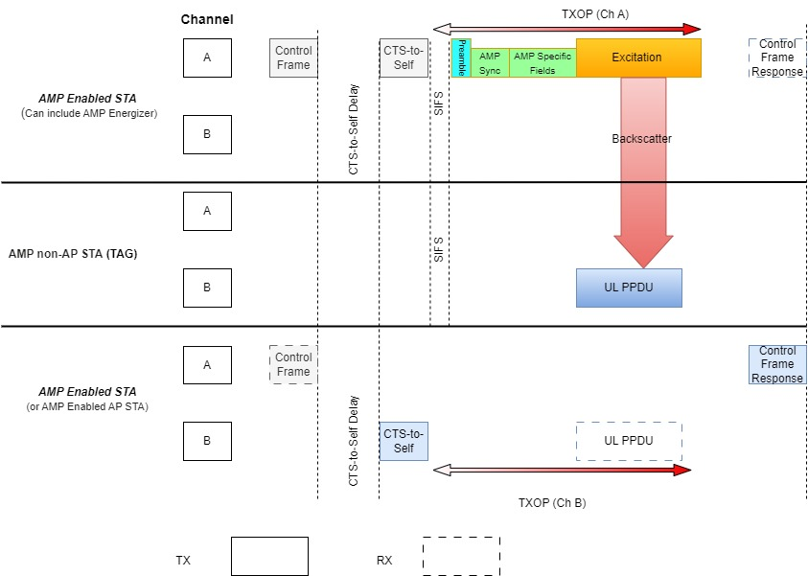
Medium Usage on Multiple Channels
The Initiator STA transmits a control frame to initiate the mechanism. After receiving the backscattered PPDU, the Receiver STA transmits a control frame to acknowledge receipt of the backscattered PPDU after the backscatter TXOP completes.
Notes:
Enhanced Multi-Link Single-Radio (EMLSR) operation has similar ICF and ICR

Slide 8
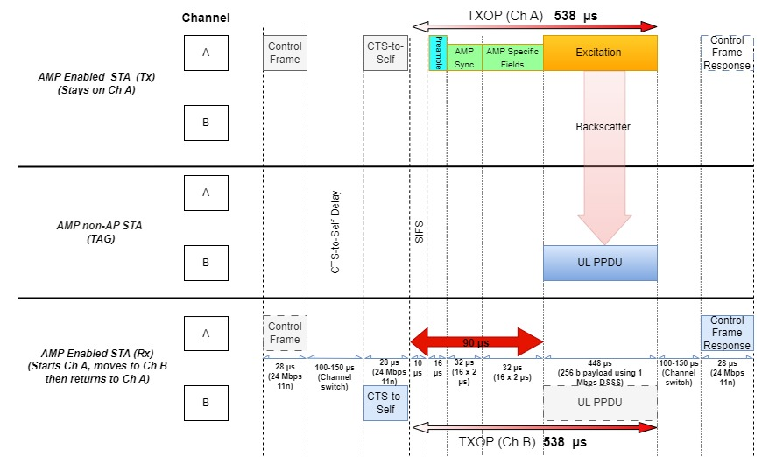
Approximate TXOP duration for the mechanism
TXOP is around 538 µs on the DL and UL channel each, total TXOP duration is 1076 µs. Less than the TXOP limit for AC_BK.

Slide 9
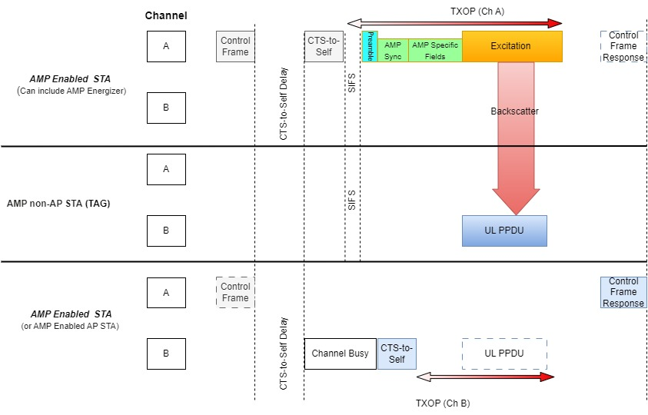
Adjust according to channel condition on channel B
CTS-to-Self can be delayed and the TXOP can be adjusted on channel B if the channel is busy.

Slide 10
AMP Control frame to initiate backscatter TXOP
The Initiator STA could use the Bandwidth Signaling TA to include additional information. This information can include:
  CTS-to-Self delay
  TXOP duration

Slide 11
AMP control frame response acknowledges the backscatter TXOP
The control frame response acknowledges the status of receiving the Backscatter PPDU.

Slide 12
Recap
CFR is there to give feedback to the initiator for retransmissions.
We can expand the CFR to provide more feedback.
This two-channel scheme helps us in providing a better range for BS, and the CTS-to-Self protection provides additional reliability for bistatic backscatter.

Slide 13
Simultaneous availability of two channels
We measured the availability of two channels to transmit CTS-to-Self simultaneously after CCA (channel is free for DIFS + Backoff)
In different environments, channels A and B are free independently between 50% to 75% of the total time to transmit CTS-to-Self
Given that one channel is free, the probability that the other channel is also free for CTS-to-Self is between 60% to 65%

Slide 14
Conclusion
There is an approximate slack time of 100 µs for CTS-to-Self on Channel B, allowing for potential delays if the channel is busy.
The total channel usage time remains within the TXOP limit for AC_BK, and the duty cycle is also very low.
A measurement study was conducted on Clear Channel Assessment across two channels in various real-world environments to estimate the success probability of the protection mechanism.

Slide 15
SP 1
Do you agree that 11bp should define a medium protection mechanism for bistatic backscatter that coordinates medium use on two channels?

Slide 16
SP 2
Do you agree that the initiator (AMP Enabled STA and may include AMP Energizer) transmits a Control Frame to request the responder (AMP Enabled STA may include an AMP AP) to receive an AMP UL PPDU on a different channel?

Slide 17
SP 3
Do you agree that the responder, in a Control Frame Response, can tell the initiator the result of the AMP UL PPDU transmission?

Slide 18
References
[1] Costa et al., Frequency Shifting in Backscatter Operations, 11-24/1687, November 2024.
[2] Kamran et al., Long-Range Backscatter Protection Mechanisms, 11-25/0264r0

Slide 19
Appendix
We measured Channel A and Channel B using two envelope detectors simultaneously every 10 µsecs.
The channel is classified as free to transmit if it is free for DIFS + Backoff
Backoff slots | Channel A % | Channel B % | % both free | Conditional Probability
0 | 59 | 60.04 | 39.82 | 66.3
1 | 57.55 | 58.45 | 38.32 | 65.6
2 | 56.25 | 57.07 | 37.05 | 64.9
3 | 55.03 | 55.87 | 35.95 | 64.3
4 | 53.87 | 54.87 | 34.97 | 63.7
5 | 52.76 | 53.99 | 34.01 | 63
6 | 51.71 | 53.31 | 33.25 | 62.4

Slide 20
Appendix
One more example scenario with the same data
Backoff slots | Channel A % | Channel B % | % both free | Conditional Probability
0 | 61.69 | 66.37 | 42.39 | 63.9
1 | 60.32 | 65.07 | 40.96 | 62.9
2 | 59.09 | 63.98 | 39.8 | 62.2
3 | 57.89 | 62.97 | 38.73 | 61.5
4 | 56.74 | 62.09 | 37.77 | 60.8
5 | 55.63 | 61.3 | 36.84 | 60.1
6 | 54.67 | 60.63 | 36.06 | 59.5

