Slide 1
Downlink Waveform Analysis
Date: 2025-05-12
Authors:
Name | Affiliation | Address | Phone | Email
Nelson Costa | HaiLa Technologies | Suite 403, 460 Saint-Catharine St. W. Montreal, QC. Canada |  | nelson@haila.io
Kamran Nishat |  |  |  | kamran@haila.io
Vytas Kezys |  |  |  | vytas@haila.io
Patricia Bower |  |  |  | pbower@haila.io

Slide 2
Abstract
In the following, we review four different downlink waveforms proposed by the group.
We analyze each waveform using a common framework, and compare the advantages and disadvantages of each waveform.
We propose a common set of metrics and properties by which we can compare downlink waveforms.

Slide 3
Background
In March, the group agreed to add a broad framework for downlink sequences into the SFD.
  The carrier waveform for AMP Downlink PPDU is constructed by repeating one predefined base waveform of TBD micro-second, and additional pseudo-random phase is applied to each base waveform
  The base waveform definition is TBD.
Within this framework, in the following we consider the four proposed base waveforms.

Slide 4
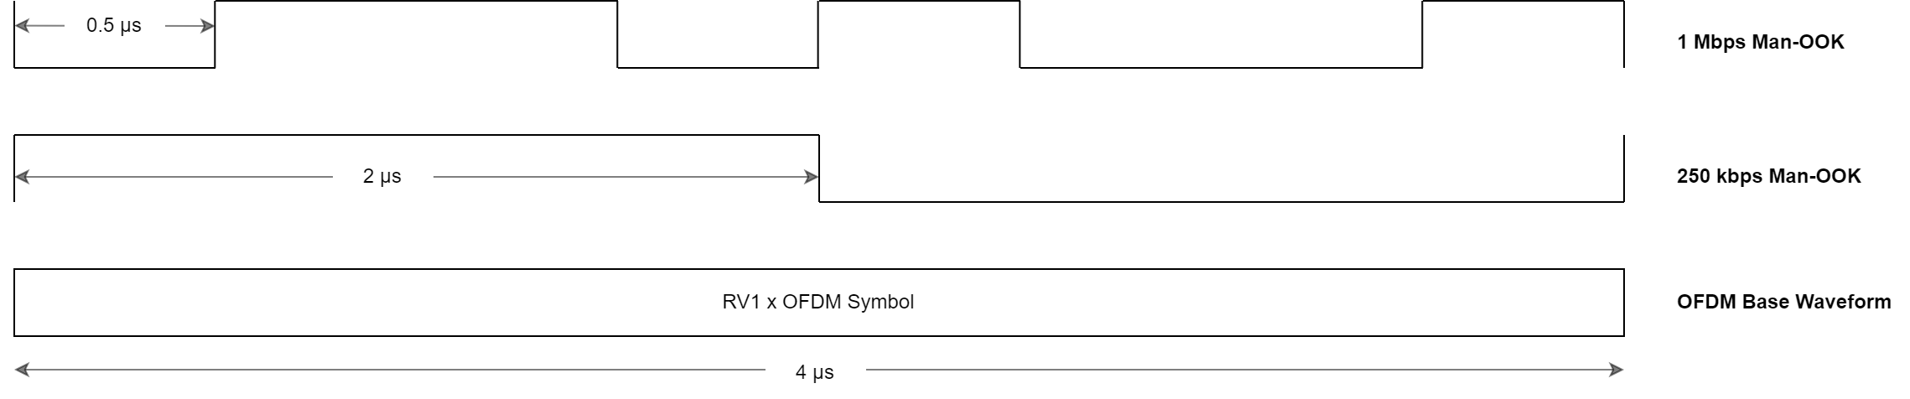
Background
In [1], the authors present a 4 µs OFDM-based waveform.
For the 250 kbps and 1 Mbps DL rates, the Man-OOK symbols “slice” the OFDM symbols.
The base waveform is 64 + 16 samples (OFDM symbol + CP) at 20 MHz.

Slide 5
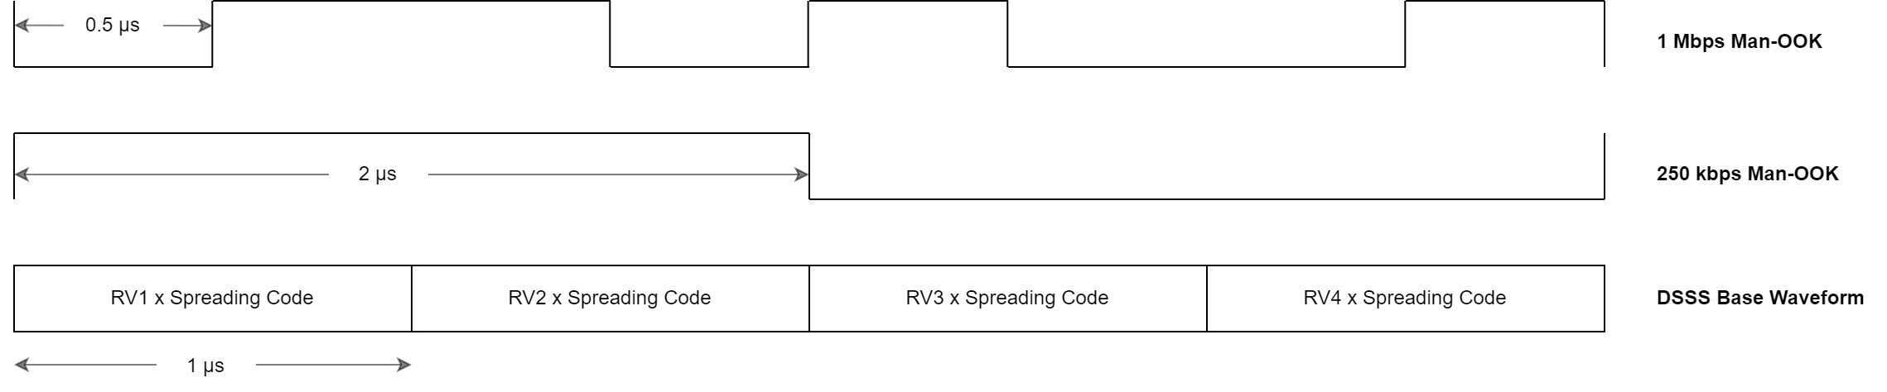
Background
In [2,3], the authors each present a different 1 µs spreading sequence.
For the 250 kbps rate, there are two 1 µs spreading sequences per 2 µs Man-OOK chip.
For the 1 Mbps rate, there are two 0.5 µs Man-OOK chips per spreading sequence.

Slide 6
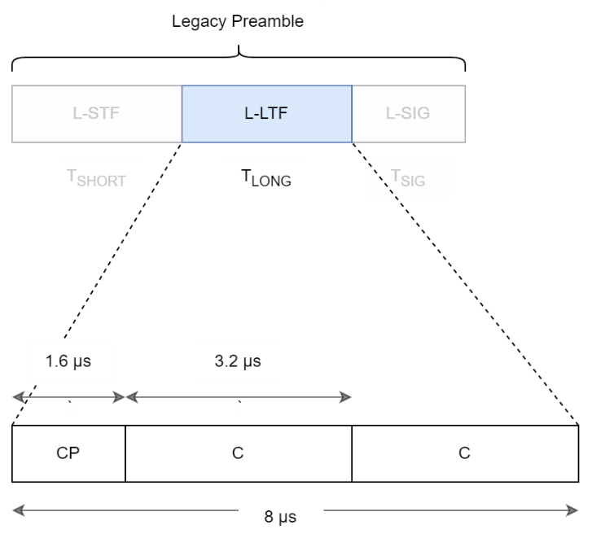
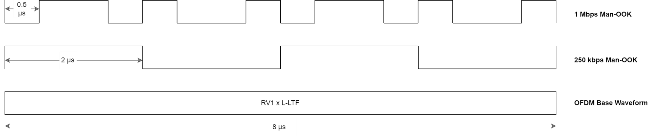
Background
The group has also discussed using the L-LTF training sequence.
The version used here is an 8 µs consisting of two repeated 3.2 µs OFDM symbols C, and a 1.6 µs cyclic prefix CP.
The CP is the second half of the OFDM symbol.
The random variable RV is multiplied by the entire 8 µs symbol.

Slide 7
Considerations: Regulatory Limits
(SFD) The base waveform cannot be <10 MHz (3 dB bandwidth).
ETSI regulations put limits on total EIRP and Power Spectral Density.
ETSI EN 300 328 V2.2.2 states the following.
  Total EIRP of ≤ 20 dBm.
  Maximum Power Spectral Density is 10 dBm per MHz.
  PSD is measured using Max Hold (peak hold).
  PSD is measured across entire 2.4 GHz band.
Here, for comparison, we present spectral density estimates for both the averaged and Max Hold cases.

Slide 8
Considerations: PAPR
Peak-to-Average power ratio (PAPR) is another metric that affects PA efficiency.
In OFDM-related contributions [3-4], the authors estimate PAPR (or they estimate a proxy metric).
It’s not clear if the PA in an OOK transmitter would have to deal with the PAPR for the entire OOK sequence, or just the ON symbols.
Here, for comparison, we present a conventional PAPR estimate for the case where 1) the PA deals with the entire Man-OOK sequence, and 2) the PA only deals with the ON symbol.
We also consider the effect of filtering on PAPR.
  Filtering the transmit waveform generally increases PAPR.

Slide 9
Consideration: PSK Backscatter Modulation
[5] describes how we can use PSK modulation in bistatic backscatter to increase link margin for backscatter devices.
  Potential 6 dB total improvement in link margin (3 dB backscatter efficiency + 3 dB receiver sensitivity)
  Backscatter STAs that are capable of PSK are also compatible with OOK backscatter modulation.
PSK modulation on backscatter requires some coherency in the base waveform.
  It is possible to backscatter OFDM, however the symbol time is incompatible with the uplink rates.
  The spreading sequences don’t work for PSK backscatter; they’re not correlative.

Slide 10
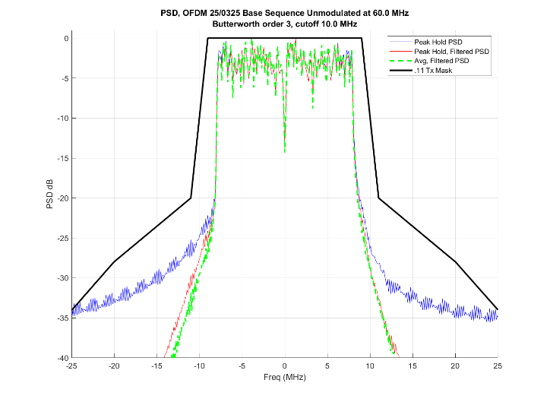
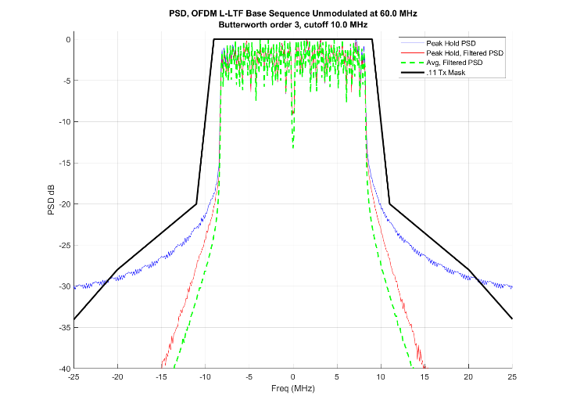
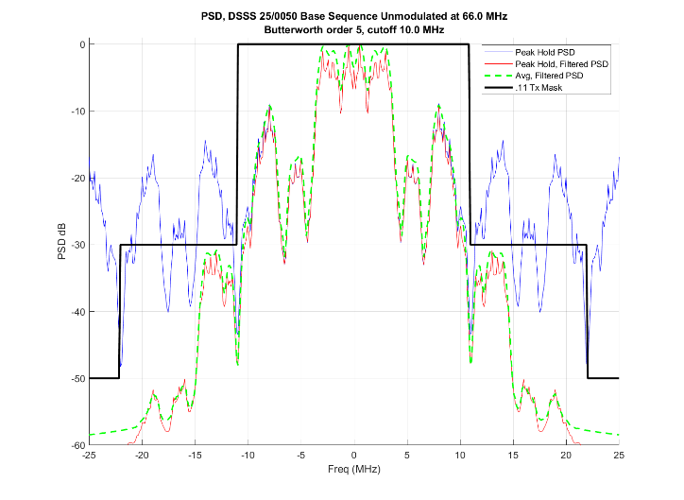
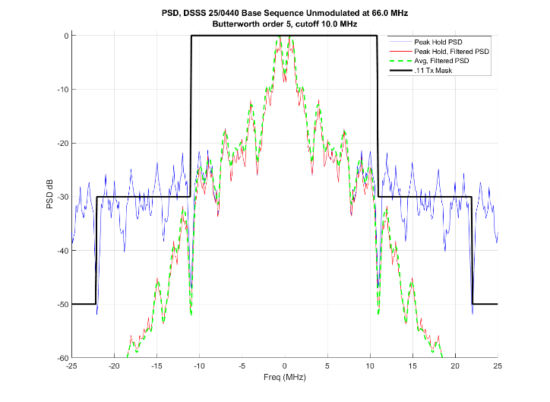
Unmodulated Base Waveforms
OFDM (11-25/0325) | L-LTF | DSSS (11-25/0050) | DSSS (11-25/0440)
PAPR (before filter): 4.1 dB PAPR (after filter): 4.1 dB | PAPR (before filter): 3.2 dB PAPR (after filter): 3.4 dB | PAPR (before filter): 0 dB PAPR (after filter): 2.7 dB | PAPR (before filter): 0 dB PAPR (after filter): 2.5 dB
Max 1 MHz bin power: 9.1 dBm | Max 1 MHz bin power: 8.1 dBm | Max 1 MHz bin power: 11.6 dBm | Max 1 MHz bin power: 15.4 dBm
As per ETSI procedure, each waveform is normalized to 20 dBm before evaluating the 1 MHz PSD limit.
PAPR is computed before and after filtering.

Slide 11
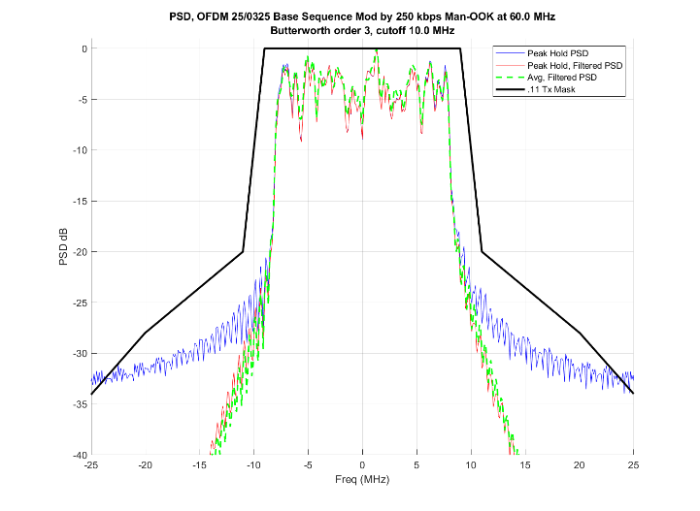
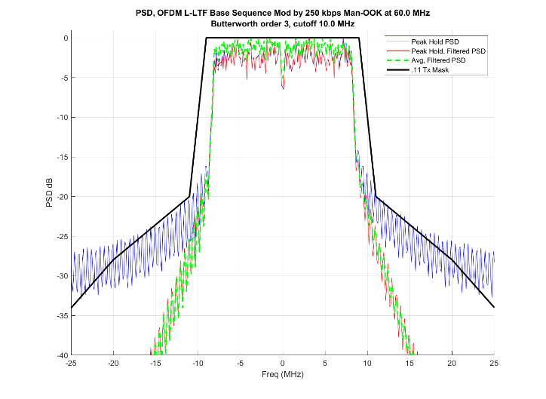
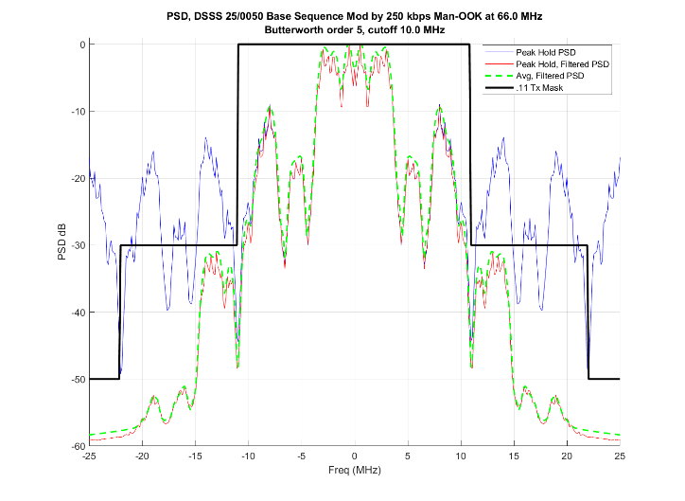
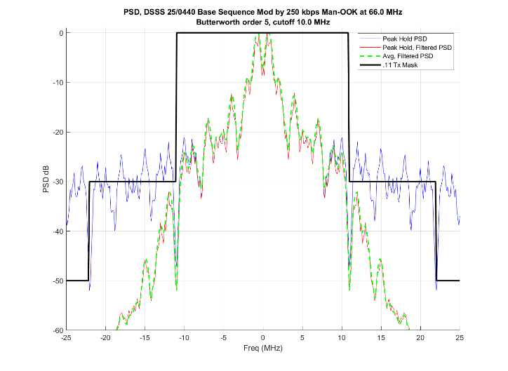
Base Waveforms Modulated with 250 kbps Man-OOK
OFDM (11-25/0325) | L-LTF | DSSS (11-25/0050) | DSSS (11-25/0440)
PAPR (before filter): 7.1 dB PAPR (filtered, full sequence): 7.2 dB PAPR (filtered, ON symbol): 5.9 dB | PAPR (before filter): 6.2 dB PAPR (filtered, full sequence): 6.4 dB PAPR (filtered, ON symbol): 5.2 dB | PAPR (before filter): 3.0 dB PAPR (filtered, full sequence): 5.7 dB PAPR (filtered, ON symbol): 4.5 dB | PAPR (before filter): 3.0 dB PAPR (filtered, full sequence): 5.5 dB PAPR (filtered, ON symbol): 4.3 dB
Max 1 MHz bin power: 9.7 dBm | Max 1 MHz bin power: 8.0 dBm | Max 1 MHz bin power: 11.8 dBm | Max 1 MHz bin power: 15.4 dBm

Slide 12
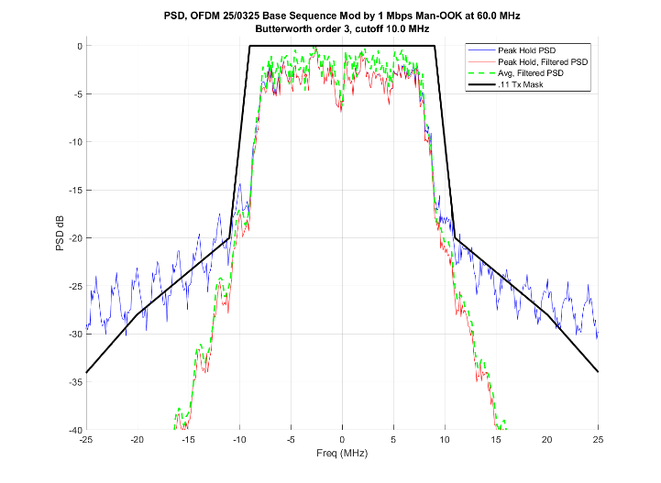
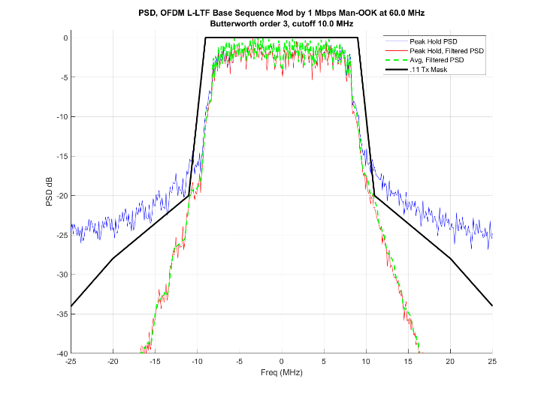
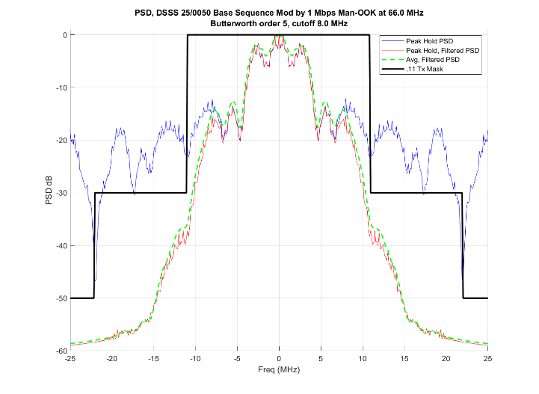
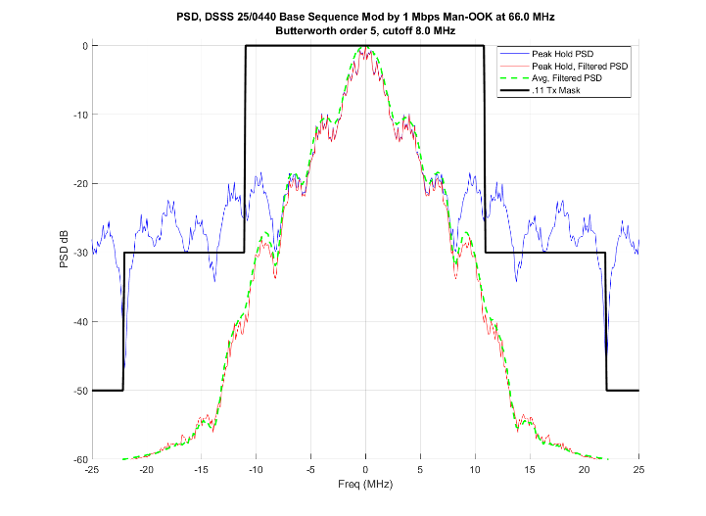
Base Waveforms Modulated with 1 Mbps Man-OOK
OFDM (11-25/0325) | L-LTF | DSSS (11-25/0050) | DSSS (11-25/0440)
PAPR (before filter): 7.1 dB PAPR (filtered, full sequence): 7.2 dB PAPR (filtered, ON symbol): 6.1 dB | PAPR (before filter): 6.2 dB PAPR (filtered, full sequence): 6.5 dB PAPR (filtered, ON symbol): 5.3 dB | PAPR (before filter): 3.0 dB PAPR (filtered, full sequence): 5.9 dB PAPR (filtered, ON symbol): 4.9 dB | PAPR (before filter): 3.0 dB PAPR (filtered, full sequence): 5.4 dB PAPR (filtered, ON symbol): 4.4 dB
Max 1 MHz bin power: 9.7 dBm | Max 1 MHz bin power: 8.0 dBm | Max 1 MHz bin power: 12.5 dBm | Max 1 MHz bin power: 14.7 dBm

Slide 13
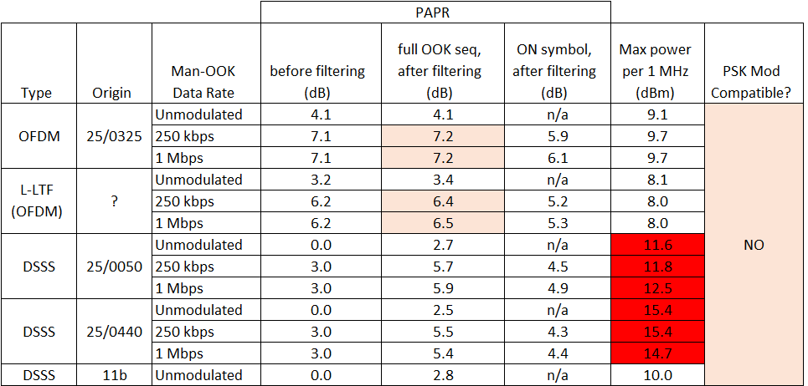
Downlink Base Waveforms: Summary

Slide 14
Conclusion
In this presentation, we reviewed four different proposed base waveforms.
These waveforms are intended to be used to carry OOK, Man-OOK data in the DL for AMP STAs. They would also be used as the backscatter “excitation” waveform.
The OFDM waveforms exhibit good spectral properties, but higher PAPR.
The DSSS waveforms all exceed the ETSI 1 MHz PSD limit.
  The DSSS waveforms generally have poor spectral properties, and require more filtering to meet the spectral mask.
  More filtering increases PAPR.
None of the proposed waveforms are suitable for PSK backscatter.
  However, with small modifications, we believe they can be.
  PSK backscatter provides up to 6 dB more link margin in bistatic backscatter.

Slide 15
References
[1] Li et al., AMP DL Wideband OOK Generation, 11-25/0050, January 2025.
[2] Wang et al., Follow-up on AMP DL OOK generation, 11-25/0440, March 2025.
[3] Shellhammer et al., AMP Downlink Bandwidth Control using OFDM Spreading Waveform, 11-25/0325, March 2025.
[4] Cao et al., AMP Downlink and Backscattering Carrier Waveform, 11-25/0305, March 2025.
[5] Costa et al., PSK Modulation for Long-Range Backscatter, 11-25/0266, March 2025.

