Slide 1
CR 1482 Discussion on NPCA Primary Channel Condition
Date: 2024-05-xx
Authors:
Name | Affiliations | Address | Phone | Email
Shravan Kumar Kalyankar | Huawei |  |  | kalyankar.shravan.kumar@huawei.com
Rojan Chitrakar
Huang Lei
Yunbo Li

Slide 2
NPCA Min. Duration Threshold
Proposes a mechanism to resolve CID 1482.
CID | Clause | Commenter | Comment | Proposed change
1482 | 37.10 | Akira Kishida | There might be a case where the channel condition of the NPCA primary channel is worse than that of the original BSS primary channel. | It should be clarified that NPCA transition to the NPCA primary channel is not necessary in such cases.

Slide 3
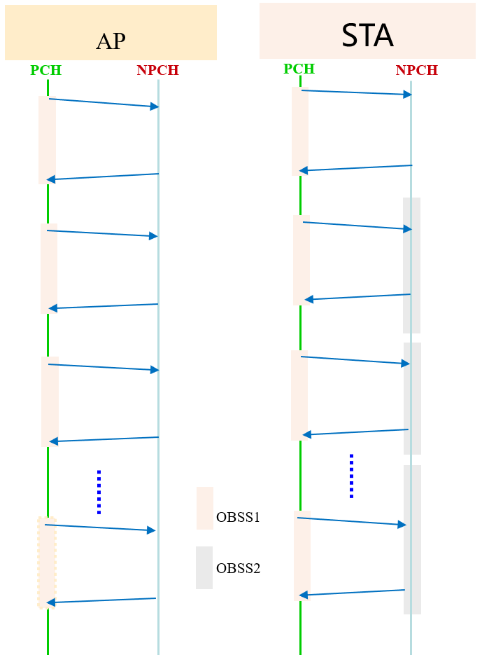
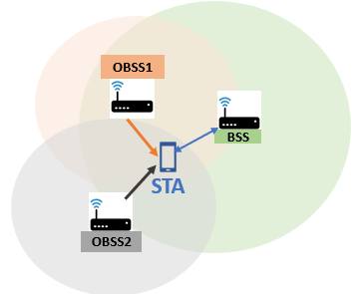
Problem
The proposed methods [2-4] recommend the NPCH selection and updating procedures.
However, if the NPCH channel is known to be busy due to ongoing OBSS (as shown in Fig. 3) or other conditions. In this case, the NPCA STA is unable to use the NPCH channel until a new NPCH is announced by the AP.
Furthermore, NPCA STA wastes power in switching back-and-forth (PCH2NPCH) until a new NPCH is announced.
Moreover, AP is unable to assess the hidden OBSS or other hidden conditions on the NPCH channel.
There is no mechanism defined to inform the AP about the poor NPCH condition and request a channel switch.
Fig. 4: STA switches back-and-forth and still fail to access the NPCH due to OBSS2 on STA NPCH.
Fig. 2: STA or a group of STA’s experiencing OBSS1 on PCH and OBSS2 on NPCH. Whereas, AP is only experiencing OBSS1.
Fig. 3: AP switches to NPCH when OBSS1 is identified, however, STA switches to NPCH and fails to access AP due to OBSS2 on NPCH.

Slide 4
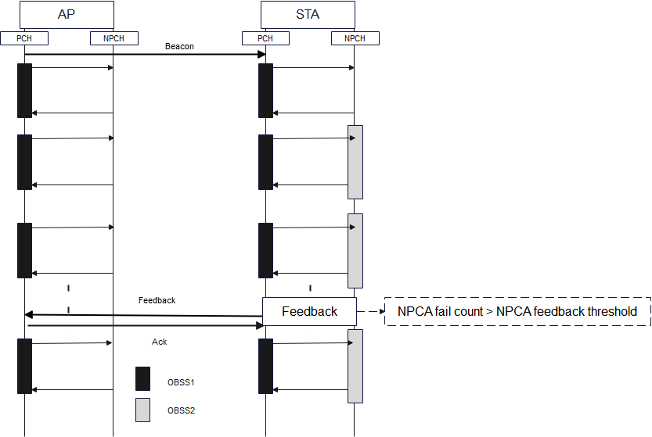
NPCA Primary Channel Feedback Mechanism
STA feedback mechanism: A mechanism where STA send a feedback about NPCH channel to AP when the NPCH channel conditions degrade (e.g. due to OBSS). The feedback contains NPCH measurement report to the AP. Additionally, STA can send NPCH channel update request.
Details: AP behavior
AP announce NPCA Feedback Threshold* along with the NPCA parameters in NPCA element via beacon.
Element ID | Length | Element ID Extension | NPCA Primary Channel | NPC Effective Time | NPCA Feedback Threshold
Fig. 5: STA send a feedback to the AP.
Fig. 6. NPCA element.
NPCA Feedback Threshold*: NPCA disable threshold can be calculated based on the AP measurement report request periodicity.
NPCA fail count*: No. of failed NPCA attempts due to partially or fully busy NPCH because of OBSS or other conditions.

Slide 5
NPCA Primary Channel Feedback Mechanism
Details: STA behavior
STA use the NPCA feedback threshold to decide the NPCA feedback bit and NPCA mode bit.
STA send the feedback as “1” to AP, if the NPCA fail count* is greater than equal to NPCA Feedback Threshold. AP may choose new NPCH based on the STA/STA’s/AP measurement report.
Fig. xx. Block Acknowledgement.
Value | Description
1 | NPCA fail count* $≥$ NPCA Feedback Threshold
0 | NPCA fail count* $<$ NPCA Feedback Threshold
Definition:
NPCA Feedback Bit: A STA sends a 1-bit indication to indicate the NPCA primary channel condition.
NPCA mode: A 1-bit indication to indicate whether the NPCA mode is enabled or disabled.
Fig. xx. NPCA Feedback.
Value | Description
1 | NPCA Mode Enabled
0 | NPCA Mode Disabled
Fig. xx. NPCA Mode.
Note: NPCA fail count* is a counter value that a STA counts. It counts the number of failed NPCA attempts due to partially or fully busy NPCA primary channel because of OBSS or other conditions.

Slide 6
Summary
In this contribution, we explored potential of sending a feedback to AP about the NPCA primary channel condition and also STA behavior while the NPCA primary channel condition degrades.

Slide 7
References
IEEE P802.11-REVme/D7.0, August 2024
NPCA Primary Channel Selection, Yuxin Lu, TCL Industries (11-24-2089-00-00bn-npca-primary-channel-selection).
Considerations on NPCA Follow Up, Maolin Zhang, Huawei (11-24-2092-00-00bn-considerations-on-npca-follow-up 0212).
Considerations on NPCA Operation, Zhenpeng Shi et al., Huawei Technologies (11-25-0065-00-00bn-considerations-on-npca-operation).

Slide 8
Straw Poll 1
Do you support that NPCA STA will send a feedback to indicate worse NPCA primary channel condition?
Y/N/A

Slide 9
Straw Poll 2
Do you support that the NPCA AP will indicate a NPCA feedback threshold?
Y/N/A

Slide 10
Straw Poll 3
Do you support that NPCA STA shall disable when the NPCA primary channel condition is worse?
Y/N/A

