Slide 1
Follow-up on AP Power Save
Date: 2025-05-09

Slide 2
Abstract
Operators are pressured to reduce the power consumption of their residential broadband gateways.
A big part of this power consumption is due to Wi-Fi.
Power consumption is even more significant since the introduction of 6 GHz – which added a third radio
At present only one solution for non-mobile AP power save has been voted into 11bn.
We need more solutions, including backward compatible solutions.

Slide 3
Background: power consumption mitigation for APs
With the European Climate Law, the EU is committing to carbon neutrality by 2050.
Telecommunication operators must reduce their emissions footprints.
They focus on the major sources of scope 3 emissions, such as handset, residential gateways, network equipments… it represented 81% of Orange carbon emissions in 2023.
More globally, 221 companies of the telecommunication sector have targets to reduce their carbon emissions: Target dashboard - Science Based Targets Initiative
Most of power saving features in Wi-Fi are addressing non-AP STAs, because they are often battery-powered devices, while APs are wall-powered and need to be always awake.
We need efficient solutions for APs.

Slide 4
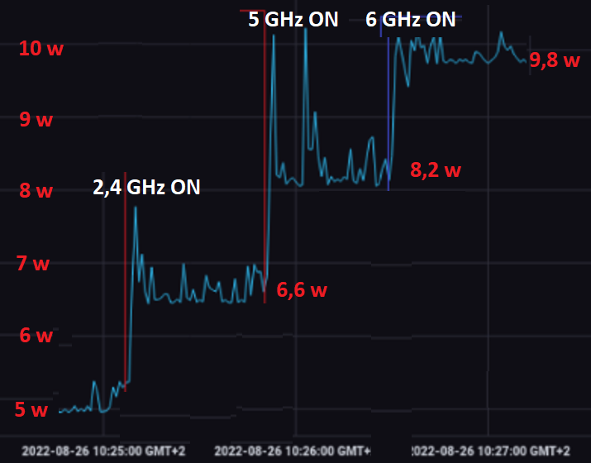
Illustration of a tri-band AP power consumption
Measurements performed by Orange on its 802.11ax tri band gateway
By default, even without any traffic, the Wi-Fi represents 50% of the total energy consumption of this residential gateway
Aggregation of total household power consumption is increasing (more frequency bands, more devices)

Slide 5
Other advantage of reducing the AP power consumption
Reducing the AP power consumption increases its service life
Increases customer satisfaction due to cost savings for customers

Slide 6
Constraints
The features must be backward compatible
It must be possible to enable them even if pre 802.11bn devices are associated to the AP
More constraints on the 2.4GHz band where IoT devices are still using old Wi-Fi versions
The features must not prevent the AP from receiving packets from associated STAs

Slide 7
Related work
Many contributions already presented discuss some existing features for power save and proposed new solutions
Existing features are not always implemented / widely supported
Existing solutions include (but are not limited to):
BW reduction
Nss / antennas reduction
Limitation of the 802.11 capabilities (generation/MCS etc)
Disablement of a frequency band:
in particular the 6GHz band if there is no 6GHz capable device in the home,
even in addition the 5GHz when there is no traffic

Slide 8
Adopted (non-Mobile) AP power save mechanism in 802.11bn
Define a new mechanism and/or enhance existing mechanism for AP power save [Motion #49 and [2, 9, 11, 12]]
Scheduled periodic power save on AP side is performed in UHR using Broadcast TWT with TWT ID=0 with Responder PM=1 (Rules for TWT scheduling AP) [Motion #161]
Compatible with legacy devices?
Operators need additional solutions

Slide 9
Summary
802.11bn needs more power saving features for non-mobile APs
Backward compatible features for existing generations of STAs
New features for 802.11bn and future generations of APs and STAs

Slide 10
References
[1] 11-22/1809 A Perspective on UHR Features for Operator Residential Deployments
[2] 11-23/10 Considerations for enabling AP power save
[3] 11-23/15 AP MLD power management
[4] 11-23/225 Considering Unscheduled AP Power Save
[5] 11-23/2112-01 Power Save for UHR
[6] 11-23/1922-01 multi-link sm power save mode
[7] 11-23/1936-00 ap mld power-save follow-up
[8] 11-23/1965-02 dynamic power-save follow-up
[9] 11-24/2040-01 Enabling AP power save – Follow Up
[10] 11-24/589-00 Dynamic TID-To-Link Mapping for AP MLD Power Save
[11] 11-24/659-01 Thoughts on AP Power Save
[12] 11-24/671-00 Enhancements on AP Power Save
[13] 11-24/813-00 Discussions on AP Power Save

Slide 11
References
[14] 11-24/1166-00 TWT-Based Power Save with Enhanced Flexibility
[15] 11-24/1167-00 EML(SR/MR) Based Dynamic Power Save Design
[16] 11-24/1502-00 Discussion on AP Power Save
[17] 11-24/1602-01 Power Save Enhancements in UHR
[18] 11-24/2001-00 Multi-Link scheduled Power Save for AP MLD
[19] 11-25/355-00 Considerations for AP Dynamic Power Save
[20] 11-24/578-00 TWT-Based AP Power Save
[21] 11-25/355-00 Considerations for AP Dynamic Power Save

