Slide 1
UHR Transmit and Receiver Specification for New MCSs- Follow Up
Date: 2025-5-13
Authors:

Slide 2
Introduction
802.11bn introduced four new MCSs for UHR MU/TB PPDU and two MCSs for UHR ELR PPDU.
The Tx and Rx specifications for these new MCSs should be defined.
The Tx EVM for the four new MCSs and receiver specification for the two ELR MCS are defined already[1-3]
In this contribution, we propose
  Transmit Constellation Error required values for the two ELR MCSs
  Required PSDU length for receiver minimum input sensitivity and adjacent channel rejection measurement for the two ELR MCSs
  Receiver specification for the four new MCSs

Slide 3
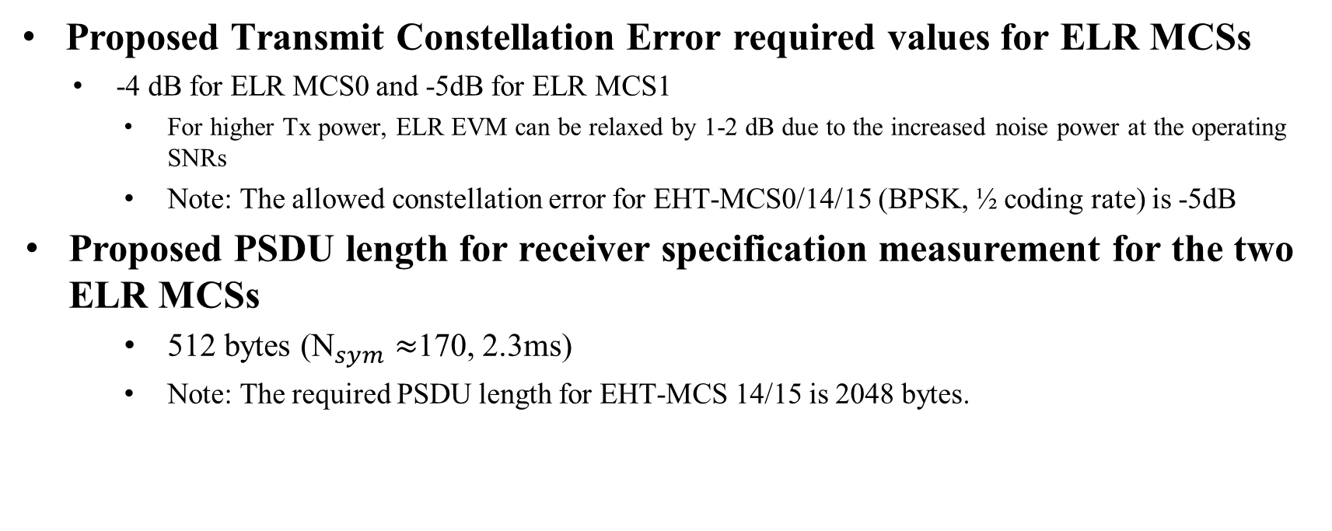
Proposed Transmit Constellation Error required values for ELR MCSs
Proposed Transmit Constellation Error required values for ELR MCSs
  -4 dB for ELR MCS0 and -5dB for ELR MCS1
    For higher Tx power, ELR EVM can be relaxed by 1-2 dB due to the increased noise power at the operating SNRs
    Note: The allowed constellation error for EHT-MCS0/14/15 (BPSK, ½ coding rate) is -5dB
  Proposed PSDU length for receiver specification measurement for the two ELR MCSs
    512 bytes (${\text{N}}_{sym}≈$170, 2.3ms)
    Note: The required PSDU length for EHT-MCS 14/15 is 2048 bytes.

Slide 4
Performance of the four new MCSs comparing to the adjacent MCSs
Simulation setup
  Packet size: 4096bytes, SU, SISO, 80MHz, MMSE receiver, ideal CSI, no impairment, AWGN/chD

Slide 5
Proposed Receiver Minimum Input sensitivity for New MCSs
According to the performance analysis under AWGN
MCS | Modulation | Code rate | snrdB @ 10% per (80MHz, AWGN) | snr difference in dB @10% per (80MHz, AWGN) | Minimum sensitivity (20 MHz PPDU) (dBm) | Minimum sensitivity (40 MHz PPDU) (dBm) | Minimum sensitivity (80 MHz PPDU) (dBm) | Minimum sensitivity (160 MHz PPDU) (dBm) | Minimum sensitivity (320 MHz PPDU) (dBm)
1 | QPSK | 1/2 | 1.7 |  | -79 | -76 | -73 | -70 | -67
17 | QPSK | 2/3 | 3.6 | -1.9↑; +0.8↓ | -78 | -75 | -72 | -69 | -66
2 | QPSK | 3/4 | 4.8 |  | -77 | -74 | -71 | -68 | -65
3 | 16QAM | 1/2 | 7.0 |  | -74 | -71 | -68 | -65 | -62
19 | 16-QAM | 2/3 | 9.5 | -2.5↑; +1.2↓ | -71 | -68 | -65 | -62 | -59
4 | 16-QAM | 3/4 | 10.9 |  | -70 | -67 | -64 | -61 | -58
20 | 16-QAM | 5/6 | 12.3 | -1.4↑; +2.2↓ | -69 | -66 | -63 | -60 | -57
5 | 64-QAM | 2/3 | 14.5 |  | -66 | -63 | -60 | -57 | -54
7 | 64-QAM | 5/6 | 17.9 |  | -64 | -61 | -58 | -55 | -52
23 | 256-QAM | 2/3 | 19.4 | -1.5↑; +1.9↓ | -60 | -57 | -54 | -51 | -48
8 | 256-QAM | 3/4 | 21.3 |  | -59 | -56 | -53 | -50 | -47

Slide 6
Proposed minimum required adjacent and nonadjacent channel rejection levels for four new MCSs
MCS | Modulation | Code rate | Adjacent channel rejection (dB) | Nonadjacent channel rejection (dB)
 |  |  | 20/40/80/160/320 MHz channel | 20/40/80/160/320 MHz channel
1 | QPSK | 1/2 | 13 | 29
17 | QPSK | 2/3 | 12 | 28
2 | QPSK | 3/4 | 11 | 27
3 | 16-QAM | 1/2 | 8 | 24
19 | 16-QAM | 2/3 | 5 | 21
4 | 16-QAM | 3/4 | 4 | 20
20 | 16-QAM | 5/6 | 3 | 19
5 | 64-QAM | 2/3 | 0 | 16
7 | 64-QAM | 5/6 | -2 | 14
23 | 256-QAM | 2/3 | -6 | 10
8 | 256-QAM | 3/4 | -7 | 9

Slide 7
Summary
  We studied the performance of the four new MCSs and two ELR MCSs comparing with the adjacent MCSs higher and lower
  Based on the simulation results and proposal from other members, we proposed
  Transmit Constellation Error required values for the two ELR MCSs
  Required PSDU length for receiver minimum input sensitivity and adjacent channel rejection measurement for the two ELR MCSs
  Receiver specification for the four new MCSs

Slide 8
Reference
11-25/354r0, Transmit Constellation Error for Additional MCSs, Genadiy Tsodik, et. al
11-25/98r0, UHR Receiver Minimum Input Sensitivity for ELR MCSs, Juan Fang, et. al
11-25/0392r0, Transmit and Receive Specifications for New MCS in 11bn, Alice Chen, et.al

Slide 9
SP1
Do you agree to add the following table at the end of the subclause 38.3.23.4.3: Transmitter constellation error of next revision of 11bn draft?
Table 38-xx —Allowed relative constellation error versus constellation size and coding rate for ELR
Modulation | Coding rate | Relative constellation error in a UHR ELR PPDU (dB)
BPSK | 1/2 | -4
QPSK | 1/2 | -5

Slide 10
SP2
Do you agree to include the following to the 11bn SFD?
The PSDU length for receiver minimum input sensitivity and adjacent channel rejection measurement shall be 512 octets for UHR ELR PPDU.

Slide 11
SP3
Do you agree to include the following to the 11bn SFD?
Receiver Minimum Input sensitivity for new MCSs are as follows
MCS | Modulation | Code rate | Minimum sensitivity (20 MHz PPDU) (dBm) | Minimum sensitivity (40 MHz PPDU) (dBm) | Minimum sensitivity (80 MHz PPDU) (dBm) | Minimum sensitivity (160 MHz PPDU) (dBm) | Minimum sensitivity (320 MHz PPDU) (dBm)
1 | QPSK | 1/2 | -79 | -76 | -73 | -70 | -67
17 | QPSK | 2/3 | -78 | -75 | -72 | -69 | -66
2 | QPSK | 3/4 | -77 | -74 | -71 | -68 | -65
3 | 16QAM | 1/2 | -74 | -71 | -68 | -65 | -62
19 | 16-QAM | 2/3 | -71 | -68 | -65 | -62 | -59
4 | 16-QAM | 3/4 | -70 | -67 | -64 | -61 | -58
20 | 16-QAM | 5/6 | -69 | -66 | -63 | -60 | -57
5 | 64-QAM | 2/3 | -66 | -63 | -60 | -57 | -54
7 | 64-QAM | 5/6 | -64 | -61 | -58 | -55 | -52
23 | 256-QAM | 2/3 | -60 | -57 | -54 | -51 | -48
8 | 256-QAM | 3/4 | -59 | -56 | -53 | -50 | -47

Slide 12
SP4
Do you agree to include the following to the 11bn SFD?
Minimum required adjacent and nonadjacent channel rejection levels for four new MCSs are as follows
MCS | Modulation | Code rate | Adjacent channel rejection (dB) | Nonadjacent channel rejection (dB)
 |  |  | 20/40/80/160/320 MHz channel | 20/40/80/160/320 MHz channel
1 | QPSK | 1/2 | 13 | 29
17 | QPSK | 2/3 | 12 | 28
2 | QPSK | 3/4 | 11 | 27
3 | 16-QAM | 1/2 | 8 | 24
19 | 16-QAM | 2/3 | 5 | 21
4 | 16-QAM | 3/4 | 4 | 20
20 | 16-QAM | 5/6 | 3 | 19
5 | 64-QAM | 2/3 | 0 | 16
7 | 64-QAM | 5/6 | -2 | 14
23 | 256-QAM | 2/3 | -6 | 10
8 | 256-QAM | 3/4 | -7 | 9

