Slide 1
Anchor Link for ML Operation with mmWave Link
Date: 2025-03-20
Authors:

Slide 2
Need for mmWave Operation
Over the years, IEEE 802.11 technology has expanded and diversified to cover multiple market segments [1]:
Residential
Enterprise
Industrial, etc.
There has been a growing demand for support of new applications with stringent throughput and latency requirements in these market segments:
XR
Proximity ranging and sensing, etc.
The large bandwidth available in the mmWave bands provides a unique opportunity to meet the growing demand and support new types of applications

Slide 3
Non-standalone mmWave operation
Non-standalone mmWave operation [1]:
The PAR document describes a non-standalone operation (NSA) in unlicensed bands between 42 and 71 GHz.
802.11 device supporting the amendment should also support at least one of the sub-7.25 GHz unlicensed bands.
The project scope proposes to expand the multi-link operation defined in sub-7.25 GHz band specifications to support non-standalone operation in the mmWave band.

Slide 4
Multi-link Operation Beaconing
MLO introduced in 802.11be provides a set of procedures for communication between MLDs over one or more links.
Beacon frame is transmitted on each link.
Beacon frame carries information useful for non-AP MLD for MLO discovery, configuration updates such as AP removal, etc.
Depending on the scenario, beacon frame body can contain a number of elements to achieve this objective.
AP MLD
Non-AP MLD
NON-AP STA3
NON-AP STA2
NON-AP STA1
AP 1
AP 2
AP 3
6 GHz
5 GHz
2.4GHz
2.4GHz
5 GHz
6 GHz
Beacon frame
Beacon frame
Beacon frame
Fig. 1 Frame exchange for MLO discovery based on beacon transmission
Fig. 2 Contents of a Beacon frame transmitted by an AP corresponding to the transmitted BSSID during MLO discovery

Slide 5
Beaconing in 11ad/ay
802.11ad and ay have a beaconing design to cope with the challenges of mmWave propagation.
A beacon interval (BI) in 11ad/ay contains –
Beacon header interval (BHI):
Beacon transmission interval (BTI): includes a sweep of DMG beacons on different sectors to cover all possible directions
Association beamforming training (A-BFT): used by STAs to train their antenna sector for communication with the AP
Announcement Transmission Interval (ATI): management information exchanges between AP and associated beam-trained STAs.
Data transmission interval (DTI)
Beacon Interval (BI)
BHI
DTI
BTI
A-BFT
ATI
A-BFT slot
…
A-BFT slot
…
Beacon sweeping
Fig. 1 Beacon interval structure. Note: figure is not to scale
Fig. 2 DMG Beacon frame format

Slide 6
Problem 1: Rethinking Beacon Design for NSA mmWave Operation
Beacon design for NSA operation needs careful consideration:
Overhead: 11bq will also need to sweep beacons in different direction. Sweeping a traditional 11be beacon (with ML info) will result in forbiddingly high overhead.
Power consumption: A longer beacon also means a longer total sweep duration. This can require battery powered devices to stay awake for a longer total sweep duration (worse case).
Frame errors: Shorter frame reduces chances of frame errors and enables edge devices to receive beacons efficiently.

Slide 7
Leveraging NSA Operation
Non-standalone (NSA) operation must be leveraged to create a light weight beacon:
Beacon contains only very basic information.
A cookie,
Minimum identifying information, etc.
Remaining information transmission (e.g., STA profiles, other elements, etc.) can be offloaded to sub-7 GHz links.

Slide 8
Proposal 1: Minimalist Beacon Design for NSA mmWave Operation (1/2)
Beacon design and procedure for NSA mmWave link operation must convey minimum information for operation of mmWave link
Beacon can be periodically broadcasted like in legacy systems or can also be on demand. More details on this will be shared in a follow up contribution.
Non-AP MLD can obtain other information from sub-7 links

Slide 9
Proposal 1: Minimalist Beacon Design for NSA mmWave Operation (2/2)
The minimum that a mmWave beacon must contain:
 | Information | Comments
1. | BSSID | Entire BSSID (48 bits) OR preferably a few bits long time varying cookie
2. | Transmit beam index | 6 – 8 bits for beam index; implicitly or explicitly.
3. | TSF | Entire TSF OR preferably a partial TSF.
4. | ??
After successfully decoding a beacon:
STA side acquires:
Receive beam, AP’s transmit beam index, basic link quality for a given AP and TSF.
AP side can acquire if necessary (possibly through sub-7 reporting):
AP’s transmit beam for a given STA, basic link quality.

Slide 10
Problem 2: NSA Cross-link Management Overhead
Broadcast information:
Other legacy beacon frame body content.
Non-AP MLD specific information:
STA specific beam management
Beam tracking measurement and reporting
DL beam training
UL beam training
Beam failure detection and recovery
Possibly feature setup/teardown, cross link power save operation, ..
➔ NSA cross-link management overhead is expected to be significantly more than traditional ML operation.

Slide 11
How to Handle NSA Cross-link Management Overhead
Design principles to for handling overhead of NSA cross link management:
For broadcast information: Minimize number of links on which broadcast information is duplicated. Avoid beacon bloating.
For non-AP MLD specific information: Allow load balancing for non-AP MLD specific management: should be distributed across different sub-7 GHz links.
E.g., non-AP MLD 1 to K managed using link a, non-AP MLD K to N managed using link b, …

Slide 12
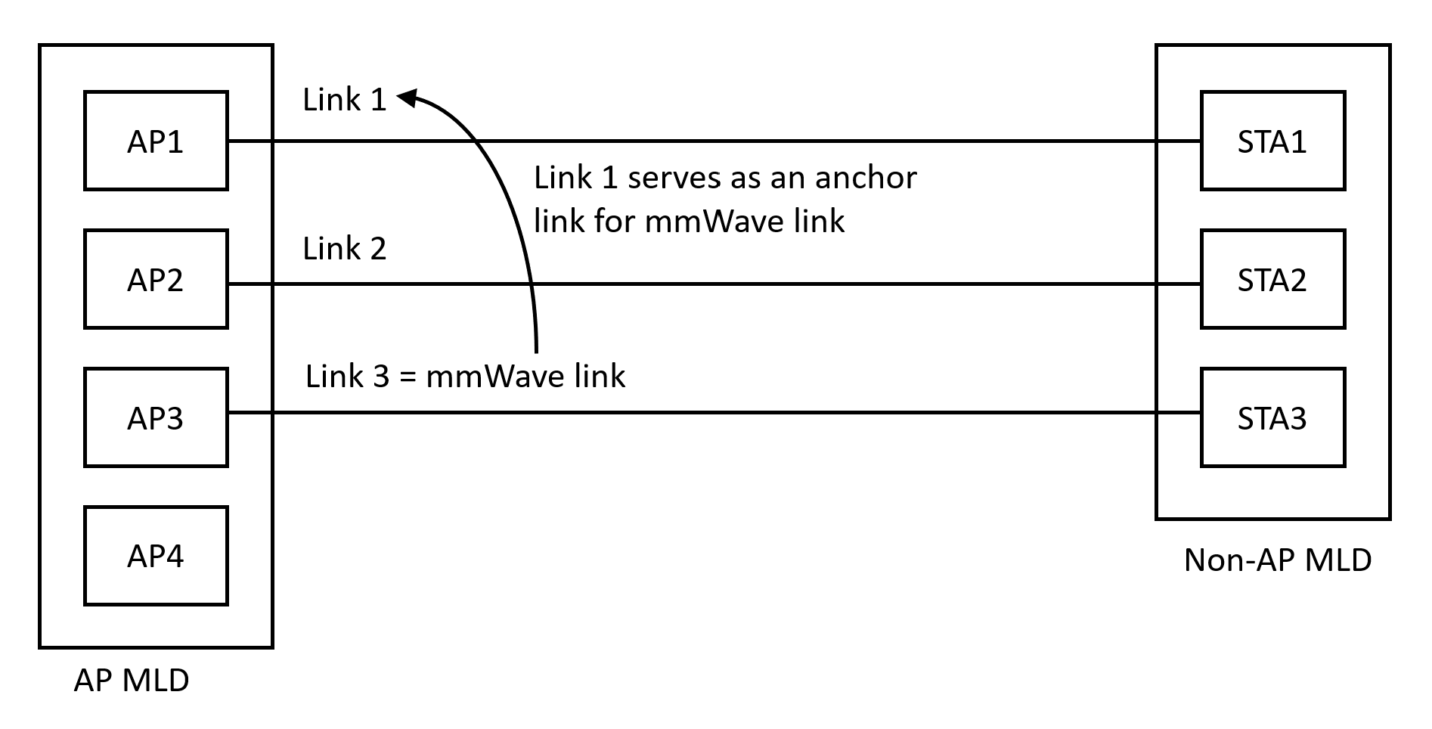
Proposal 2: Anchor Link
To enable an efficient NSA mmWave link operation, we propose to design an anchor link
Information corresponding to the mmWave link will be selectively offloaded to an anchor link.
A non-AP MLD that intends to use the mmWave link must also connect on an anchor link.
Can consider multiple anchor links to avoid an overload on one anchor link.
Fig. Anchor Link for NSA mmWave operation

Slide 13
Anchor Link Design
Option 1: Single anchor link per AP MLD
AP MLD maintains a single anchor link.
Non-AP MLD that wants to use mmWave link connects on the single anchor link as well
Option 2: One anchor link that is non-AP MLD specific
Anchor link is configured per non-AP MLD.
Either AP MLD configures one link of the non-AP MLD’s links as an anchor link OR
Non-AP MLD can chose one out of a candidate anchor link list
Option 3: Multiple non-AP MLD specific anchor links
Multiple of the sub-7 GHz can serve as anchors.
Flexible/dynamic usage for NSA cross link management.

Slide 14
Anchor Link Indication
An AP MLD can indicate which link is serving as an anchor link for mmWave link. E.g., indication in the per-STA profile of the anchor link.
Non-AP MLD can ensure that it connects over at least one anchor link if it intends to use the mmWave link.

Slide 15
Rules for Link Setup and Reconfiguration
A few basic rules may need to be defined for usage of the mmWave link:
During initial link setup, the AP MLD can ensure that the non-AP MLD is connected over at least one anchor link if it intends to use the mmWave link.
During link reconfiguration, the AP can ensure that the non-AP MLD adding the mmWave link has already connected over/is adding an anchor link.
During link deletion, at least one anchor link should be maintained between the AP MLD and the non-AP MLD if the non-AP MLD intends to maintain the mmWave link

Slide 16
Conclusion
In this contribution, we share two key proposals that for NSA mmWave operation:
Proposal 1: Minimalist design approach for beacon on mmWave link.
Proposal 2: Use of an anchor link for NSA mmWave operation.

Slide 17
Straw Poll 1
Do you agree that NSA mmWave link beacon shall provide minimal information necessary for operation of mmWave link?
Note: Minimal information includes at least BSSID, transmit beam index, TSF.

Slide 18
Straw Poll 2
Do you agree that NSA mmWave operation should operate with the assistance of an Anchor link?

Slide 19
Straw Poll 3
Do you agree that an anchor link can carry the broadcast information corresponding to a mmWave link?
Note: TBD on what broadcast information can be carried.

Slide 20
Straw Poll 4
Do you agree that an anchor link can carry non-AP MLD specific information corresponding to a non-AP MLD’s affiliated STA operating on the mmWave link?

Slide 21
Reference
[1] IEEE 802.11-24/0116, “802.11 IMMW Proposed PAR”

