Slide 1
A Mode of Operation Where NSA mmWave Link is Used in DL-only Direction
Date: 2025-04-15
Authors:

Slide 2
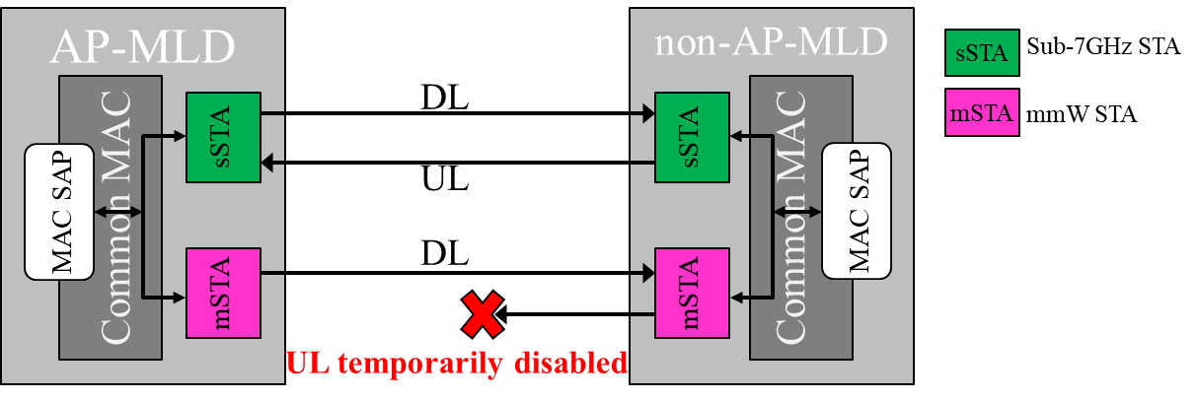
Overview
PHY Problem
  mmWave UL will be severely limited and unreliable compared to mmWave DL
MAC Solution
  NSA (Non-StandAlone) mmWave can be used in DL-only direction (supplemental DL)

Slide 3
Abstract
11bq should support a mode of operation where NSA mmW link is used in DL-only direction
  At times, capability of an 11bq user-device will get reduced to DL-only (RX-only) operation in mmWave, for various reasons (discussed later)
  As a by-product: This mode will enable a simpler & cheaper 11bq user-device without mmWave TX hardware, which can prove a catalyst for 11bq adoption
AP-MLD
non-AP-MLD
sSTA
Sub-7GHz STA
Common MAC
DL
Common MAC
mSTA
sSTA
sSTA
mmW STA
MAC SAP
UL
MAC SAP
DL
mSTA
mSTA
UL temporarily disabled
Or TX not implemented at non-AP mSTA

Slide 4
Many arguments presented during SG in favor of NSA mmW are also valid arguments for DL-only mode
23/1819r0
  “success of integrated 802.11 systems depends significantly on the ability to offset the substantial area and complexity of mmWave RF/antenna technology.”
  Reduce power consumption, support asymmetric links, push higher complexity to AP
23/1905r0
  “commercial success of IMMW technology depends on whether complexity, cost and power consumption are given high priorities in the design”
23/2004r0
  “limited scope is critical to… minimal implementation complexity and larger market adoption”
24/0066r0
  “collaborative operation between sub-7 GHz and mmWave bands may be one of the most important factors”
23/1977r1, 24/0008r2
  Some of the demanding applications and use-cases are naturally DL heavy (projector, display, dock)

Slide 5
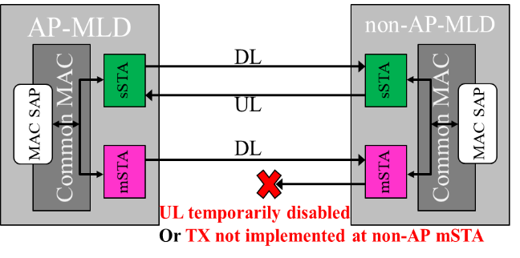
Motivation for a DL-only mode . for NSA mmWave link .
Large DL vs UL coverage mismatch in mmWave
MPE* requirements will at times force further mmWave UL power reduction, essentially prohibiting UL in mmWave
  E.g., based on user grip (or any clutter) in proximity to the TX array
Significant cost, power consumption, and area to add mmWave TX chains (and associated thermal regulation)
  As a byproduct of removing TX chain, slight improvement in RX (~1.5dB) due to removal of T/R switch
Some applications and use-cases that motivate 11bq are naturally DL heavy (projector/TV/display, dock)
Supporting user-devices with RX-only in mmWave could be a stepping stone to 11bq success, increasing number of 11bq user devices, thus promoting adoption of 11bq on AP side too.
*MPE: Maximum Permissible Exposure

Slide 6
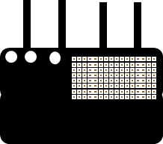

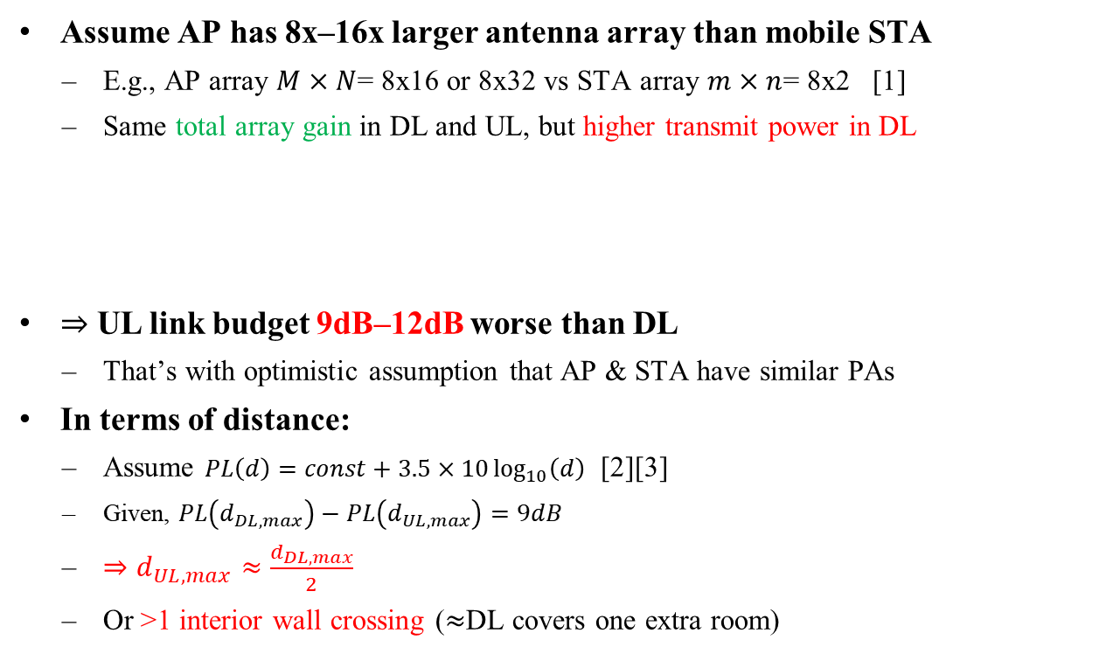
1. Large DL vs UL coverage mismatch in mmWave
Assume AP has 8x‒16x larger antenna array than mobile STA
  E.g., AP array $M×N$= 8x16 or 8x32 vs STA array $m×n$= 8x2 [1]
  Same total array gain in DL and UL, but higher transmit power in DL
$⇒$ UL link budget 9dB‒12dB worse than DL
  That’s with optimistic assumption that AP & STA have similar PAs
In terms of distance:
  Assume $PL\left(d\right)=const+3.5×10\log_{10}\left(d\right)$ [2][3]
  Given, $PL\left(d_{DL,max}\right)−PL\left(d_{UL,max}\right)=9dB$
  $⇒d_{UL,max}≈\frac{d_{DL,max}}{2}$
  Or >1 interior wall crossing ($≈$DL covers one extra room)
Total array gain between AP & STA
Total TX power
$${DL: P}_{out,AP }+10\log\left(M⋅N\right)+G_{AP}+10\log\left(M⋅N\right)+G_{STA}+10\log\left(m⋅n\right)$$
$${UL: P}_{out,STA}+10\log\left(m⋅n\right)+G_{AP}+10\log\left(M⋅N\right)+G_{STA}+10\log\left(m⋅n\right)$$
DL coverage
UL coverage
Sub-7 coverage

Slide 7
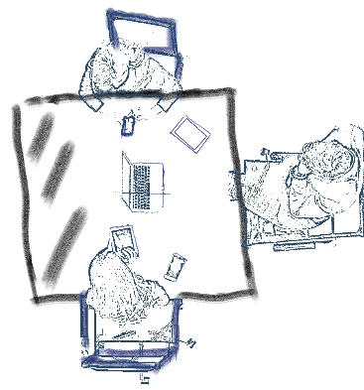
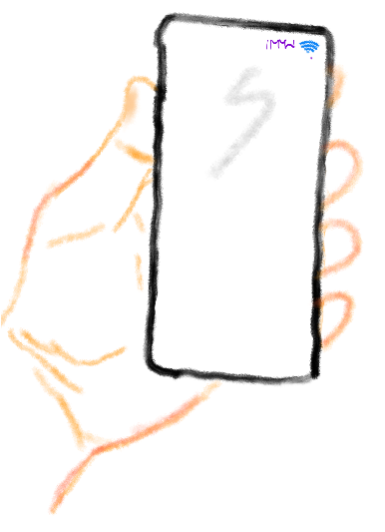
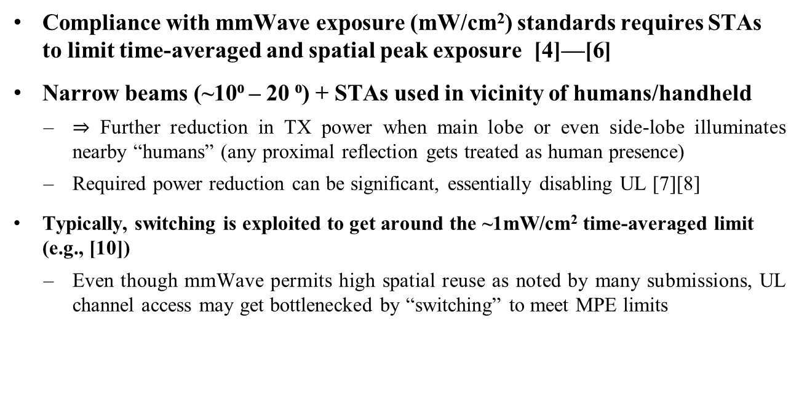
2. Further UL power reduction due to MPE*
Compliance with mmWave exposure (mW/cm²) standards requires STAs to limit time-averaged and spatial peak exposure [4]—[6]
Narrow beams (~10⁰ ‒ 20 ⁰) + STAs used in vicinity of humans/handheld
  $⇒$ Further reduction in TX power when main lobe or even side-lobe illuminates nearby “humans” (any proximal reflection gets treated as human presence)
  Required power reduction can be significant, essentially disabling UL [7][8]
Typically, switching is exploited to get around the ~1mW/cm² time-averaged limit (e.g., [10])
  Even though mmWave permits high spatial reuse as noted by many submissions, UL channel access may get bottlenecked by “switching” to meet MPE limits
*MPE: Maximum Permissible Exposure

Slide 8
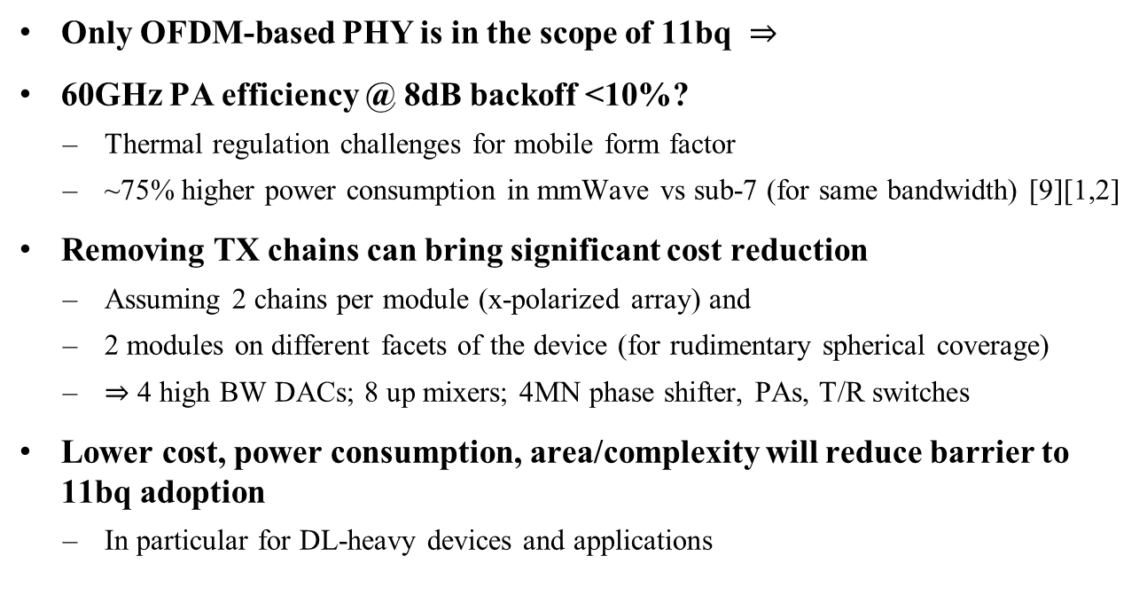
3. Cost, power consumption, area
Only OFDM-based PHY is in the scope of 11bq $⇒$
60GHz PA efficiency @ 8dB backoff <10%?
  Thermal regulation challenges for mobile form factor
  ~75% higher power consumption in mmWave vs sub-7 (for same bandwidth) [9][1,2]
Removing TX chains can bring significant cost reduction
  Assuming 2 chains per module (x-polarized array) and
  2 modules on different facets of the device (for rudimentary spherical coverage)
  $⇒$ 4 high BW DACs; 8 up mixers; 4MN phase shifter, PAs, T/R switches
Lower cost, power consumption, area/complexity will reduce barrier to 11bq adoption
  In particular for DL-heavy devices and applications

Slide 9

RECAP (PHY part) .
Why support a DL-only mode in mmWave:
Large DL vs UL coverage mismatch in mmWave
MPE* requirements will at times force further mmWave UL power reduction, essentially prohibiting UL data in mmWave
Significant cost, power consumption, and area to add mmWave TX chains (and associated thermal regulation)
Some applications and use-cases that motivate 11bq are naturally DL heavy (projector/TV/display, dock)
Supporting user-devices with RX-only in mmWave could be a stepping stone to 11bq success, increasing number of 11bq user devices, thus promoting adoption of 11bq on AP side too.
*MPE: Maximum Permissible Exposure

Slide 10
MAC discussion
Cross-link BA to enable NSA mmWave link in DL-only mode
Preliminary feasibility exploration

Slide 11
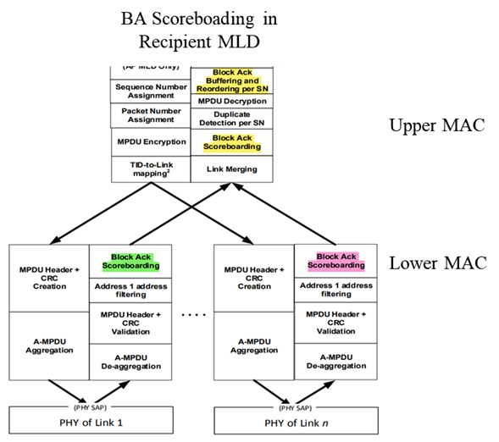
Baseline MLD MAC .
Consider a TID mapped to
  a Sub-7 link
  a mmW link (that we want to operate in DL-only mode)
Scoreboard kept at MLD level, as well as, per-link level [11]
  Flexible syncing requirements for Link1 scoreboard → MLD scoreboard → Link2 scoreboard (similarly, Link2 to MLD to Link1)
  Flexible requirements for BA containing cross-link scoreboard (successfully received MSDUs)
PHY of Sub-7 Link
PHY of mmW Link

Slide 12


Baseline MLD MAC .
Consider BA reported by Sub-7GHz link
  BA “shall” include own scoreboard status between $self.winStart_{R}$ and self.$winEnd_{R}$.
  BA “may” include cross-link scoreboard status (successfully received MSDUs on mmW link) for bitmap indices included in the BA
“shall”
“may”
$$b_{0} { b}_{1}⋯ ⋯{b_{61}b_{62}b}_{63}$$
SSN
x
x
x
x
x
x
x
PHY of Sub-7 Link
PHY of mmW Link

Slide 13

MLD MAC in DL-only mode on mmW link
Consider BA reported by Sub-7GHz link
  BA “shall” include own scoreboard status between $self.winStart_{R}$ and self.$winEnd_{R}$.
  Under certain conditions, BA “shall” include cross-link scoreboard status (successfully received MSDUs on mmW link) for bitmap indices included in the BA
“shall”
“shall” (when conditions met)
$$b_{0} { b}_{1}⋯ ⋯{b_{61}b_{62}b}_{63}$$
SSN
x
x
x
x
x
x
x
PHY of Sub-7 Link
PHY of mmW Link

Slide 14
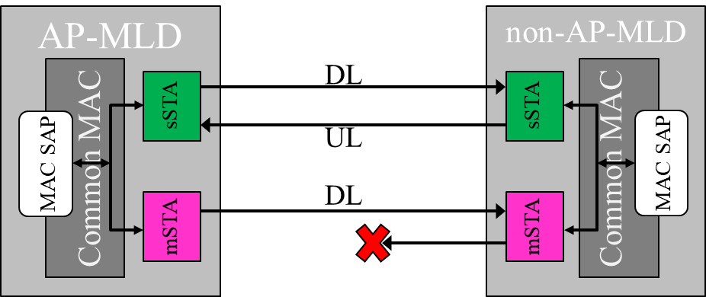
Future Work
Details of cross-link BA to support DL-only mode on NSA mmW link
DL-only mode capabilities indication, setup, transition in/out, termination procedures
Other MAC changes/recommendations needed to support DL-only mode
*MPE: Maximum Permissible Exposure

Slide 15
Recap and closing comments
PHY Problem
  mmWave UL will be severely limited and unreliable compared to mmWave DL
    PHY-centric solutions: E-ELR, Narrow band or DRU-like power-boasted UL
      But this is like driving a Ferrari on dirt road, just to go pickup your Amazon delivery
MAC Solution
  With minor enhancements, NSA mmWave can be used in DL-only direction (supplemental DL)

Slide 16
Conclusion
The third time’s the charm (ad, ay, bq)? Are we sure?
From previous attempts at mmWave, we’ve learnt that NSA (Non-StandAlone) is perhaps the key, as clearly captured in PAR
Now we better use this key to (at least) design a Minimum Viable System
  We need to use NSA to get around the limitations of mmWave UL, so that 11bq can be adopted for the mainstream use-case: data offload to mmWave to reduce congestion on Sub-7GHz link
*MPE: Maximum Permissible Exposure

Slide 17
Straw Poll
The Non-StandAlone operation defined in 11bq should also support a DL-only mode in mmWave.
  Yes, No, Abstain

Slide 18
References
[1] 15/0866r4, 11ay Evaluation Methodology
[2] 14/0882r4, 11ax Channel Model Document
[3] 3GPP TR 38.901, Study on channel model for frequencies from 0.5 to 100 GHz
[4] C95.1-2019 - IEEE Standard for Safety Levels with Respect to Human Exposure to Electric, Magnetic, and Electromagnetic Fields, 0 Hz to 300 GHz
[5] ICNIRP. Guidelines for limiting exposure to electromagnetic fields (100 kHz to 300 GHz). Health Phys 118(00):000–000; 2020
[6] FCC-19-126A1
[7] He et al., Implications of Incident Power Density Limits on Power and EIRP Levels of 5G Millimeter-Wave, IEEE Access, 2020
[8] 3GPP TS 38.321 (See MPE P-MPR in Power Headroom Report)
[9] 3GPP TR 38.840, Study on User Equipment (UE) power saving in NR
[10] Qualcomm Smart Transmit
[11] P802.11be/D7.0 [35.3.8 Block ack procedures in MLO]

