Slide 1
Further considerations for NPCA operation
Date: 2025-3-3
Authors:

Slide 2
Abstract
This document discusses our thoughts on several different aspects of NPCA operation.

Slide 3
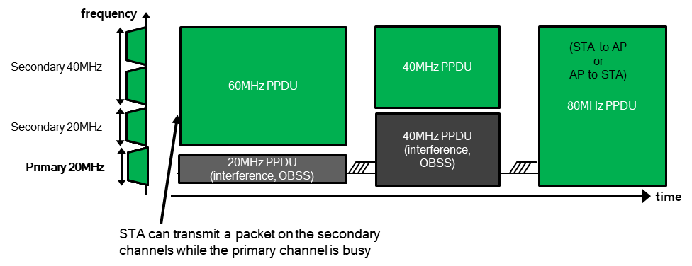
Non-primary Channel Access - Recap
Per baseline, if the primary channel (PCH) is busy due to an OBSS transmission, then no BSS transmissions are possible even if there is a secondary channel that is idle.
As a solution, non-primary channel access (NPCA) mechanism has been proposed [1-14].
In NPCA operation, NPCA AP defines an NPCA backup PCH.
If an OBSS transmission occupies the PCH of the AP, the AP and associated NPCA supporting non-AP STAs switch to the NPCA backup PCH for frame exchanges.
The frame exchanges are performed while treating that backup PCH as the temporary PCH. These exchanges may continue till either:
  The end of the PPDU duration set by the OBSS transmission on the PCH. We refer to this as PPDU duration based NPCA.
  The end of the NAV duration set by the OBSS transmission on PCH. We refer to this as NAV duration based NPCA.
The AP and non-AP STAs return to the PCH at the end of the duration.

Slide 4
NPCA open issues
Several issues with NPCA operation need to yet be resolved:
  How does NPCA behavior co-exist with the Spatial Reuse operation?
  How to prevent a non-AP STA with a large NPCA switch delay from degrading performance of NPCA operation?
  How to ensure that medium is reserved on NPCA PCH till a peer device completes the NPCA switch?
  Further details on a trigger-based and a non-trigger based operation on NPCA PCH are required.
Solutions to the aforementioned 4 issues are discussed in this proposal.

Slide 5
1. NPCA operation with Spatial Reuse
Problem 1: How does NPCA behavior co-exist with the Spatial Reuse operation?
If an AP enables spatial reuse mechanisms (OBSS-PD or PSR), then a legacy STA may initiate a TXOP with the AP, after the AP has triggered an NPCA switch due to an OBSS transmission.
  This can lead to wasteful transmissions on the primary channel, which can also potentially harm the OBSS transmissions.
Proposed solution: When a UHR AP enables NPCA operation it shall follow one of the following options:
  Option 1 (preferred): The AP shall disable Spatial reuse operation before enabling NPCA, by setting the PSR Disallowed subfield and Non-SRG OBSS PD SR Disallowed subfield of the SR Control field of the Spatial Reuse Parameter Set element transmitted by the AP to 1.
  Option 2: If the AP continues to allow spatial reuse operation in its BSS, NPCA shall be triggered only if the received OBSS transmission is a HE+ PPDU that disallows spatial reuse, as indicated in the Spatial Reuse fields(s) of the SIG A field of the PPDU.

Slide 6
2. Indicating maximum NPCA switch delay
Problem 2: Prevent a large NPCA switch delay from degrading NPCA performance?
After observing an NPCA trigger condition, NPCA AP may switch to the NPCA primary channel (PCH) and poll the NPCA STAs to determine their availability.
  Note: The polling has to be performed after all the intended non-AP STAs have performed the NPCA switch.
Non-AP STAs requiring a large NPCA switch delay lead to wastage of resources and reduced channel access opportunity on NPCA PCH.
  Note: If it is unclear if the AP will poll such an non-AP STA or not, there is little incentive for the non-AP STA to participate in NPCA.
Proposed solution:
  An AP when enabling NPCA operation shall indicate in the NPCA Parameters the Maximum NPCA Switch Delay for which it will defer polling after performing NPCA switch.
  A non-AP STA with a longer NPCA switch delay either: (i) shall not participate in NPCA operation or (ii) is not expected to be triggered/polled by the AP in the first frame exchange after performing the switch to NPCA PCH.
    In other words, the Maximum NPCA Switch Delay is informational for the non-AP STA to help determine if it should participate in NPCA operation.
  Note: The AP may still serve NPCA STAs with a longer NPCA Switch Delay, but later within the TXOP.
AP’s NPCA Switch Delay
Max{NPCA Switch Delay of intended recipients}
Polling Control frame
NPCA switch trigger time

Slide 7
3. Medium reservation on NPCA PCH (1/3)
Problem 3: How to ensure that medium is reserved on NPCA PCH till a peer device completes the NPCA switch?
After observing an NPCA trigger condition, NPCA STA 1 may transmit an initial control frame (ICF) to peer NPCA STAs to initiate transmission with it.
  Note: The ICF has to be transmitted after the intended recipient(s) have performed the NPCA switch.
Waiting till all the intended recipient(s) have performed NPCA switch to start channel contention can lead to low probability of winning channel access.
Max{NPCA Switch Delay of intended recipients}
STA1’s NPCA Switch Delay
Initial Control frame
NPCA switch trigger time
Contention

Slide 8
3. Medium reservation on NPCA PCH (2/3)
Proposed solution:
  Define a new Action No ACK frame called Padding frame that carries padding bits and is included in a PPDU for reserving medium time.
  The TA and RA of the MAC header can be set to the transmitting STA.
  The Duration field is set to 0.
  The frame body can have: (i) a Control field to indicate presence of optional fields, (ii) a NAV Duration field to indicate the NAV duration of the whole TXOP and (iii) a Padding field.
  The frame shall always be transmitted at a fixed MCS, and the length of the frame body/padding is determined by this MCS value and the required deferral duration.
  The frame shall not solicit an acknowledgement.
MAC Header | Frame Body | FCS
Order | Information
1 | Category
2 | UHR Action
3 | Control
4 | NAV Duration
5 | Padding

Slide 9
3. Medium reservation on NPCA PCH (3/3)
Proposed solution (continued):
  STA1 after performing NPCA switch and winning channel access on NPCA PCH, can transmit the Padding frame till all the intended recipients of the Initial Control frame have completed their NPCA switch.
  The frame may be transmitted in a non-HT duplicate PPDU format on all the sub-channels of the TXOP and is sent at a fixed MCS, e.g., 6Mbps.
The Padding frame can also be used in other mechanisms like Coexistence, DPS, DSO, etc., for either (see Backup slides):
  Medium reservation for deferred channel access to a peer STA, or
  Medium protection to prevent loss of medium synchronization at a peer STA.
Max{NPCA Switch Delay of intended recipients}
STA1’s NPCA Switch Delay
Padding frame
SIFS
Initial Control frame
NPCA switch trigger time
Contention

Slide 10
4. NPCA channel access for TB only mode (1/2)
Problem 4: Further details on a trigger-based NPCA operation on NPCA PCH are required.
Option 1:
  Only the NPCA AP performs channel contention, after NPCA switch and any applicable channel access defer interval.
  After winning channel access, the AP may transmit (sequentially):
    a padding frame to protect medium till a required duration (if applicable), and
    transmit an initial control frame to NPCA STAs.
Max{NPCA Switch Delay of intended recipients}
Trigger based frame exchange
AP’s NPCA Switch Delay
Padding frame
SIFS
ICF
NPCA switch trigger time
Contention
ICR

Slide 11
4. NPCA channel access for TB only mode (2/2)
Option 2:
  Each NPCA STA after performing NPCA switch, may perform channel contention, after any applicable channel access defer interval.
  If AP wins contention, the AP may transmit (sequentially):
    a padding frame to protect medium till a required duration (if applicable), and
    an initial control frame to NPCA STAs.
  If a non-AP STA wins channel access, the non-AP STA shall transmit (sequentially):
    a padding frame till the AP has completed the NPCA switch (if applicable), and
    an MU-RTS TXS trigger frame to share the TXOP with the AP. (needs spec changes)
    Note: It is TBD if a separate ICF-ICR exchange is required with the before the MU-RTS TXS transmission.
    The AP shall allocate resources to the non-AP STA which won and shared the TXOP with the AP.
Preference: We prefer Option 2 since it significantly boosts the chance of winning channel contention. Also non-AP STA has some guarantee of being served if it wins TXOP.
AP’s NPCA Switch Delay
AP owns the TXOP and performs trigger based frame exchange
Non-AP STA’s NPCA Switch Delay
CTS
Contention
Padding frame
SIFS
MU-RTS TXS
NPCA switch trigger time

Slide 12
4. NPCA channel access for non-TB mode
Problem 4: Further details on non-trigger based NPCA operation on NPCA PCH are required.
Each NPCA STA after performing NPCA switch, may perform channel contention, after any applicable channel access defer interval.
If AP wins contention, the AP may transmit (sequentially)
  a padding frame to protect medium till a required duration (if applicable), and
  an initial control frame to NPCA STAs.
If a non-AP STA wins channel access, the non-AP STA shall transmit (sequentially):
  a padding frame till the AP has completed the NPCA switch (if applicable), and
  transmit an initial control frame to the AP
  transmit uplink data to the AP.
Max{NPCA Switch Delay of intended recipients}
Downlink frame exchange
AP’s NPCA Switch Delay
Padding frame
SIFS
ICF
NPCA switch trigger time
Contention
ICR
AP’s NPCA Switch Delay
Uplink frame exchange
Non-AP STA’s NPCA Switch Delay
ICR
Contention
Padding frame
SIFS
ICF
NPCA switch trigger time

Slide 13
Conclusions
The interaction of NPCA and baseline Spatial Reuse has to be clarified.
  Spatial reuse methods (PSR, OBSS-PD) shall be disabled when NPCA is used, or
  NPCA is only performed on PPDUs that disallow spatial reuse over them.
  First option is preferred since it is simpler, and chance of NPCA use is higher.
AP after performing NPCA switch may not wait for too long to poll the available non-AP STAs on the NPCA PCH. This may cause NPCA STAs with long switch delay to waste power by switching.
  AP should the maximum defer time for Polling, which can help a non-AP STA to make an informed decision to perform NCPA switch or not.
The spec should define a new Padding frame, which can be transmitted by a NPCA STA after performing NPCA switch, to reserve the medium till the peer NPCA STA is expected to be available.
  The Padding frame can also be used for other features like Coexistence, DPS, DSO etc.
In TB NPCA mode we can have two options:
  Only the AP performs channel contention.
  Non-AP STAs can also perform contention but are required to perform immediate TXOP sharing with the AP.
  Second option is preferred, since (i) it increases chance of winning channel access, and (ii) it gives the non-AP STA an incentive to perform NPCA switch in TB NPCA mode.

Slide 14
Straw poll - 1
Do you agree that a UHR AP operating in NPCA mode shall disable PSR and OBSS-PD within its BSS by setting the PSR Disallowed subfield and Non-SRG OBSS PD SR Disallowed subfield of the SR Control field of the Spatial Reuse Parameter Set element transmitted by the AP to 1?
  Yes
  No
  Abstain

Slide 15
Straw poll - 2
Do you agree that a UHR AP operating in NPCA mode shall indicate the maximum NPCA Switch Delay for which it may defer transmission of the initial control frame on the NPCA primary channel?
Note: The provided indication is to aid a non-AP STA to make an informed decision regarding participating in NPCA operation.
  Yes
  No
  Abstain

Slide 16
Straw poll - 3
Do you agree to define in 802.11bn a Padding frame that is intended for transmission by a STA to occupy medium time within a TXOP?
  The format of the Padding frame, and UHR features for which it can be used are TBD.
  Note: The Padding frame can be used for deferred transmission to a peer STA or preventing loss of medium synchronization at a peer STA.
  Yes
  No
  Abstain

Slide 17
Straw poll - 4
Do you agree to allow a NPCA non-AP STA to contend for channel access on the NPCA PCH in trigger-based NPCA mode?
  A non-AP STA which wins channel contention is expected to share the TXOP immediately to the NPCA AP.
  The AP shall allocate resources to the non-AP STA within the shared TXOP.
  Yes
  No
  Abstain

Slide 18
References
11-23/1288r0 Non-primary channel utilization - follow-up (Sindhu Verma, Broadcom)
11-23/2005r1 Non-primary channel access (NPCA) (Minyoung Park, Intel)
11-24/0070r2 Some details about non-primary channel access (Yunbo Li, Huawei)
11-24/0426r0 EDCA for Non-Primary Channel Access (Dongju Cha, LGE)
11-24/0427r0 Enabling Non-Primary Channel Access (Dongju Cha, LGE)
11-24/0458r2 Considerations on Non-Primary Channel Access (Salvatore Talarico, Sony)
11-24/0496r1 Secondary Channel Usage Follow Up (Liwen Chu, NXP)
11-24/0498r0 Non-Primary Channel Access (NPCA) – Follow Up (Minyoung Park, Intel)
11-24/1115r1 Channel switching rules for NPCA (Vishnu Ratnam, Samsung)
11-24/1762r23 PDT-MAC-NPCA (Matthew Fischer, Broadcom)
11-24/1853r1 Channel access for NPCA operation (Serhat Erkucuk, Ofinno)
11-24/1891r2 NPCA follow up (Liwen Chu, NXP)
11-24/2092r0 Considerations on NPCA Follow Up (Maolin Zhang, Huawei)
11-25/1104r5 Some details on NPCA (Seongho Byeon, Samsung)

Slide 19
Backup slides

Slide 20


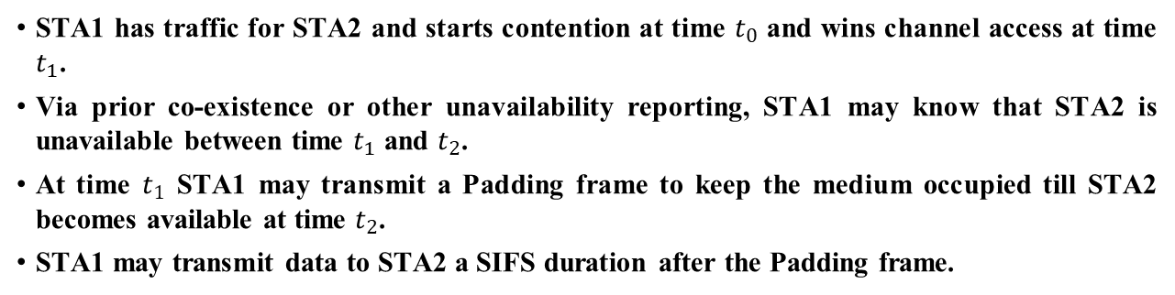


Use of Padding frame for Coexistence
STA1 has traffic for STA2 and starts contention at time $t_{0}$ and wins channel access at time $t_{1}$.
Via prior co-existence or other unavailability reporting, STA1 may know that STA2 is unavailable between time $t_{1}$ and $t_{2}$.
At time $t_{1}$ STA1 may transmit a Padding frame to keep the medium occupied till STA2 becomes available at time $t_{2}$.
STA1 may transmit data to STA2 a SIFS duration after the Padding frame.
STA 1 initiates contention
STA 1 wins channel access
STA 2 available
Padding frame
STA 1
Time
STA 2
STA 2 unavailable
Time
Medium Busy
$$t_{1}$$
$$t_{2}$$

Slide 21

Use of Padding frame for DPS - uplink
A non-AP STA (STA 1) initiates transmission with a mobile AP (STA 2) operating in DPS mode with a DPS ICF.
At the end of the frame exchange, after sending the acknowledgement to STA 1, STA 2 transitions back to the low power state.
  This can lead to loss of frame exchanges and/or loss of medium synchronization at the mobile AP (STA 2).
To ensure that STA 2 does not lose medium synchronization, a SIFS duration after receiving the acknowledgement from STA 2, STA 1 may transmit a Padding frame to keep the medium occupied while the second STA performs the transition to the low power state.
SIFS
STA 2 available
DPS ICF
Padding frame
STA 1
Time
DPS ICR
Time
STA 2
(DPS)
STA 2 unavailable
STA 2 Low power state
STA 2 High power state
STA 2 Low power state
$$t_{1}$$
$$t_{2}$$

Slide 22


Use of Padding frame for DPS - downlink
A non-AP STA (STA 1) receives downlink traffic from a mobile AP (STA 2) operating in DPS mode in the high power state.
At the end of the frame exchange, after receiving the acknowledgement from STA 1, STA 2 transitions back to the low power state.
  This can lead to loss of frame exchanges and/or loss of medium synchronization at the mobile AP (STA 2).
To ensure that STA 2 does not lose medium synchronization, a SIFS duration after transmitting the acknowledgement to STA 2, STA 1 may transmit a Padding frame to keep the medium occupied while STA 2 performs the transition to the low power state.
SIFS
STA 2 available
Padding frame
STA 1
Time
Time
STA 2
(DPS)
STA 2 unavailable
STA 2 High power state
STA 2 Low power state
$$t_{1}$$
$$t_{2}$$

