Slide 1
802.11 Working Group Opening Report
May 2025
Authors:
Date: 2025-05-11

Slide 2
Introduction
This presentation, together with the reports cited herein, forms the opening report of the IEEE 802.11 Working Group for May 2025
“Mx.y.z” in slide title references agenda item

Slide 3


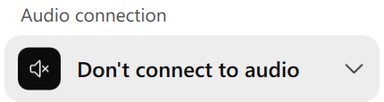


M1.3 Meeting Decorum
Please observe proper decorum in meetings
No photography or recording
Press (i.e., anyone reporting publicly on this meeting) must announce their presence
In-person attendees:
  Laptop / tablet speakers and cell phone ringers off
  Join Webex using the “Don’t connect to audio” option
  Wear your badge in the meeting areas (helps hotel staff improve the general security)
Remote attendees must mute when not speaking
All attendees use Webex chat to enter the queue to speak

Slide 4
M2.2.1 Summary of Liaisons
Liaison from ITU-T SG15 on Recommendation of G.9949, formerly named G.wmci (WLAN management control interface - WMCI)
Conveys wireless coordination information to control the Wi-Fi AP
Starts “Last Call” for comments
ITU-T Q3/15 looks forward to any comments from the IEEE 802.11 on the coordination of Wi-Fi access points over wired (fibre) backhaul
Liaisons website, see https://grouper.ieee.org/groups/802/11/Liaisons/Liaisons-and-External-Communications.html

Slide 5
M2.3 Recent and anticipated 802 LMSC actions
March 2025
P802.11bf and P802.11bk (conditional) to RevCom
P802.11br PAR to NesCom
July 2025
P802.11bi PAR extension

Slide 6
M2.3 IEEE SA Standards Board (SASB)
March 24-28, 2025 – NesCom/RevCom/SASB (Feb 15, 2025, submission deadline)
P802.11br PAR
May 7, 2025, NesCom/RevCom telecon (Mar 28, 2025, submission deadline)
P802.11bk and P802.11bf
Both recommended for approval; awaiting SASB ballot result
June 16-20, 2025, NesCom/RevCom/SASB (May 9, 2025, submission deadline)
Nothing
September 8-10, 2025 – NesCom/RevCom/SASB (July 31, 2025, submission deadline)
P802.11bi PAR extension

Slide 7
M3.1 802.11 Working Group Session Documents
WG Session Reports
WG Agenda | https://mentor.ieee.org/802.11/dcn/25/11-25-0593
Opening report | https://mentor.ieee.org/802.11/dcn/25/11-25-0594
Snapshot slides | https://mentor.ieee.org/802.11/dcn/25/11-25-0560
1st vice chair | https://mentor.ieee.org/802.11/dcn/25/11-25-0006
2nd vice chair | https://mentor.ieee.org/802.11/dcn/25/11-25-0562
Treasurer | https://mentor.ieee.org/802-ec/dcn/25/ec-25-0001
Chair's Supplementary Material | https://mentor.ieee.org/802.11/dcn/25/11-25-0595
Motions | https://mentor.ieee.org/802.11/dcn/25/11-25-0559
Session report | https://mentor.ieee.org/802.11/dcn/25/11-25-0561
Previous Session Minutes | https://mentor.ieee.org/802.11/dcn/25/11-25-0229

Slide 8
M3.2 Joint meetings and Reciprocal Credit
Attendance at the May 2025 session DOES count toward maintaining 802.11 voting rights. Attending 13 timeslots achieves the 75% threshold for a “qualifying attendance”.
If you are an 802.11 voter and a voter in one of the following groups, then you will receive reciprocal attendance credit
  802.18, 802.19, 802.24, 802.1, and 802 JTC1 SC
If you attend an 802.11 meeting you will receive credit in the other group, and if you attend a meeting in the other group, you will receive 802.11 credit
  For 802.18, this only applies to the timeslots when 802.18 meets
  For the other groups, any timeslot gives reciprocal credit

Slide 9
M3.2 802.18 (Radio Regulatory TAG) details
See https://www.ieee802.org/18/
Meeting times: Tuesday AM2, Thursday AM1
Agenda
  Review and approve draft responses to the following consultations:
    Iraqi CMC: Draft regulation on Short Range Devices (SRD) and UWB
    South Africa ICASA: Draft regulations on dynamic spectrum access and opportunistic spectrum management in the innovation spectrum 3800-4200 MHz and 5925-6425 MHz
    South Africa ICASA: National radio frequency plan 2025 (NRFP)
  Discuss the latest topics related to spectrum and regulation in Europe, North America, and Asia Pacific, including ETSI BRAN May 2025 update.
  Invited presentation: Dr. Steve Leach (Principal Spectrum Engineer, Ofcom)
    Moving forward with 6 GHz band for commercial mobile and Wi-Fi services: update on UK and CEPT progress

Slide 10
M3.2 802.19 (Wireless Coexistence WG) details
See https://www.ieee802.org/19/
Meeting times: Monday PM2 and Thursday 6:30pm
Agenda

Slide 11
M3.2 Other 802 WG meetings
IEEE 802 website: https://www.ieee802.org/
  Includes links to all WG webpages
Consolidated calendar: https://ieee802.org/802tele_calendar.html
Documents: 802.11, 15, 18, 19, 24: https://mentor.ieee.org/802/bp/StartPage

Slide 12
M4.1.1 IEEE 802.11 Groups
Type | Group | WG & Infrastructure
WG | WG11 | The IEEE 802.11 Working Group
SC | ARC | Architecture
SC | COEX | Coexistence
SC | PAR | PAR review
802 SC | JTC1 | ISO/IEC JTC1/SC6
Type | Group | Amendments/Revision
TG | BF | WLAN Sensing
TG | BI | Enhanced Data Privacy Protection (EDP)
TG | BK | 320 MHz Positioning
TG | BN | Ultra High Reliability (UHR)
TG | BP | Ambient Power (AMP)
TG | BQ | Integrated mmWave (IMMW)
TG | BR | Enhanced Light Communications (ELC)
TG | MF | Revision (REVmf)
Type | Group | New Work
SC | WNG | Wireless Next Generation
SC | AIML | AI/ML in 802.11
SG | PQC | Post Quantum Cryptography
TIG | AUTO | Automotive

Slide 13
M4.1.2 PAR Expiration/Renewal Schedule
Project | PAR Expiration Date
P802.11 (REVmf) | 31 Dec 2028
P802.11bf | 31 Dec 2026
P802.11bi | 31 Dec 2025 – extend in July
P802.11bk | 31 Dec 2026
P802.11bn | 31 Dec 2027
P802.11bp | 31 Dec 2028
P802.11bq | 31 Dec 2028
http://www.ieee802.org/11/PARs/index.html

Slide 14
M4.1.3 802.11 WG Appointed positions
WG Secretary –Volker Jungnickel
Treasurer – Jon Rosdahl
ANA – Carol Ansley
WG Technical Editor – Emily Qi

Slide 15
M4.1.3 Officers
Cat | Group | Chair | Vice Chair | Technical Editor | Secretary
WG |  | Robert Stacey | Jon Rosdahl, Stephen McCann | Emily Qi | Volker Jungnickel
SC | ARC | Mark Hamilton | Joseph Levy |  | Joseph Levy
SC | Coex | Marc Emmelmann | Sebastian Max, Manish Kumar |  | Guido Hiertz
SC | PAR | Jon Rosdahl | Michael Montemurro |  | Michael Montemurro
SC | WNG | Jim Lansford | Lei Wang |  | Lei ang
SC | AIML | Xiaofei Wang | Ming Gan, Gaurang Naik |  | Liangxiao Xin
TG | MF | Michael Montemurro | Mark Hamilton, Mark Rison | Po-Kai Huang, Edward Au | Jon Rosdahl
TG | BF | Tony Xiao Han | Sang Kim, Assaf Kasher | Claudio Da Silva | Leif Wilhelmsson
TG | BI | Carol Ansley | Jerome Henry, Antonio de la Oliva | Po-Kai Huang | Stephane Baron
TG | BK | Jonathan Segev | Ali Raissinia, Assaf Kasher | Roy Want | Dibakar Das
TG | BN | Alfred Asterjadhi | Laurent Cariou, Jianhan Liu, Kiseon Ryu | Ross Jian Yu | Yusuke Asai
TG | BP | Bo Sun | Steve Shellhammer, Rakesh Taori | Yinan Qi | Sebastian Max
TG | BQ | Edward Au | Abhishek Patil, Sang Gook Kim, Rui Cao |  | Jonghoe Koo
TG | BR | Nikola Serafimovski |  |  | Mohamed Islim
SG | PQC | Stephen Orr
TIG | AUTO | Jim Lansford | Azin Neishaboori, Jing Ma | Carol Ansley
New since last session

Slide 16
M4.1.4 IEEE 802.11 Revisions
802.11-1997
802.11-1999
802.11-2003
802.11-2007
802.11-2012
802.11-2016
802.11-2020
802.11-2024
11d
Intl Roaming
11e
QoS
11k
RRM
11s
Mesh
11aa
Video Transport
11aq
Pre-association Discovery
11bc
Broadcast Services
MAC
11h
DFS & TPC
11u
WIEN
11v
WNM
11ae
QoS Mgt Frames
11ak
General Link
11i
Security
11z
TDLS
11r
Fast Roam
11ai
Fast Initial Link Setup
11ax
High Efficiency WLAN
11f
Inter AP
11w
Management Frame Security
11ay
Enhanced mmWave
11az
Enhanced Positioning
11n
High Throughput (>100 Mb/s)
11af
TV Whitespace
PHY & MAC
11ba
Wake-up Radio
11a
OFDM
54 Mb/s in 5 GHz
11g
54 Mb/s in 2.4 GHz
11ac
VHT
> 1 Gb/s in 5 GHz
11p
WAVE
11ah
Sub-1 GHz
11bb
Light Communications
11b
HR/DSSS
11 Mb/s in 2.4 GHz
11j
JP bands
11y
Contention Based Protocol
11ad
VHT
> 1 Gb/s in 60 GHz
11aj
China mmWave
11bd
Next Gen V2X
Notes:
doc.: IEEE 802.11-11/0483r0
May 2011
Bruce Kraemer (Marvell)
Page 16

Slide 17
M4.1.4 IEEE 802.11 Standards Pipeline
802.11
-2024
AUTO TIG
802.11bi
EDP
802.11bh
RCM
MAC
WNG
PQC SG
802.11bn
UHR
802.11bk
320 MHz Pos
802.11be
EHT
MAC & PHY
802.11bp
AMP
802.11bf
SENS
802.11bq
IMMW
802.11br
ELC
REVmf
Liaison Topics
Discussion Topics
TIG/Study
groups
TG without
Approved draft
WG
Letter Ballot
SA
Ballot
Published
Amendment
Published
Standard
Notes:
doc.: IEEE 802.11-11/0483r0
May 2011
Bruce Kraemer (Marvell)
Page 17

Slide 18
M4.1.5 Summary of ballots and comment collections
Type | Label | Group | Opened (mm-dd) | Dur (d) | # Comments | Ballot Group | Approve | Disapprove | Abstain | Return % | Approve % | Result
T | SA Recirc 2 | TGbk | 03-10 | 10 | 3 | 150 | 126 | 2 | 4 | 84 | 98 | Pass
T | SA recirc 4 | TGbf | 03-25 | 10 | 0 | 162 | 129 | 2 | 2 | 82 | 98 | Pass
Both conditionally approved by 802 LMSC to forward to RevCom
On completing these ballots, both met conditions
Recommended for approval by RevCom on May 7 telecon
Awaiting SASB ballot

Slide 19
M4.1.6 Current Membership Status
Updated following March session
Status | Number
Aspirant | 103
Potential Voter | 31
Voter | 677
Ex Officio Voter | 9
Definitions:
  Aspirant: a member who has attended 1 qualifying meeting
  Potential Voter: a member who has attended 2 qualifying meetings and will become a voter at the start of the next plenary they attend
  Ex Officio Voter: a voter who has voting rights by virtue of their membership of the 802 EC and has requested to be recorded as an ex officio voter in 802.11

Slide 21
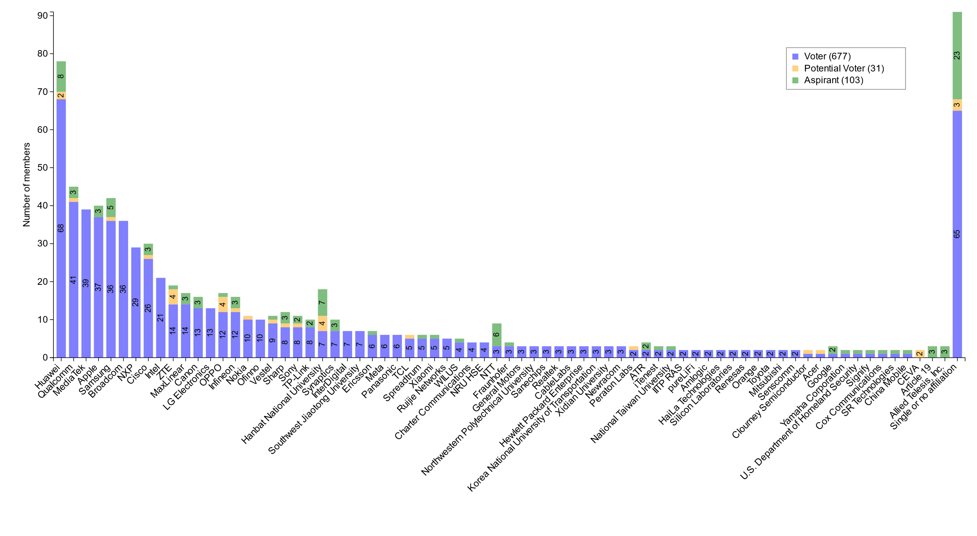
M4.1.7 Members by affiliation

Slide 22
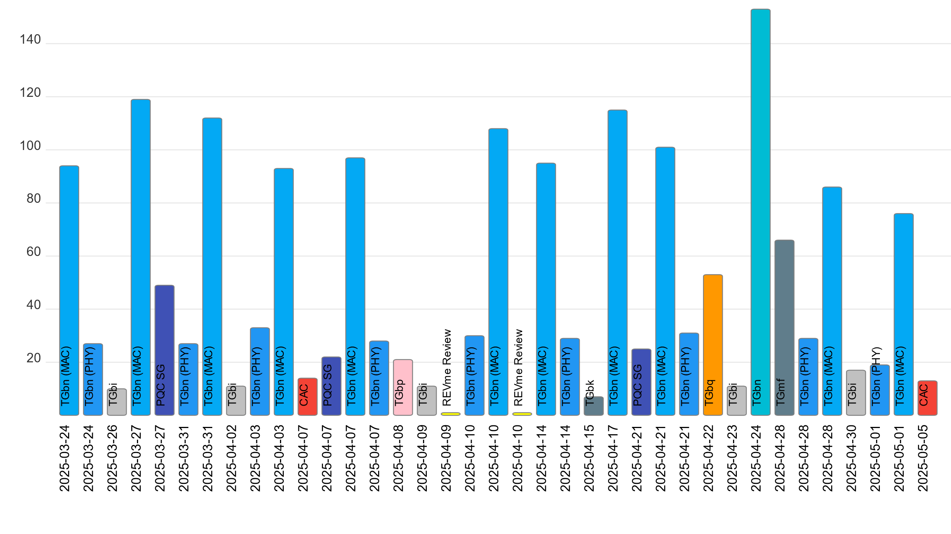
M4.1.7 Telecon attendance (January to March)

Slide 23
M6.1 Announcements: 2025 May Designation of Individual experts
Individual experts who attend electronically for a specific purpose/presentation can be designated as such by the WG Chair and receive a registration fee waiver and limited attendance rights.
See section 5 in https://mentor.ieee.org/802-ec/dcn/17/ec-17-0090-25-0PNP-ieee-802-lmsc-operations-manual.pdf ,
  The Working Group Chair may designate specific individual experts who are allowed to participate in Working Group discussions via electronic means during an in-person meeting for the benefit of the group. These individuals are not considered to be attending the meeting and so they are not required to pay meeting fees and they do not get participation credit. The participation of these individuals should be limited to specific technical topics. Such participation shall be documented in the minutes of the Working Group meeting.
The individuals listed below are hereby designated as specific individual experts on their respective topics and subject to the restrictions and benefits described in the 802 OM.
  Emily Qi, Self, Editors
  Mathy Vanhoef, KU Leuven, TGmf
For WNG, attendance for each is limited to the WNG timeslot in which the respective presentation is scheduled.

Slide 24
M6.1 Announcements: Liaise 802.11 to ISO/IEC JTC1
802.11 standards are currently stalled in the ISO/IEC JTC1 process
Try to reset the process by liaising:
  IEEE Std 802.11-2024
  IEEE Std 802.11bh-2024
  IEEE Std 802.11be-2024
This set represents the complete current standard
Need WG and 802 LMSC approval
  Plan to run liaison motion on Friday

Slide 25
M6.1 Announcements: 802.11 Calendar in Outlook
Many of you use the Microsoft Outlook calendar
It is possible to synchronize the 802.11 calendar with Outlook
  Instructions here: See your Google Calendar in Outlook
However, historically there has been a problem with the size of the public iCal file for our calendar
To reduce the size of this file, use a start-min parameter:
https://calendar.google.com/calendar/ical/802.11calendar%40gmail.com/public/basic.ics?start-min=2025-01-01
This limits updates to events occurring after 2025-01-01
If you have had this problem in the past, try using the above link.
I have also added this link to our web page

Slide 26

M6.1 Announcements: IEEE SA Awards

Slide 27
Additional Reference material

Slide 28
Comment Resolution Resources
Comment resolution resources
  See https://mentor.ieee.org/802.11/dcn/13/11-13-0230-05-0000-comment-resolution-tutorial.ppt
  See https://mentor.ieee.org/802.11/dcn/11/11-11-1625-02-0000-comment-resolution-guide.doc
There are many examples of good practice for documentation of comment analysis and resolution; ensures there is a record of comment consideration and agreed resolution
  https://mentor.ieee.org/802.11/dcn/18/11-18-0237-00-000m-cid-177.docx
  https://mentor.ieee.org/802.11/dcn/18/11-18-0930-00-000m-cid-1007.docx
  https://mentor.ieee.org/802.11/dcn/18/11-18-0669-04-000m-revmd-mac-comments-assigned-to-hamilton.docx
  https://mentor.ieee.org/802.11/dcn/18/11-18-1410-00-00ax-lb233-cr-spatial-reuse.docx

Slide 29
Motion and other templates
WG11 templates
  Motions: see https://mentor.ieee.org/802.11/dcn/22/11-22-1967-01-0000-working-group-motions-templates.pptx
  Liaison: see https://grouper.ieee.org/groups/802/11/Rules/2018-03 Liaison submission template.docx
802 LMSC templates
  Motions: https://mentor.ieee.org/802-ec/dcn/16/ec-16-0170-04-00EC-802-ec-motion-template.pptx
  CSD: https://mentor.ieee.org/802-ec/dcn/18/ec-18-0064-01-0PNP-csd-template-in-doc-format.doc
  Liaison: https://mentor.ieee.org/802-ec/dcn/17/ec-17-0012-01-00EC-802-liaison-template.docx

