Slide 1
Service Period based Dynamic Subchannel Operation (SP-based DSO)
Date: 2025-04-03
Name | Affiliations | Address | Phone | email
Seongho Byeon | Samsung Electronics |  |  | sh.byeon@samsung.com
Jack Jonghyo Lee
Jaheon Gu
Jennifer Jihye Lee
Jinho Choi
Jonghoe Koo
Jungjun Kim
Suhwook Kim
Taeyoung Ha

Slide 2
Introduction
One of main objectives for UHR PAR
At least one mode of operation capable of improving efficient use of the medium
Many Wi-Fi STAs do not support the full bandwidth option supported by the AP
While APs may support up to 320 MHz, STAs may support only 80 MHz or 160 MHz
Large portions of the operational bandwidth go underutilized, leading to poor spectral efficiency
[RECAP] Dynamic Subchannel Operation (DSO) discussed in TGbn
An AP can dynamically allocate different parts of subchannels within its operating bandwidth to non-AP STAs depending on their operating bandwidth capabilities, channel conditions and QoS requirements within a TXOP [1-6]

Slide 3
Some Thoughts on DSO
Operating bandwidth switching overhead [8]
Expected padding delay required for DSO STAs
Low capable STAs have the switching (back) delay of up to 256 𝜇s or more
In multi-user transmission, the required padding may be the largest among all the DSO STAs served
Some thoughts on TXOP-based DSO
Discomforts for obtaining high efficiency
Further usage of resources
Intermediate-FCS and/or extra padding is required for the DSO ICF
Additional efforts are needed to increase the ICR reception success rate in the DSO subchannel
Switching back delay at the end of TXOP for DSO STA moving its radio back on the primary channel
Additional power consumption of DSO STAs is expected due to operating bandwidth switching
Difficulty of fitting UL Target Received Power and CFO requirement [5]
Due to the aperiodic operating bandwidth change of DSO STA, the complexity of channel estimation (i.e., MCS selection), MIMO operation (i.e., lack of sounding reference) or interference management increases
If there is hidden interference outside the operating bandwidth of DSO STAs, a race condition may occur within the TXOP

Slide 4
Concept of Service Period (SP) based DSO
Add HE SST functionality to R-TWT using DSO rules ➔ SP-based DSO
Each STA completes the operating bandwidth switching by the start point of the R-TWT SP (NOTE: Nothing changes for the STAs which have 160 MHz operating bandwidth)
Trigger frame (BSRP or MU-RTS) can be used to confirm 1) the awake status of associated STAs and 2) the subchannel on which the STAs is parking
Trigger-enabled Broadcast R-TWT SP
S160
Broadcast TWT 1
Basic
TF
M-STABA
DL MU
PPDU
Basic
TF
M-STA BA
AP (320 MHz)
P160
Beacon
Broadcast TWT IE
DSO STA1 AID 8 (160 MHz)
S160
TB PPDU
doze
PS-P
BA
P160
After receiving the Broadcast R-TWT IE, STA1 finishes transitioning to the awake state exactly when the service period arrives and completes changing the operating bandwidth to S160
At the end of the SP, STA1 transitions to the doze state (or to the primary subchannel). For the next TBTT and corresponding awake state, it may configure the operating bandwidth set as P160 to receive Beacon
DSO STA2 AID 9
(160 MHz)
S160
doze
P160
TB PPDU
QoS N
BA

Slide 5
Further Details of SP-based DSO
AP operates DSO within its R-TWT SP:
Example of configuration of DSO information subfield
DSO subchannel pool
DSO on/off notification per R-TWT SP
DSO subchannel scheduling info.
…
STA can switch its operating bandwidth to one of the DSO subchannels
Opt. 1) Each DSO STA can move to a randomly selected subchannel among candidates in the subchannel pool (i.e., one of 80 MHz DSO subchannel within 320 MHz) announced by the DSO Info field, when it has uplink BU
Opt.2 ) AP can assign subchannel(s) individually to each DSO STA
(Re)association response, probe response, or (unsolicited) TWT response frame
Broadcast TWT Parameter Set field format (individually assigned subfield for DSO scheduling)
Request Type
Target Wake Time
Nominal Minimum TWT Wake Duration
TWT Wake Interval Mantissa
Broadcast TWT Info
Restricted TWT Traffic Info (optional)
DSO Info (optional)
Octets:
2
2
2
2
2
0 or 3
0 or n
Extension of Figure 9-790 -- Broadcast TWT Parameter Set field format

Slide 6
Further Details of SP-based DSO
Advantages of SP-based DSO
Through an increase in the efficiency of bandwidth utilization, the quality of service (QoS) requirements for R-TWT members can be more easily achieved without imposing any additional overhead
Since STAs finish setting up the operating bandwidth at the start point of the SP, there is no waste of resources caused by the switching delay within the TXOP
Similarly, when the STA transitions from the doze state to the awake state, it sets up the operating bandwidth to be used during the SP, so that no additional power consumption due to frequent changes in the operating bandwidth does occur
DSO can be effectively managed with just a few necessary pieces of information field added to the R-TWT framework, thus minimizing the amount of signaling overhead required
E.g., 2 bytes for AID12 + DSO Subband allocation
At the beginning of the SP, the operating bandwidth switch has been completed, making it possible to achieve calibration easily, using a single ICF like the MU-RTS or BSRP/Basic Trigger frames
Especially good combination w/ the trigger-based TXOP
Easy to check normal DSO operation and awake state simultaneously

Slide 7
Conclusion
In this presentation, we propose a Service Period based Dynamic Subchannel Operation (SP-based DSO), harnessing the combined potential of HE SST and R-TWT
This allows the AP to provide a simpler and easier way to improve the efficient use of medium, reducing the burden on DSO STAs
The proposed SP-based DSO can coexist independently with DSO operating on a TXOP basis

Slide 8
Q&A
What is the difference between 11ax SST?
HE subchannel selective transmission (SST) operation is defined on individual TWTs. Therefore, there are many constraints in the real-world because the service period (SP) is not protected within the BSS. In addition, channel is assigned in units of 20 MHz using a bitmap, and there may be difficulties in scheduling multiple 20 MHz support or subchannel selection.
However, SP-based DSO operates on R-TWT. Therefore, it can be protected within the BSS when the SP starts, and if it follows the rule of Co-RTWT, it can also protect the DSO SP from neighboring BSSs. In addition, channel is assigned on the top of DSO subchannel rule, so that channel allocation becomes easier to solve.
Most importantly, individual TWT supports a single STA, but (although grouping is possible, it is complex) SP-based DSO operates on broadcast TWT w/ multiple members, so it is easy for the AP to use full bandwidth.

Slide 9
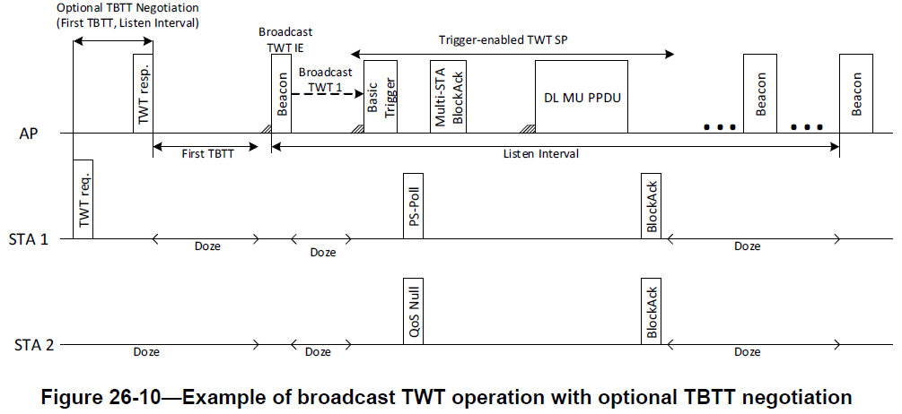
Q&A
When the DSO SP starts, isn't there a possibility that the DSO STA operating on the secondary channel will miss the synch of the primary channel?
If the SP is not set as Trigger-enabled, it may be advantageous for the DSO STA with a frame to send an uplink to stay on the primary channel rather than the DSO subchannel when the DSO SP starts.
However, considering that R-TWT is basically a Trigger-enabled TWT; An R-TWT scheduling AP should set the Trigger field to 1 in the Restricted TWT Parameter Set field(s) it transmits. (IEEE P802.11be/D7.0, 35.8 Restricted TWT); from this perspective, there is no concern about synch loss because the DSO STA begins data exchange by the trigger frame reception sent by the DSO AP, whether it is on the primary channel or the DSO subchannel, when the SP starts.
In other words, the DSO AP should send a Basic Trigger frame or a BSRP Trigger frame to verify the awake state of the STAs (and DSO subchannel where the DSO STAs stay). In this process, the DSO AP can easily use full bandwidth and DSO ICF does not require to add i-fcs and padding.

Slide 10
Q&A
When the DSO SP starts, isn't there a possibility that the DSO STA operating on the secondary channel will miss the synch of the primary channel? (cont.)
What will happen if the DSO AP fails to occupy the channel when the DSO SP arrives? The DSO STAs, which are members of the corresponding R-TWT, will wait for the AdjustedMinimumTWTWakeDuration for the trigger frame reception. (AdjustedMinimumTWTWakeDuration refers to the value of the Nominal Minimum TWT Wake Duration field).
DSO STAs that do not receive the trigger frame sent by the DSO AP within the AdjustedMinimumTWTWakeDuration can return to the doze state or return from the DSO subchannel to the primary channel. From this point of view, the basic operation is the same whether the DSO STA is on the DSO subchannel or on the primary channel.

Slide 11
Q&A
How will the AP serve the DSO STA parked on the DSO subchannel when there is no traffic for STAs on the primary channel?
First of all, periodic traffic arrival matching the R-TWT SP pattern is a common underlying assumption for setting up a TWT schedule during the SP. Depending on the traffic pattern and volume of member/requested STAs that make up R-TWT, it is generally unlikely that the issue will occur because APs selectively assign some DSO STAs to DSO subchannels in advance. For example, if the traffic load level can be sufficiently handled within a given SP, the demand can be met by using TXOP-based DSOs at the expense of overhead, or by using only the primary channel.
More importantly, we need to focus on what action the AP takes first when the R-TWT SP arrives. When an SP protected inside or outside the BSS (e.g. via Co-RTWT) arrives, the AP should check whether the member/requested STAs respond normally within the SP, including checking the awake state of the STAs. It will also need to identify resources required for the uplink using the BSRP Trigger frame, etc. This procedure occurs equally in TXOP-based DSO in the same SP. At the moment, what happens if the ICR for the DSO ICF is not received on the primary subchannel after sending the DSO ICF? The AP will transmit a dummy payload such as random padding to the primary subchannel simultaneously, or it will let the DSO STA parked in the DSO subchannel be back to the primary subchannel. The above procedure can be applied exactly the same way to SP-based DSO.

Slide 12
Straw Poll 1
Do you support defining a mechanism in 11bn enabling channel allocations to non-AP STAs outside of their current operational bandwidth and within the associated AP's operational bandwidth on a per Broadcast R-TWT Service Period basis?
[Note 1] A DSO channel allocation for a given non-AP STA in a R-TWT SP is restricted to the DSO channels predefined for that non-AP STA.
[Note 2] The signaling associated with a Broadcast R-TWT that includes DSO allocations is TBD.
[Note 3] Whether only UHR non-AP STAs can participate in a Broadcast R-TWT that includes DSO allocations is TBD.
Y / N / A

Slide 13
Straw Poll 2
Do you agree that the UHR non-AP STA participating in a DSO SP shall complete switching to the allocated DSO subchannel and be ready for transmission and reception when the DSO SP starts.
Y / N / A

Slide 14
References
[1] 11-23/2141r3 Further Discussion on Dynamic Subband Operation (Sindhu Verma, Broadcom)
[2] 11-23/2027r2 Considerations for DSO Sub-band switch delay (Vishnu Ratnam, Samsung)
[3] 11-23/1892r0 Thoughts on Dynamic Subchannel Operation (Gaurang Naik, Qualcomm)
[4] 11-24/0449r3 Considerations on Dynamic Subchannel Operation – Follow (Liuming Lu, OPPO)
[5] 11-24/0299r1 Initial ctrl frame for BW switching modes (Vishnu Ratnam, Samsung)
[6] 11-24/0493r2 Dynamic Channel Switch Operation (Liwen Chu, NXP)
[7] 11-24/0171r8 TGbn Motions List – Part 1 (Alfred Asterjadhi, Qualcomm)
[8] 11-24/0517r0 Pre-allocation of sub-band for DSO – follow up (Vishnu Ratnam, Samsung)

Slide 15
Backup

Slide 16
Recap
[11ax] HE SST using Individual TWT
HE subchannel selective transmission (SST) operation
SST setup by negotiation of individual TWT
An HE SST non-AP STA and an HE SST AP set up SST operation by negotiating a individual trigger-enabled TWT
TWT Channel field composed of 8 bits (each of 20 MHz channels) of the TWT element is used to indicate the secondary channel in TWT request/response
Frame exchanges during SPs
HE SST AP allocates individually addressed RUs to the HE SST non-AP STA that are within the subchannel(s) indicated in the TWT Channel field of the TWT response
HE SST non-AP STA is available in the subchannel(s) indicated in the negotiated TWT Channel field at TWT SP start
[11be] Restricted TWT (R-TWT)
Restricted TWT: Trigger-enabled Broadcast TWT operation
To minimize medium contention and allow power saving STAs to reduce power consumption by explicitly identifying the time periods when they should be awake
A non-AP EHT STA as a TXOP holder shall ensure the TXOP ends before the start time of any active R-TWT SPs

