Slide 1
TWT-Based AP Power Save
Date: 2024-11-11
Authors:

Slide 2
Abstract
AP power save: scheduled, unscheduled, dynamic [1-17]
Scheduled AP power save based on TWT [1-4, 12-17]
  Inside of TWT SPs: AP is in active state
  Outside of TWT SPs: AP is in doze state
This submission, as a follow-up of [14, 15]
  Inside of TWT SPs: AP is in active state
  Outside of TWT SPs: AP is in low capability mode or in doze state
  May have option for reverse scheme: AP in low capability inside of TWT SPs and in high capability outside of TWT SPs

Slide 3
Recap: AP Power Save
AP power save in PPDU/TXOP/SP/BI levels by different options [14]
Focus of this submission: scheduled AP power save by TWT [1-4, 12, 14, 15]
  AP in awake state during TWT SPs and in power save mode outside of TWT SPs
Timing Information |  | Timing Type and Pattern |  | Example
When, how long and how often | Start time, duration, interval, stop time | Long-term | repeatable/periodic | Using TWT
 | Start time, duration, interval (persistent) | Long-term | repeatable/periodic | Using TWT with Persistence subfield = 255
When and how long | Start time, duration (long) | Long-term | one-time/on-demand | Using TTLM
 | Start time, duration (short) | Short-term | one-time/on-demand | Using TWT in SP level or ICF in TXOP level
When | Start time (w/o duration or stop time, persistent until explicitly terminated) | Long-term | one-time/on-demand | Using OMI/OMN
 |  | Short-time | one-time/on-demand | Using ICF/CF-END in TXOP level

Slide 4
Proposal: TWT-Based AP Power Save
AP is in low capability mode or doze state outside of TWT SPs (this submission and [14, 15])
AP is in active state inside of TWT SPs
May have option for reverse scheme:
  AP in low capability inside of TWT SPs
  AP in high capability outside of TWT SPs

Slide 5
Outside of TWT SPs
AP in doze state outside of TWT SPs (existing submissions [1-4, 12, 14, 15])
  AP is not able to receive or respond outside of TWT SPs
  Legacy STAs assume AP is always available and may try to do frame exchanges outside of TWT SPs. Same for STAs that do not know AP is in doze state
AP in low capability mode outside of TWT SPs (this submission and [14, 15])
  AP may receive and respond
  AP may switch to high capability mode, upon receiving requests from upper layer or from other STAs
  Can reuse the high and low capability modes used for unscheduled/dynamic AP power save
  Can coexist with unscheduled/dynamic AP power save, both inside and outside of TWT SPs

Slide 6
Inside of TWT SPs
AP in active state inside of TWT SPs
  AP is operating in normal/high capability mode
  Pre-UHR STAs can operate in their normal/high capability mode as usual
  UHR STAs operating in normal/high capability mode
    do not need to send/receive mode switch request in ICF,
    do not need to switch between high/low capability modes,
    and do not need extra padding

Slide 7
Adjustment of TWT Duration/Interval/Persistence
The AP may adjust the TWT Duration/Interval/Persistence to change how long/often for the AP operating in low capability and high capability
It can coexist with dynamic/unscheduled AP power save and enhance each other
For low traffic/channel load, or low performance requirement, or high power save requirement
  Longer duration for AP in low capability mode, or AP in low capability by default
  Mode switch requests in ICF from AP/STA to let the AP switch to high capability mode when needed
For high traffic/channel load, high performance requirement, low power save requirement, or too many/frequent capability switch requests
  Longer duration for AP in high capability mode, or AP in high capability by default
  Reduce overhead from mode switch requests, mode switch operations, and extra padding

Slide 8
TWT-Based and Unscheduled/Dynamic AP Power Save (1/2)
Unscheduled/dynamic power saving has three aspects
  capability information;
  enablement/disablement;
  capability switch request/response and I-FCS/padding in ICF/ICR.
Pre-UHR STAs do not understand these new signaling/procedure. So when there are pre-UHR STAs present, the AP may
  enable unscheduled/dynamic power save: pre-UHR STAs would operate in low capability
  disable unscheduled/dynamic power save: reduced power save benefit, or frequent enablement/disablement actions with increased complexity when pre-UHR STAs come and go. Many IoT devices would be pre-UHR STAs for a long time.

Slide 9
TWT-Based and Unscheduled/Dynamic AP Power Save (2/2)
TWT-based AP power save can be used to enhance the enablement/disablement operations for unscheduled/dynamic AP power save.
  Pre-UHR STAs can understand the enablement/disablement (indirectly by reusing TWT), so they can operate in normal/high capability within TWT SPs.
  UHR and post-UHR STAs can also operate in normal/high capability within TWT SPs without capability switch request/response and I-FCS/padding.
  The enablement/disablement operations can be more efficient, smooth and flexible.
It is aligned with TGbn SP (Scheduled periodic power save on AP side with Broadcast TWT ID = 0 and Responder PM Mode = 1), and the only difference is that the AP may operate in low/high capability outside/inside of TWT SPs.
It can be enabled by scheduled periodic power save and DPS enablement/disablement.

Slide 10
Options for Signaling: Reuse Existing Frame/Element
To indicate that AP operates in low capability mode outside of TWT SPs
  AP needs to indicate that a TWT is associated with certain capability modes
  The indication can be in existing frame/element or in a new frame/element
Reuse existing frame/element
  Option 1: TWT element: Broadcast TWT Recommendation field value: 5-7 are reserved
  Option 2: TWT Information Extension element: Control field: B1-B7 are reserved; B-TWT Info field: B5-B7 are reserved
  Other options
  May not be needed if another field/element already contains the indication

Slide 11
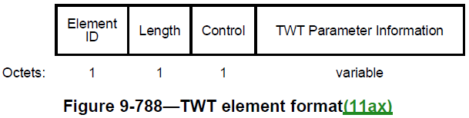
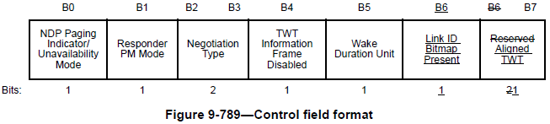
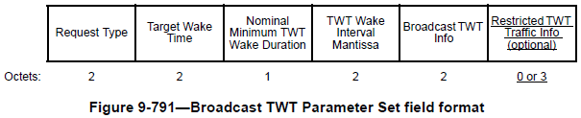
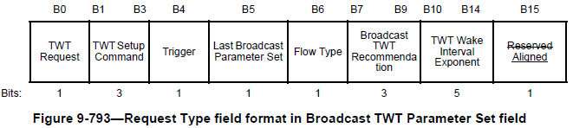
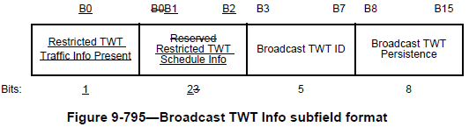
Reuse TWT Element for Signaling
Option 1: Use Broadcast TWT Recommendation field to indicate that the TWT is associated with certain capability mode. Values 5-7 are reserved
Notes:
9.4.2.13 Power Capability element
9.4.2.25 Extended Capabilities element
9.4.2.33 QoS Capability element
9.4.2.54 HT Capabilities element
9.4.2.70 Nontransmitted BSSID Capability element
9.4.2.76 QoS Traffic Capability element
9.4.2.96.8 Mesh Capability
9.4.2.126 DMG Capabilities element
9.4.2.146 Relay Capabilities element
9.4.2.156 VHT Capabilities element
9.4.2.247 HE Capabilities element
9.4.2.323 EHT Capabilities element

Slide 12
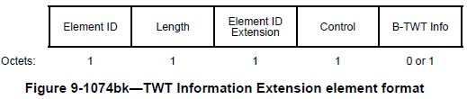
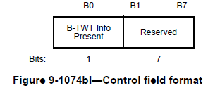
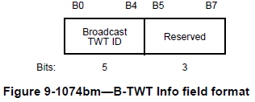
Reuse TWT Information Extension Element for Signaling
Option 2: Use Control field or B-TWT Info field to indicate that the TWT is associated with certain capability mode.
  More freedom/flexibility than reusing TWT Element, but with higher overhead
Notes:
9.4.2.13 Power Capability element
9.4.2.25 Extended Capabilities element
9.4.2.33 QoS Capability element
9.4.2.54 HT Capabilities element
9.4.2.70 Nontransmitted BSSID Capability element
9.4.2.76 QoS Traffic Capability element
9.4.2.96.8 Mesh Capability
9.4.2.126 DMG Capabilities element
9.4.2.146 Relay Capabilities element
9.4.2.156 VHT Capabilities element
9.4.2.247 HE Capabilities element
9.4.2.323 EHT Capabilities element

Slide 13
Options for Signaling: Define New Frame/Element
To indicate that AP operates in low capability mode outside of TWT SPs
Define new frame/element
  Option 1: Define in UHR Capabilities element, may use two UHR Capabilities elements
  Option 2: Define a capabilities element to indicate high and low capability modes
  Other options
  Need to indicate that the capabilities element is used together with a certain TWT
  May send OMI/OMN together with a certain TWT
  May reuse the definition of high and low capability modes from unscheduled/dynamic AP power save, which can be announced in Beacons or ICF [8, 10, 12]

Slide 14
Conclusion
This submission presents a mechanism for scheduled AP power save
  Inside of TWT SPs: AP is in active state
    Pre-UHR and UHR STAs can operate in normal/high capability, without mode switch request, mode switch operation, or extra padding
  Outside of TWT SPs: AP is in low capability mode or in doze state
    AP may operate in low capability mode with reduced power consumption
    AP may receive and respond to certain frames/requests
    AP may switch to high capability mode, upon receiving requests from upper layer or other STAs
  It can be used to enhance the enablement/disablement operations for unscheduled/dynamic AP power save: to be more efficient, smooth and flexible
  May have option for reverse scheme:
    AP in low capability inside of TWT SPs
    AP in high capability outside of TWT SPs

Slide 15
References
[1] 23/0010r0, Considerations for enabling AP power save, Alfred Asterjadhi (Qualcomm Inc.)
[2] 23/2040r1, Enabling AP power save_follow up, Alfred Asterjadhi (Qualcomm Inc.)
[3] 23/0015r0, AP MLD power management, Liwen Chu (NXP)
[4] 23/1936r0, AP MLD power save follow up, Liwen Chu (NXP)
[5] 23/0225r0, Considering Unscheduled AP Power Save, Guogang Huang (Huawei)
[6] 23/1420r0, Expedited Wake-up in Unscheduled AP MLD Power Saving, Juseong Moon (KNUT)
[7] 24/0451r0, AP state transitions in DPS mode, Vishnu Ratnam (Samsung Electronics)
[8] 24/0833r0, Dynamic Power Saving for AP, Geonhwan Kim (LG Electronics)
[9] 24/0671r0, Enhancements on AP Power Save, Sanghyun Kim (WILUS)
[10] 24/1146r0, Considerations on AP Power Save Mode, Jerome Gu (Clourney Semiconductor)
[11] 24/0782r1, AP power saving, Chaoming Luo (OPPO)
[12] 24/0659r1, Thoughts on AP Power Save, Binita Gupta (Cisco Systems)
[13] 24/0589r1, Dynamic TID-To-Link Mapping for AP MLD Power Save, Yongsen Ma (Samsung)
[14] 24/0813r0, Discussions on AP Power Save, Yongsen Ma (Samsung)
[15] 24/0097r0, AP Power Management - Follow up, Yongsen Ma (Samsung)
[16] 23/1835r0, AP Power Management, Yongsen Ma (Samsung)
[17] 24/1611r0, Power Save Capabilities, Manasi Ekkundi(Samsung Electronics)

Slide 16
Straw Polls
SP1: Do you support to define a mechanism in TGbn to allow AP enter and exit a low capability mode based on a schedule?
Definition of “low capability mode” is TBD, e.g., BW=20MHz, NSS=1, and may reuse the definition from unscheduled/dynamic AP power save
May reuse existing mechanisms, e.g., TWT and OMN/OMI
Results
Y: , N: , A:

