Slide 1
802.11 WG May 2025 Session Report
Date: 2025-05-15
Authors:

Slide 2
Abstract
This document is a digest of the closing reports of all 802.11 sub-groups for presentation at the May 2025 closing plenary meeting. Liaison reports (including liaison reports from the opening plenary) are also included.

Slide 4
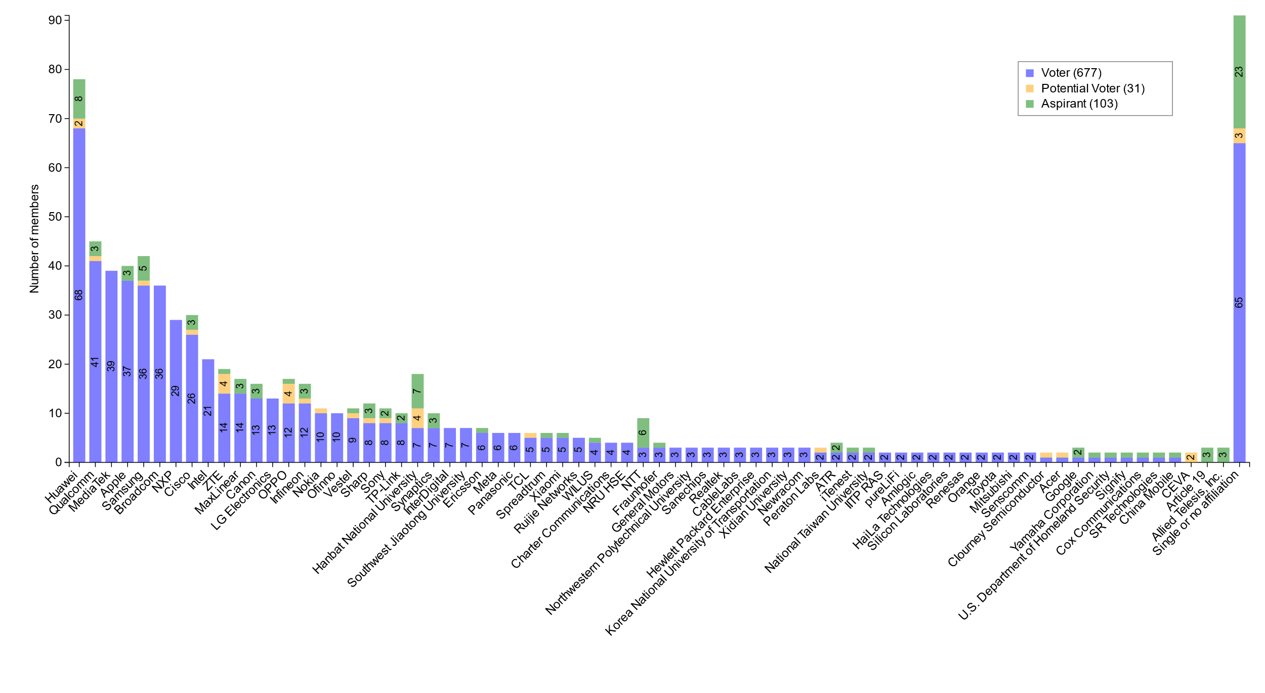
M4.1.7 Members by affiliation

Slide 5
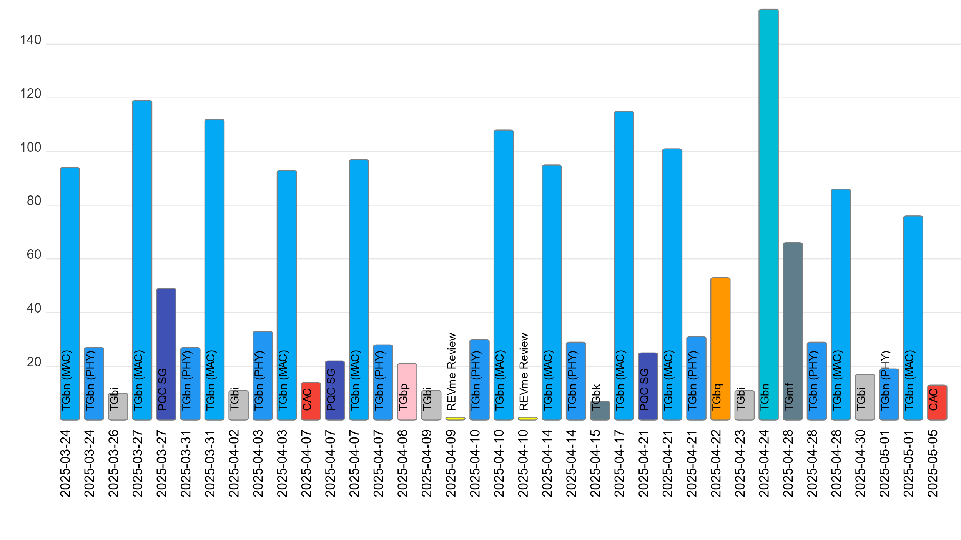
M4.1.7 Telecon attendance (March to May)

Slide 6
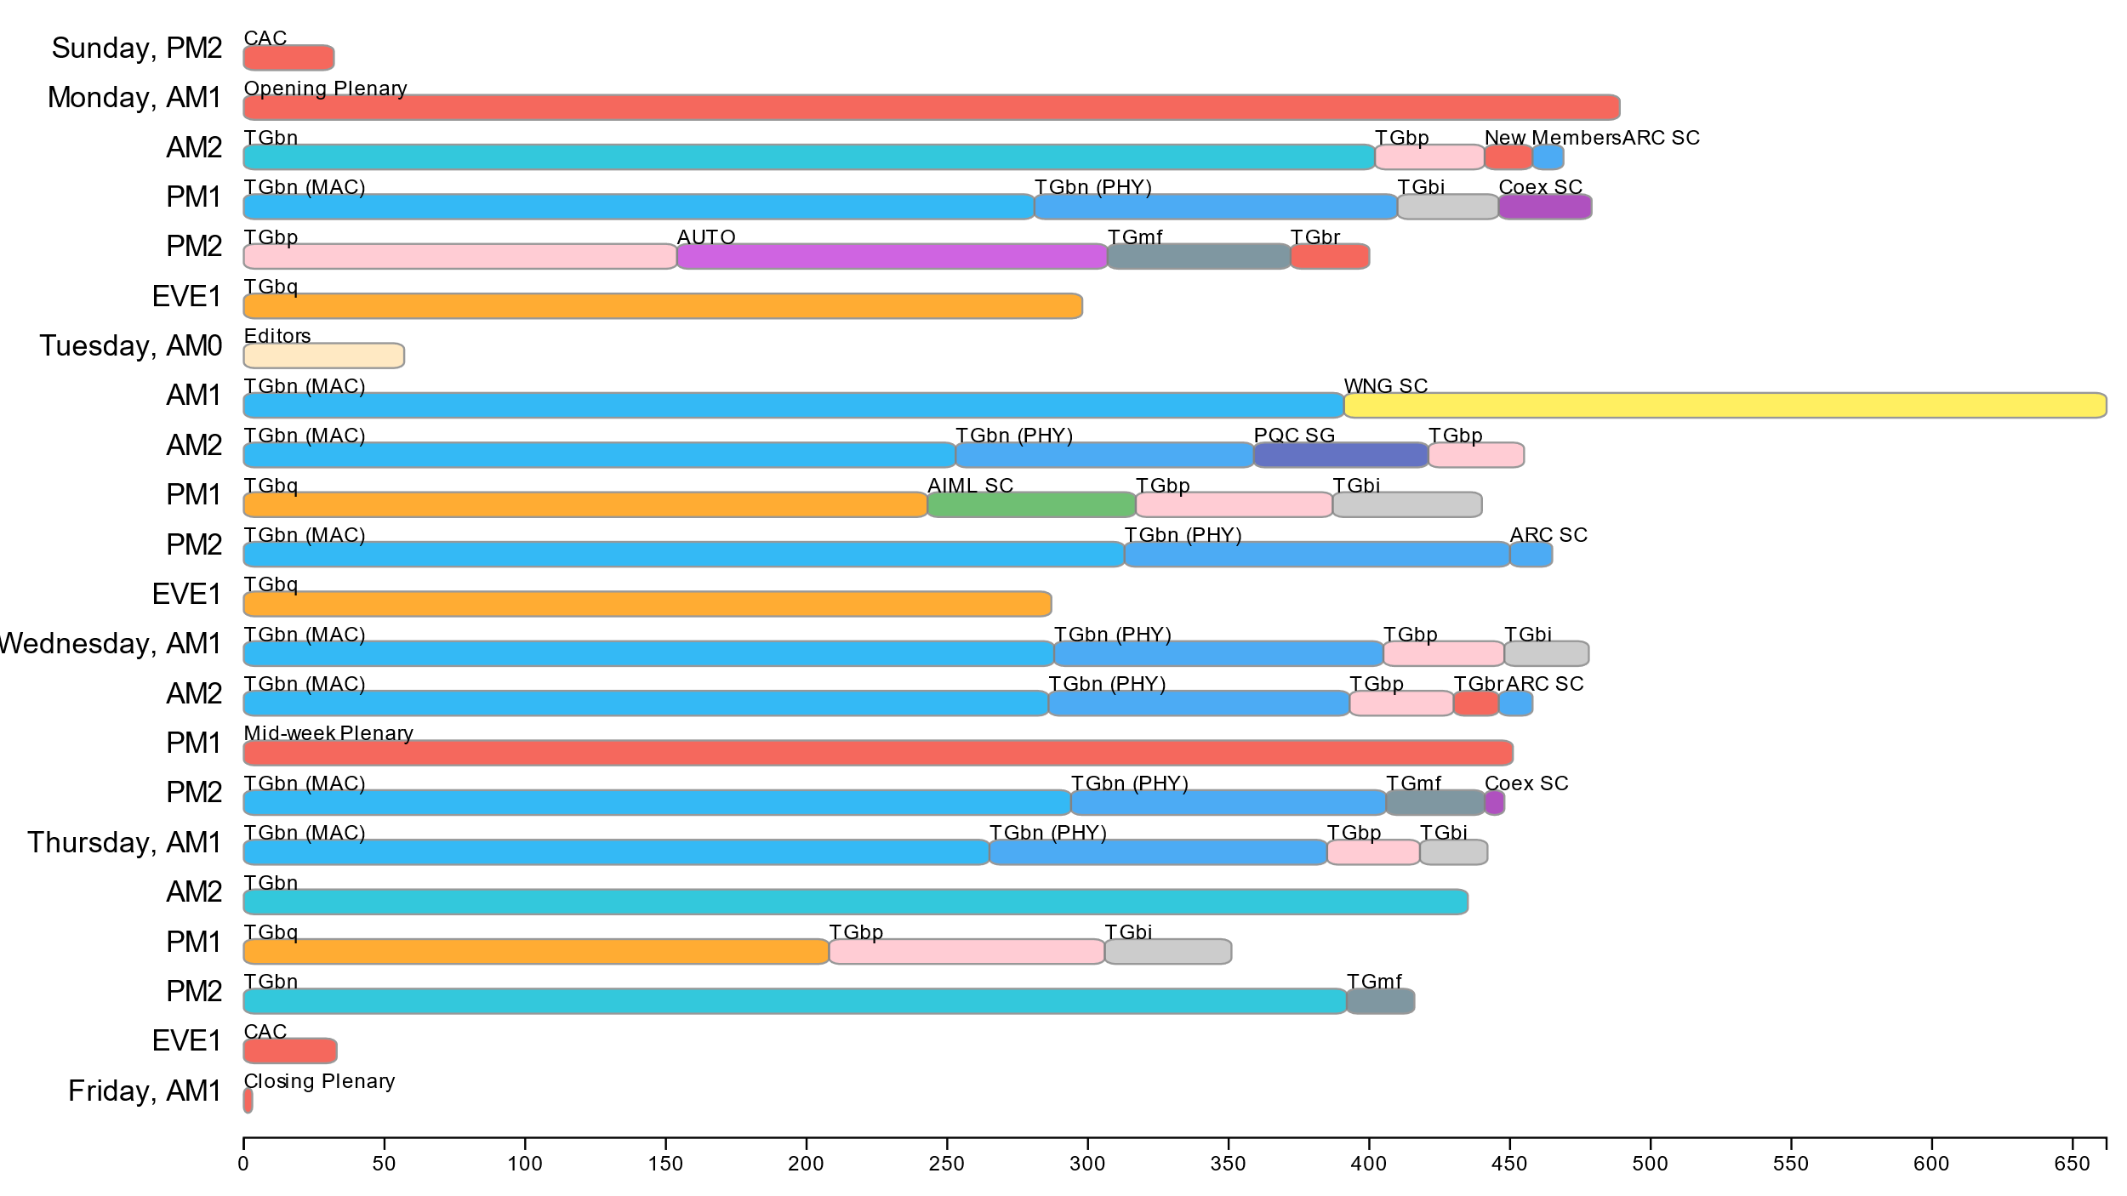
Attendance by breakout (May 2025 interim)

Slide 7
802.11 WG Editor’s Closing Report (May 2025)
Date: 2025-05-15
Authors:

Slide 8
May 2025 Editors’ Meeting Agenda and Report
Roll Call / Contacts / Reflector
Brief status report
Amendment alignments and draft development snapshot
Review publication process
Publication review committees and status
802.11bh-2024 publication review
Discuss some editorial issues for 11bn
Editorial Style guide updates and issues for feedback
ANA number spaces

Slide 9
Volunteer Editor Contacts
  WG – Robert Stacey – robert.stacey@intel.com, Emily Qi – emily.h.qi@gmail.com
  REVme – Emily Qi – emily.h.qi@gmail.com, Edward Au – edward.ks.au@gmail.com
  TGbh – Carol Ansley – carol@ansley.com
  TGbe – Edward Au – edward.ks.au@gmail.com
  TGbk – Roy Want RoyWant@google.com
  TGbf – Claudio da Silva – wifi.phy@gmail.com
  TGbi – Po-kai Huang – po-kai.huang@intel.com
  TGbn- Ross Jian Yu ross.yujian@huawei.com
  TGbp – Yinan Qi - v-qiyinan@oppo.com
  TGbq – Cheng Chen - cheng.chen@intel.com
  REVmf - Po-kai Huang – po-kai.huang@intel.com, Edward Au – edward.ks.au@gmail.com

Slide 10
May meeting roundtable status report (to be updated)
REVme – D7.0, approved by IEEE SASB, will be published as IEEE Std 802.11™-2024 ➔ Published in April 2025.
11bh – D6.0, approved by IEEE SASB, will be published as IEEE Std 802.11bh™-2024
11be – D7.0, approved by IEEE SASB, will be published as IEEE Std 802.11be™-2024
===
11bk – Recommended approval from RevCom. Awaiting SASB approval.
11bf – Recommended approval from RevCom. Awaiting SASB approval.
11bi – Doing comment resolution on D1.0. Should complete around 20-30% of comments in May. Possibly ready with D2.0 in September.
11bn – Released D0.2. Expect to approve D1.0 this week. Using FrameMaker.
11bp – Start drafting D0.1, should be ready by July.
REVmf – Expect to run motion to release D1.0 this week. D1.0 = 802.11-2024+11bh+11be+approved motions (except 11be related).

Slide 11
Editor Amendment Ordering
See http://grouper.ieee.org/groups/802/11/Reports/802.11_Timelines.htm
Changes are usually based on MDR readiness.
As discussed in November 2024
Amendment Number | Task Group | Page Count | Projected RevCom Date (submission)
REVme | TGm | 6213 | September 2024 - Approved
802.11-2024 Amendment 1 | TGbh | 34 | September 2024 - Approved
802.11-2024 Amendment 2 | TGbe | 1089 | September 2024 – Approved
802.11-2024 Amendment 3 | TGbk | 111 | March 2025
802.11-2024 Amendment 4 | TGbf | 220 | March 2025
802.11-2024 Amendment 5 | TGbi | 138 | ?
802.11-2024 Amendment 6 | TGbn | 250 | May 2028
REVmf 802.11-xxxx Amendment x | TGm TGbp | 6000+ | Feb 2028 ?

Slide 12
Draft Development Snapshot
Changes from last report shown in red.
May 2025
TG | Published or Draft Baseline Document |  |  |  |  |  |  |  |  | Source | MDR | Editor | Snapshot Date
 | Published | bh | be | bk | bf | bi | bn | bp | mf
bh | Y | 6.0 |  |  |  |  |  |  |  | FrameMaker | Yes | Carol Ansley | July 16, 2024
be | Y | 6.0 | 7.0 |  |  |  |  |  |  | FrameMaker (old) | Yes | Edward Au | July 15, 2024
bk | Y | 6.0 | 7.0 | 5.0 |  |  |  |  |  | Word | Yes | Roy Want | March 10, 2025
bf | Y | 6.0 | 7.0 | 3.0 | 7.0 |  |  |  |  | FrameMaker 2020 | Yes | Claudio da Silva | January 14, 2025
bi | Y | 6.0 | 7.0 | 4.0 | 7.0 | 1.1 |  |  |  | FrameMaker 2020 |  | Po-kai Huang | May 7, 2025
bn | Y | 6.0 | 7.0 | 5.0 | 8.0 | 1.1 | 0.1 |  |  | FrameMaker 2020 |  | Ross Jian Yu | May 7, 2025
bp | N | 6.0 | 7.0 | 5.0 | 8.0 | 1.1 | 0.1 | 0.1 |  |  |  | Yinan Qi | May 7, 2025
mf |  |  |  |  |  |  |  |  |  |  |  | Po-kai Huang, Edward Au

Slide 13
Publication Review Committees and Status
11bh Review Committee
Carol Ansley (lead);
Mark Hamilton: mark.hamilton2152@gmail.com
Emily Qi;
Robert Stacey;
Status: Completed the first-round review.
11be Review Committee
Edward Au (lead);
Alfred Asterjadhi: aasterja@qti.qualcomm.com
Emily Qi;
Robert Stacey;
Carol Ansley
Status: ?
REVme Review Committee
Emily Qi (lead): emily.h.qi@gmail.com
Edward Au: edward.ks.au@gmail.com
Mike Montemurro: montemurro.michael@gmail.com
Robert Stacey: robert.stacey@intel.com
Carol Ansley: carol@ansley.com
Po-kai Huang: po-kai.huang@intel.com
Joseph Levy
Mark Hamilton
Status: Published in April 2025
Congratulations to All!

Slide 14
802.11bh-2024 Publication Review
Carol & Robert lead the discussion
Incorporated Mark Hamilton’s changes into the marked up PDF
Robert will forward to Michelle

Slide 15
ANA managed number space
Protocol Version subfield: 9.2.4.1.2
Frame types and subtypes: 9.2.4.1.3, Tables 9-1 and 9-2
Element ID and Element ID extension: Table 9-128
Capability Information field: 9.4.1.4
Extended Capabilities: 9.4.2.25, Table 9-190
Reason codes: 9.4.1.7, Table 9-77
Status codes: 9.4.1.9, Table 9-78
Action frame categories: 9.4.1.11, Table 9-79
Authentication algorithm: 9.4.1.1
RSNE: 9.4.2.23
Cypher suites: Table 9-186
AKM suites: Table 9-188
RSN Capabilities: Figure 9-345
RSNXE Capabilities: 9.4.2.240, Table 9-365
ANQP-element (Info ID): 9.4.5.1, Table 9-412
Neighbor Report subelements: 9.4.2.35, Table 9-210
FTE subelements: 9.4.2.46, Table 9-219
Public Action frames: 9.6.7.1, Table 9-450
WMN-Notification Types: 9.6.13.29, Table 9-516
Mesh Configuration Active Path: 9.4.2.96.2, Table 9-277
TLV encodings: 9.4.4
KDE Selector Data Type: 12.7.2
Operating classes: Annex E
global, USA, Europe, Japan
MIB objects: Annex C
ieee802dot11, dot11smt, dot11phy, dot11mac, dot11StationConfigEntry, dot11OperationEntry, dot11Compliances, dot11Groups

Slide 16
11bn questions on style
Do we need to add the abbreviation terms (Subclause 3.4) that are already used in the baseline standard or amendments but have not explicitly been defined in subclause 3.4 yet?
(e.g. CFO, SINR, RL-SIG are already used but not included in the subclause 3.4.)
Ans: if only used in one Clause (subclause) expand on first use and don’t add to 3.4
If used throughout standard add to 3.4
Do we need to define the abbreviation terms that are newly defined in subclause 3.2?
(e.g. TGbn D0.1 newly defines DRU in subclause 3.2. Do we also need to define abbreviation of DRU in subclause 3.4 as well?)
Ans: No need
How do we utilize the hyphen? (e.g. Which is better for the abbreviation of "intermediate FCS", IFCS or I-FCS?)
IFCS
Co-BF
Co-SR
Co-TDMA
Co-RTWT
Ans: Recommend no Co-; use CBF, CSR, etc.

Slide 17
May 2025 AIML SC Closing Report
Date: 2025-05-14
Authors:

Slide 18
Work Completed
  1 Meeting Slot
    Tuesday PM 1
    Agenda: 11-25/591r0
    SP and Motion Booklet: 11-24/765r5
  Achievements
    Technical presentations
      MAPC Co-SR scheduling
    Approved minutes of AIML SC for March 2025 Plenary: 11-25/606r0

Slide 19
Plans for July 2025
No teleconference planned
Technical presentations
  Technical report drafts
    Generate the 1st Annual technical report
  Additional results, exploration and feasibility for existing use cases
  Additional AIML use cases

Slide 20
ARC Closing Report
Date: 2025-05-15
Authors:

Slide 21
Annex G update/replacement
  Continued discussion on the proposal to replace Annex G with tutorial/informational material on:
  “Frame exchange sequence” (and its relationship to/meaning for other behaviors like power save/doze, off-channel scanning, etc.)
  Relation of frame exchange sequence to medium protection (NAV, etc.)
  The definition/extent of an instance of the Wireless Medium
    Relation of wireless medium to beamforming, sectorization, MU operation, etc.
    11-23/0880r8, 11-25/0738r0
Will continue discussion in July. Allocating 2 meeting slots worked well – will do that again, to try to sort out these terms and concepts.

Slide 22
(New topic) Review MIB attribute conventions (and more)
  11-25/0780r1
What does a feature is “implemented” mean? Is “supported” the same thing? How does it differ from “activated”?
How much should 802.11 describe management interactions (beyond/sideways from over-the-air interoperability)?
Relates to discussion on MLME-RESET, MLME-START versus MLME-JOIN, MLME-END
Maybe even the scope/use of the PICS is related
Will continue this discussion in July, also.

Slide 23
Std 802 update impacts on 802.11
Ran out of time, and didn’t get to this. Will pick up on a teleconference, and then in July
Contribution in the queue: 11-25/0923r1
Continue review of 11-25/0150r4 also

Slide 24
Organizational and Plans
Agenda is here: 11-25/0609r3
Plan for 1 teleconference, on Std 802 topic
Plans for July:
Continue Annex G replacement
Continue MIB conventions discussion
Continue EPD/LPD clean-up, other Std 802 alignment
Four meeting slots requested in July

Slide 25
Coex SC Closing Report
Date: 2025-05-15
Authors:

Slide 26
Coex SC’s week at a glance
Coex SC met once this week
Technical discussion topics
ETSI BRAN Update
Information Items
802.15.4ab NB Status Update
802.15.6ma CAD
BT-SIG Updates

Slide 27
ETSI BRAN Update to 802.11 (1/1)
EN 303 687 (Wireless Access System/Radio Local Area Network (WAS/RLAN) in the license-exempt 6 GHz band)
EN 303 687 only active work item
Draft 1.1.7 published
Discussion items:
  Client-to-Client (C2C) operation
  Medium access for Narrowband Frequency Hopping (NB FH) devices: Discussions related to operating NB FH with or without Listen-before-Talk (LBT) continued
New measurement results related to C2C discussed: Measurements of outdoor signal strength of IEEE 802.11 indoor transmissions

Slide 28
Information Items (1/2)
  802.15.4ab NB Status Update
  802.15.4ab is going through comment resolution
  Coex-related comments not (yet) discussed (as of May 11)
  802.15.6ma CAD (802.15.6ma UWB PHY)
  Section 7.1.1 hints on potential coexistence issues with .11 and concludes that "Further study of coexistence impacts is needed …”.
  Members of Coex SC are encouraged to look at the document and decide if Coex SC should monitor .15.6ma activities or if additional actions for collaboration are considered useful

Slide 29
Information Items (2/2)
  Future of BT SIG Updates
  No BT SIG update this week.
  Rich Kennedy will attend the July meeting in person. He will retire and July will likely be his last meeting as a BT SIG representative
  Any other members volunteering to update us on BT SIG?
  Directly reporting from BT SIG ?
  Resulting input to ETSI BRAN as part of ETSI BRAN report?

Slide 30
Plans for July
One dot11 Coex (only) slots
Wednesday PM2
One joint session with 802.15.4ab Tuesday PM3
Attention: if there are no announced submissions for the joint slot by Sunday 14.00h local meeting time (right before the session week), the slot will be cancelled
Topics:
Update on ETSI BRAN
Update on Bluetooth SIG
Technical submissions (tba)
Note: coexistence-related topics are welcome. Please contact the Chair

Slide 31
Telcos
No telco scheduled.
May be announced with 10-day notice. Member feeling the need for telco and have submissions ready for discussion are asked to approach the Chair.

Slide 32
References for this week
Agenda for this week: 11-24/0617
Snapshot Slide: 11-24/0618
Meeting / Chair’s Slide Deck: 11-24/0619
Closing report: 11-24/0220
Meeting minutes: 11-25/0935

Slide 33
WNG SC Closing Report
Date: 2025-05-16
Authors:

Slide 34
Summary
Final Agenda
  https://mentor.ieee.org/802.11/dcn/25/11-25-0605-00-0wng-agenda-for-wng-sc-2025-may.pptx
Presentations at May 2025 meeting
  “Field measurements of EDCA characteristics,” Jim Lansford, Jimmy Nolan, Ben Nowatny (University of Colorado)
    https://mentor.ieee.org/802.11/dcn/25/11-25-0897-00-0wng-field-measurements-of-edca-characteristics.pptx
Minutes
  https://mentor.ieee.org/802.11/dcn/25/11-25-0947-00-0wng-wng-meeting-minutes-2025-may-warsaw-meeting.docx
Plans for July
  TBD: call for presentations will be sent out in June
No motions in the SC, no straw polls

Slide 35
IEEE 802 JTC1 Standing Committee
May 2025 (mixed-mode) closing report
Date: 2025-05-16
Author:

Slide 36
The IEEE 802 JTC1 SC reviewed the PSDO process status, including IPR issues holding up 802.11
Agenda - ec-25/0090r04; Minutes – ec-25/0109
WG | Completed | In-process
802.1 | 58 | 9
802.3 | 32 | 8
802.11 | 13 | 0
802.15 | 5 | 6
802.16 | 0 | 0
802.19 | 0 | 1
802.21 | 3 | 0
802.22 | 4 | 0
All | 111 | 29
802.11 IPR issue
We will be submitting IEEE 802 standards with negative LoAs under IEEE policy to see if different LoAs are submitted under ISO’s policy.
Next steps:
  Send IEEE 802.11-2024 to JTC 1/SC 6 for information
  Look for response to LMSC letter sent to IEEE SA President expressing the impacts of ISO/IEC IPR impasse and requesting closer coordination
  Observe how IEEE 802.3 fares in the on-going ITU-T SG15 process

Slide 37
The IEEE 802 JTC1 SC will undertake its usual work at its mixed-mode meeting in Madrid in July ’25
IEEE 802 JTC1 SC plans for July 2025 …
  Execute PSDO process
    The following standards are currently in ballot: IEEE 802.1Qdy (60-day pre-ballot), IEEE 802-REVc (60-day pre-ballot), IEEE 802.1DC (FDIS), IEEE 802.1Qdj (FDIS), and IEEE 802.15.7-2018 (FDIS).
  Monitor ISO/IEC JTC 1/SC 6 activities
  Report back on relevant outcomes from JTC 1/SC 6’s June plenary
  Review response to IEEE 802 LMSC chair’s letter from IEEE SA President, if any

Slide 38
REVmf Closing Report – May 2025
Date: 2025-05-15
Authors:

Slide 39
Work Completed
Discussed contributions on modifications REVme D7.0 and TGbe
Agenda doc: https://mentor.ieee.org/802.11/dcn/25/11-25-0590-04-000m-revmf-agenda-may-2025-session.pptx
Approved motion to go to initial letter ballot on D1.0 which includes:
  P802.11bh-2024 roll-in
  P802.11be-2024 roll-in
  Approved modifications to IEEE Std 802.11-2024
  (see motion on later slide)

Slide 40
Plans for July
Teleconferences scheduled
  None
July: 4 slots
Objectives:
  Begin comment resolution on comments received from the initial letter ballot on D1.0.

Slide 41
TGmf Timeline
Nov 2024 – PAR Approval
Nov 2024 – Initial meeting, contributions on REVme D7.0
Jan - Mar 2025 – Contributions on REVme D7.0/IEEE 802.11-2024
Jan - May 2025 – Publication of 802.11-2024 and roll-in of TGbh and TGbe
May 2025 – Initial D1.0 WG Letter ballot
May-Nov 2025 – Roll-in TGbf and TGbk
Jan 2026 – D2.0 Recirculation LB
Jul 2026 – D3.0 Recirculation
Jan 2027 – D4.0 Initial SA Ballot – Roll-in TGbi
Jul 2027 – D5.0 Recirculation SA Ballot
Nov 2027 – D6.0 Recirculation SA Ballot
Jan 2028 – D6.0 Recirculation SA Ballot (clean recirculation)
Feb 2028 – RevCom/SASB Approval

Slide 42
Initial WG LB Motion
Instruct the editor to prepare REVmf D1.0 and
Approve at least a 30-day Working Group Technical Letter Ballot that will complete no earlier than July 25th 2025, asking the question “Should REVmf D1.0 be forwarded to SA Ballot?”
Note: REVmf D1.0 will include the roll-in of 802.11bh-2024 and 802.11be-2024, and the content identified in approved changes in document 11-24/1925r6.
Moved: Stephen McCann
Second: Jon Rosdahl
Results: 20 – Yes; 0 – No; 0 - Abstain. Motion Passes.

Slide 43
TGbi Closing Report
Date: 2025-05-15
Authors:
Name | Affiliation | Address | Phone | Email
Carol Ansley | Cox Communications |  | +1 404 229 1672 | carol@ansley.com

Slide 44
IEEE 802.11 TGbi
TGbi met 5 times during this interim session.
We continued working through comment resolutions, motioning 383 comment resolutions, with additional comment resolutions reviewed but not yet motioned.
We will have weekly teleconferences between now and the July plenary meeting.
    Wednesday 10:00-12:00 EDT
    Dates: May 28, June 4, 18, 25, July 16, 23

Slide 45
IEEE 802.11 TGbi
We are requesting a virtual ad hoc in July to help get through our comment collection.
Where: Virtual!
When: July 7, 8, 9, 10, 4 hours a day
    8am EDT – 12:15pm EDT
What: Comment resolution
Note that we will follow our teleconference practices in these ad hoc sessions with straw polls to gauge support for submissions. We will motion the accumulated comment resolutions in the July Plenary.

Slide 46
Timeline – Small change
TG use case start: March 2021
Use case completion: February 2022
Features identified: September 2022
Comment collection: May 2024
LB initial: January 2025
LB re-circ: August 2025
MDR: August 2025
Ballot Pool: September 2025
SA ballot: January 2026
SA re-circ: March 2026
802.11/LMSC approval: May 2026
RevCom/SASB approval: July 2026
Because the July plenary ends in August, we can’t start our re-circ until later in August.

Slide 47
TGbn May Closing Report
Date: 2025-05-15
Authors:

Slide 48
TGbn (Ultra High Reliability)
TGbn had scheduled 11 slots during the May interim
  Discussed proposed draft texts (PDTs), comment resolution (CR) docs
    Resolved around 1300 comments from CC50
  Approved over 45 motions that added additional concepts to the TGbn SFD, and spec text to the latest TGbn draft
  Ran a motion to approve the creation of TGbn D1.0 and initiate a WG letter ballot which did not go well.
    Instructed the TGbn Editor to create TGbn D0.3
  Planning a TGbn MAC/PHY ad-hoc (mixed mode) meeting in San Diego, CA, USA between 10-12 Sept. 2025
Agenda is available in 11-25/0568r14,
Motions are available in 11-25/0014r22.
Goals for July 2025:
  Continue resolving comments from CC50
  Complete inclusion of PDTs to TGbn draft
  Target approving delivery of TGbn D1.0

Slide 49
Teleconference Plan
May 19-23 (Monday-Friday) Holiday
May 26 (Monday) – MAC 19:00-21:00 ET
May 29 (Thursday) – Joint 10:00-12:00 ET
June 02 (Monday) – MAC 19:00-21:00 ET
June 05 (Thursday) – MAC 10:00-12:00 ET
June 09 (Monday) – MAC 19:00-21:00 ET
June 12 (Thursday) – Joint 10:00-12:00 ET
June 16 (Monday) – MAC 19:00-21:00 ET
June 19 (Thursday) – MAC 10:00-12:00 ET
June 23 (Monday) – MAC 19:00-21:00 ET
June 26 (Thursday) – Joint* 10:00-12:00 ET
June 30 (Monday) – MAC 19:00-21:00 ET
July 03 (Thursday) – MAC 10:00-12:00 ET
July 07 (Monday) – MAC 19:00-21:00 ET
July 10 (Thursday) – Joint* 10:00-12:00 ET
July 14-18 (Monday-Friday) Holiday
* TGbn joint session during which there can be motions, subject to WG chair approval and with 10-day advanced notice. PHY ad-hoc session to be announced 10 days in advance.

Slide 50
TGbn Timeline And Status
  PAR approved July 2023
  First TG meeting Nov 2023
  D0.1 Jan 2025
  D1.0 Letter Ballot July 2025
  D2.0 LB May 2026
  D3.0 LB Jan 2027
  Initial SA ballot (D4.0) May 2027
  Final 802.11 WG approval Mar 2028
  802 EC approval Mar 2028
  RevCom and SASB approval May 2028

Slide 51
IEEE 802.11 May 2025 Interim
TGbp Closing Report
Chair: Bo Sun (Sanechips)
Elected Vice Chairs: Steve Shellhammer (Qualcomm)
Rakesh Taori (Infineon)
Secretary : Sebastian Max (Ericsson)
Tech Editor: Yinan Qi (OPPO)

Slide 52
TGbp’s Progress during this week
8 TGbp meetings were planned and held during May interim session, with the agenda include in the latest revision of 11-25/0611r7.
TGbp approved the updated SFD documents incorporating approved motions in Mar 2025.
Totally 33 tech contributions were presented and discussed, on PHY/MAC solutions, Wireless Power Transmission and security.
Lots of technical Motions for SFD were approved as captured in 11-25/0611r7.
  Consensus on duty-cycle, power-save, security, sync field design, S1G communication, channel access, WPT design, chip duration, etc.
The 11bp timeline was unchanged.
3 teleconferences were planned after May interim session.
Goal of future TGbp work:
  Continue developing FRD and SFD based on consensus
  PDT development based on approved SFD
  Open technical discussion and prepare for PDT development

Slide 53
TGbp Timeline Plan (unchanged)
  PAR approved Mar 2024
  First TG meeting May 2024
  D0.1 (ready for CC) Jul, 2025
  D1.0 Letter Ballot Feb, 2026
  D2.0 LB recirculation Nov, 2026
  Form SA Ballot Pool Mar 1 to Mar 31, 2027
  Initial SA Ballot (D4.0) Aug, 2027
  Final 802.11 WG approval Jan 2028
  802 EC approval Mar 2028
  RevCom and SASB approval May 2028

Slide 54
TGbp Teleconference Plan
  May 27th (Tuesday), 10:00am, ET, 2 hours; Webex
  Jun 17th (Tuesday), 10:00am, ET, 2 hours; Webex
  Jul 8th (Tuesday), 10:00am, ET, 2 hours; Webex

Slide 55
Task Group BQ May 2025 Closing Report
Date: 2025-05-16
Author:

Slide 56
Work Completed
Confirmed the selection procedure for draft development
Confirmed the timeline of the task group
  D0.1: July 2026
  D1.0: March 2027
  D2.0: September 2027
  D3.0: March 2028
  D4.0: September 2028
  Final 802.11 WG approval: May 2029
  IEEE 802 LMSC approval: May 2029
  RevCom and SASB approval: July 2029
Reviewed technical contributions

Slide 57
Plans for July 2025 plenary
Teleconferences scheduled for technical contributions
  Tuesday, 3 June, 9:30am ET to 11:00am ET
  Tuesday, 10 June, 9:30am ET to 11:00am ET
  Tuesday, 17 June, 9:30am ET to 11:00am ET
  Tuesday, 24 June, 9:30am ET to 11:00am ET
Objectives in July 2025 plenary
  Review and discuss technical contributions

Slide 58
TGbr (Enhanced Light Communications)
May 2025 Closing Report
Date: 2025-5-15
Authors:

Slide 59
TGbr activities at the May 2025 meeting
  Content
  TGbr considered a number of contributions and approved:
    Specification Framework Document (doc. 11-25/0941r0)
    Work plan (doc. 11-25/0912r0)
    Officers (Vice-Chairs, Technical Editor, Secretary)
  Contributions discussed included:
    Technical Proposals for Consideration (doc. 11-25/0830r0)
    PAPR reduction considerations (doc. 11-25/0945r0)
    On the timeline for TGbr (doc. 11-25/0956r0)
    Proposal for Addition to SFD (doc. 11-25/0962r0)
  Meeting agenda is available in doc. 11-25/0616
  Motions and straw polls are available in doc. 11-25/0968
  Minutes of the meeting are available in doc. 11-25/0974

Slide 60
TGbr moving forward
Mar-2025 PAR approved
May-2025 Create SFD and consider technical contributions
Jul-2025 Continue consider technical contributions and develop SFD
Nov-2025 agree main features (PHY) and close SFD for PHY
Jan-2026 start draft development (PHY)
Jul-2026 complete PHY (D0.1)
Sep-2026 agree main features (MAC) and close SFD for MAC
Nov-2026 start draft development (MAC)
Jan-2027 complete MAC (D0.2), start internal CC
Jul-2027 complete D0.x, start CC in 802.11 WG
Nov-2027 D1.0 for WG letter ballot
Jan-2028 D2.0
Mar-2028 D3.0
May-2028 start SA ballot
Nov-2028 submit to RevCom
2029 publish

Slide 61
May 2025 PQC SG Closing Report
Date: 2025-05-14
Authors:

Slide 62
Work Completed
  1 Meeting Slot
    Tuesday AM 2
    Agenda: 11-25/861r3
  Achievements
    Approved PAR and CSD in study group
    PQC Draft PAR 11-25/0597r4
    PQC Draft CSD 11-25/0598r3
    Technical presentations
    ML-KEM in 802.11, Jay Yang (ZTE) (11-25/0722r0)
    A PQC PAKE, Dan Harkins (HPE) (11-25/0770r1)
    Working Group approved PAR and CSD during Mid Week Plenary

Slide 63
Plans for June/July 2025
Teleconference to be scheduled for June
July
  Three slots and expect to respond to PAR comments

Slide 64
Automotive TIG Closing Report
Date: 2025-05-16
Authors:

Slide 65
Summary
Final Agenda
  https://mentor.ieee.org/802.11/dcn/25/11-25-0604-00-auto-agenda-for-automotive-tig-2025-may.pptx
Presentation of submissions
  “Location Information Assisted AP Discovery,” Hitoshi Morioka (SRC Software)
    https://mentor.ieee.org/802.11/dcn/25/11-25-0896-01-auto-location-information-assisted-ap-discovery.pptx
  “Thoughts on Throughput Improvement for high-mobility STAs,” Azin Neishaboori (General Motors)
    https://mentor.ieee.org/802.11/dcn/25/11-25-0733-00-auto-thoughts-on-throughput-improvement-for-high-mobility-stas.potx
  “Follow-up on proposed IEEE 802.11 Automotive TIG Technical Report Text,” Jing Ma (Toyota)
    https://mentor.ieee.org/802.11/dcn/25/11-25-0832-01-auto-follow-up-on-proposed-ieee-802-11-automotive-tig-technical-report-text.doc
Minutes
  https://mentor.ieee.org/802.11/dcn/25/11-25-0943-02-auto-auto-tig-meeting-minutes-2025-may.docx
Plans for July
  Presentations on use cases, requirements and KPIs
No motions or teleconferences
  Request of the IEEE 802.11 WG to extend the Automotive TIG until January 2026

Slide 66
802.15 Liaison Report – May 2025
Date: 2025-05-15
Authors:

Slide 67
Working Group 15 November Agenda
Agenda:
https://mentor.ieee.org/802.15/dcn/25/15-25-0167-03-0000-may-2025-802-15-agenda.xlsx
WG opening report:
https://mentor.ieee.org/802.15/dcn/25/15-25-0168-03-0000-may-2025-802-15-opening-report.pptx

Slide 68
Subgroup Closing Reports
Title | URL
TG15.6ma Closing Report for May 2025 | https://mentor.ieee.org/802.15/dcn/25/15-25-0265-00-006a-tg15-6ma-closing-report-for-may-2025.pptx
SCM Agenda, Opening and Closing Report May 2025 | https://mentor.ieee.org/802.15/dcn/25/15-25-0235-01-0mag-scm-agenda-opening-and-closing-report-may-2025.pptx
TG4ab May Closing Report | https://mentor.ieee.org/802.15/dcn/25/15-25-0272-00-04ab-tg4ab-may-2025-closing-report.pptx
TG4ac May Opening and Closing Report | https://mentor.ieee.org/802.15/dcn/25/15-25-0215-01-04ac-may-opening-and-closing.pptx
TG4ad Agenda, Opening and Closing Report May 2025 | https://mentor.ieee.org/802.15/dcn/25/15-25-0219-01-04ad-tg4ad-agenda-opening-and-closing-report-may-2025.pptx
TG4ae (ASCON) May Opening and Closing | https://mentor.ieee.org/802.15/dcn/25/15-25-0216-01-04ae-may-opening-and-closing.pptx
IG Access agenda opening and closing report and Minutes | https://mentor.ieee.org/802.15/dcn/25/15-25-0238-01-acss-ig-access-may-2025-meeting-slides.pptx
TG9A May Opening and Closing report | https://mentor.ieee.org/802.15/dcn/25/15-25-0217-01-009a-may-opening-and-closing.pptx
TG16me Revision to 802.16-2017 | https://mentor.ieee.org/802.15/dcn/25/15-25-0271-00-16me-tg16me-may-2025-closing-report.pptx

Slide 69
802.15 Overview
Wireless Specialty Networks Active standards:
802.15.3 - no active projects but a bunch of really cool stuff
802.15.4 - many current projects (see next slide)
802.15.6a Body Area Networks: WG ballot recirculations
802.15.7a Higher Rate, Longer Range Optical, in publication
802.15.9a KMP Transport, extensions to key management: Working group ballot
802.16t Extension to 802.16 for specific bands: approved (DONE!)
802.16.me Revision of 802.16-2017 – first TG meeting
Interest Group Access: Several technical concepts to be developed into potential new projects
SC THz: discussing future THz communications with Terabit/second data rates – did not meet this session

Slide 70
802.15.4 Projects
802.15.4ab Next Generation UWB: First WG recirculation
802.15.4ac Enhanced Privacy: Initial WG ballot
802.15.4ad Next Generation SUN PHYs: Pre-draft, technical contributions and proposals
802.15.4ae ASCON light weight encryption extension for 802.15.4: draft in progress

Slide 71
802.15.4ab Next generation UWB: Amendment to IEEE Std 802.15.4-2024 (rev E)
Recirculation comment resolution in progress
Closing report: https://mentor.ieee.org/802.15/dcn/25/15-25-0272-00-04ab-tg4ab-may-2025-closing-report.pptx
 | Current Schedule
First recirculation | March 2025
Recirculation comment resolution | March-July 2025
Second recirculation | Aug 2025
Recirculation comment resolution | Aug-Spet 2025
First SA-Ballot | After Sept 2025…
SA-Ballot comment resolution | After that

Slide 72
802.15.4ac Enhanced Privacy
This amendment specifies modifications to the IEEE Std 802.15.4 medium access control (MAC) specification to specify mechanisms that address and improve user privacy. These mechanisms include randomized addresses, and exchanges that support session continuity. This amendment maintains backward compatibility with the base standard.
State: WG Recirculation comment resolution
Opening and closing report: https://mentor.ieee.org/802.15/dcn/25/15-25-0215-01-04ac-may-opening-and-closing.pptx

Slide 73
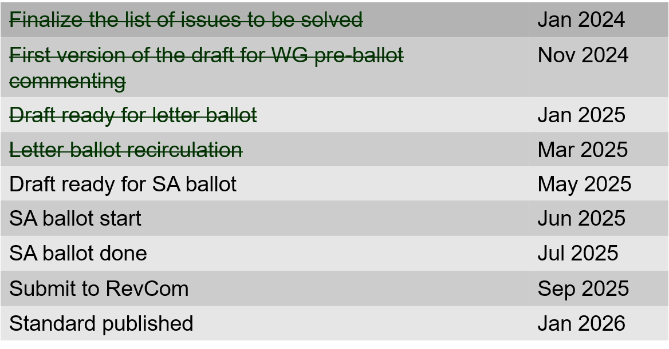
802.15.4ac Enhanced Privacy Timeline

Slide 74
802.15.4ad Next Generation SUN PHYs
Developing enhancements to the 802.15.4 SUN PHYs (FSK, OFDM)
State: pre-draft development
Meeting goals:
  Considering technical contributions
  15 contributions heard
Objectives completed
Closing report: https://mentor.ieee.org/802.15/dcn/25/15-25-0219-00-04ad-tg4ad-agenda-opening-and-closing-report-may-2025.pptx

Slide 75
802.15.4ad Timeline
2024
November: Approve Technical Guidance Document
Call for proposals issued
2025
January: Hear initial proposals
March: Hear updated proposals
March to May – 2 conference calls
  Simulation results of remaining proposals not yet provided
  Prepare table of proposals for analysing against technical guidance document
May: Hear final proposals
May to July – 2 conference calls
  Simulation results and proposal categorisation.
July and beyond: Merging and start drafting the standard

Slide 76
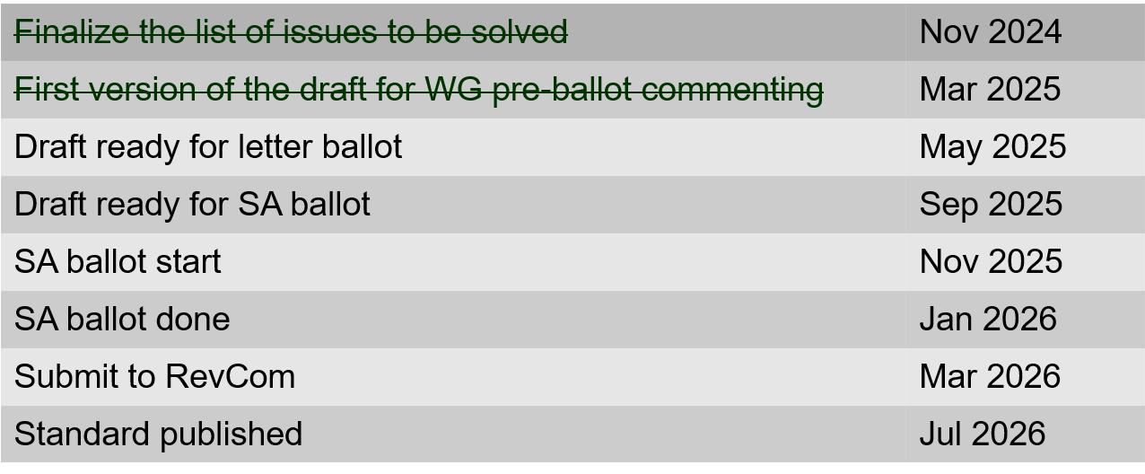
802.15.4ae (ASCON)
ASCON light weight encryption extension for 802.15.4
Meeting achievements
Reviewed pre-letter ballot comments
Created draft ready for letter ballot
Start letter ballot after this meeting
Closing report: https://mentor.ieee.org/802.15/dcn/25/15-25-0216-01-04ae-may-opening-and-closing.pptx

Slide 77
802.15.6ma
Draft in WG ballot
Completed 2nd recirculation 10-May
Resolved comments
Preparing for 3rd recirculation
Preparing for initial SA ballot (post July)
Closing report: https://mentor.ieee.org/802.15/dcn/25/15-25-0265-00-006a-tg15-6ma-closing-report-for-may-2025.pptx

Slide 78
TG 6ma Timeline(expected)
Final SB recirculation, if required. Submission to RevCom
Jan 2026
Tech Req Doc July 2022
Presentation of proposals
May 2023
Comment Resolutionfor LB210
Nov. 2024
Comment Resolutionfor LB212
March 2025
Comment Resolutionfor LB217
May
2025
Comment Resolution for LB217
July
2025
SA Ballot
Sept
2025
WG PreBallot submission for Draft2.5 August 2024
Revcom Approve
March 2026
SA recirculation if required
Oct 2025
^{Draft V1,18 Com}
May. 2024
Recirculation (LB212)
Jan. 2025
RevcomSubmission
Feb. 2026
TRD,CMD
Call Proposals Sept 2022
Std. Draf V1.9 Proposals
Nov. 2023
Comment Resolution fo Draft v2.3 on WG for PreBallot July 2024
1st Letter Ballot(LB210)
Sept. 2024
2nd Recirculation (LB217)
April 2025
3rd Recirculation (LB)
June 2025
Unconditional approval for Standard Association Ballot (SA)
July 2025
Request EC approval for SA Ballot
Nov. 2026
Comment Resolution for SA Ballot
Oct. 2025
Notes: SASB/RevCom scheduled for 2024 a guess

Slide 79
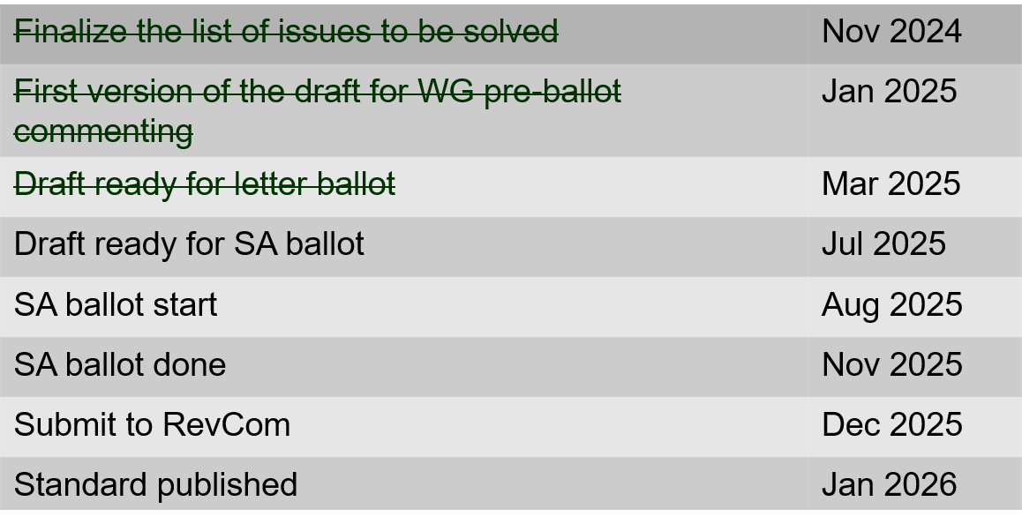
802.15.9a KMP Transport
Extensions to key management: extending to support EDHOC
State: Completed initial WG ballot
Session objectives
  Resolve comments
  Initiate recirculation ballot
Opening and closing report: https://mentor.ieee.org/802.15/dcn/25/15-25-0217-01-009a-may-opening-and-closing.pptx

Slide 80
IG Access
CCA modes for suspendable CSMA-CA
  https://mentor.ieee.org/802.15/dcn/25/15-25-0243-01-acss-cca-modes-for-suspendable-csma-ca.pptx
Contribution on 802.15.4 Spectrum Resource Measurement features
  https://mentor.ieee.org/802.15/dcn/25/15-25-0245-01-acss-overview-of-srm-function.pptx

Slide 81
Licensed Narrowband Amendment TG16t
Approved, in publication

Slide 82
TG16me Revision of 802.16-2017
Revision PAR approved
First meeting as TG
Beginning revision work
Heard technical contributions
Closing report: https://mentor.ieee.org/802.15/dcn/25/15-25-0271-00-16me-tg16me-may-2025-closing-report.pptx

Slide 83
TG16me Revision Project Timeline
Milestone | Date
Task Group Start | March 2025
Draft Development | May – Sept 2025
Informal TG review of draft | Nov 2025
Working Group Letter Ballot | March 2026
Working Group Recirculation Letter Ballot | May 2026
SA Ballot | Sept 2026
SA Recirc | Jan 2027
Forward to RevCom | March 2027

Slide 84
802.18 Liaison Report – May 2025
Date: 14 May 2025
Author:
Name | Company | Address | Phone | Email
Edward Au | Huawei Technologies |  |  | edward.ks.au@gmail.com

Slide 85
RR-TAG at a glance
Membership as of 14 March 2025
  65 voters (including 10 on LMSC)
  6 nearly voters
  14 aspirants
Officers
  Chair: Edward Au (Huawei Technologies)
  Co-Vice Chair: Gaurav Patwardhan (Hewlett Packard Enterprise)
  Co-Vice Chair: Al Petrick (Jones-Petrick Associates)
  Secretary: Chenhe Ji (Huawei Technologies)
  IEEE SA Program Manager: Jodi Haasz (IEEE SA)

Slide 86
Progress since the 2025 March plenary
Reviewed the latest ongoing consultations
Approved the following IEEE 802 LMSC submissions:
  Australia ACMA: Five-year spectrum outlook 2025–30 and 2025–26 work program
  Lithuania RRT: Public survey on the prospects for the use of the radio frequency band 6425-7125 MHz
  UK Ofcom: Proposals for AFC in Lower 6 GHz and mobile / Wi-Fi sharing in Upper 6 GHz
  Australia ACMA: Remaking the low interference potential devices class licence
  USA FCC: Promoting the Development of Positioning, Navigation, and Timing Technologies and Solutions (WT Docket No. 25-110)
Discussed the latest topics related to spectrum and regulation in Europe, North America, and Asia Pacific.

Slide 87
Objectives this week (1)
Review and approve draft responses to the following consultations:
    Iraqi CMC: Draft regulation on Short Range Devices (SRD) and UWB
    South Africa ICASA: Draft regulations on dynamic spectrum access and opportunistic spectrum management in the innovation spectrum 3800-4200 MHz and 5925-6425 MHz
    South Africa ICASA: National radio frequency plan 2025 (NRFP)
Discuss the latest topics related to spectrum and regulation in Europe, North America, and Asia Pacific, including ETSI BRAN May 2025 update.

Slide 88

Objectives this week (2)
Invited presentation (bimonthly member enrichment activities)
  Dr. Steve Leach (Principal Spectrum Engineer, Ofcom)
  Moving forward with 6 GHz band for commercial mobile and Wi-Fi services: update on UK and CEPT progress
  Abstract:
    In February this year, Ofcom published its latest proposals to enable Wi-Fi and commercial mobile in the upper 6 GHz band and to expand access for Wi-Fi services in the Lower 6 GHz band in the UK. Steve will present the details of these proposals, which aim to provide early access for indoor Wi-Fi across the whole band as soon as possible whilst committing to introduce mobile at a later stage in at least part of the band. This talk will also cover the progress that has been made in CEPT on evaluating how Wi-Fi and mobile networks can share the Upper 6 GHz band. The resulting report is under public consultation and is intended to be finalised in June.
    To facilitate shared use by both networks, it is likely that some enhanced sensing of mobile transmissions by Wi-Fi access points will be necessary. Steve will present the approaches currently in discussion in Europe and which the UK intends to align with once they are finalised – along with the implications for the 802.11 and 3gpp standardisation processes.
    Finally Steve will offer his longer term views on how better integration between mobile and Wi-Fi networks could facilitate services for indoor users, through the use of protocols such as Open Roaming and Passpoint.
Source: Steve Leach

Slide 89
802.19 WG May 2025 Liaison Report
Date: 2025-5-14
Authors:

Slide 90
IEEE 802.19 Overview
IEEE 802.19 group reviews coexistence assessment documents (CAD) produced by working groups developing new wireless standards for unlicensed devices.
IEEE 802.19 develops standards for coexistence between wireless standards of unlicensed devices.
Monday PM3 and Thursday PM3 (6:30 PM).
Position | Person
Working Group Chair | Tuncer Baykas (Self)
Working Group Vice Chair | Steve Shellhammer (Qualcomm)
Work Group Secretary | Yukimasa Nagai (Mitsubishi Electric)
Task Group 3a Chair | Ben Rolfe (Blind Creek Associates)
Liaison To/From 802.11 | Tuncer Baykas (Self)

Slide 91
Coexistence Assessment Document Letter Ballots
IEEE P802.15.4ab CAD
Y:23 N:20 A:1
LB failed
IEEE P802.15.6ma CAD
Y:21 N:4 A: 2
LB Passed

Slide 92
802.19.3a Task Group
Scope of the project: This amendment updates and expands coexistence recommendations to address new market requirements, increasing data traffic, greater device density of devices, and increased potential for congestion based on both IEEE Std 802.11-2020 and IEEE Std 802.15.4 sub-1 GHz standards.
This amendment includes recommendations with respect to new devices, as well as compatibility with deployed legacy devices
Plan of coexistence experiment between IEEE 802.15.4g and IEEE 802.11ah systems. IEEE 802.19-25-31r0

Slide 93
802.19.3a Task Group
Scope of the project: This amendment updates and expands coexistence recommendations to address new market requirements, increasing data traffic, greater device density of devices, and increased potential for congestion based on both IEEE Std 802.11-2020 and IEEE Std 802.15.4 sub-1 GHz standards.
This amendment includes recommendations with respect to new devices, as well as compatibility with deployed legacy devices
Plan of coexistence experiment between IEEE 802.15.4g and IEEE 802.11ah systems. IEEE 802.19-25-31r0

Slide 94
IEEE SA Standards Awards Nominations
Submit your nominations of deserving honorees today
https://standards.ieee.org/about/awards/nominate/
The nomination period is now open and will run until 31 July 2025.
IEEE SA CONFORMITY ASSESSMENT AWARD IEEE SA CORPORATE AWARD
IEEE SA STANDARDS BOARD DISTINGUISHED SERVICE AWARD
IEEE SA LIFETIME ACHIEVEMENT AWARD
IEEE SA INTERNATIONAL AWARD IEEE SA STANDARDS COMMITTEE AWARD FOR OUTSTANDING CONTRIBUTION TO ENTITY STANDARDS IEEE SA STANDARDS MEDALLION

Slide 95
IEEE Elections
The IEEE Annual Election balloting starts on 15 August 2025 and ends at 12:00 noon ET (17:00 UTC-4) on 1 October 2025
https://www.ieee.org/about/corporate/election/candidates.html.
2026 IEEE Standards Association President-Elect
Gary Stuebing (Nominated by IEEE Standards Association)
Dorothy V. Stanley (Nominated by IEEE Standards Association)

Slide 96

CSCN 2025
IEEE Conference on Standards for Communications and Networking
15–17 September 2025 // Bologna, Italy
Submission deadline: 15 June 2025

Slide 97
Being IEEE Senior Member
Recognition: The professional recognition of your peers for technical and professional excellence.
Letter of commendation: A letter of commendation on the achievement of Senior member grade will be sent to your employer (upon request).
Complimentary Society Membership: You may join one new IEEE Society for one year.
Senior Member plaque: An engraved plaque you can proudly display to colleagues, clients, and employers.
For more information: https://www.ieee.org/membership/senior/

Slide 98
802.24 liaison
No report

Slide 99
802c status
No report

Slide 100
WBA liaison
No report

Slide 101
IEEE 802.11-IETF Liaison Report
Date: 2025-05-14
Authors:

Slide 102
IETF Meetings
Upcoming Meetings:
  July 19-25, 2025 – Madrid, ES
  November 1-7, 2025 – Montreal, QC, CA
IETF meeting fee waivers
http://www.ietf.org
  Newcomer training: https://www.ietf.org/about/participate/get-started/
  April 2016: Wireless Tutorial (Donald Eastlake), 802.11 & 802.15 tutorials (Dorothy Stanley, Charlie Perkins), see 11-16/500, September 2016: Pat Thaler & Juan Carlos – 802.1E (Privacy Considerations) and 802c (Local MAC address usage) https://datatracker.ietf.org/group/edu/materials/

Slide 103
IETF- IEEE 802 Liaison Activity
Joint meetings, agenda and presentations
  http://www.iab.org/activities/joint-activities/iab-ieee-coordination/
  Proceedings: https://datatracker.ietf.org/iabasg/ietfieee/meetings/
  Coordination topics include: Layer 2/Layer 3 Interaction for Time-Sensitive Traffic, Development of YANG models in the IEEE 802, Capability Discovery, MADINAS
  IETF-IEEE 802 coordination teleconferences: February 19, 2025

Slide 104
IETF protocol use with 802.11 technology
RFC 9724 (State of Affairs for Randomized and Changing Media Access Control (MAC) Addresses) has been published.

Slide 105
BOFs at IETF 122 March 15-21, 2025
See https://datatracker.ietf.org/wg/bofs/
nasr | Network Attestation for Secure Routing
skex | Symmetric Key Establishment and Exchange

Slide 106
IETF/IRTF groups being (re-)chartered
See https://datatracker.ietf.org/group/chartering/
hrpc | Human Rights Protocol Considerations
ccamp | Common Control and Measurement Plane
diem | Digital Emblems
dmarc | Domain-based Message Authentication, Reporting & Conformance
hpke* | HPKE Publication, Kept Efficient
ianabis | Update to IANA Considerations
spring | Source Packet Routing in Networking

Slide 107
YANG Model Catalog
YANG catalog development
  A YANG model catalog and registry that allows users to find models relevant to their use cases from the large and growing number of YANG modules being published.
  YANG Catalog was developed through a collaboration between the IETF and the Broadband Forum, and contains many data models, including from other Standards Development Organizations (SDOs) such as the IEEE, as well as some vendor-specific data models. Interest and participation from other SDOs, equipment vendors, open-source projects and network operators is encouraged.
See https://www.ietf.org/blog/yang-catalog-latest-developments-ietf-100-hackathon/
See https://yangcatalog.org/ and https://1.ieee802.org/yangsters/

Slide 108
IoT-related work
6LO
  Working Group website: https://datatracker.ietf.org/wg/6lo/
  Focus: IPv6 over Networks of Resource-constrained Nodes
Updates
  Revised: Fixing the C-Flag in EARO: https://datatracker.ietf.org/doc/draft-ietf-6lo-updating-rfc-8928/ (April 2025)
  Revised: IPv6 Neighbor Discovery Prefix Registration: https://datatracker.ietf.org/doc/draft-ietf-6lo-prefix-registration/ (April 2025)
  Revised: Generic Address Assignment Option for 6LowPAN Neighbor Discovery: https://datatracker.ietf.org/doc/draft-ietf-6lo-nd-gaao/ (March 2025)

Slide 109
IoT-related work (cont.)
ROLL: Working Group website: https://datatracker.ietf.org/wg/roll/
  Focus: Routing over Low Power and Lossy Networks
CORE: (Constrained RESTful Environments) Working Group website: http://datatracker.ietf.org/wg/core/
  Focus: framework for resource-oriented applications intended to run on constrained IP networks.
IoT Directorate:
  Reviews IETF drafts that are IoT related
  See: https://datatracker.ietf.org/group/iotdir/about/

Slide 110
MADINAS WG
See https://datatracker.ietf.org/wg/madinas/
MAC Address Device Identification for Network and Application Services
  This is the IETF’s equivalent of IEEE 802.11bh – how to deal with the implications of the deployment of random and changing MAC addresses.
Updates
  Published as RFC 9724: Randomized and Changing MAC Address State of Affairs: https://www.rfc-editor.org/info/rfc9724 (March 2025)
  In RFC Editor’s queue: Randomized and Changing MAC Address Use Cases and Requirements: https://datatracker.ietf.org/doc/draft-ietf-madinas-use-cases/ (December 2024)

Slide 111
EAP Method Update (EMU)
See https://datatracker.ietf.org/wg/emu/
  This working group has been chartered to provide updates to some commonly used Extensible Authentication Protocol methods including of EAP-TLS, EAP-AKA, EAP-AKA’ (for 5G), EAP-SIM, etc.
  The group should document any recently gained new knowledge on vulnerabilities or the possible implications of pervasive surveillance or other new concerns.
Updates
  In IETF Last Call: The eap.arpa domain and EAP provisioning: https://datatracker.ietf.org/doc/draft-ietf-emu-eap-arpa/ (April 2025)
  Returned to the WG by request to Security AD: Tunnel Extensible Authentication Protocol (TEAP) Version 1: https://datatracker.ietf.org/doc/draft-ietf-emu-rfc7170bis/ (March 2025)

Slide 112
Operations Area Working Group
https://datatracker.ietf.org/wg/opsawg/
Updates
  Revised: Link-Layer Types for PCAP-related Capture File Formats: https://datatracker.ietf.org/doc/draft-ietf-opsawg-pcaplinktype/ (April 2025)
Background
  Of interest: RFC 6632, An Overview of the IETF Network Management Protocols, see https://tools.ietf.org/html/rfc6632
  Automated network management, including YANG data models, see https://www.ietf.org/topics/netmgmt/

Slide 113
Internet Area Working Group
https://datatracker.ietf.org/wg/intarea/
Updates
  Revised: Communicating Proxy Configurations in Provisioning Domains: https://datatracker.ietf.org/doc/draft-ietf-intarea-proxy-config/ (March 2025)

Slide 114
Transport Layer Security (TLS)
See: https://datatracker.ietf.org/wg/tls/
Updates
  Held for formal analysis but revised: TLS 1.3 Extension for Using Certificates with an External Pre-Shared Key: https://datatracker.ietf.org/doc/draft-ietf-tls-8773bis/ (May 2025)
  Adopted: ML-KEM Post-Quantum Key Agreement for TLS 1.3: https://datatracker.ietf.org/doc/draft-ietf-tls-mlkem/ (April 2025)
  In IESG Evaluation: IANA Registry Updates for TLS and DTLS: https://datatracker.ietf.org/doc/draft-ietf-tls-rfc8447bis/ (April 2025)
  Approved for publication: TLS 1.2 is in Feature Freeze: https://datatracker.ietf.org/doc/draft-ietf-tls-tls12-frozen/ (April 2025)
  Adopted: Post-quantum hybrid ECDHE-MLKEM Key Agreement for TLSv1.3: https://datatracker.ietf.org/doc/draft-ietf-tls-ecdhe-mlkem/ (March 2025)

Slide 115
Deterministic Networking (DETNET)
DETNET: https://datatracker.ietf.org/wg/detnet/
  The Deterministic Networking (DetNet) Working Group focuses on deterministic data paths that operate over Layer 2 bridged and Layer 3 routed segments, where such paths can provide bounds on latency, loss, and packet delay variation (jitter), and high reliability.
  The IEEE 802.11be activities seem like they may fit in with DetNet and there was a joint IEEE-IETF DetNet discussion in Bangkok (November 2018).
  Addresses Layer 3 aspects in support of applications requiring deterministic networking.
  The Working Group collaborates with IEEE 802.1 Time Sensitive Networking (TSN), which is responsible for Layer 2 operations, to define a common architecture for both Layer 2 and Layer 3.
  Example applications for deterministic networks include professional and home audio/video, multimedia in transportation, engine control systems, and other general industrial and vehicular applications being considered by the IEEE 802.1 TSN Task Group.
Updates:
  In RFC Editor’s queue (missing reference): Reliable and Available Wireless Technologies: https://datatracker.ietf.org/doc/draft-ietf-raw-technologies/ (April 2025)
  Waiting for WG Chair Go-Ahead: Reliable and Available Wireless Architecture: https://datatracker.ietf.org/doc/draft-ietf-raw-architecture/ (February 2025)

Slide 116
Autonomic Networking Integrated Model and Approach (ANIMA)
ANIMA: https://datatracker.ietf.org/group/anima/
  ANIMA designs protocols to allow network operations (e.g., on-boarding) to be carried out without requiring low-level management of individual devices
Updates:
  AD follow-up needed: BRSKI with Pledge in Responder Mode (BRSKI-PRM): https://datatracker.ietf.org/doc/draft-ietf-anima-brski-prm/ (April 2025) [2 DISCUSS positions]
  Revised: A Voucher Artifact for Bootstrapping Protocols: https://datatracker.ietf.org/doc/draft-ietf-anima-rfc8366bis/ (April 2025)

Slide 117
References
RFC 7241, “The IEEE 802/IETF Relationship” (RFC 4441 update)
  https://datatracker.ietf.org/doc/rfc7241/
IEEE 802 Liaisons list is available
  http://ieee-sa.centraldesktop.com/802liaisondb/FrontPage

