Slide 1
Cross-BSS CSI Feedback for Co-BF
Date: 2025-01-11
Authors:

Slide 2
Abstract
Coordinated Beamforming (Co-BF) is defined in UHR to enable concurrent transmissions from two APs to each AP’s associated STA(s) while minimizing interference to OBSS STAs [1]
IEEE P802.11bn/D0.1 defines explicit feedback mechanisms, i.e., UHR TB sequential/joint NDP sounding, for in-BSS sounding and cross-BSS sounding to measure and report the channel state information (CSI).
This contribution presents examples and options of MAC procedures for cross-BSS CSI feedback from unassociated non-AP STAs.

Slide 3
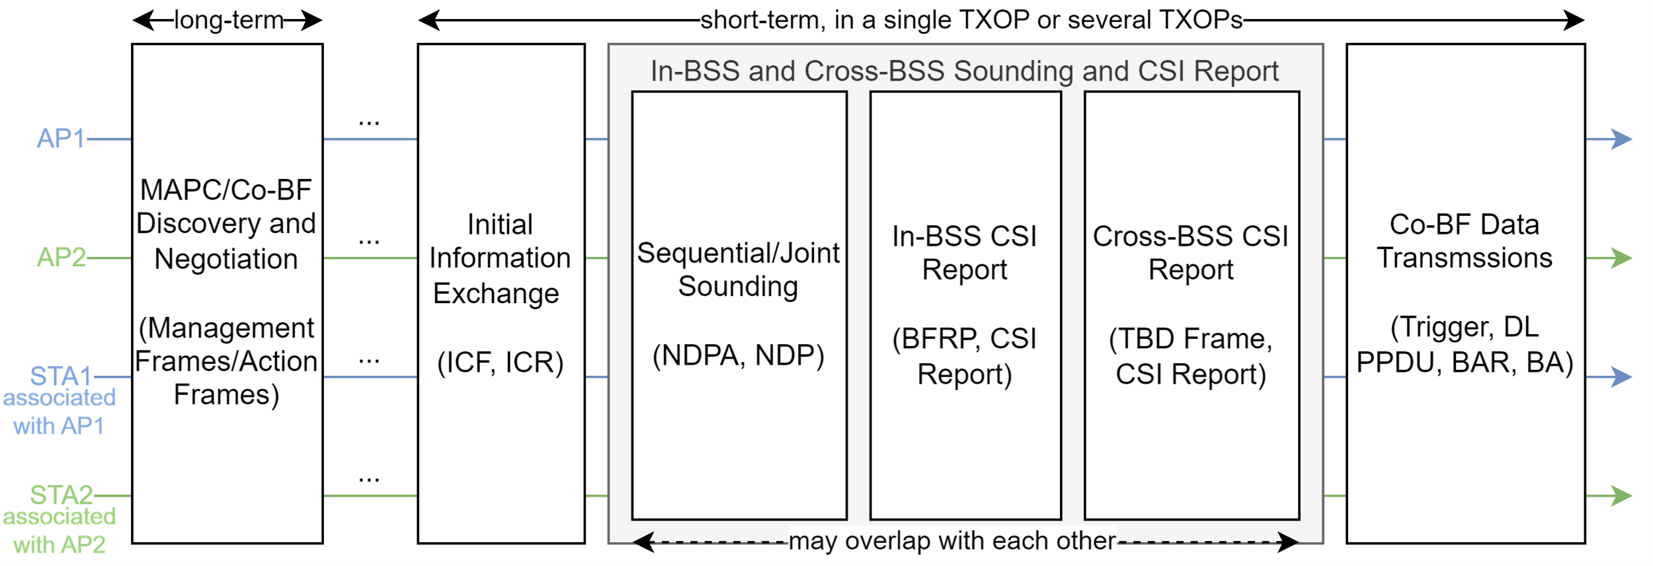
Recap: Co-BF Procedures
The main focus of this contribution is cross-BSS CSI report.
After sequential/joint sounding, the initiating AP and responding AP shall confirm that both APs received in-BSS/cross-BSS CSI and are ready before performing Co-BF data transmissions.

Slide 4
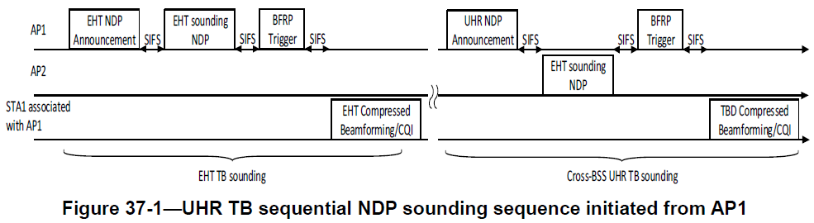
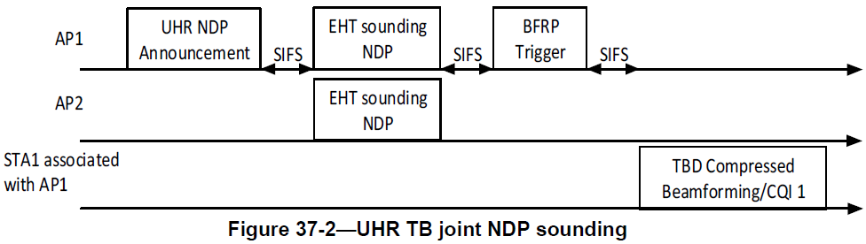
Recap: Sequential/Joint Sounding
IEEE P802.11bn/D0.1 defines UHR TB sequential/joint NDP sounding [1]
AP1 does not know whether AP2 receives the CSI feedback from STA1
Same issue for when AP2 sends the NDP Announcement

Slide 5
Recap: Cross-BSS CSI Feedback
An AP can overhear the CSI feedback from unassociated STA(s) over the air
  Does not need extra airtime for cross-BSS CSI report, low overhead if no errors
  Need security setup/overhead and good link quality between AP and unassociated STA(s)
An AP can forward the CSI feedback to another AP over the air
  Does not need assumption of overhearing/backhaul capabilities, can shift the processing and complexity to APs, usually more reliable than the overhearing method
  Need wireless AP-to-AP communications, need extra airtime for cross-BSS setup/CSI report, need extra overhead/complexity for TX/RX/encoding/decoding/… for APs
An AP can forward the CSI feedback to another AP over the wired backhaul
  Does not need extra airtime for cross-BSS CSI report, low overhead if no errors
  Need wired backhaul connection between APs, need signaling/coordination between the wired backhaul and wireless connections

Slide 6
Requirements for Cross-BSS CSI Feedback
For all the three options of cross-BSS CSI feedback:
Each AP needs to confirm with the other AP about the current status, e.g.,
  AP1 needs to know if AP2 received cross-BSS CSI feedback from unassociated STA(s)
Each AP needs to notify/trigger its associated Co-BF non-AP STAs about the current status and/or next step actions, e.g.,
  both APs are ready for Co-BF data transmissions
  non-AP STAs should be prepared for sounding/CSI feedback/Co-BF data transmissions/BA
If there is no status check of cross-BSS CSI feedback:
AP1/AP2 does not know whether cross-BSS CSI feedback fails or not, which may lead to performance degradation.

Slide 7
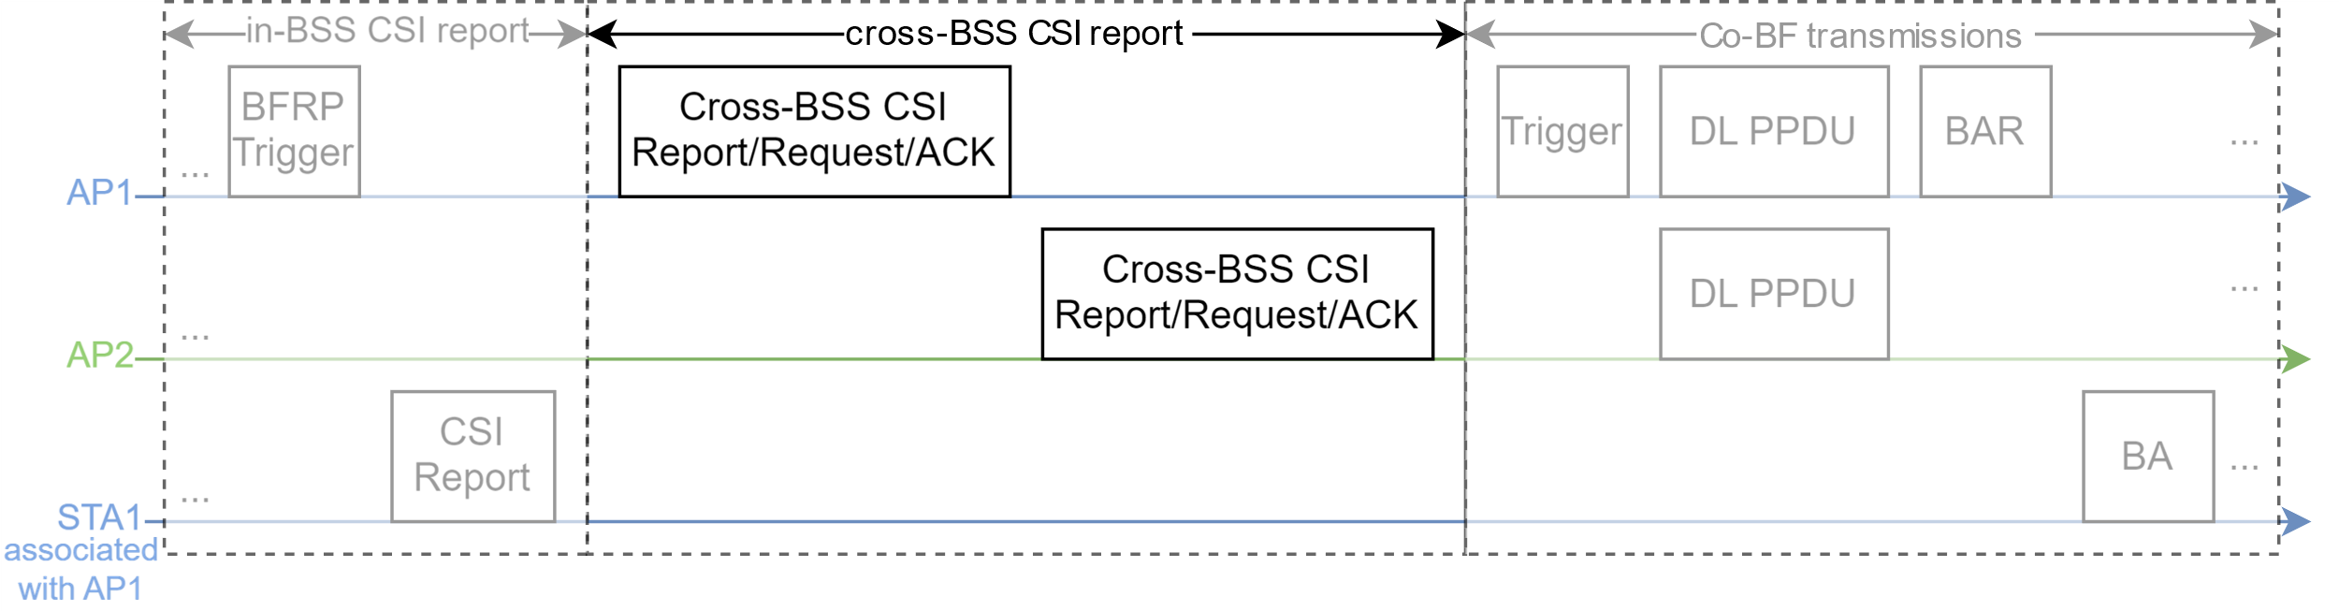
Proposal: Cross-BSS CSI Status Check and/or Report
AP1 and AP2 may check the status of each AP and/or send cross-BSS CSI report, after sequential/joint sounding and before Co-BF data transmission.
Example 1
Other examples in backup slides
May contain cross-BSS CSI Fail check (1 bit or several bits in new/existing frame), and initiate NDPA retransmission if the cross-BSS CSI reception fails, e.g., AP2 sends a frame to AP1 to indicate that AP2 didn't receive cross-BSS CSI from STA1

Slide 8
Proposal: Options for Cross-BSS CSI Failure
Other options if the cross-BSS CSI reception fails:
Continue Co-BF as is, with incomplete CSI feedback
Cross-BSS CSI retransmission/forwarding
Restart sounding (NDPA retransmission)/restart Co-BF
Roll back to Co-SR/Co-TDMA
Non-coordinated transmission from AP1 or AP2
Optionally cross-BSS CSI Request/Response/Report between Co-BF APs. It reduces overhead:
If AP1 receives CSI feedback (NDPA/NDP/BFRP/Compressed Beamforming/CQI do not fail),
meanwhile AP2 does not receive cross-BSS CSI feedback (e.g., due to bad link quality between AP2 and unassociated STA(s)),
then AP1 may forward cross-BSS CSI to AP2 and does not need to restart NDP sounding.

Slide 9
Other MAC Considerations for Co-BF
A Co-BF AP shall (or should) only initiate Co-BF if the TXOP for the Co-BF data part is longer than a TBD length.
  This is to make sure the data transmission part is long enough, so that Co-BF gains are high enough to justify the MAC overhead (ICF/ICR, NDPA/NDP/BFRP, in-BSS/cross-BSS CSI, TF/BAR/BA).
  Otherwise, Co-BF may reduce network performance such as throughput, efficiency, etc.
  The TXOP threshold can be calculated in different cases and set during MAPC/Co-BF negotiation.
A Co-BF non-AP STA shall (or should) be available for the negotiated parameters (e.g., channel, bandwidth, and time window) during the Co-BF TXOP(s).
  This is to reduce potential errors/retransmissions/interruptions/switching operations during Co-BF TXOP(s). Otherwise, it will increase the overhead/complexity and reduce the performance.
  Some features, e.g., DPS, DUO, NPCA, DSO, PM=1, etc., should be limited/disabled for the non-AP STAs that are participating in Co-BF. Otherwise, it will introduce extra overhead/complexity.
  There might be exceptions: certain Co-BF non-AP STAs may enter power save/unavailability mode depending on the Co-BF type (sequential/joint sounding) and scheduling within the Co-BF TXOP(s).

Slide 10
Conclusion
This contribution presents options and examples for cross-BSS CSI feedback for Co-BF.
To balance different system requirements such as performance, overhead, complexity, flexibility, etc., prefer to have
  Cross-BSS CSI Status Check initiated from the initiating AP
  Or bidirectional cross-BSS CSI Status Check initiated from the initiating/responding AP
  Optionally cross-BSS CSI Request/Response between Co-BF APs: may reduce overhead in some cases, but may introduce extra complexity.

Slide 11
References
[1] IEEE P802.11bn/D0.1, January 2025

Slide 12
Straw Polls
SP1: Do you support to add the following text to the TGbn SFD?
For Co-BF, the initiating AP and responding AP shall check with each other that the cross-BSS channel state information are received by both APs before performing Co-BF data transmissions.
Note: a Co-BF AP may send a TBD frame to a second Co-BF AP 1) to check or acknowledge whether the cross-BSS channel state information is received, and/or 2) to forward or request for the cross-BSS channel state information.
Result: Yes: , No: , Abstain:

Slide 13
Straw Polls
SP2: Do you support to add the following text to the TGbn SFD?
For Co-BF, if the initiating AP or responding AP fails to receive the cross-BSS CSI, the initiating AP may retransmit NDPA to restart the sounding procedure.
Note: if the in-BSS or cross-BSS CSI reception fails, Co-BF APs may have different options, such as continue Co-BF with incomplete CSI feedback, retransmit cross-BSS CSI, restart sounding, restart Co-BF, switch to Co-TDMA/Co-SR, or switch to non-coordinated transmissions from AP1 or AP2.
Result: Yes: , No: , Abstain:

Slide 14
Backup

Slide 15
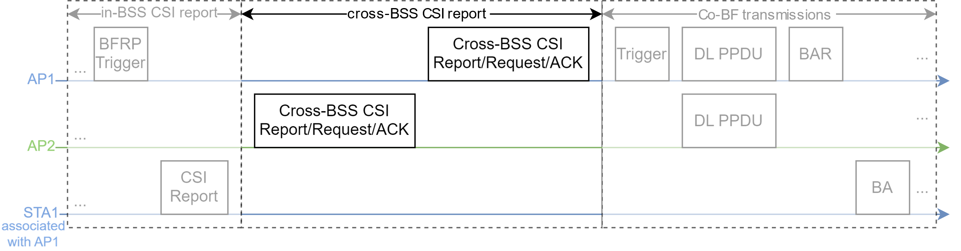
Example 2: Cross-BSS CSI Report and Status Check Initiated from the Responding AP
AP1 and AP2 may check the status of each AP and/or send cross-BSS CSI report, after sequential/joint sounding and before Co-BF transmission.
From the responding AP to the initiating AP

Slide 16
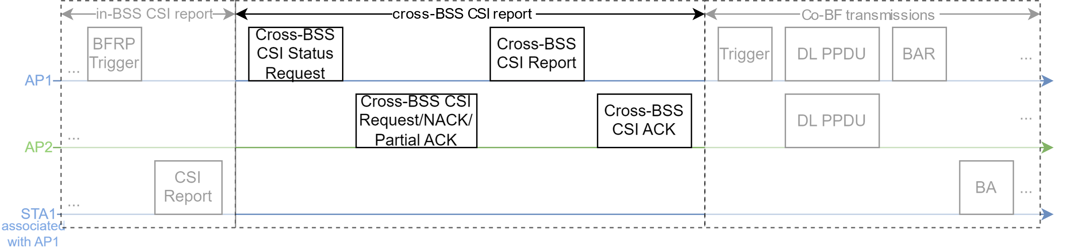
Example 3: Cross-BSS CSI Status Request and Report from Initiating AP
AP1 checks the status of AP2, then AP1 forwards cross-BSS CSI to AP2 if needed
Works for all cases: overhearing, forwarded over the backhaul/air.
Needs extra airtime for AP1 to check AP2’s status and to forward cross-BSS CSI feedback to AP2.

Slide 17
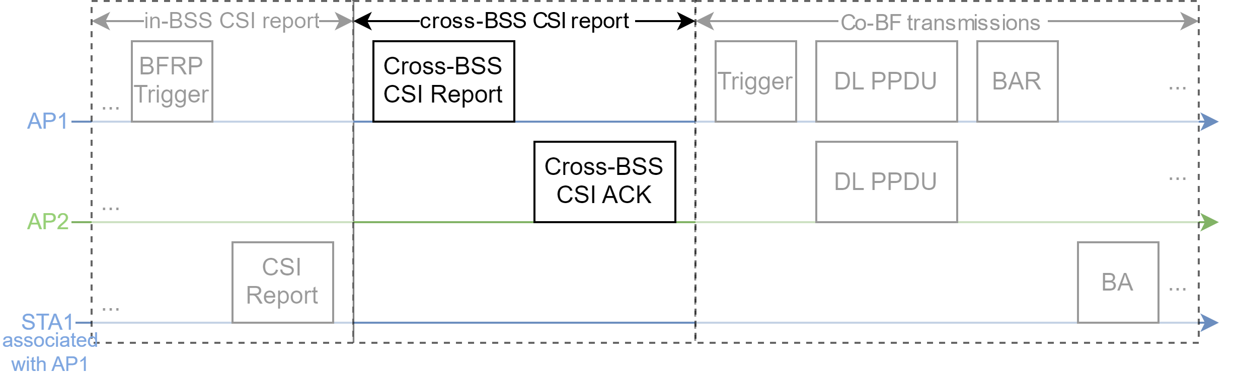
Example 4: Cross-BSS CSI Report from Initiating AP
AP1 directly forwards cross-BSS CSI report to AP2
Works for all cases: overhearing, forwarded over the backhaul/air.
Extra overhead if AP2 already received cross-BSS CSI Report by overhearing STA1 or forwarded from AP1 over the backhaul.

Slide 18
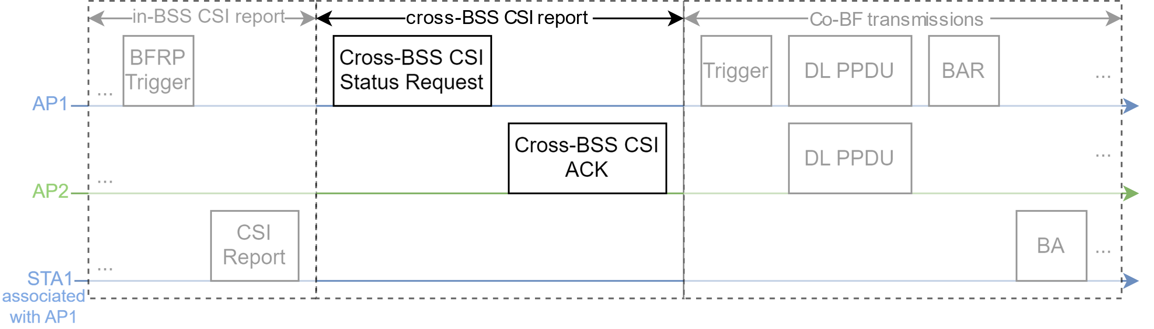
Example 5: Cross-BSS CSI Status Request from Initiating AP
Only works if AP2 already received the CSI report by overhearing from STA1, or forwarded from AP1 over backhaul.
Small overhead if AP2 already received cross-BSS CSI report.
Gives extra time and signaling for AP2 to make sure cross-BSS CSI is ready

Slide 19

Example 6: Cross-BSS CSI Report from Initiating AP with Retransmissions
Works for all cases: overhearing, forwarded over the backhaul/air.
Extra overhead if AP2 already received cross-BSS CSI Report by overhearing STA1 or forwarded from AP1 over the backhaul.
Needs extra airtime in case of retransmissions.

Slide 20
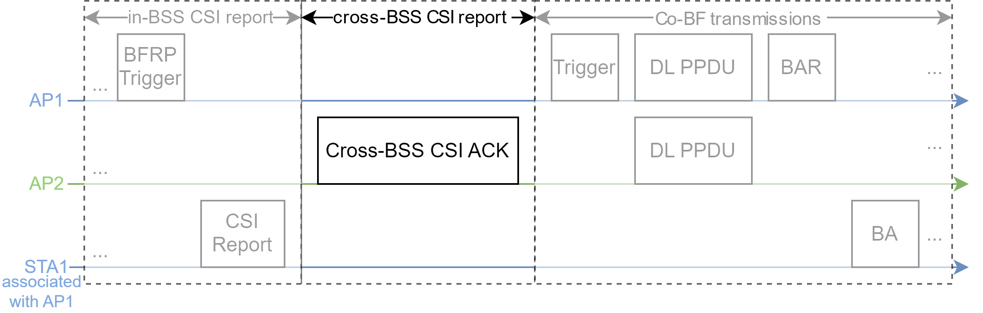
Example 7: Cross-BSS CSI ACK from Responding AP
Only works if AP2 already received the CSI report by overhearing from STA1, or forwarded from AP1 over backhaul.
AP2 needs to know that AP1 and STA1 are ready for cross-BSS CSI report, or define rules to let AP2 always send cross-BSS CSI ACK to AP1.

Slide 21
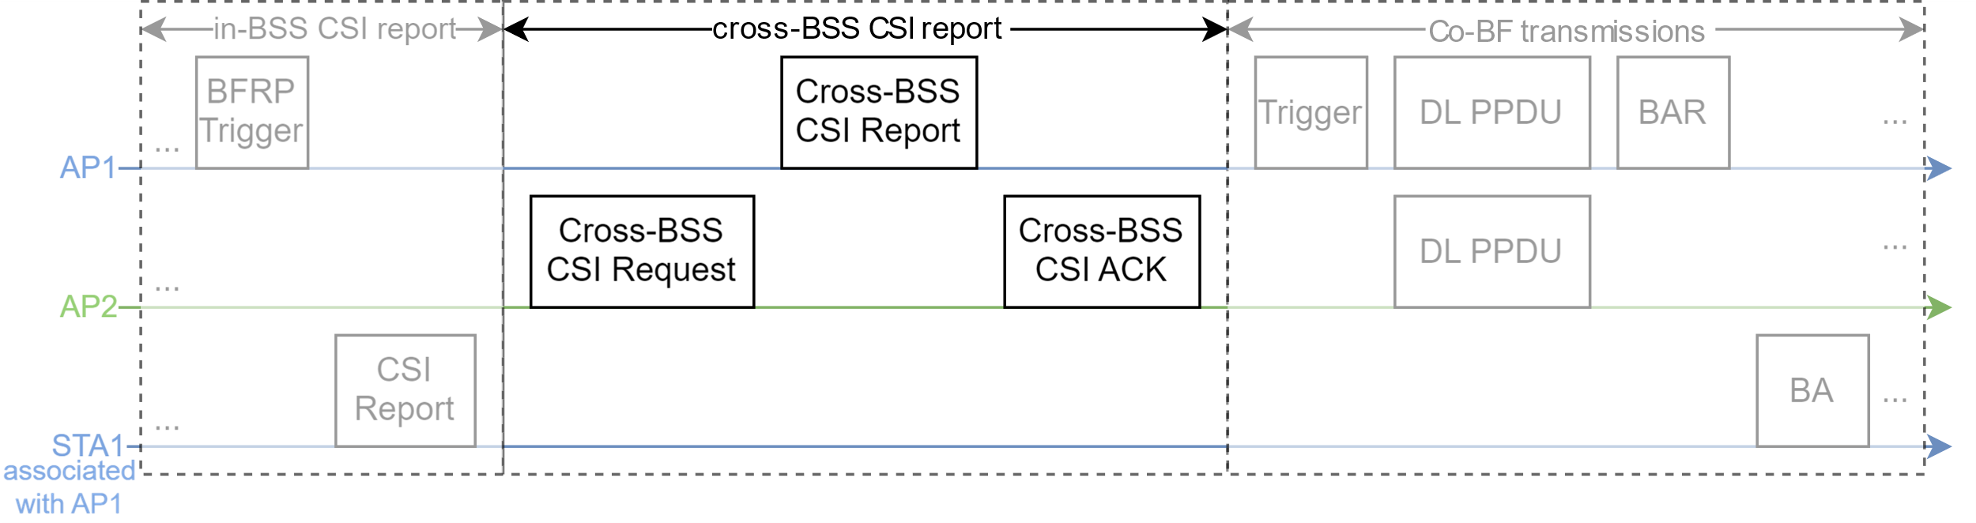
Example 8: Cross-BSS CSI Request from Responding AP
Works for all cases: overhearing, forwarded over the backhaul/air.
Cross-BSS CSI Request may be combined with cross-BSS CSI ACK/BFRP.
AP2 needs to know that AP1 and STA1 are ready for cross-BSS CSI report.

