Slide 1
Multi-AP coordination for AP power saving
Date: 2025-03-26
Authors:

Slide 2
Introduction
AP power saving is an important functional requirement of the TGbn standards[1].
  Some types of APs[3] with different power saving requirements can be listed down as below:
    battery powered, socket powered, enterprise APs during non-working hours, stadium/mall APs during non-operating hours and so on.
  Accordingly, various AP power saving schemes have been introduced[4] such as:
    capability reduction, link disablement, scheduled AP PS, dynamic AP PS and so on.
  MAC motion#49 has been approved[2] for AP PS and it states below:
    Define a new mechanism and/or enhance existing mechanism for AP power save
M-AP coordination topic is being extensively investigated to achieve efficient channel & resource utilization with reduced interference among APs, in both enterprise & residential scenarios. e.g. schemes: C-TDMA, C-rTWT, C-BF, C-SR and so on.
  MAC motion#29 has been approved[2] for M-APC and it states below:
    Define a multi-AP Coordinated Spatial Reuse at TxOP-level with power control
    Define multi-AP Coordinated Beamforming
    Other multi-AP coordination modes are TBD
  Joint motion#50 and 51 have been approved[2] for M-APC and they state below respectively:
    11bn defines a common framework of a M-AP Coordination for various coordination schemes.
      Note - Coordination schemes such as (but not limited to): Co-SR (TXOP-based with power control), Co-BF, Co-TDMA , C-RTWT, etc.
    11bn defines a common framework of a M-AP Coordination that can enable the following procedures:
      M-AP Coordination Discovery procedure
      M-AP Coordination agreement negotiation procedure
      Note: Details of the procedures and whether the above procedures are mandatory/optional – TBD

Slide 3
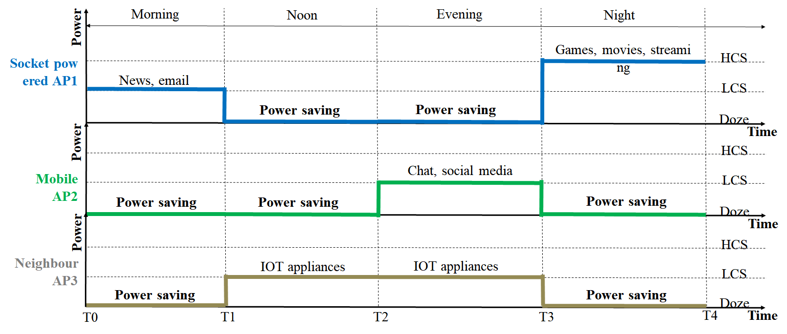
Motivation
Considering a typical residential scenario which may comprise: a socket powered AP1, a portable Wi-Fi AP2, a mobile hotspot AP3 - kind of three APs which can coordinate to pair-up for “datatype-to-AP binding” such that:
  AP1 serving highest QoS data such as streaming, movies, gaming, 4k content etc. in HCS during night time
  AP2 serving medium QoS data such as email, chat, browsing, background etc. in medium capability during evening time
  AP3 serving lowest QoS data such as IoT, meter readings etc. in LCS during noon/evening time
  While above APs are in active state, there is an intuitive way for “power state coordination” achievable which may help to maximize AP power savings as well as meet the required QoS of the household.
Most of the M-APC schemes, currently, aim to optimize channel usage and protect the OBSS AP’s TXOP by using methods such as C-TDMA, C-rTWT or trying to avoid interference and increase reliability of transmissions using methods such as C-BF, C-SR etc.
The uniform M-APC framework can be leveraged further to achieve a “coordinated AP power saving” to optimize the maximum possible AP power saving while simultaneously supporting the participating APs to meet the QoS of the associated clients as well.
For the same, the uniform M-AP coordination framework needs to be extended to also include parameters associated to AP power saving capability for parameter sharing and negotiations during the coordination.

Slide 4
Abstract
Present M-AP coordination schemes aim to protect part of the ‘wake-up/active period’ of the AP state.
But there is no protection (via coordination) for the periods consisting of doze/in-active/low capability state(LCS) of the AP.
These doze/in-active/LCS states are the actual durations (of an AP's power cycle) which are responsible for achieving the expected power saving and these states are easily interrupted by several external factors such as:
  A Trigger/Control frame received in low power listen only mode (e.g. in legacy systems - such as WUR frame, in UHR context – an ICF frame), may wakeup AP to go to full awake state.
  A STA forcing AP to move from LCS to HCS to meet the QoS requirement.
  A STA with high priority, time sensitive traffic may pre-empt the ongoing transmission of the AP causing suspension & resumption of the ongoing data transmission thus causing AP to remain awake for overall longer duration.
  Other channel and data transmission related environment dynamics, which in turn also affects the STA performance in terms of loss of service, signalling overhead, inefficient radio resource utilization, STA power consumption etc.
Protecting these low power consumption states(of AP) is of equal importance to achieve the desired UHR goal of AP power savings and accordingly, this contribution introduces the concept to –
  extends the M-AP coordination framework to bring in coordinated power saving among the neighbouring APs thus trying to optimize the maximum possible power saving and minimize any interruption events.

Slide 5
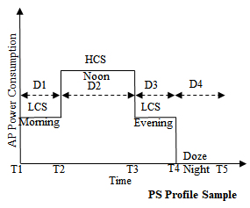

Extending uniform M-APC framework for AP PS
Phase1: Initiation
Phase2:
Capability Advertisement & Discovery
Phase3:
Negotiation
Phase4:
Pre-operations
Phase5:
Extended protection
Cater both (non-) enterprise scenarios.
In non-enterprise scenario, initiator can be household owner for different types of APs supporting the feature.
Can be closed group of APs e.g. within set of apartments.
Can be open group of APs.
Benefits even enterprise AP to initiate for any ad-hoc change in user-density or traffic profile at any location, at any time of day.
Trigger for initiation can be:
initiated by owner
initiated by any AP at boot-up/ power save mode on
initiated by any AP at ad hoc/ threshold based change in traffic profile
initiated by any AP at ad hoc/ threshold based change in power consumption etc.
Phase2a (capability configuration):
A supporting UHR AP shall have a PS Profile(PP) that it can share among other APs for negotiation/ coordination purposes.
PP comprises of an ‘information set (parameters: TBD)’ which represents the power saving needs & pattern of an AP.
To generate a PP, the system may comprise at least an input layer, an analysis function(AF) and an output layer, wherein AF can be realized either at AP itself or the backend DS system.
Phase2b (advertisement & discovery):
A supporting UHR AP shall advertise the set of relevant information(+PP), for discovery.
It may also advertise, optionally, the support of other M-APC schemes (e.g. C-TDMA, C-rTWT, C-SR, C-BF etc.) to be used as schemes for the awake period of the AP and also help to realize a common unified framework for M-APC (format: TBD)
During the negotiation process, PPs of all participating APs shall be used for further processing using a negotiation function(NF) which can be realized either at an AP or at the backend DS system.
NF shall generate a Negotiated PS Profile(NPP) for all the participating APs and inform them of the same.
NF shall ensure to meet certain criteria while creating NPP for optimization and fairness.
Criteria example:
fair probability/ chance to conserve power for each participating AP
ensure at least one OBSS AP is available in HCS state
ensure at least one OBSS AP is available in LCS state
ensure there is no coverage hole
Each AP shall apply their corresponding power saving configuration (from NPP) in their BSS.
Additionally - if there is any other M-APC scheme negotiated to be used in AP's awake state then it shall be applied in its BSS.
An AP shall inform its associated clients about the configured power saving pattern at the earliest possible TXOP.
During the coordinated operation, participating APs may help each other to handle any disrupting event using existing/new mechanism of relocating STA,
Thus APs help to achieve extended protection for each other’s negotiated PP and help to maximize the AP power saving & meet the QoS while strictly following the coordinated PS cycles.
Disrupting event example:
a STA that may lose service if serving AP anticipates going into doze/sleep state.
a STA whose QoS is not met in current capability state of serving AP.
a STA causing the need for load balancing on serving AP.

Slide 6
Summary
AP power saving is one of the key functional requirements for UHR TGbn standards.
Currently in the M-AP coordination schemes, there is no protection and no coordination for the periods consisting of doze, in-active or low capability state(LCS) of the AP, while these are the actual durations which are responsible for achieving the expected power saving of any type of AP device.
Accordingly, in this contribution we have proposed to extend the uniform M-APC framework to realize the scheme of: a multi-AP coordination for AP power saving, which is beneficial for both non-enterprise as well as enterprise scenario.
Coordinated handling and protection of participating AP’s negotiated power saving cycles will also help to conserve their associated STA’s power via reduced signalling overheads.

Slide 7
SP#1
Do you support extending the uniform multi-AP coordination framework to support AP power saving (of the participating APs) in TGbn ?
- Yes / No / Abstain

Slide 8
References
[1] 11-23/244r1 “AP Power Save PAR addition proposal”, Amelia Andersdotter, et. al.
[2] 11-24-0171-15-00bn-tgbn-motions-list-part-1
[3] 11-23-1835-00-00bn-ap-power-management
[4] 11-23-0010-00-0uhr-considerations-for-enabling-ap-power-save

