Slide 1
Co-SR Power Control
Date: 2025-03-26
Authors:

Slide 2
Introduction
TGbn defines a multi-AP Coordinated Spatial Reuse (Co-SR) at TXOP-level with power control [1].
There are some discussions on method of power control, but currently no consensus on this topic.
  In [2], The Trigger frame that initiates the Co-SR transmission indicates the TX power limit of the shared AP.
  In [3], [4], ICF and ICR for exchanging control information between APs can be used for power control.
In this contribution, we introduce a power control solution for Co-SR with some shared information, involving two negotiation modes using ICF/ICR exchange to facilitate power control.

Slide 3
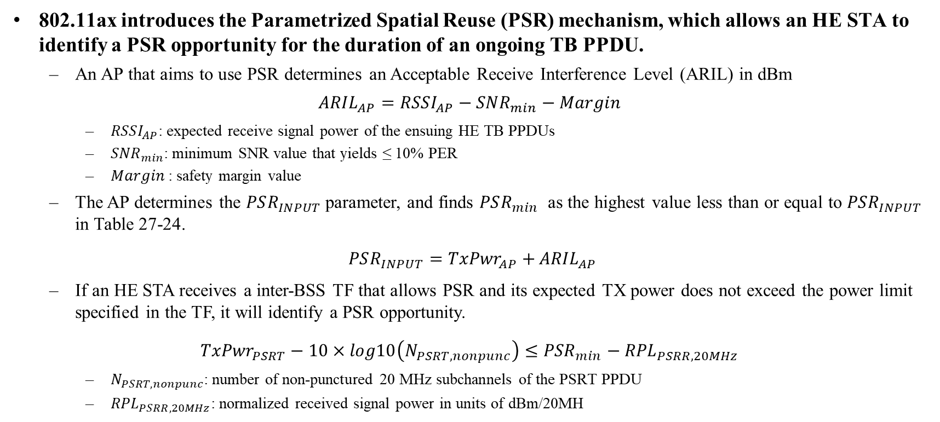
Recap: Power Limitation in PSR
802.11ax introduces the Parametrized Spatial Reuse (PSR) mechanism, which allows an HE STA to identify a PSR opportunity for the duration of an ongoing TB PPDU.
  An AP that aims to use PSR determines an Acceptable Receive Interference Level (ARIL) in dBm
$${ARIL}_{AP}={RSSI}_{AP}−{SNR}_{min}−Margin$$
    ${RSSI}_{AP}$: expected receive signal power of the ensuing HE TB PPDUs
    ${SNR}_{min}$: minimum SNR value that yields ≤ 10% PER
    $Margin$: safety margin value
  The AP determines the $PSR_{INPUT}$parameter, and finds $PSR_{min}$ as the highest value less than or equal to $PSR_{INPUT}$ in Table 27-24.
$PSR_{INPUT}={TxPwr}_{AP}+$ ${ARIL}_{AP}$
  If an HE STA receives a inter-BSS TF that allows PSR and its expected TX power does not exceed the power limit specified in the TF, it will identify a PSR opportunity.
${TxPwr}_{PSRT}−10×log10\left(N_{PSRT,nonpunc}\right)≤{PSR}_{min}−$ ${RPL}_{PSRR,20MHz}$
    $N_{PSRT,nonpunc}$: number of non-punctured 20 MHz subchannels of the PSRT PPDU
    ${RPL}_{PSRR,20MHz}$: normalized received signal power in units of dBm/20MH

Slide 4
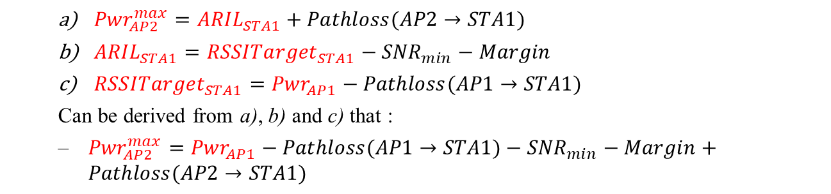
Power Limitation in Co-SR
Unlike PSR, Co-SR involves simultaneous DL transmission. When AP1 utilizes Co-SR for delivering DL PPDU to STA1, it shall determine the maximum TX power limit of AP2:
  ${Pwr}_{AP2}^{max}={ARIL}_{STA1}+Pathloss(AP2→STA1)$
  ${ARIL}_{STA1}={RSSITarget}_{STA1}−{SNR}_{min}−Margin$
  ${RSSITarget}_{STA1}={Pwr}_{AP1}−Pathloss(AP1→STA1)$
  Can be derived from a), b) and c) that :
  ${Pwr}_{AP2}^{max}={Pwr}_{AP1}−Pathloss(AP1→STA1)−{SNR}_{min}−Margin+Pathloss(AP2→STA1)$
The same way for AP2 to determine the maximum TX power limit of AP1.
According to the above equation, we can draw the following conclusion:
  Except for the AP TX power, the other items on the right side of the equation are semi-static parameters related to the STA, and the AP can obtain these parameters through the measurement procedure.
  When AP’s TX power increases, the maximum TX power limit of the OBSS AP will increase proportionally.
  When OBSS AP’s TX power is reduced, the maximum TX power limit of the AP will also be reduced proportionally.

Slide 5
Power Control for Co-SR (1/3)
In this contribution, we assume that the APs have completed both the MAP negotiation and the Co-SR measurement procedure, and have already obtained measurement results related to their STAs (i.e., Pathloss, minimum SNR and other TBD parameters).
An AP’s shared information for power control (for each STA and MCS):
  Expected TX power: The expected TX power deliver DL PPDU during Co-SR transmission.
  Maximum TX power limit of OBSS AP: Determined by the expected TX power of the AP and the measurement results.
  Power headroom (or Maximum TX power): The gap between the expected and the maximum TX power of the AP in units of dB.
  Minimum TX power: The minimum TX power by the AP, ensuring that its STA is available to decode the PPDU without interference from OBSS AP.

Slide 6
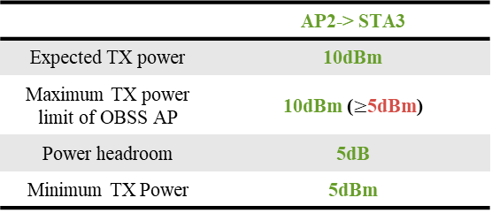
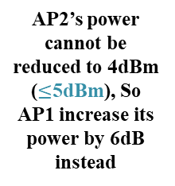
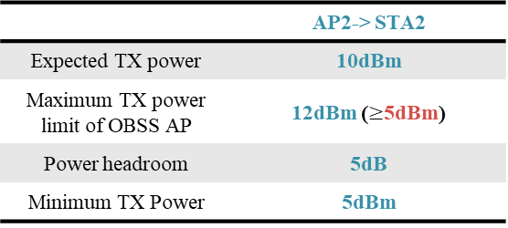
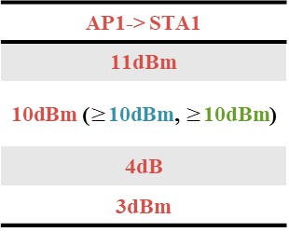
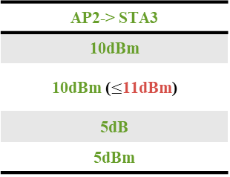
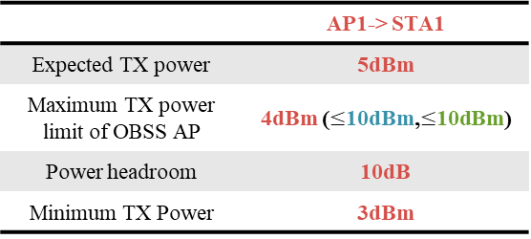
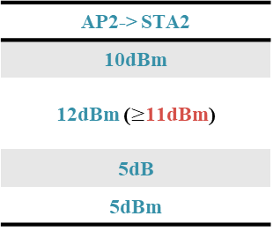
Power Control for Co-SR (2/3)
Example: An AP equipped with global power control information can adjust parameter values using Power headroom to meet the power requirements of both APs.
 | AP1-> STA1
Expected TX power | 5dBm
Maximum TX power limit of OBSS AP | 4dBm ($≤$10dBm,$≤$10dBm)
Power headroom | 10dB
Minimum TX Power | 3dBm
AP2’s power cannot be reduced to 4dBm ($≤$5dBm), So AP1 increase its power by 6dB instead
AP1-> STA1
11dBm
10dBm ($≥$10dBm, $≥$10dBm)
4dB
3dBm
Expected TX power of AP1
 | AP2-> STA2
Expected TX power | 10dBm
Maximum TX power limit of OBSS AP | 12dBm ($≥$5dBm)
Power headroom | 5dB
Minimum TX Power | 5dBm
AP2-> STA2
10dBm
12dBm ($≥$11dBm)
5dB
5dBm
Adjusted TX power of AP1
 | AP2-> STA3
Expected TX power | 10dBm
Maximum TX power limit of OBSS AP | 10dBm ($≥$5dBm)
Power headroom | 5dB
Minimum TX Power | 5dBm
AP2-> STA3
10dBm
10dBm ($≤$11dBm)
5dB
5dBm
AP2 discards STA3 because it cannot meet the requirements no matter how the power is adjusted.

Slide 7
Power Control for Co-SR (3/3)
The benefits of AP gathering such global power control information before performing Co-SR:
  Using global information for power control overcomes the deficiency of an AP recommending power for an OBSS AP based solely on its own information. For example:
    While recommending the maximum TX power limit for the OBSS AP, the AP is unaware of its impact on the OBSS STA, which can potentially lead to transmission failure.
    In some cases, the APs cannot do Co-SR transmission due to one AP’s power cannot be reduced below its minimum TX power. Since no shared information like power headroom is provided, Co-SR cannot be achieved in an alternative way: increasing the other AP’s TX power.
  Therefore, it is also important to negotiate the power in advance to avoid sudden transmission failures before performing Co-SR transmission.
  AP can also perform STA selection from more than one candidate STAs according to these information.

Slide 8
Two Co-SR Power Control Negotiation Modes
The power control negotiation is done by performing ICF/ICR exchange during the polling phase Before Co-SR transmission.
  Whether to allow more than one candidate shared AP is TBD.
Mode 1: Decision by sharing AP
  Pre-transmission: AP1 selects one or more candidate STAs.
  ICR: If AP2 is willing to participate, the ICR includes the shared power control information of its candidate STAs.
  Co-SR trigger: Based on known information, If there is a change in AP2’s power from the expected TX power, the Co-SR trigger includes the adjusted TX power of AP2, or it includes the expected TX power.
Mode 2: Decision by shared AP.
  Pre-transmission: AP1 decides to transmit only to STA1.
  ICF: The ICF includes the shared power control information.
  ICR: Based on known information, if AP2 determines to participate, and there is a change in AP1’s power from the expected power, the ICR includes the adjusted TX power of AP1, or it includes the expected TX power.
Shared power control information
Adjusted power
Adjusted power
Shared power control information

Slide 9
Summary
This contribution introduces a power control solution based on shared power control information for Co-SR.
  Two possible modes for power control signaling based on ICF/ICR exchange are proposed.

Slide 10
Straw Poll
SP: Do you support to include the following text to 11bn SFD?
  In UHR Co-SR, One of the APs needs to obtain global power control information before Co-SR transmissions. The following shared power control information of an AP shall be carried either in the ICF or the ICR during the polling phase before Co-SR transmission:
    Expected TX power
    Maximum TX power limit of OBSS AP
    Power headroom (or Maximum TX power)
    Minimum TX power
  The adjusted TX power shall be carried either in the ICR or the trigger frame that initiates Co-SR.

Slide 11
References
[1] 11-24-0209-12-00bn-specification-framework-for-tgbn
[2] 11-25-0254-00-00bn-co-sr-power-control-considerations
[3] 11-24-1514-01-00bn-multi-ap-framework-for-c-sr
[4] 11-25-0343-00-00bn-consideration-on-multi-ap-framework-for-co-sr

