Slide 1
Details on the unified MAPC framework
Date: YYYY-MM-DD
Authors:
Name | Affiliation | Address | Phone | Email
Junbin Chen | TP-Link Systems Inc. |  |  | chenjunbin@tp-link.com.hk
Yunpeng Yang |  |  |  | yangyunpeng@tp-link.com.hk
Renfang Zhou |  |  |  | zhourenfang@tp-link.com.hk
Yaoshen Cui |  |  |  | cuiyaoshen@tp-link.com.hk
Haozheng Li |  |  |  | lihaozheng@tp-link.com.hk
Qingwei Fu |  |  |  | fuqingwei@tp-link.com.hk
Shuyu Shi |  |  |  | shishuyu@tp-link.com.hk
Yu Zhu |  |  |  | zhuyu@tp-link.com.hk

Slide 2
Recap: MAP framework
In 11bn D0.1 [1-2] we have agreed that the MAP shall be defined in a unified framework:
[M50] 11bn defines a common framework of a Multi-AP Coordination for various coordination schemes.
Note - Coordination schemes such as (but not limited to): Co-SR (TXOP-based with power control), Co-BF, Co-TDMA, Co-RTWT, etc.
[M51] 11bn defines a common framework of a Multi-AP Coordination that can enable the following procedures:
Multi-AP Coordination Discovery procedure
Multi-AP Coordination agreement negotiation procedure
Note: Details of the procedures and whether the above procedures are mandatory/optional - TBD

Slide 3
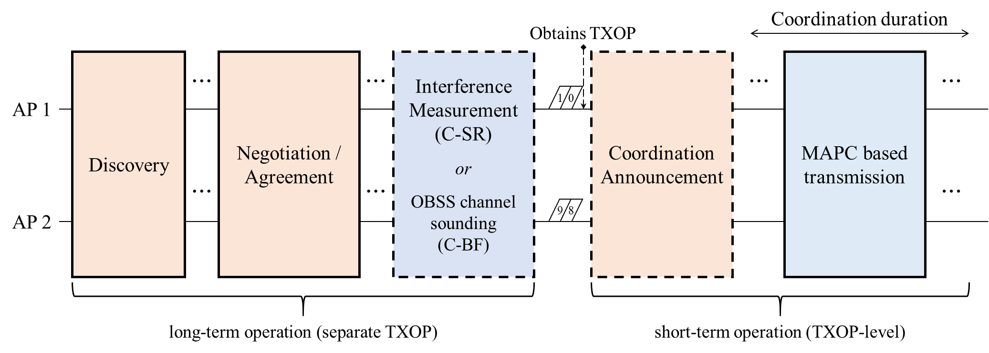
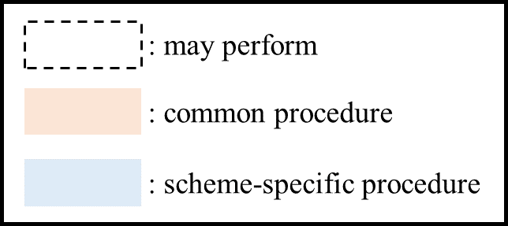
Recap: unified MAPC framework
The unified MAPC framework has been discussed a lot.
Specifically, the MAPC framework is divided into the long-term and short-term operations in [3].
The long-term operation is composed of Discovery, Negotiation, and some feature-specific long-term phase.
The short-term operation is composed of MAPC announcement and feature-specific MAPC transmission.

Slide 4
A timeline of the MAPC framework
(long-term) The APs shall announce their MAPC capability in the discovery phase.
A natural way is to announce via the beacon frame or
define a new probe behavior between APs.
(long-term) The APs negotiate for one or more MAPC agreements if they are discovered by each other.
Here we shall define a unified frame exchange for the negotiation of different MAPC features.
The unified negotiation had better to be able to setup more than one agreements via only a round of frame exchange.
E.g., assume that AP1 sends a MAPC Req frame requesting for both the C-SR and C-BF agreements.
The agreement(s) is valid until it has been renegotiated or deleted.
MAP Discovery
MAPC agreement is valid for period 1
MAPC agreement is renegotiated
TXOP1
TXOP2 of AP1
TXOP3 of AP2
TXOP4
TXOP5 of AP1
Beacon
Negotiation phase
e.g., C-SR & C-BF
Query ICF
Transmission phase w/ or w/o MAPC
e.g., C-SR
Query ICR
Transmission phase w/ or w/o MAPC
e.g., C-BF
Negotiation phase
e.g., C-SR & C-BF
& C-TDMA
Query ICF
Transmission phase w/ or w/o MAPC
e.g., C-TDMA
AP1
Beacon
Query ICR
Query ICF
Query ICR
AP2

Slide 5
A timeline of the MAPC framework
(short-term) The sharing AP query for the MAPC intention of candidate APs.
The AP who has negotiated a least one MAPC agreement and wins TXOP is the sharing AP.
The query procedure can be an ICF-ICR frame exchange, indicating the specific MAPC feature to be used in this TXOP.
The candidate APs respond with ICR indicating their intention to participate in the MAPC transmission in this TXOP.
(short-term) The sharing AP and shared APs perform the specific MAPC operations.
The specific MAPC transmission would be scheduled by the sharing AP at any time during the TXOP.
E.g., the sharing AP may communicate with its own associated STAs first and then trigger the MAPC transmission later.
MAP negotiation is valid until updated negotiation
MAPC agreement is renegotiated
TXOP1
TXOP2 of AP1
TXOP3 of AP2
TXOP4
TXOP5 of AP1
AP1
Negotiation Req
Query ICF
Transmission for BSS1
MAPC Transmission
e.g., C-SR
Query ICR
Transmission phase
e.g., C-BF
Negotiation Resp
Query ICF
Transmission phase
e.g., C-TDMA
Negotiation Resp
Negotiation Request
Query ICR
Query ICF
Transmission for BSS2
Transmission for BSS2
Query ICR
AP2

Slide 6
The MAPC negotiation phase
To negotiate one or more MAPC agreements via only a round of frame exchange, we suggest to define a new Action frame as follows.
The MAPC Action field indicates that it is a MAPC negotiation setup Request/Response or delete Request/Response frame.
The MAPC feature bitmap indicates the specific MAPC feature that is to be negotiated (or to be delete).
The specific negotiation element (e.g. Co-SR negotiation element) includes the information required for agreement setup.
MAPC negotiation Request/Response frame
Category
UHR Action
Dialog Token
MAPC Action
APID assignment
MAPC feature bitmap
Co-SR negotiation subelement
Co-TDMA negotiation subelement
...
Octets: 1 1 1 1 0 or 2 1 0 or TBD 0 or TBD
Note: the MAPC feature bitmap can function as status code to some degree. E.g., a specific feature negotiation that is requested but not in the response can be regarded as a failed negotiation.
Or, the status code can be carried in each MAPC subelement.
0/1-ADD MAPC req/resp
2/3-update MAPC req/resp
4/5-DEL MAPC req/resp

Slide 7
The MAPC query phase
At each TXOP, the TXOP holder may initiate an ICF/ICR exchange to query for the intention of participating MAPC transmission.
Generally the ICF can be a trigger frame (e.g., the BSRP), then the ICR can be multi-STA BA with feedback information.
In the common info (or special user info), the TXOP holder shall indicate that which specific MAPC scheme is going to be executed in this TXOP.
We suggest to indicate such information in the Trigger dependent User Info subfield of the Special User info field.
The presence of such a trigger dependent user info field can be identified by the tuple {Trigger type + PHY Version identifier}.
A example is shown as follows, the Query type subfield distinguish the BSRP for unavailability query and that for MAPC intention query.
Octets: 2 2 6 6 8 or more variable variable variable 4
Frame control
Duration
RA
TA
Common Info
Special User Info
User Info List
Padding
FCS
AID12
PHY Version Identifier
…
Trigger dependent User Info
Query type
MAPC feature bitmap
…

Slide 8
Summary
We review the unified MAPC framework, and present some considerations on the details of the unified MAPC framework.
The MAPC framework shall be divide into the long-term operation and short-term operation.
The MAPC negotiation shall be a long-term operation.
A unified MAPC negotiation frame format is proposed, and APs may setup one or more MAPC agreements via only a round of such negotiation frame exchange.
We suggest that the short-term MAPC operation shall be initiated by a MAPC query phase.
An ICF format is proposed and sharing AP may use it to query for the MAPC intention of candidate APs.

Slide 9
References
[1] 802.11bn-D0.1
[2] 24/0171 TGbn Motions List - Part 1
[3] 24/1514 Multi-AP framework for C-SR, Geonhwan Kim (LG Electronics)

Slide 10
Straw Poll 1
Do you support the following:
The TXOP earned by sharing AP can be divided into several phases, including:
the MAPC negotiation phase, wherein the sharing AP initiate, update or tear down one or more MAPC agreements with shared AP(s);
the MAPC query phase, wherein the sharing AP announce a specific MAPC scheme and query with shared APs for the intention of participating MAPC;
the exclusive transmission phase, wherein the sharing AP may occupy the wireless medium and serve the STAs belong to its own BSS;
the MAPC transmission phase, wherein the sharing AP cooperates with shared AP(s) to transmit data at the same time, or shares TXOP with shared AP(s);

Slide 11
Straw Poll 2
Do you agree that a sharing AP may initiate, update or tear down one or more MAPC agreements with a shared AP during one MAPC negotiation phase?
One MAPC negotiation phase is composed of a TBD negotiation request frame and a TBD negotiation response frame.
The established MAPC agreements are valid for multiple TXOPs until it is explicitly updated or teared down.

Slide 12
Straw Poll 3
Do you agree that during each TXOP the sharing AP earned, a sharing AP shall query with shared AP(s) for the intention of participating MAPC, if the sharing AP wants to perform MAPC in that TXOP?
The sharing AP shall announce a specific MAPC scheme, which might be performed by the sharing AP in that TXOP, in the MAPC query frame.
The details of the MAPC query frame and its response are TBD.
If the sharing AP decide not to perform any MAPC in this TXOP, the MAPC query phase can be omitted.

