Slide 1
802.15.4 Coexistence Feature Update
TG 19.3a Contribution
Date: 2025-03-13
Authors:
Name | Affiliations | email
Benjamin Rolfe | BCA, et al | Ben.rolfe @ ieee.org
Notice: This document has been prepared to assist IEEE 802.19. It is offered as a basis for discussion and is not binding on the contributing individual(s) or organization(s). The material in this document is subject to change in form and content after further study. The contributor(s) reserve(s) the right to add, amend or withdraw material contained herein.

Slide 2
Summary
802.15.4 has had several amendments and two revisions since 2019
Some useful features and changes added since 2019 may be useful for coexistence recommendations
This identifies some new or revised features that might be useful to this group

Slide 3
802.15.4 Channel Access: 802.15.4-2024 (Revision E)
Multiple CSMA variations
  Multiple Clear Channel Assessment Methods
  Multipole Prioritized CSMA schemes
  Suspendable CSMA-CA algorithm *new*
  Latency bounded random access (SSBD)
Multiple scheduled access methods
  Some with, some without CSMA
  Some cleanup in Revision E
  Some changes to make TSCH more general in draft 15.4ab
  Peer-wise coordination (distributed) added in 802.15.4z
  Some use channel access with sensing (listen) in conjunction with scheduled access

Slide 4
Multiple CCA methods
Mode 1: Energy above threshold (ED).
Mode 2: Carrier sense only (CS)
CCA Mode 3: Combination of ED and CS
  3a ED and CS
  3b ED or CS
ED Threshold and Duration variable
Flexibility to meet different operating environments, performance profiles, and regulator requirements

Slide 5
Random Access: multiple CSMA Variations
Simple unslotted CSMA
Slotted CSMA with scheduled access
  Multiple superframe types defined
  TSCH, DSME and RCC support slotted CSMA
CSMA with Priority (PCA)
CSMA with linear backoff (latency bounding) aka Spectrum Sensing Based Deferral (SSBD)

Slide 6
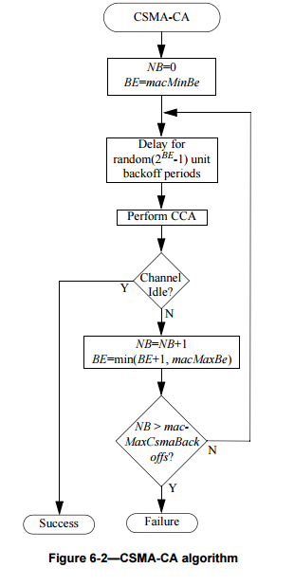
Brief look at CSMA
Simple and flexible
  Can reduce to simple LBT without iterative backoff
  Can bound backoff growth

Slide 7
Optional backoff suspension in
CSMA-CA algorithm
Incorporated into 802.15.4-2024 (Rev E)
Adds capability to sensed channel using the selected CCA mode during the backoff delay period.
Provides improved performance in congested spectrum
Grew out of changing requirements in key applications such as smart energy/grid modernization in Japan and other regions
Expands trade-off space for optimizing and adaptation
More information: https://mentor.ieee.org/802.15/dcn/23/15-23-0234-02-04me-proposed-csma-changes.docx
https://mentor.ieee.org/802.15/dcn/23/15-23-0167-00-0000-the-csma-gap-analysis-between-ieee-802-15-4-and-japanese-standard-jj-300-10.pptx

Slide 8
Added contention-based channel access introduced in (draft) P802.15.4ab: SSBD
Spectrum Sensing Based deferral
CSMA with linear backoff and a few other changes
Iterative sense/backoff/sense as in CSMA
  Uses linearly growth in random backoff
  Provides for fine resolution bounding of channel access latency
  Intended for low-latency use cases
Include optional persistence
  Simplified version of 802.11 persistent channel access
  Alters channel backoff bounds for retransmission attempts

Slide 9
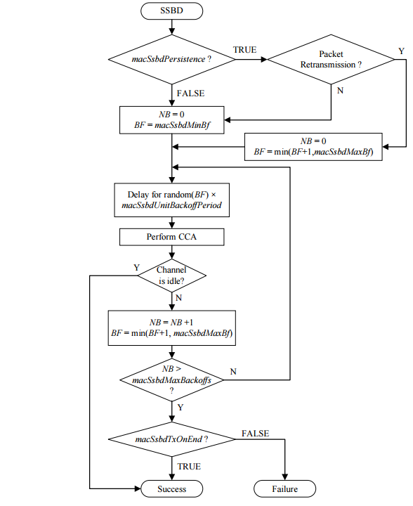
SSBD
Similar to CSMA with
  Linear backoff growth
  Can reduce to simple LBT
  Includes fallback to Aloha option
  Optimized for low-latency uses
  Includes optional persistence
Reference: https://mentor.ieee.org/802.15/dcn/22/15-22-0485-03-04ab-ssbd-channel-access.pptx

Slide 10
802.15.4s Spectrum resource measurement (SRM)
(rolled into 802.15.4-2024)
Provides functionality and data structures to exchange MAC performance and spectrum characterization information
  Channel access and retransmission performance
  Receiver performance
  Channel characterizations
Could be useful for new coexistence recommendations

Slide 11
Other possibly interesting things: 802.15.9
Created to support Key Management Protocol transport over 802.15.4
Includes fragmentation which might be useful for link adaptation

Slide 12
Conclusion
These are just a few of the changes and new features since 2019
Lots of tools we can use
This is only half of the story (802.15.4)
Next step: look into 802.11-2024

