Slide 1
Global CSD Starting Index Assignment for DBW60
Date: 2025-03
Authors:
Name | Affiliation | Address | Phone | Email
Chenchen Liu | Huawei Technologies Co., Ltd | Huawei Base, Bantian, Shenzhen |  | liuchenchen1@huawei.com
Jian Yu
Ming Gan

Slide 2
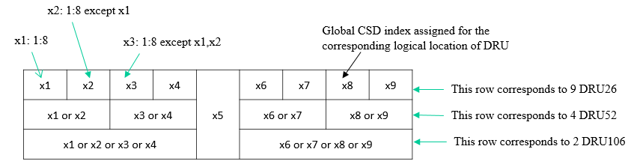
Introduction
Global CSD has been used for DRU UHR-STF transmission to solve unintentional beamforming issue.
We have decided to reuse the 8 CSD table/values in 11ax/be for global CSD allocation[1]
To minimize signaling overhead, the DRU hierarchical structure will be utilized to indicate the global CSD starting index via the DRU index [2].

Slide 3
Existing global CSD Assignments
The optimal CSD index assignment minimizing CSD value collisions for DBW 20MHz, 40MHz, and 80MHz is presented in [2]. However, DBW 60MHz has not been addressed in the current design.
Global CSD starting index for corresponded DRU Index
For DRU26
For DRU52
For DRU106
1 | 2 | 3 | 4 | 5 | 5 | 6 | 7 | 8
2 |  | 4 |  |  | 6 |  | 8
3 |  |  |  |  | 7
BW20
For DRU26
For DRU52
For DRU106
For DRU242
1 | 5 | 2 | 6 | 3 | 3 | 7 | 4 | 8 | 1 | 5 | 2 | 6 | 7 | 3 | 7 | 4 | 8
1 |  | 2 |  |  | 3 |  | 4 |  | 5 |  | 6 |  |  | 7 |  | 8
2 |  |  |  |  | 4 |  |  |  | 6 |  |  |  |  | 8
3 |  |  |  |  |  |  |  |  | 7
BW40
For DRU52
For DRU106
For DRU242
For DRU484
1 | 5 | 2 | 6 | 3 | 7 | 4 | 8 | 1 | 5 | 2 | 6 | 3 | 7 | 4 | 8
1 |  | 2 |  | 3 |  | 4 |  | 5 |  | 6 |  | 7 |  | 8
2 |  |  |  | 4 |  |  |  | 6 |  |  |  | 8
3 |  |  |  |  |  |  |  | 7
BW80

Slide 4
Challenges of Reusing 80MHz DBW CSD Index Assignment for 60MHz
For DRU52
For DRU106
For DRU242
For DRU484
1 | 5 | 2 | 6 | 3 | 7 | 4 | 8 | 1 | 5 | 2 | 6 | 3 | 7 | 4 | 8
1 |  | 2 |  | 3 |  | 4 |  | 5 |  | 6 |  | 7 |  | 8
2 |  |  |  | 4 |  |  |  | 6 |  |  |  | 8
3 |  |  |  |  |  |  |  | 7
BW80
For 60MHz DBW, the simplest approach would be to reuse the global CSD starting index mapping from 80MHz DBW.
However, this would not minimize CSD value collisions. Specifically, collisions between large DRUs from the left 40MHz and 52-tone DRUs from the third 20MHz can be avoided.
For example:
  The 106-tone DRU 1 and 52-tone DRU 9 share the same CSD starting index 1.
  The 242-tone DRU 1 and 52-tone DRU 11 share the same CSD starting index 2.
  The 106-tone DRU 5 and 52-tone DRU 11 share the same CSD starting index 2.

Slide 5
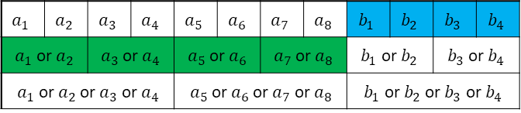
Global CSD Index Assignment Optimizations
The valid DRU Allocation has 5*5*5=125 cases
An exhaustive search was conducted according to the structure outlined below
DRU52
DRU106
DRU242
$$a_{1}$$ | $$a_{2}$$ | $$a_{3}$$ | $$a_{4}$$ | $$a_{5}$$ | $$a_{6}$$ | $$a_{7}$$ | $$a_{8}$$ | $$b_{1}$$ | $$b_{2}$$ | $$b_{3}$$ | $$b_{4}$$
$a_{1}$ or$a_{2}$ |  | $a_{3}$ or$a_{4}$ |  | $a_{5}$ or$a_{6}$ |  | $a_{7}$ or$a_{8}$ |  | $b_{1}$ or$b_{2}$ |  | $b_{3}$ or$b_{4}$
$a_{1}$ or$a_{2}$ or$a_{3}$ or$a_{4}$ |  |  |  | $a_{5}$ or$a_{6}$ or$a_{7}$ or$a_{8}$ |  |  |  | $b_{1}$ or$b_{2}$ or$b_{3}$ or$b_{4}$
Note: Green and blue regions are restricted from sharing any CSD index.

Slide 6
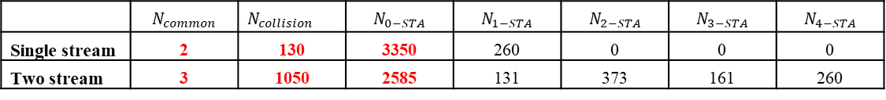
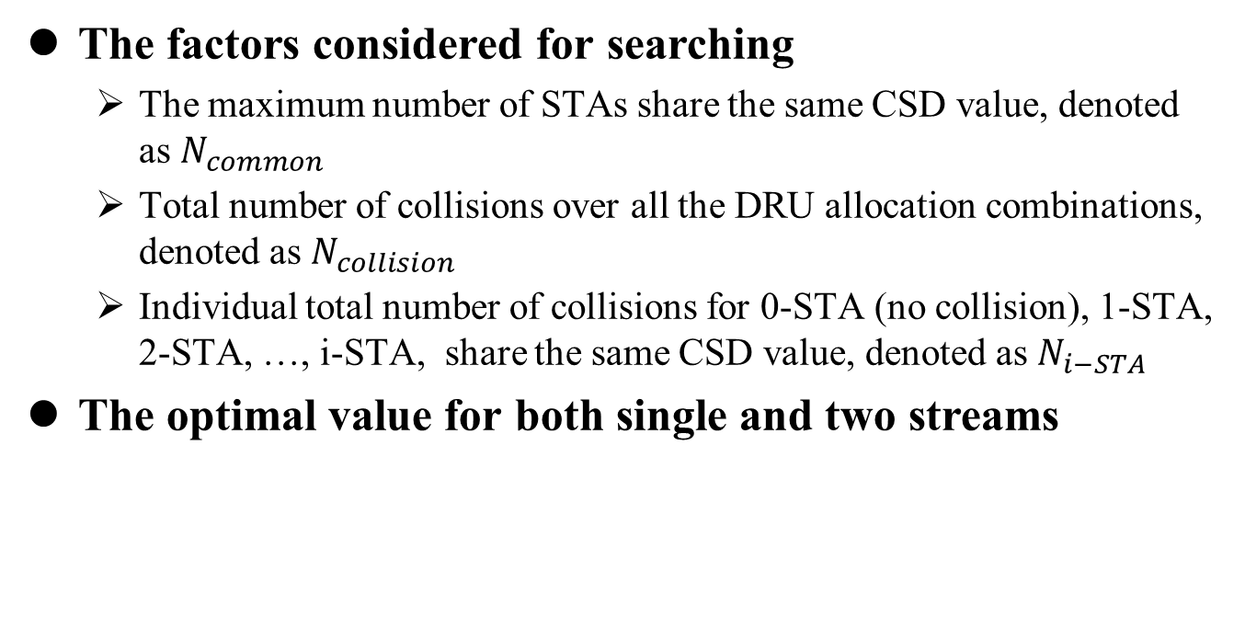
Global CSD Index Assignment Optimizations
The factors considered for searching
  The maximum number of STAs share the same CSD value, denoted as $N_{common}$
  Total number of collisions over all the DRU allocation combinations, denoted as $N_{collision}$
  Individual total number of collisions for 0-STA (no collision), 1-STA, 2-STA, …, i-STA, share the same CSD value, denoted as $N_{i−STA}$
The optimal value for both single and two streams
 | $$N_{common}$$ | $N_{collision}$ | $$N_{0−STA}$$ | $$N_{1−STA}$$ | $$N_{2−STA}$$ | $$N_{3−STA}$$ | $$N_{4−STA}$$
Single stream | 2 | 130 | 3350 | 260 | 0 | 0 | 0
Two stream | 3 | 1050 | 2585 | 131 | 373 | 161 | 260

Slide 7
Proposed global CSD index assignment for 60MHz DBW
Because no single assignment can simultaneously achieve optimal performance for both Nss=1 and Nss=2, we propose two different approaches.
Option 1 is optimized for Nss=1, yet suboptimal for Nss=2
Option 2 reuses the 80DBW approach with minor changes
52-tone DRU | 1 | 2 | 7 | 4 | 3 | 6 | 5 | 8 | 6 | 2 | 4 | 8
106-tone DRU | 1 |  | 7 |  | 3 |  | 5 |  | 6 |  | 4
242-tone DRU | 1 |  |  |  | 3 |  |  |  | 6
52-tone DRU | 1 | 5 | 2 | 6 | 3 | 7 | 4 | 8 | 7 | 5 | 8 | 6
106-tone DRU | 1 |  | 2 |  | 3 |  | 4 |  | 5 |  | 6
242-tone DRU | 2 |  |  |  | 4 |  |  |  | 6

Slide 8
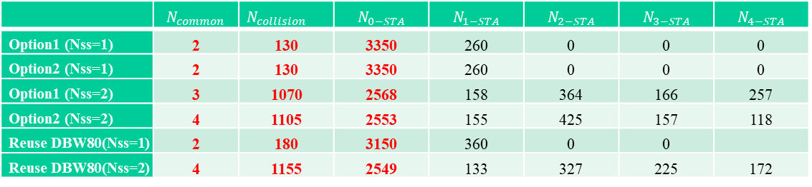
Performance evaluation
Performance evaluation for the two options:
The comparation of the two options:
 | $$N_{common}$$ | $N_{collision}$ | $$N_{0−STA}$$ | $$N_{1−STA}$$ | $$N_{2−STA}$$ | $$N_{3−STA}$$ | $$N_{4−STA}$$
Option1 (Nss=1) | 2 | 130 | 3350 | 260 | 0 | 0 | 0
Option2 (Nss=1) | 2 | 130 | 3350 | 260 | 0 | 0 | 0
Option1 (Nss=2) | 3 | 1070 | 2568 | 158 | 364 | 166 | 257
Option2 (Nss=2) | 4 | 1105 | 2553 | 155 | 425 | 157 | 118
Reuse DBW80(Nss=1) | 2 | 180 | 3150 | 360 | 0 | 0
Reuse DBW80(Nss=2) | 4 | 1155 | 2549 | 133 | 327 | 225 | 172
 | Nss=1 | Nss=2 | implementation
Option1 | Optimal | Suboptimal | Has a good pattern, so only the CSD index for 52-tone DRU need to be stored
Option2 | Optimal | Not optimized | Minor changes to existing table for 80DBW

Slide 9
Summary
In this contribution, we propose two global CSD starting index mapping for 60MHz DBW:
  Option 1 is optimized for Nss=1, yet suboptimal for Nss=2. Has a good pattern which can reduce the memory.
  Option 2 requires minimal modifications to reuse the existing 80DBW table. Optimal for Nss=1.

Slide 10
References
[1] 11-24-0209-09-00bn-specification-framework-for-tgbn
[2] 11-24-1188-02-00bn-global-csd-index-assignment-for-dru-stf-transmission-in-11bn

Slide 11
SP1
Do you support to include the following text to the 11bn SFD?
  Global CSD start index assignment of 60MHz DBW for DRU UHR-STR transmission will be based on the following table
DRU size | Global CSD starting index of DBW60
DRU52, i=1:16 | {1,2,7,4,3,6,5,8,6,2,4,8}
DRU106, i=1:8 | {1,7,3,5,6,4,}
DRU242, i=1:4 | {1,3,6}

Slide 12
SP2
Do you support to include the following text to the 11bn SFD?
  Global CSD start index assignment of 60MHz DBW for DRU UHR-STR transmission will be based on the following table
DRU size | Global CSD starting index of DBW60
DRU52, i=1:16 | {1,5,2,6,3,7,4,8,7,5,8,6}
DRU106, i=1:8 | {1,2,3,4,5,6}
DRU242, i=1:4 | {2,4,6}

