Slide 1
Misc. CBF Topics
Date: 2025-03-10
Authors:
Name | Affiliations | Address | Phone | email
Ron Porat | Broadcom |  |  | ron.porat@broadcom.com
Srinath Puducheri | Broadcom
Karim Toussi | Broadcom
Dignus-Jan Moelker | Broadcom

Slide 2
Introduction
Discuss two topics related to CBF sounding and CBF PPDU transmission

Slide 3
Topic 1 – Sounding Feedback
Sounding feedback for DL MU-MIMO can use UL MU-MIMO or UL OFDMA (for >1 STA).
However CBF includes joint sounding and cross-BSS sequential sounding (NDP transmitted by OBSS AP) which requires more robustness from the feedback as it needs to be received by the OBSS AP.
→ Propose to disallow UL MU-MIMO in joint/cross-BSS sounding feedback to improve robustness.
In-BSS sequential sounding feedback can use any option as in 11be

Slide 4
Topic 2 – GI+LTF for CBF PPDU (1)
CBF PPDU transmission comes from 2 AP, hence may look similar to TB PPDU and require longer GI options e.g. 1.6uS and 3.2uS.
However, our view is that CBF is not exactly like TB PPDU:
Only one AP synchronizes to the sharing AP, hence only expect up to +/-400nS timing offset
STA only needs to decode its own BSS signal
Path loss differential (X) between APs could help minimize acquisition timing issues
In here we provide simulation results for the option of 2x+0.8 as it is anyway mandatory to support for MU PPDU and can provide an easy 5.5% Tput gain.
This is especially important given the potential overheads in the AP-AP and AP-STA exchanges needed before a CBF PPDU and in soliciting ACKs after.

Slide 5
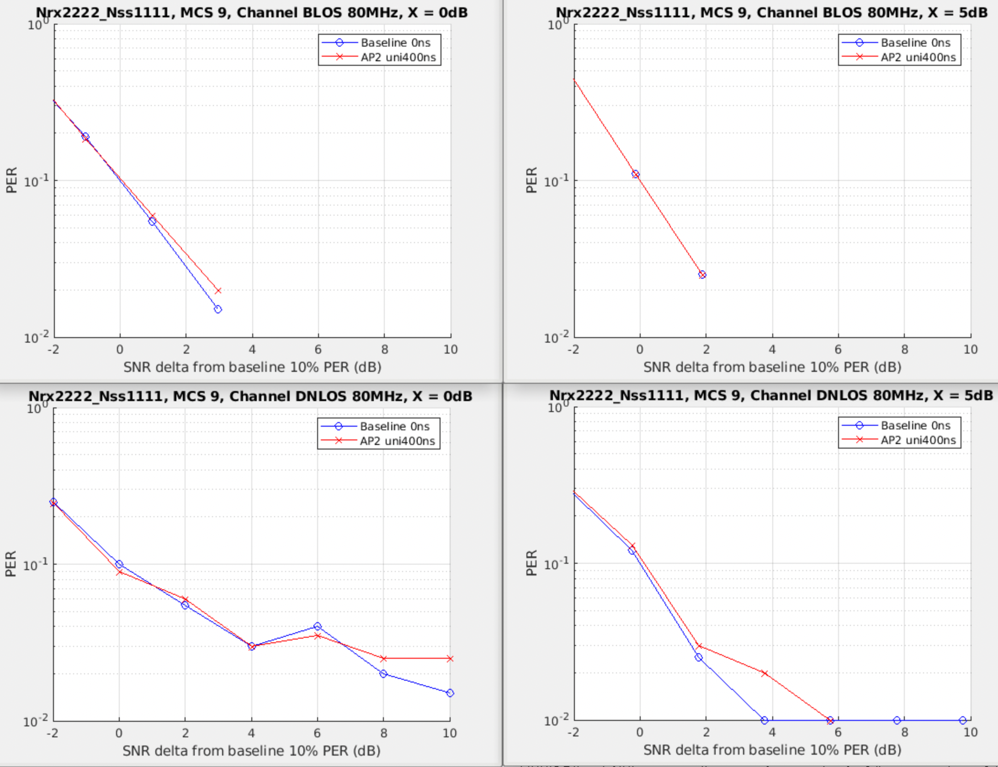
Simulation Results with Uniform +/-400nS Timing Offset (1)

Slide 6
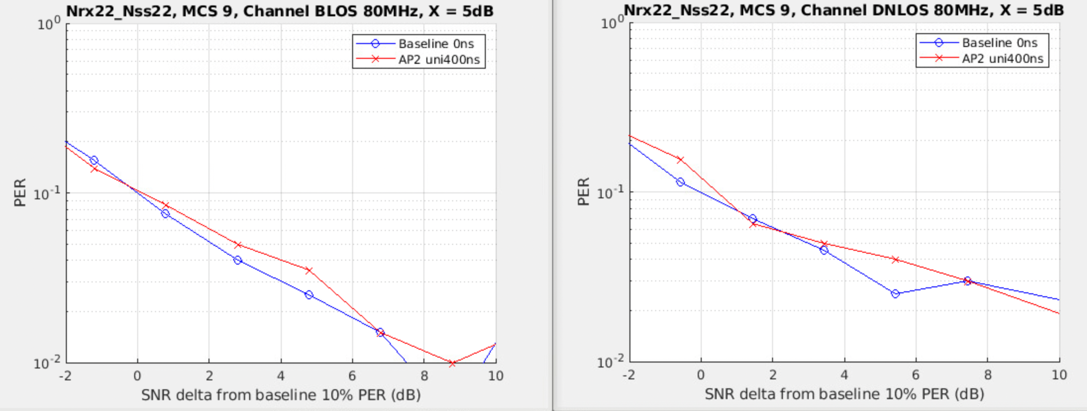
Simulation Results with Uniform +/-400nS Timing Offset (2)
Simulation results do not show practical loss for MCS9

Slide 7
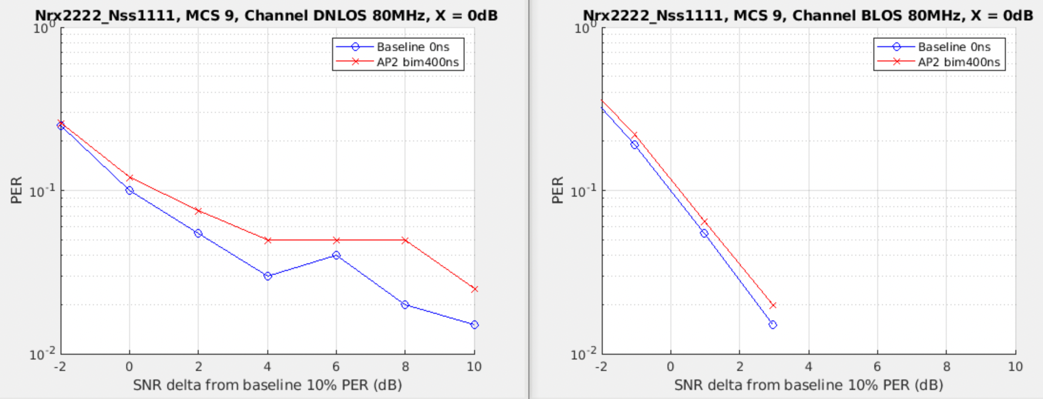
Simulation Results with Bimodal +/-400nS Timing Offset (2)
A small loss can be seen in an extreme scenario of bimodal offset in DNLOS

Slide 8
SP#1
Do you support to add the following to the SFD?
Joint/cross-BSS sounding feedback is limited to UL OFDMA if >1 STA is sounded

Slide 9
SP#2
Do you support to add the following to the SFD?
2x+0.8uS is mandatory to support for AP and non-AP STA for COBF PPDU transmission

