Slide 1
Parameter Update in NPCA mode
Date: 2024-12-31
Authors:

Slide 2
Abstract
This document discusses mechanisms for a STA operating in Non-primary Channel Access (NPCA) mode to indicate and/or update one or more of its NPCA parameters.

Slide 3
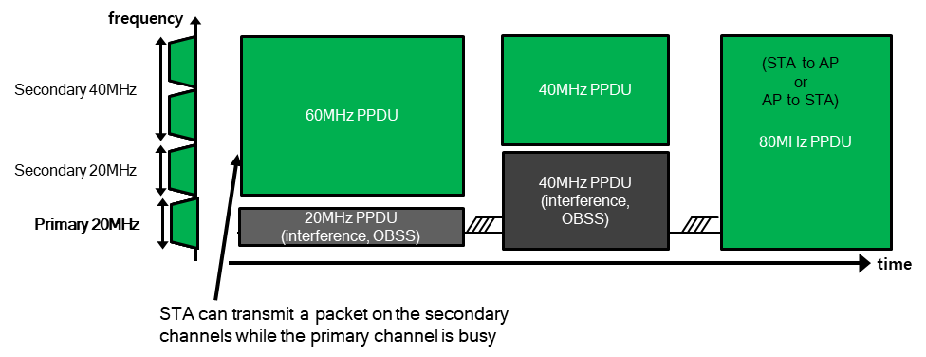
Non-primary Channel Access - Recap
Per baseline, if the primary channel (PCH) is busy due to an OBSS transmission, then no BSS transmissions are possible even if there is a secondary channel that is idle.
As a solution, non-primary channel access (NPCA) mechanism has been proposed [1-8].
In NPCA operation, NPCA AP defines an NPCA backup PCH.
If an OBSS transmission occupies the PCH of the AP, the AP and associated NPCA supporting non-AP STAs switch to the NPCA backup PCH for frame exchanges.
The frame exchanges are performed while treating that backup PCH as the temporary PCH. These exchanges may continue till either:
  The end of the PPDU duration set by the OBSS transmission on the PCH [6]. We refer to this as PPDU duration based NPCA.
  The end of the NAV duration set by the OBSS transmission on PCH [1-2]. We refer to this as NAV duration based NPCA.
The AP and non-AP STAs return to the PCH at the end of the duration.

Slide 4
NPCA mode parameters
A STA operating in NPCA mode may have several associated parameters:
  An indication of whether the NPCA mode is enabled or disabled.
  Applicable delays: NPCA Switching delay and NPCA Switch-back delay.
  Channel number of the NPCA backup primary channel.
  Minimum residual NAV duration for triggering NPCA operation.
  Indication of service periods where NPCA operation is disabled.
  Minimum OBSS RSSI for triggering NPCA switch.
  Maximum OBSS bandwidth for triggering NPCA switch, etc.
Some of these parameters may also be updated over time.
In this contribution:
  We first discuss how updates to NPCA mode and updates to NPCA parameters can be indicated by an AP and a non-AP STA.
  We next discuss how some of the currently used NPCA parameters at an AP can be indicated.
  We finally discuss how some of the aforementioned NPCA parameters can be encoded.

Slide 5
NPCA update indication
Before the NPCA mode or its parameters are updated at AP or non-AP STA, the updates are indicated in:
  Option 1: A new element -- NPCA Parameters element
  Option 2: Field of an existing element, e.g., UHR Operations element, ML Reconfiguration element, etc.
  This element/field is transmitted by the AP in Beacon frames and Probe Response frames, while the update is scheduled.
  This element/field is transmitted by the non-AP STA in the UHR Operation Mode Notification frame.
The NPCA Parameters element/field includes:
  NPCA Mode field which indicates whether NPCA mode is being enabled, disabled, or NPCA parameters are updated. (while remaining enabled)
  A Start Time field that counts down to the TBTT at which the indicated update takes effect.
  The Updated NPCA Parameters field is present when the Start Time field is set to a non-zero value and NPCA Mode is set to either “Enable” or “Parameter Update”. It includes all NPCA parameters
    Some parameters, e.g., NPCA PCH, Duration Threshold may be reserved for a non-AP STA.
When transmitted by an AP, the update is applicable when the scheduled start time has elapsed.
  The AP should include the NPCA Parameters element/field sufficiently in advance of the start time, to ensure all associated STAs are able to receive the indication before the update is applicable.

Slide 6
NPCA update indication – contd.
When transmitted by a non-AP STA, the update is applicable upon receiving a corresponding response frame. (similar to EMLSR)
  The Start Time field is set to 0 or is reserved or not present for a Non-AP NPCA STA.
After the scheduled update takes effect, the NPCA Parameters element/field is included in Probe Response frames while NPCA mode is enabled at the AP, but is not included in Beacon frames.
NPCA Mode | Description
0 | NPCA Disable
1 | NPCA Enable*
2 | NPCA Param Update*
3 | Reserved
NPCA Parameters element/field
NPCA Mode | Start Time | Updated NPCA Parameters | Other fields
Bits: 2 6 0 or variable
Order | Information
1 | Category
2 | Protected UHR Action
3 | Dialog Token
4 | NPCA Parameters
Indication by NPCA AP
Indication by NPCA non-AP STA
Inclusion in Beacon frame,
Probe Response frames.
*Note: It is TBD if separate modes are needed for “NPCA Enable” and “NPCA Param Update”.

Slide 7
Current NPCA parameter indication by AP
While an AP is operating in NPCA mode, it may periodically indicate some of the currently operational NPCA parameters in Beacon frames.
Option 1: These parameters are indicated in the UHR Operations element of the Beacon frame.
Option 2: These parameters are indicated in the NPCA Parameters element (defined in slides 5-6) of the Beacon frame, i.e., it indicates both current NPCA parameters & updates.
  The Current NPCA Parameters field indicates some of current parameters when NPCA is enabled.
  The field is reserved/not present when transmitted by a non-AP STA.
UHR Operation element
Element ID | Length | Element ID Extension | UHR Operation Parameters | Basic UHR-MCS And Nss Set | UHR Operation Information
Other fields | NPCA Enabled
Other fields | Current NPCA Parameters
NPCA Parameters element
Element ID | Length | NPCA Mode | Start Time | Updated NPCA Parameters | Current NPCA Parameters
Bits: 8 8 2 6 0 or variable 0 or variable

Slide 8
Indication of unavailability periods for NPCA
An AP in NPCA mode may indicate certain periodic service periods during which it will not use NPCA operation. The reason for such behavior can include:
  As a result of a multi-AP coordination with a neighboring AP (whose primary channel overlaps with the NPCA backup primary channel).
The indication may use the Periodic Unavailability Operation (PUO) indication method, with a field indicating that the unavailability is for NPCA operation.
An NPCA UHR non-AP STA should not initiate NPCA transmission to an NPCA AP during the NPCA unavailability service periods indicated by the AP.
It is TBD if a similar unavailability indication can be used by a non-AP NPCA STA, for example, for Co-ex reasons.

Slide 9
Conclusion
When an NPCA STA is updating its NPCA mode or parameters, the updated parameters can be indicated in either (i) a NPCA-specific element or (ii) field of an existing element.
  The advantage of defining a NPCA-specific element is modularity, and ease of expansion in future Wi-Fi generations.
  The few additional octets for Element ID and Length fields is insignificant, since the indication is only provided when there is a NPCA update scheduled.
When an AP has enabled NPCA mode, some currently operational NPCA parameters can be indicated in the Beacon frames.
It is beneficial to have a mechanism for an NPCA AP may indicate periodic service periods during which it is unavailable for NPCA operation.

Slide 10
Summary
 | AP behavior | Non-AP STA behavior
NPCA update scheduled | Indicate “all” updated NPCA parameters in Beacon frames and Probe Response frames. | Include “all” updated NPCA parameters in a TBD Action frame.
NPCA enabled, no update scheduled. | Include “all” NPCA Parameters in Probe Response frames. Include “some” current NPCA parameters in Beacon frames. | No signaling required.

Slide 11
References
11-23/1288r0 Non-primary channel utilization - follow-up (Sindhu Verma, Broadcom)
11-23/2005r1 Non-primary channel access (NPCA) (Minyoung Park, Intel)
11-24/0070r2 Some details about non-primary channel access (Yunbo Li, Huawei)
11-24/0426r0 EDCA for Non-Primary Channel Access (Dongju Cha, LGE)
11-24/0427r0 Enabling Non-Primary Channel Access (Dongju Cha, LGE)
11-24/0458r2 Considerations on Non-Primary Channel Access (Salvatore Talarico, Sony)
11-24/0496r1 Secondary Channel Usage Follow Up (Liwen Chu, NXP)
11-24/0498r0 Non-Primary Channel Access (NPCA) – Follow Up (Minyoung Park, Intel)
11-24/1115r1 Channel switching rules for NPCA (Vishnu Ratnam, Samsung)

Slide 12
Straw poll 1
Do you agree to define in 802.11bn a mechanism for a non-AP STA updating its NPCA mode or NPCA parameters to indicate the updates in a TBD Action frame transmitted by the non-AP STA.
  Yes
  No
  Abstain

Slide 13
Straw poll 2
Do you agree to define in 802.11bn a mechanism for an AP updating its NPCA mode or NPCA parameters to indicate the updates in the Probe Response and Beacon frames, along with an indication of the start time at which the change is applicable.
  Inclusion of the updates in the frame(s) shall be classified as a critical update for UHR non-AP STAs.
  The indication of the update should be provided sufficiently in advance to ensure associated UHR non-AP STAs are able to receive the indication before the start time.
  Note: The element where the updates are carried is TBD for e.g., a new NPCA-specific element, UHR Operation element or the Reconfiguration ML element.
  Yes
  No
  Abstain

Slide 14
Straw poll 3
Do you agree to define in 802.11bn a mechanism for a UHR AP that is enabling or updating NPCA mode to indicate unavailability service periods during which it is unavailable for NPCA operation.
Note: It is TBD whether the mechanism is applicable for a non-AP STA.
  Yes
  No
  Abstain

Slide 15
Backup slides

