Slide 1
Intermediate FCS location indication
Date: 2025-01-07
Authors:

Slide 2
Abstract
This document discusses mechanisms for the transmitter of a trigger frame containing an intermediate FCS (I-FCS) to aid the receiver in simplifying the trigger frame reception process

Slide 3
Introduction
Group has agreed to carry an intermediate FCS field in a trigger frame when one or more recipient UHR STA(s) operating in DSO, EMLSR or DPS modes require it.
The I-FCS can be carried in in Trigger frames in dedicated User Info field(s)
In this presentation, we discuss the complications in the reception process of the I-FCS and propose some solutions to address the same.
Frame Control | Duration | RA | TA | Common Info | User Info List | Padding | FCS
Special User Info | Some User Info fields | I-FCS | Some User Info fields

Slide 4
Reception of I-FCS
In some implementations early processing of frames based on I-FCS is difficult, because the PHY doesn't know how much data the MAC wants.
If the MAC doesn’t get enough data (that covers I-FCS), it has to ask for some more data from PHY and then either re-process from the start (wasteful/slow) or remember its parsing state (non-trivial).
Without knowing how much more data to send, the MAC may get too much (causing wastage of padding), or even worse get too little and has to ask for even more iteratively.
Correspondingly, to ensure that sufficient data is forwarded from PHY to the MAC that covers the I-FCS, it is helpful to either:
  Have a pre-deterministic location of the I-FCS, or
  Have an indication of the location of the I-FCS early within the trigger frame.
In this contribution, we discuss a method for such I-FCS indication, and the corresponding receiver behavior.
To little data forwarded by PHY to MAC
Too much data forwarded by PHY to MAC, causing wastage of padding
PHY Header | MAC Header | Common Info | User Info List 1 | I-FCS | User Info List 2 | Padding | FCS

Slide 5
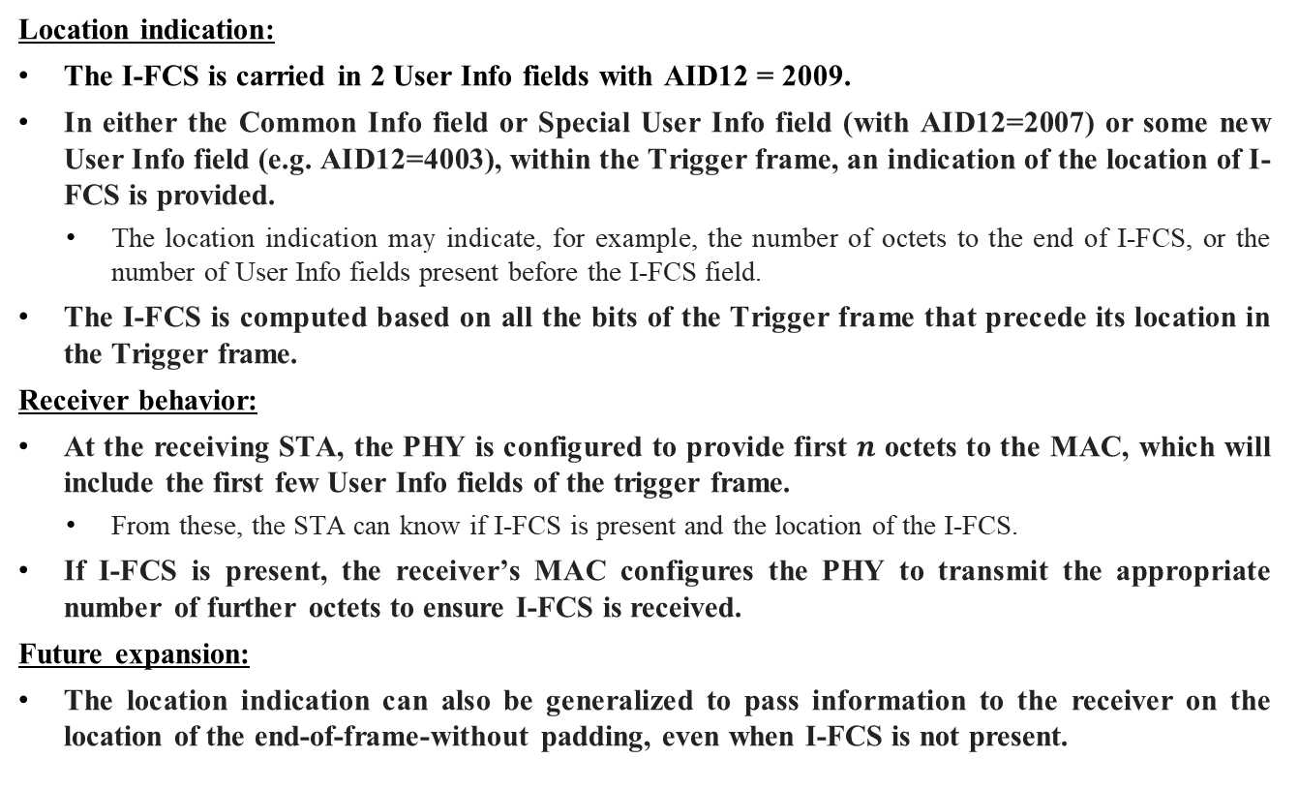
Proposed solution
Location indication:
The I-FCS is carried in 2 User Info fields with AID12 = 2009.
In either the Common Info field or Special User Info field (with AID12=2007) or some new User Info field (e.g. AID12=4003), within the Trigger frame, an indication of the location of I-FCS is provided.
  The location indication may indicate, for example, the number of octets to the end of I-FCS, or the number of User Info fields present before the I-FCS field.
The I-FCS is computed based on all the bits of the Trigger frame that precede its location in the Trigger frame.
Receiver behavior:
At the receiving STA, the PHY is configured to provide first $n$ octets to the MAC, which will include the first few User Info fields of the trigger frame.
  From these, the STA can know if I-FCS is present and the location of the I-FCS.
If I-FCS is present, the receiver’s MAC configures the PHY to transmit the appropriate number of further octets to ensure I-FCS is received.
Future expansion:
The location indication can also be generalized to pass information to the receiver on the location of the end-of-frame-without padding, even when I-FCS is not present.

Slide 6
Conclusion
Having an unknown location of the I-FCS field in a trigger frame can complicate the reception process at a receiver.
This can be remedied by carrying an indication of the location of the I-FCS early within the trigger frame.
The length indication can also be used as a generic mechanism to pass information to the receiver.

Slide 7
References
11-23/1873r1 Post-fcs-mac-padding
11-23/2003r1 Client-power-save
11-24/0544r1 Power-save-protocols-for-uhr-follow-up
11-24/1227r1 Some-usage-of-intermediate-fcs
11-24/1129r1 Discussion-on-intermediate-fcs-signaling
11-24/1702r0 Consideration-on-the-signalling-method-of-intermediate-fcs (Yanchao Xu, Amlogic)

Slide 8
Backup slides

