Slide 1
CoBF PHY design consideration
Date: 2025-3-11
Authors:

Slide 2
Introduction
802.11bn has defined the pre-UHR portion [1] of the MU PPDU with CoBF enabled as non-beamformed mode. Both two APs need to send the MU CoBF PPDU with same content in L-SIG, RL-SIG, U-SIG and UHR-SIG.
This contribution focuses on which information should be carried in the CoBF sync/trigger frame to trigger the MU CoBF PPDU transmission.

Slide 3
Example Sequence for MU CoBF PPDU transmission
Shared TXOP
Sharing AP
CoBF Sync
DL PPDU
Invite
Information sharing (AP1-STA1 pairs, SS, L-length, BW)
Information collection & parameter calculation/definition & trigger frame preparing
Mapping from Trigger frame to L-SIG, U-SIG and UHR-SIG
Sync.
Data preparing
CoBF Confirm
Information sharing (AP2-STA2 per User Info.)
Shared AP
DL PPDU
The detail control frame exchange sequence is under discussion
This contribution focuses on which information should be carried in the CoBF Sync frame and map them easily to the preamble of DL MU CoBF PPDU

Slide 4
U-SIG and UHR-SIG format for MU CoBF PPDU
U-SIG format for MU CoBF PPDU:
UHR-SIG format for MU CoBF PPDU:
U-SIG1 | B0-B2 | B3-B5 | B6 | B7-B12 | B13-B19 | B20-B25
 | PHY version (set to 1) | PPDU BW | UL/DL | BSS color 1 | TXOP | BSS color 2
U-SIG2 | B0-B1 | B2 | B3-B7 | B8 | B9-B10 | B11-B15 | B16-B19 | B20-B25
 | PPDU Type | CoBF/CoSR | Punctured Channel Information | Validate | UHR-SIG MCS | Number of UHR-SIG Symbols | CRC | Tail
Common field for non-OFDMA transmission
B0-B3 | B4-B5 | B6-B8 | B9 | B10-B11 | B12 | B13 | B14-B15 | B16-B18
Spatial Reuse | GI+LTF Size | Number of UHR-LTF Symbols | LDPC Extra Symbol Segment | Pre-FEC padding Factor | PE Disambiguity | IM | Disregard | Number of non-OFDMA Users
User field format for an MU-MIMO allocation
B0-B10 | B11-B15 | B16-B19 | B20 | B21 | B22
STA-ID | MCS | Spatial Configuration | Res | BSS color differentiation | 2x LDPC

Slide 5
Summary of all the fields must or recommended to be carried in CoBF sync frame
Field in L-SIG, U-SIG of MU CoBF PPDU |  | Field must/recommended to be carried in CoBF Sync for CoBF data PPDU
L-SIG | Length | “Must” to indicate PPDU length
U-SIG | PHY Version Identifier | Set to 1
 | Bandwidth | “Must” to indicate PPDU BW
 | UL/DL | Set to DL
 | BSS Color | Recommended to carry for easy copy/paste at shared AP
 | TXOP | Recommended to carry for NAV setting
 | BSS Color 2 | Recommended to carry for easy copy/paste at shared AP
 | PPDU Type And Compression Mode | Set to non-OFDMA DL MU MIMO
 | CoBF/CoSR Indication | Set to 0
 | Punctured Channel Information | “Must” to indicate the static puncturing channel information
 | UHR-SIG MCS | Fix to 0
 | Number of UHR-SIG Symbols | “Must” to indicate the number of UHR-SIG symbols of the Mu CoBF PPDU

Slide 6
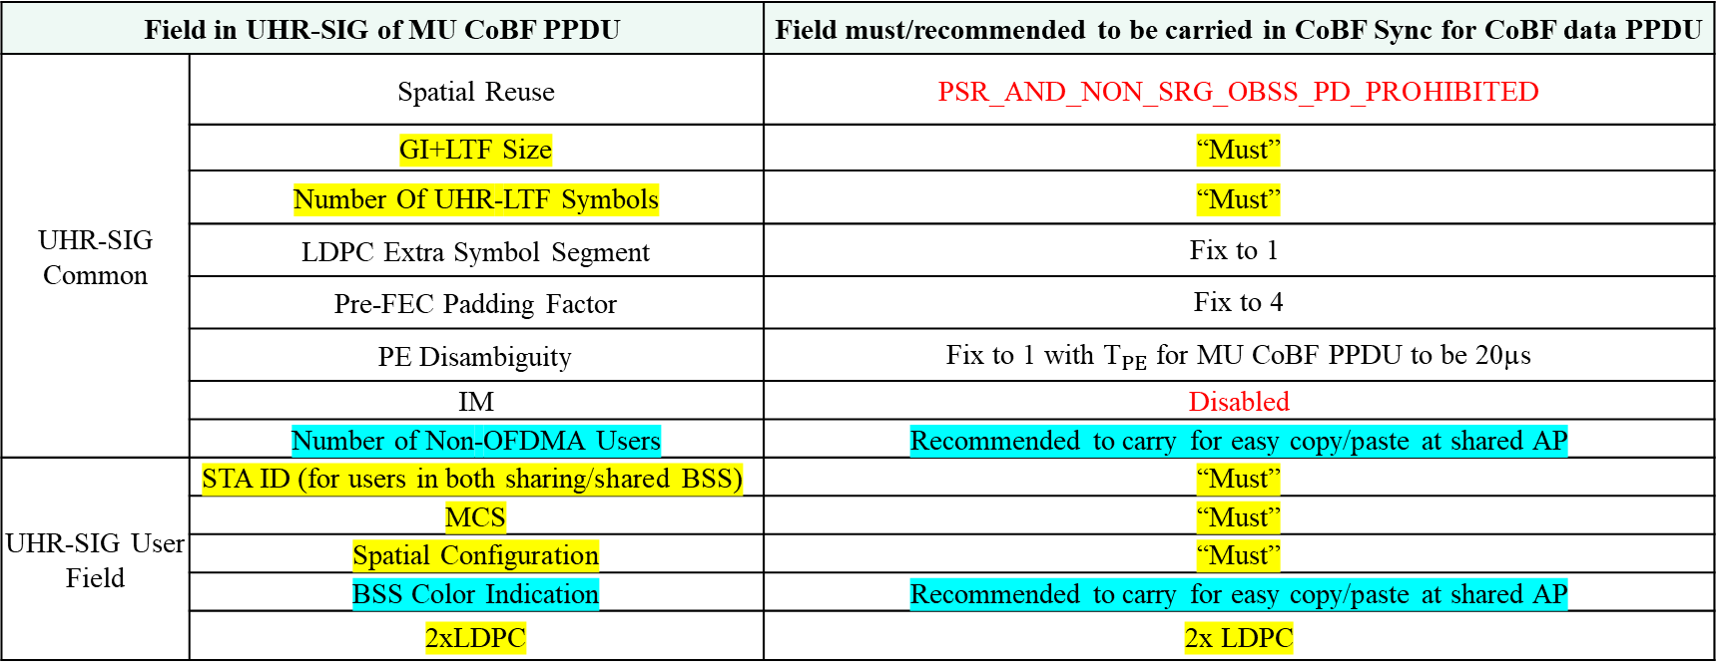
Summary of all the fields must or recommended to be carried in CoBF sync frame (cont.)
Field in UHR-SIG of MU CoBF PPDU |  | Field must/recommended to be carried in CoBF Sync for CoBF data PPDU
UHR-SIG Common | Spatial Reuse | PSR_AND_NON_SRG_OBSS_PD_PROHIBITED
 | GI+LTF Size | “Must”
 | Number Of UHR-LTF Symbols | “Must”
 | LDPC Extra Symbol Segment | Fix to 1
 | Pre-FEC Padding Factor | Fix to 4
 | PE Disambiguity | Fix to 1 with ${\text{T}}_{PE}$ for MU CoBF PPDU to be 20µs
 | IM | Disabled
 | Number of Non-OFDMA Users | Recommended to carry for easy copy/paste at shared AP
UHR-SIG User Field | STA ID (for users in both sharing/shared BSS) | “Must”
 | MCS | “Must”
 | Spatial Configuration | “Must”
 | BSS Color Indication | Recommended to carry for easy copy/paste at shared AP
 | 2xLDPC | 2x LDPC

Slide 7
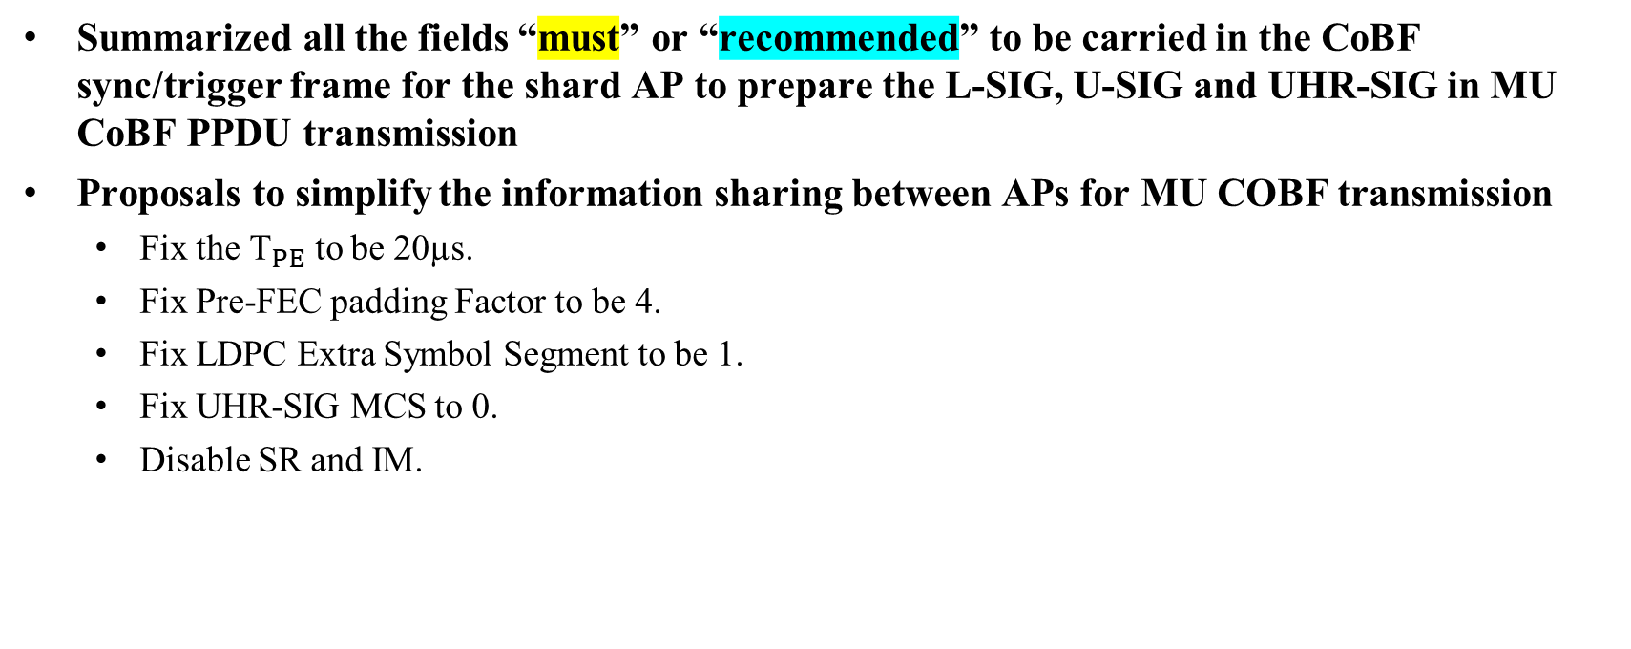
Summary
Summarized all the fields “must” or “recommended” to be carried in the CoBF sync/trigger frame for the shard AP to prepare the L-SIG, U-SIG and UHR-SIG in MU CoBF PPDU transmission
Proposals to simplify the information sharing between APs for MU COBF transmission
  Fix the ${\text{T}}_{PE}$ to be 20µs.
  Fix Pre-FEC padding Factor to be 4.
  Fix LDPC Extra Symbol Segment to be 1.
  Fix UHR-SIG MCS to 0.
  Disable SR and IM.

Slide 8
References
[1] https://mentor.ieee.org/802.11/dcn/24/11-24-1822-04-00bn-cobf-design-for-uhr.pptx

Slide 9

SP1
Do you agree to include the following into the 11bn SFD?
The ${\text{T}}_{PE}$ for UHR MU PPDU with CoBF enabled is fixed to be 20µs?

