Slide 1
Sync field design considerations
Date: 2025-03-10
Authors:
Name | Affiliations | Address | Phone | Email
You-Wei Chen | Mediatek | 2840 Junction Ave. San Jose, CA, 95134 |  | You-Wei.Chen@mediatek.com
Jianhan Liu
Shengquan Hu
Thomas Pare

Slide 2
Introduction
Sync field design for backscatter and non-backscatter non-AP AMP STAs are widely discussed [1-6].
Passed motion [7]:
IEEE 802.11bp defines at least one AMP-Sync in the AMP Downlink PPDU in 2.4 GHz for backscatter communication, and at least one AMP-Sync in the AMP Downlink PPDU in 2.4 GHz for non-backscatter communication. The AMP-Sync is independent of the integrated and non-integrated deployment.
In this presentation, we will review some contributions related to sync design and discuss out thought.

Slide 3
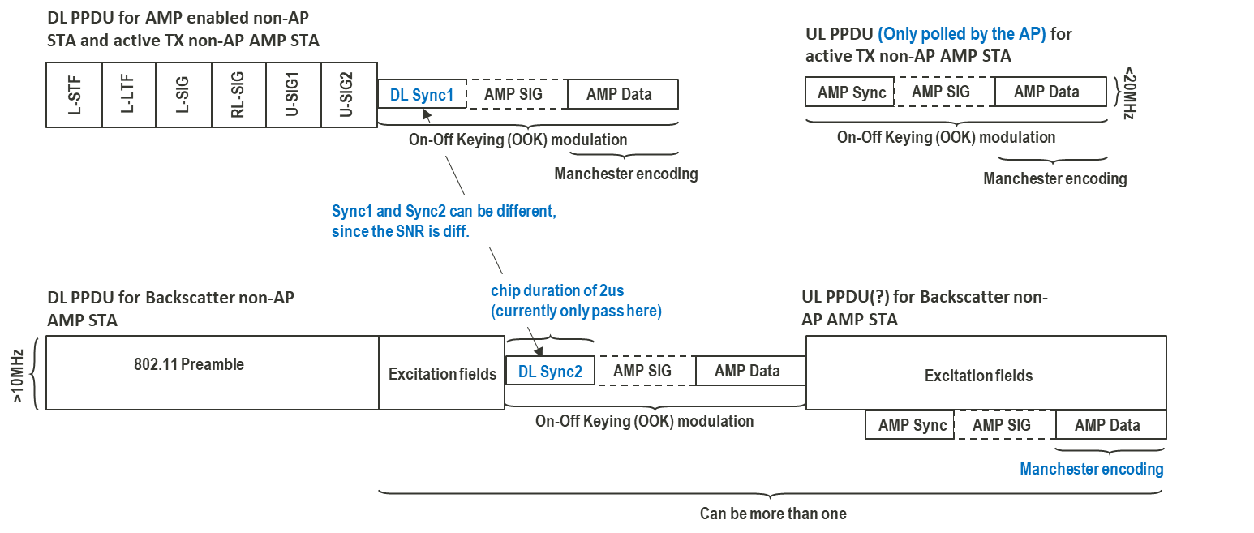
Passed: AMP PPDU formats
Since receiver capabilities for backscatter and non-backscatter non-AP STAs are quite different, DL sync designs can be different.
Currently, chip duration of 2us is only for backscatter type DL PPDU.

Slide 4
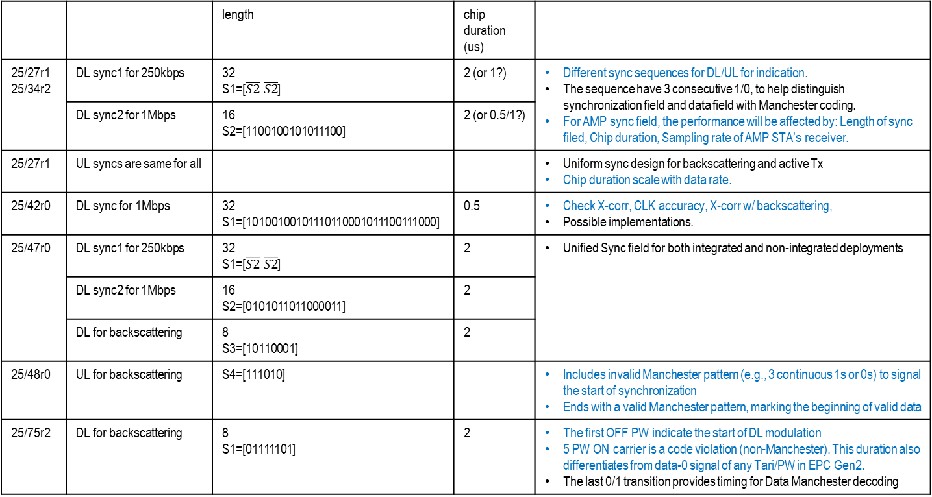
Brief summary of contributions
 |  | length | chip duration (us)
25/27r1 25/34r2 | DL sync1 for 250kbps | 32 S1=[$\overline{S2} \overline{S2}$] | 2 (or 1?) | Different sync sequences for DL/UL for indication. The sequence have 3 consecutive 1/0, to help distinguish synchronization field and data field with Manchester coding. For AMP sync field, the performance will be affected by: Length of sync filed, Chip duration, Sampling rate of AMP STA’s receiver.
 | DL sync2 for 1Mbps | 16 S2=[1100100101011100] | 2 (or 0.5/1?)
25/27r1 | UL syncs are same for all |  |  | Uniform sync design for backscattering and active Tx Chip duration scale with data rate.
25/42r0 | DL sync for 1Mbps | 32 S1=[10100100101110110001011100111000] | 0.5 | Check X-corr, CLK accuracy, X-corr w/ backscattering, Possible implementations.
25/47r0 | DL sync1 for 250kbps | 32 S1=[$\overline{S2} \overline{S2}$] | 2 | Unified Sync field for both integrated and non-integrated deployments
 | DL sync2 for 1Mbps | 16 S2=[0101011011000011] | 2 | [Note] 4 consecutive zeros, means 8µs without power. There's a risk to lose the channel.
 | DL for backscattering | 8 S3=[10110001] | 2
25/48r0 | UL for backscattering | S4=[111010] |  | Includes invalid Manchester pattern (e.g., 3 continuous 1s or 0s) to signal the start of synchronization Ends with a valid Manchester pattern, marking the beginning of valid data
25/75r2 | DL for backscattering | 8 S1=[01111101] | 2 | The first OFF PW indicate the start of DL modulation 5 PW ON carrier is a code violation (non-Manchester). This duration also differentiates from data-0 signal of any Tari/PW in EPC Gen2. The last 0/1 transition provides timing for Data Manchester decoding

Slide 5
Few checkboxes for Sync field design
Each Sync field need to have a low false alarm rate with different data rate and different types of non-AP AMP STAs.
For example, DL S1-S3 for non-backscattering and backscattering tag.
Better distinguish between Sync field, Excitation field and Data field.
For example, starts with OFF, or carries consecutive 1/0.
To differentiates from other standards would be an additional bonus

Slide 6
UL Sync field considerations
Different DL and UL Sync field.
Serve as a UL/DL indicator. Save power for third party non-AP AMP STA.
Depends on the DL Sync discussion, UL Sync field should be different for backscatter and non-backscatter non-AP STAs.
Since UL only be polled by AP, UL Sync for different data rate can be the same.
For example, UL S1 and S2 for non-backscattering and backscattering tag, respectively.

Slide 7
Other Sync field considerations
Based on aforementioned reasons, we needs:
3 DL Sync designs (2 non-backscattering +1 backscattering)
2 UL Sync designs (1 non-backscattering +1 backscattering)
Sync part has a better receiver sensitivity than Data part.
There should be few more steps before detailed sync field design, e.g., Data field bandwidth, receiver capabilities.

Slide 8
Straw Poll #1
Do you agree to add the following text to the SFD:
DL and UL AMP-Syncs are different and can be treated as a DL/UL indicator.
UL AMP-Syncs are different for non-backscatter and backscatter communication.

Slide 9
References
[1] 11-25/27, AMP PPDU Design, Yinan Qi et al., OPPO
[2] 11-25/34, Sync field for AMP PPDU, Wang Ke et al., OPPO
[3] 11-25/42, AMP Downlink Sync Field Study, Steve Shellhammer et al., Qualcomm.
[4] 11-25/47, Follow up on Downlink Sync Field Design, Bin Qian et al., Huawei.
[5] 11-25/48, Discussion on Uplink Transmissions for Backscatter STAs, Bin Qian et al., Huawei
[6] 11-25/75, Further Thoughts on AMP DL PPDU for Mono-static Backscattering, Rui Cao et al., NXP
[7] 11-24/1322, IEEE 802.11 TGbp Motion Dock

