Slide 1
Spatial Streams Indication for CoBF TF and PPDU
Date: 2025-03-09
Authors:
Name | Affiliation | Address | Phone | Email
Junghoon Suh | Huawei | Ottawa, ON Canada |  | junghoon.suh@huawei.com
Mahmoud Hasabelnaby
Yan Xin
Osama AboulMagd
Abdalla Hussein

Slide 2
Background
For the CoBF DL PPDU, the PHY header is supposed to be identical between two CoBF DL PPDUs
The signaling in the PHY header needs to be exchanged during the Sync frame transmission sent by the Sharing AP
TXOP
Sharing
AP1
CoSR/CoBF
Trigger
Frame (Sync)
CoSR/CoBF
DL PPDU
ICF
(Invite)
ICF
Shared
AP 2
ICR
(Response)
ICF
CoSR/CoBF
DL PPDU
STAs
Associated
With AP1
ICR
BA
STAs
Associated
With AP2
ICR
BA

Slide 3
Background continues
The Sync frame can be a unicast frame to the Shared AP, and may not need any User Info field
However, there are still many bits required to be signaled in the Sync field
There can be maximum 4 users scheduled across two APs for the CoBF
We need 44 bits for the STA ID only
With a new Trigger Frame (TF) type, we can designate a Type dependent Common Info field or a Type dependent User Info field in the Special User Info field, or both to avoid the User Info field [1]
We can repurpose the existing subfields and carry the additional signaling in the Type dependent fields
With a existing TF type, we can also update the User Info fields with the proposed SS Allocation indication for the CoBF
SS Allocation can move to any Reserved subfield of Common Info field or Special User Info field
User Info field (40 bits) can be packed with two user information (STA ID (11 bits), MCS (5 bits), 2x LDPC (1 bit) and BSS Differentiation (1 bit))

Slide 4
Example User Info field for CoBF Sync frame in an existing Trigger Frame type
B0-B11 | B12-B16 | B17 | B18 | B19-B29 | B30-B34 | B35 | B36 | B37-B39
AID12/STA ID (11) | UL MCS | BSS color Differentiation | 2x LDPC | STA ID (11) | UL MCS | BSS color Differentiation | 2x LDPC | Reserved

Slide 5
Indication of Spatial Streams (SS) for CoBF
We need to indicate the total number of scheduled Spatial Streams (N_SS) across two APs, each individual N_SS of each scheduled STA, and the starting Spatial Streams either explicitly or implicitly
Additionally, we also need to indicate the total number of scheduled users across two APs, and the number of scheduled users per each BSS, and the total number of LTFs for the CoBF DL PPDUs
Since we have a limitation in the maximum N_SS across two APs or each BSS, and the maximum number of scheduled users across two APs and each BSS, we can come up with a simple table-based method to indicate the Spatial Streams for CoBF in a Sync frame
In this way, we can fit all the signaling bits within the Common field and the Special User Info field

Slide 6
Proposed SS Indication for CoBF
First of all, we prepare a table for the indication of total number of scheduled users (3 bits)
This table indicates the total number scheduled users per BSS but implies the total number of scheduled users across two APs with simply adding these two
Index | AP1 (Sharing AP) | AP2 (Shared AP)
0 | 1 | 1
1 | 1 | 2
2 | 2 | 1
3 | 2 | 2
4 | 1 | 3
5 | 3 | 1
6 | Reserved | Reserved
7 | Reserved | Reserved
Table 1

Slide 7
Proposed SS Indication for CoBF continues
Second, the N_SS of each BSS can sum up to the total N_SS across the coordinated APs. We can borrow a table from [2] for the possible combination of SS in the UHR CoBF (3 bits)
We can have one bit indication for the number of LTFs (N_LTF)
Bit 0 means the same N_SS total across two APs, and Bit 1 means the 2 times of N_SS total across two APs
8 LTFs will replace 6 LTFs case
Index | Total N_SS in Sharing AP | Total N_SS in Shared AP
0 | 1 | 1
1 | 1 | 2
2 | 2 | 1
3 | 2 | 2
4 | 1 | 3
5 | 3 | 1
6 | Reserved | Reserved
7 | Reserved | Reserved
Table 2
Table 2

Slide 8
How to interpret 6 bits of CoBF SS signaling
6 bits: total number of scheduled users (3 bits) and N_SS of each BSS (3 bits)
Ex. Index 2 of Table 1 and Index 2 of Table 2
Denoting those two STAs scheduled with Sharing AP as STA1 and STA2, and denoting the STA scheduled with Shared AP as STA3, then, the STA1 is scheduled with 1 SS, STA2 is scheduled with 1SS and STA3 is scheduled with 1 SS
Ex. Index 1 of Table 1 and Index 3 of Table 2
Denoting the STA scheduled with Sharing AP as STA1 and those STAs scheduled with Shared AP as STA2 and STA3, then, the STA1 is scheduled with 2 SS, STA2 is scheduled with 1SS and STA3 is scheduled with 1 SS
Ex. Index 1 of Table 1 and Index 4 of Table 2
Denoting the STA scheduled with Sharing AP as STA1 and those STAs scheduled with Shared AP as STA2 and STA3, then, the STA1 is scheduled with 1 SS, STA2 is scheduled with 2 SS and STA3 is scheduled with 1 SS
Within a BSS, the STA with larger N_SS should always come first.

Slide 9
Example
Index 1 of Table 1 (3 bits) and Index 4 of Table 2 (3 bits)
Hence the 3 bit N_User, 3 bit N_SS, and 1 bit N_LTF may identify the total N_User across two APs, N_User each BSS, total N_SS across two APs, N_SS each BSS, N_SS per each user, and the total N_LTFs in any available subfields of Common Info and/or Special STA Info field without any repetition in the STA Info fields
Table 1
Table 2
Index | N_Users of AP1 (Sharing AP) | N_Users of AP2 (Shared AP)
0 | 1 | 1
1 | 1 | 2
2 | 2 | 1
3 | 2 | 2
4 | 1 | 3
5 | 3 | 1
6 | Reserved | Reserved
7 | Reserved | Reserved
Index | Total N_SS in Sharing AP | Total N_SS in Shared AP
0 | 1 | 1
1 | 1 | 2
2 | 2 | 1
3 | 2 | 2
4 | 1 | 3
5 | 3 | 1
6 | Reserved | Reserved
7 | Reserved | Reserved
STA1
STA2 & STA3
STA1(1 SS)
STA2(2 SS) STA3(1 SS)
The total N_SS across two APs is the addition of N_SS per each BSS, which is 4 SS (1+3),
and the N_LTF can be either 4 or 8 →1 bit N_LTF may indicate N_SS or 2*N_SS of LTFs

Slide 10
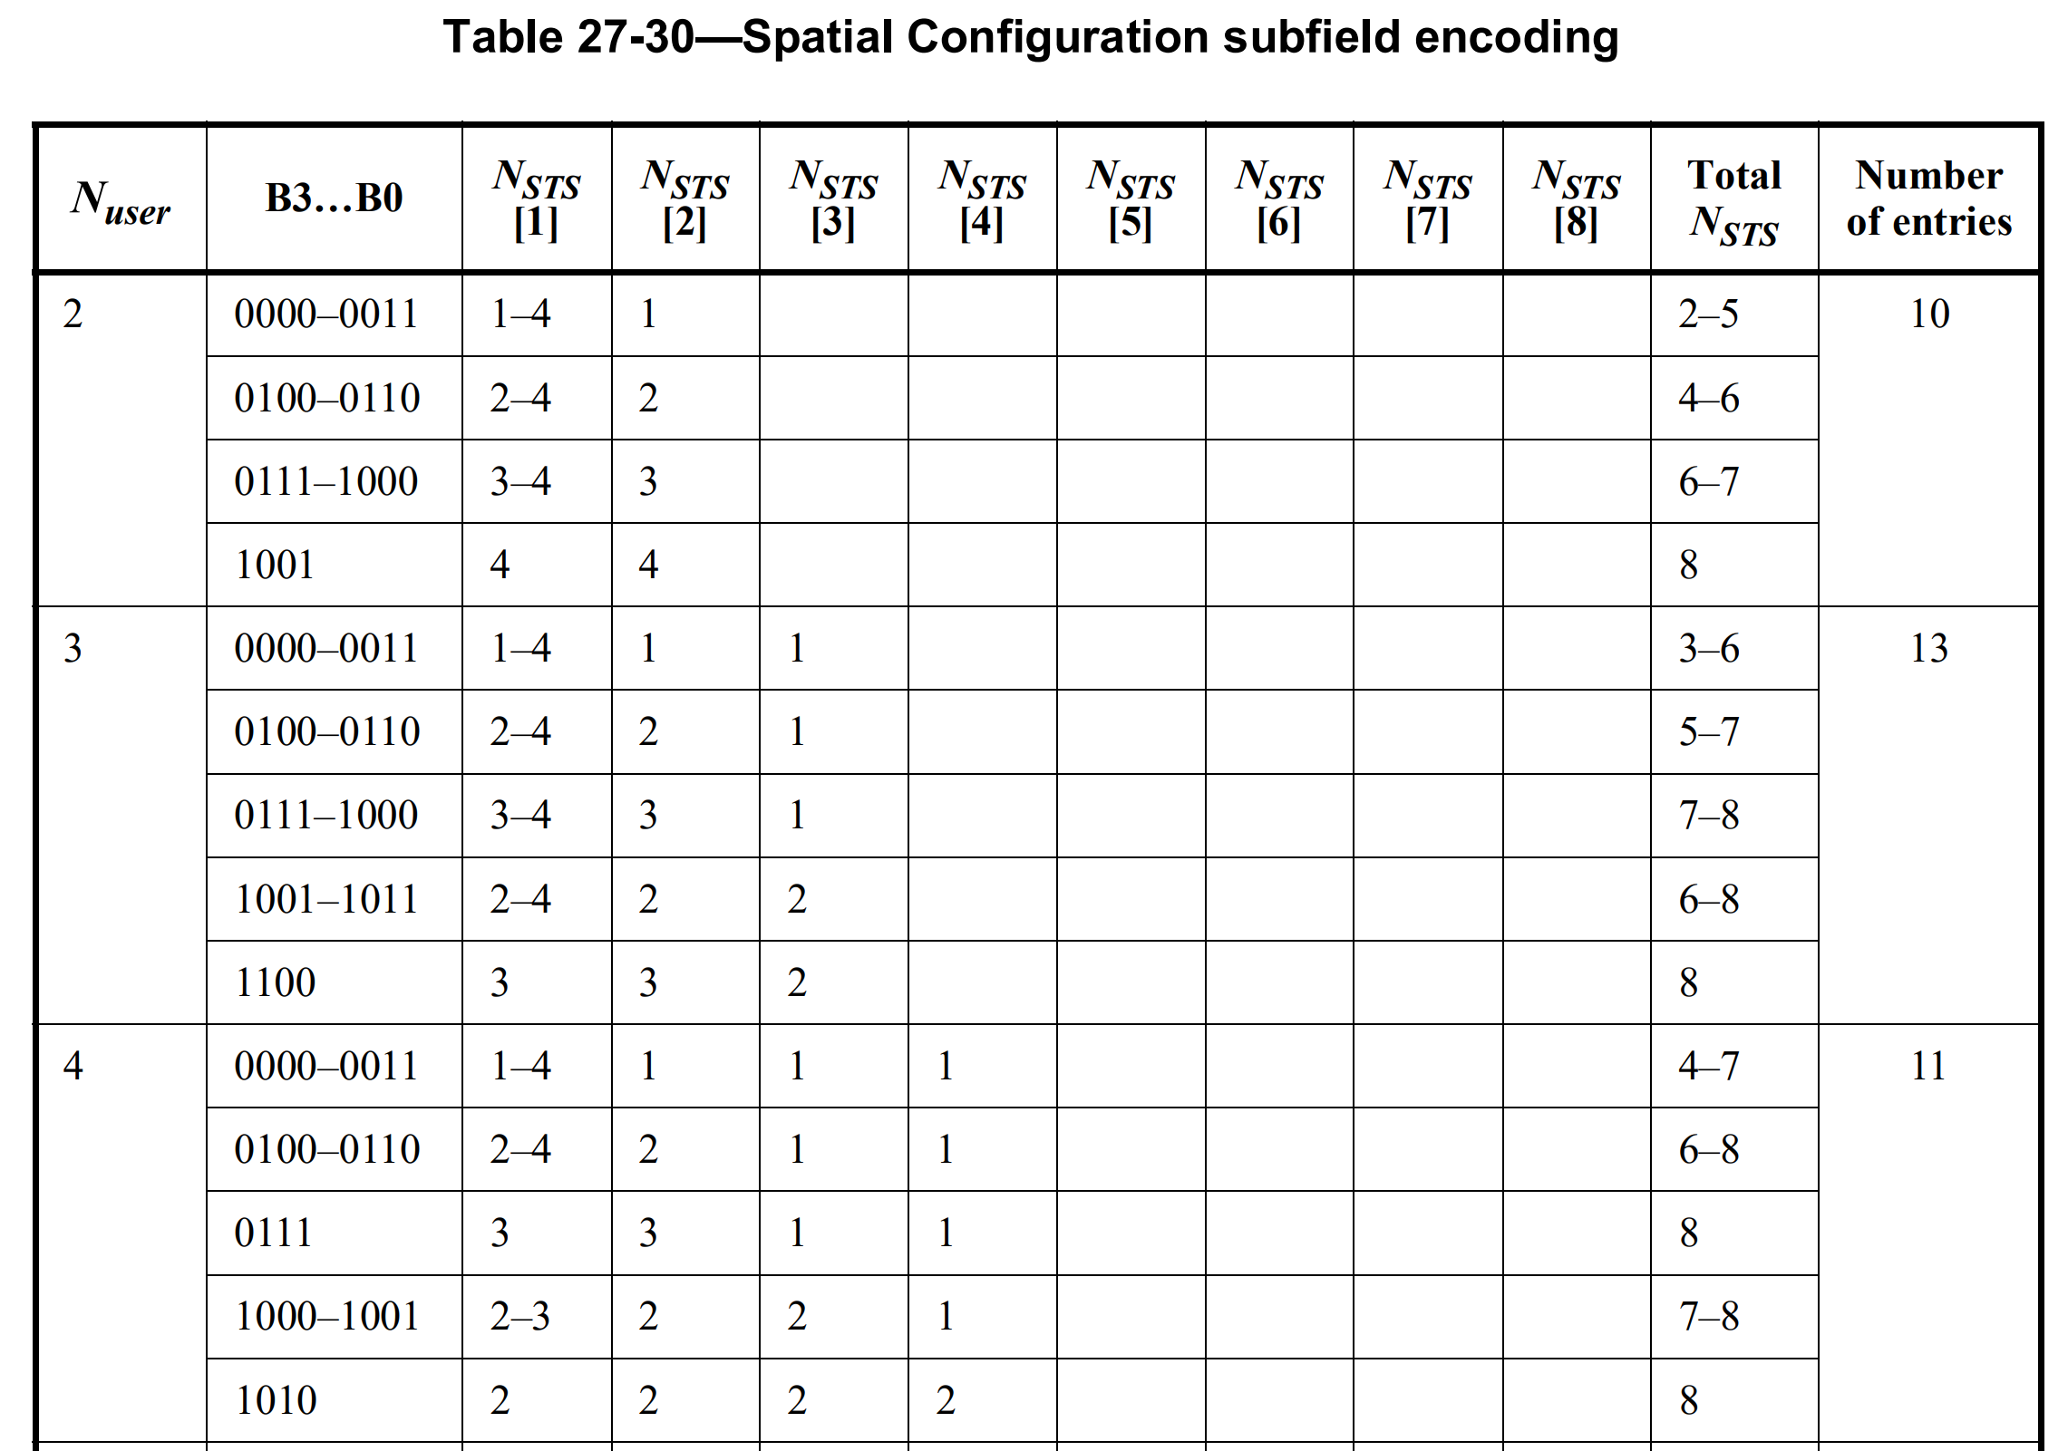
SS Allocation in the CoBF DL PPDU
The Spatial Configuration subfield in User field of UHR-SIG field in PPDUs for COBF transmission re-uses the same design as in UHR DL MU-MIMO [Motion 171]
Encoding table will be same as 11ax
In a PPDU of COBF transmission, all the User fields of UHR-SIG belonging to an AP and the corresponding spatial streams are contiguous. [Motion 172]
The user fields of one AP are together followed by the ones of the other AP and the same holds for spatial streams
The total number of users scheduled across two APs can be indicated in the “Number of Non-OFDMA Users” subfield of the UHR-SIG Common field
SS Allocation per user is allocated through the Spatial Configuration table (11ax Table shown below). The order of users in the Table 27-30 follows the user info list in the User field of UHR-SIG. For BW >= 40 MHz, the user list in the 1st content channel needs looking-up in the Table prior to the user list in the 2nd content channel
UHR-SIG
Common
field
1st Content
Channel
User field 1
User field 2
Common
field
User field 3
User field 4
2nd Content
Channel

Slide 11
The order of user information in the CoBF DL PPDU and Sync frame
The Issue here is the N_SS per user of Shared AP (AP2) can be larger than the N_SS per user of Sharing AP (AP1)
Ex. 1 user with AP1 (N_SS = 1) and 2 users with AP2 (N_SS =2 and 1)
The user information of the BSS having the largest N_SS in one of its scheduled STA should come first in the UHR-SIG User field followed by the user information of the other BSS. Within each BSS, the user information of the larger N_SS comes first.
In case the largest N_SS of all non-AP STAs in the 2 BSSs is the same, then the User Information of BSS1 (sharing AP) comes first
Ex. For 1 user (STA 1) with AP1 (N_SS = 1) and 2 users (STA 2 and STA 3) with AP2 (N_SS =2 and 1) case, we place the user information of STA 2 first followed by the user information of STA 3, and then, we place the user information of STA 1.
For BW >= 40 MHz, the user information of STA 2 & 3 will be placed in the 1st content channel, whereas the user information of STA 1 will be placed in the 2nd content channel
The order of user information in the Sync frame does not have to be restricted like the CoBF DL PPDU as far as the STA ID comes with its belonging user information, but it is recommended to be aligned with the order of users in the UHR-SIG User field

Slide 12
Summary
We proposed 6 bits to indicate the number of total scheduled users, number of scheduled users each BSS, the total N_SS across two APs and the N_SS per each user and per each BSS
We proposed to place the user information of the user having the largest N_SS first in the UHR-SIG User field followed by the user information of the next largest N_SS in the same BSS followed by the user information of the other BSS having the larger N_SS followed by the user information of the other BSS having the smallest N_SS

Slide 13
References
[1] M. Hasabelnaby, et. al., “11-25/xxxr0 TF Design for CoSR and CoBF”
[2] A. Chen, et. al., ”11-25/xxxr0 Information Exchange in the CoBF Transmission Phase Follow-up”

Slide 14
SP 1
Do you support to use 6 bits for the indication of the number of total scheduled users, number of scheduled users each BSS, the total N_SS across two APs and the N_SS per each user and per each BSS ?
3 bits for the total number of scheduled users across two APs
3 bits for the N_SS of each BSS
Y/N/A

Slide 15
SP 2
Do you support to place the user information of the BSS having the largest N_SS in one of its scheduled STA first in the UHR-SIG User field followed by the user information of the other BSS?
Within each BSS, the user information of the larger N_SS comes first
Y/N/A

Slide 16
SP 3
Do you support that the order of user information in the Sync frame is aligned with the order of users in the UHR-SIG User field?
Y/N/A
Support doc:[11-25/389r0, 11-25/399r0]

