Slide 1
Link Reconfiguration Framework for Preparation and Execution Phases of Seamless Roaming
Date: 2024-08-06
Authors:

Slide 2
Abstract
In this contribution, we discuss signaling for preparation and execution phases for seamless roaming
  Extension to 11be link reconfiguration framework
  Additional information that can be carried in the link reconfiguration request and response frames

Slide 3
Seamless Roaming Procedural Overview
TGbn has agreed to define procedures that enable a non-AP MLD to roam from current AP MLD to target AP MLD while remaining in state 4.
A number of contributions have discussed various procedures for seamless roaming (summarized in the table)
A number of target use cases/scenarios have also been discussed so far:
  Preparation of target AP MLD links through current AP MLD prior to roaming
  Preparation (context transfer) done through target AP MLD
  …
Phase | Purpose
Enh. Discovery | Domain AP info gathering
Recommendation | Info gathering for candidate AP assessment considering: Context Load, etc.
Preparation | Prepare 1 target AP MLD for roaming (more than one is TBD) Near static context transfer
Execution | Initiate transition procedures: Dynamic context transfer DS remapping
Buffered data handling | Handling buffered data at current AP Can be considered a part of the above stage

Slide 4
Signaling Details for Preparation and Execution
A signaling framework that can be used across all the use cases/scenarios is needed.
In this contribution, we discuss the signaling for preparation and execution phases based on an extension of the link reconfiguration concept defined in 11be.

Slide 5
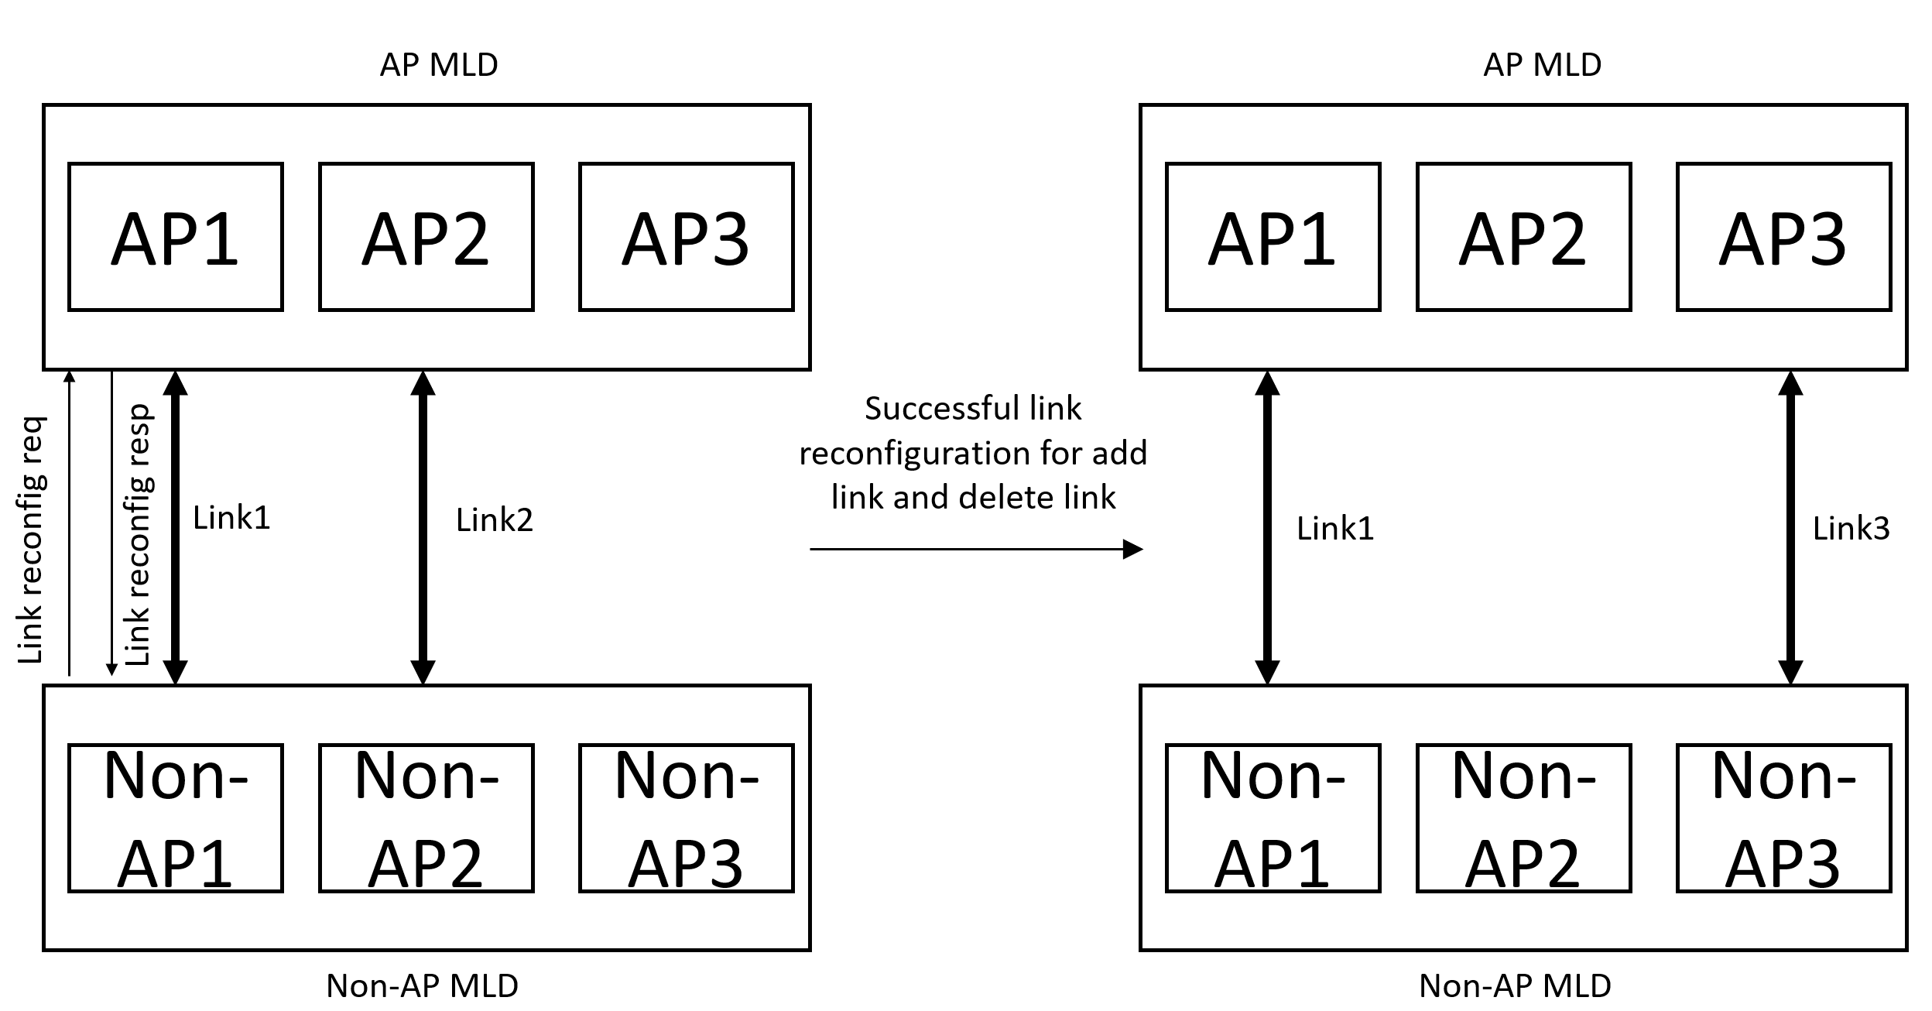
Link Reconfiguration Framework in 11be
Link reconfiguration framework in 11be allows a non-AP MLD to add/delete links with its AP MLD.
The non-AP MLD can transmit a link reconfiguration request frame and AP MLD can transmit a link reconfiguration response frame

Slide 6
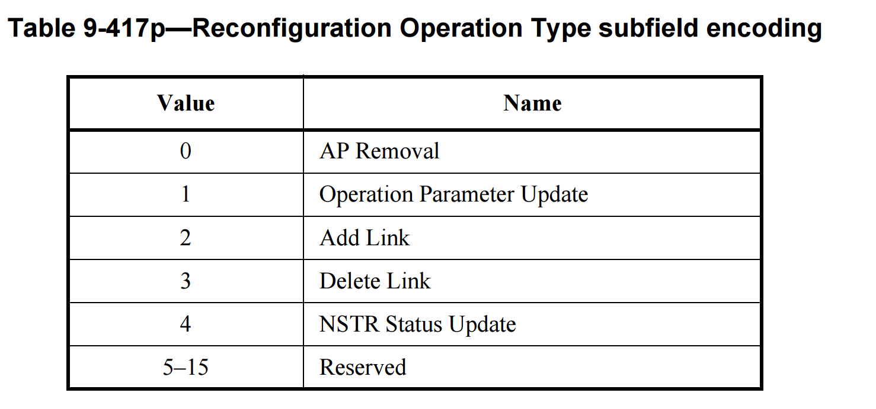
Link Reconfiguration Request and Response Frames Overview
Link reconfiguration req
Link reconfiguration resp
Reconfiguration ML element
Reconfiguration Status List
Group Key Data
Basic ML element
Common Info
Per-STA profiles
Reconfig Status Duple
Common Info
Per-STA Profile
STA control
STA Info
STA Profile
Link ID
Status
Complete profile of the AP on the added link
Reconfiguration operation type
Link ID
Complete profile of a STA

Slide 7
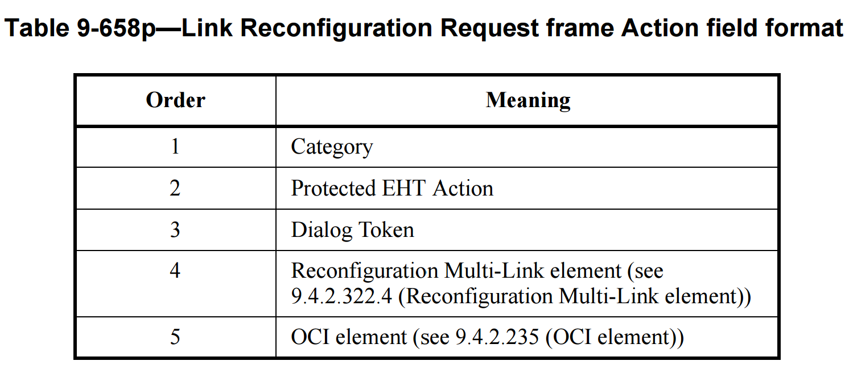
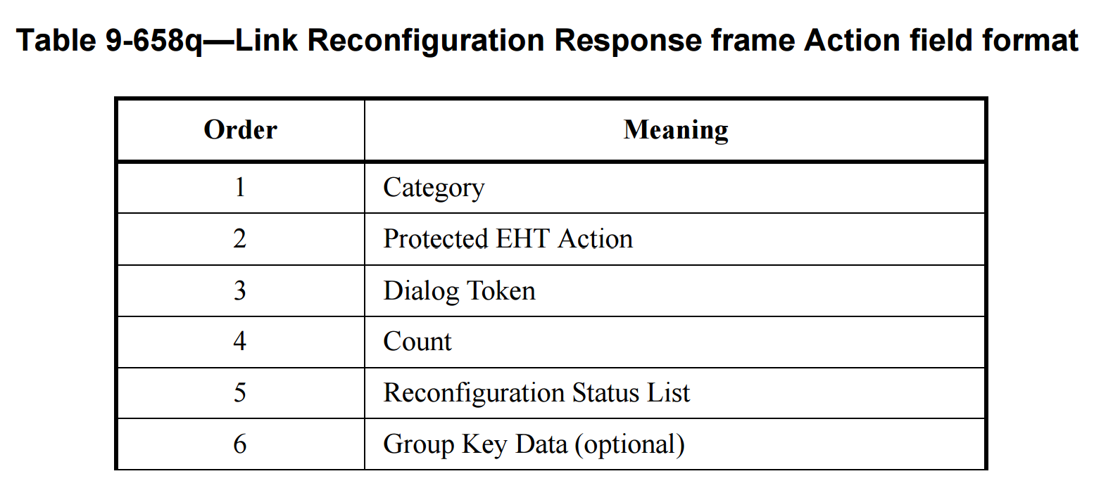
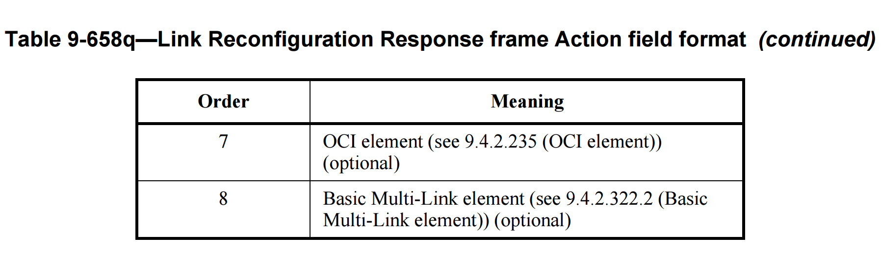
Signaling Details

Slide 8
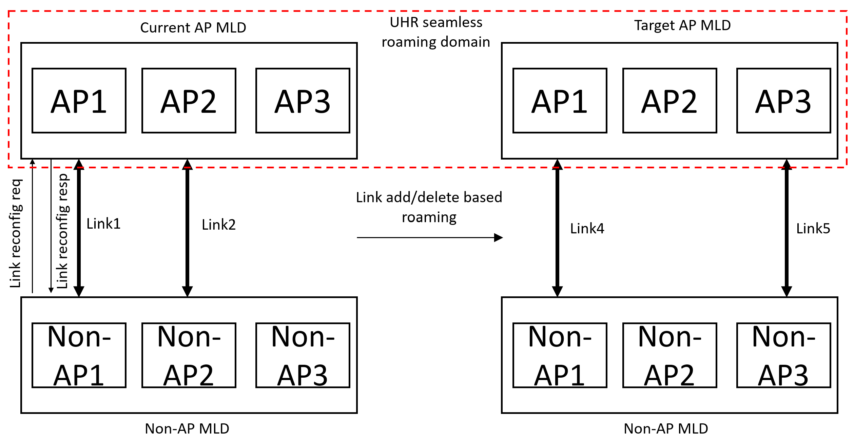
Link Reconfiguration for Seamless Roaming
The link reconfiguration framework concept can be used for designing signaling for preparation and execution phases of seamless roaming:
  Non-AP MLD transmits a modified link reconfiguration request to the current AP MLD to add links at the target AP MLD
  This can result in transfer of context to the target AP MLD
  Target AP MLD and current AP MLD must be from the same UHR seamless roaming domain.
Context transfer

Slide 9
Additional Information to include in Reconfiguration Request Frame
AP MLD identifier:
  Can be set to target AP MLD identifier when performing roaming through current AP MLD.
  Can be set to current AP MLD when performing roaming through target AP MLD. Alternatively, this can be carried in a separate field.
Action/type indicator:
  Can indicate if the request frame is meant for preparation/execution phase.
Context to be transferred:
  Non-AP MLD can indicate to the current AP MLD, the context that it intends to have transferred to the target AP MLD.

Slide 10
Additional Information to include in Reconfiguration Response Frame
AID:
  Non-AP MLD can be assigned an AID
Transferred context indication:
  Indication of what near static context were successfully transferred to the target AP MLD.
Operational parameters:
  Operational parameters needed for SCS, EPCS setups if transferred from current AP MLD to the target AP MLD.
Suggested parameters:
  If context is rejected at target AP MLD, then suggested value to help non-AP MLD to renegotiate and converge faster at target AP MLD. E.g., suggested delay bounds for rejected SCSs.

Slide 11
Conclusion
In this contribution we a link reconfiguration framework for seamless roaming in next generation WLANs
  Extend the 11be concept to perform seamless roaming
  Information items that can be carried in the link reconfiguration request and response frames

