Slide 1
Some Open Issues on COBF
Date: 2025-03-10
Authors:
Name | Affiliations | Address | Phone | email
Sameer Vermani | Qualcomm Technologies Inc. |  |  | svverman@qti.qualcomm.com
Alice Chen
Bin Tian
Youhan Kim
Meriam Rezk
Sherief Helwa
Ahmed Elsherief

Slide 2
Introduction
In these slides we cover some miscellaneous topics related to Coordinated Beamforming (COBF)
Support for 2x LTF + 0.8us GI for COBF
Indication of packet durations in COBF invite and response
BSS ordering of per-user-SIG fields
Pre-sounding exchange

Slide 3
Background
We assume that there are at-least the following three frames before the COBF PPDU
Invite Frame from sharing AP
Response Frame from shared AP
Sync Frame from sharing AP
Sharing AP
COBF
COBF
Sync
DL PPDU
Invite
Shared AP
COBF
DL PPDU
Response
Note: Other MAC related frames (ICF, ICR etc..) maybe needed but are not shown here

Slide 4
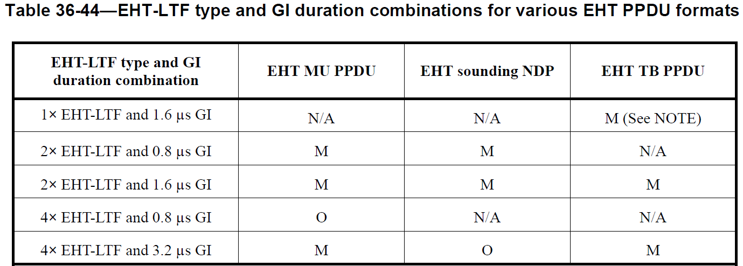
GI And LTF Size
GI+LTF size in EHT MU PPDU supports 3 options as mandatory
Suggest to support the same choices {2x LTF +0.8us, 2xLTF+1.6us, 4xLTF+3.2us} for COBF PPDUs in UHR as well
2x LTF+0.8 us needs special attention, see next slide
Suggest to indicate GI+LTF size in the Invite frame
More on this on the next slide

Slide 5
2xLTF+0.8 GI for the COBF data
COBF data is transmitted by two APs
On the surface, it seems that COBF would need higher CP as it is akin to an UL TB PPDU
However, the situation is more benign
Relative timing offset between two APs (where one AP synchronizes to the other) leads to half the error spread compared to STAs trying to synchronize to an AP → Errors of two STAs can be in opposite directions
Isolation between BSSs helps lower the effective delay spread seen at the STA
Nulling makes the OBSS signal appear at a much lower level in the UHR section
Suggest to make 2x LTF+0.8us CP for COBF PPDUs to be mandatory at the AP and STA
However, we also think that each AP is the best judge for which CP to use for the STAs being transmitted to
If for some reason AP thinks it is operating in higher delay spread situations, it should be able convey that to the other AP at the COBF group formation stage

Slide 6
GI+LTF combination negotiation
Sharing AP will pick the GI+LTF combination in the invite frame
Need a way for the shared AP to be able to have a say in avoiding 2x+0.8us GI
If it knows 2x+0.8GI will not work well for its STAs
2x LTF+0.8us GI support for a COBF pair is exchanged at the group formation stage
Each AP conveys if it can support 2x+0.8us GI for this COBF group or not
No further last-minute negotiation before transmission
Invite frame from sharing AP dictates the LTF+GI combination keeping the shared AP’s support in mind

Slide 7
Indication of packet sizes in pre-transmission exchange
In the pre-transmission information exchange for COBF it is important to provide the shared AP an idea about the packet size
So, it can make good scheduling decisions for its STAs
Also, maybe good to give shared AP some say in this process
Mainly to ask for a higher packet size if needed
Indication of exact packet length is not possible in invite frame as the Nss of shared AP and hence the MCS of the COBF PPDU is not known
Proposed solution
Indicate the following in the information in the invite frame
Minimum number of symbols (Max-Nsym) in COBF PPDU
Maximum number of symbols (Min-Nsym) in COBF PPDU
Indicate “Suggested Nsym” in the COBF response frame from shared AP
Sharing AP is allowed to ignore the shared AP’s suggestion
Suggested value shall not be smaller than the min-Nsym value from sharing AP
No spec requirement and corresponding testing of the accuracy of min/max Nsym calculations or suggested Nsym calculation
In the extreme case the min and max can even carry an Nsym that corresponds to 0 and max possible PPDU length respectively

Slide 8
BSS ordering of per-user-SIG
Per-user-SIG field ordering
When either AP can go first while maintaining the decreasing order of ss, we want to have a fixed rule where sharing AP goes first
E.g., In the following cases the user fields of the sharing BSS go first
Per-user Nss=[2] in sharing BSS, per-user Nss=[2] in shared BSS
Per-user Nss=[1] or [1,1] or [ 1 1 1] in sharing BSS, per-user Nss=[1] or [1,1] or [ 1 1 1] in shared BSS

Slide 9
Pre-sounding exchange
An AP may choose to be involved in COBF sounding/Tx with a limited number of APs
AP may need to maintain carrier frequency correction per COBF group
Some APs may want to avoid this situation altogether by doing COBF sounding/Tx with only one AP at a time
Eases the memory requirements at a COBF capable AP
Need to store OBSS STA CSIs for a smaller number of OBSSs
A pre-sounding exchange becomes useful
Need a way for the AP to decline a COBF sounding request when it is already involved in an active COBF agreement with too many APs
This decline message is also useful for situations when the AP doesn’t have traffic to send to the COBF candidate STAs or does not have any STAs which are good COBF candidates
Need it for exchanging sounding capability of the participating STAs as well
Simple 2 frame exchange (further details up-to the MAC group)
COBF Sounding Invite and COBF Sounding Response
Sounding Response can decline a sounding invite

Slide 10
Summary
GI+LTF options for COBF
2x+0.8us option can be supported at both AP and STA in addition to 2x+1.6us and 4x+3.2us
Give some freedom to shared AP to be able to avoid 2x+0.8GI if it is not suitable
Min/Max Nsym indication in invite is helpful for good scheduling decisions at shared AP
BSS ordering proposal
In case of a tie, sharing AP’s per-user SIG fields always go first
Pre-sounding exchange is needed
Reject a sounding invite due to various reasons
Also exchange Nss-for-sounding capability of STAs being sounded in each BSS

Slide 11
SP1
Do you support the following for the COBF PPDU’s GI+LTF support and signaling ?
Support of following GI+LTF combinations to be mandatory at both AP and STA
2x LTF +0.8us, 2xLTF+1.6us, 4xLTF+3.2us
Additionally, 2x LTF+0.8us GI usage for a COBF pair is exchanged at the group formation stage
Each AP conveys if it can use 2x+0.8us GI for this COBF group or not
No further last-minute negotiation before COBF transmission
Invite frame from sharing AP dictates the LTF+GI combination keeping the shared AP’s ability to use 2x LTF+0.8us in mind

Slide 12
SP2
Do you support having the following information exchanged before COBF PPDU?
Min-Nsym and Max-Nsym indication about the COBF PPDU length sent in the COBF invite frame
Suggested Nsym indication in the COBF response frame from shared AP
Sharing AP is allowed to ignore the shared AP’s suggestion
Suggested value shall not be smaller than the min-Nsym value from sharing AP

Slide 13
SP3
Do you support the following about BSS ordering of per-user SIG fields
In the cases where the user fields of either BSS may go first, while preserving the Nss in non-increasing order, the user fields of the sharing BSS go first

Slide 14
SP4
Do you support to have a frame-exchange before COBF sounding between the two APs which will at-least serve the following goals:
Unavailability/decline indication from the responding AP
Used by responding AP to refuse participation in a COBF sounding process
Exchange of sounding Nss capability of the STAs being sounded in the two BSSs
The minimum sounding Nss capability of the participating STAs in each BSS will be exchanged
Note: Design of the frames is TBD by MAC group

Slide 15
appendix
Some protocol details

Slide 16
Sequential sounding
Same Nss is needed
Phase 1
Phase 2
Sharing
AP1
NDPA
NDP
BFRP
NDPA
BF
RP
NDP
Shared
AP2
CFO
Precorrection
NDP
NDPA
NDP
BFRP
NDPA
BFRP
STA1
associated
with AP1
CSI
CSI
STA2
associated
with AP2
CSI
CSI

