Slide 1
Multi-AP Coordination Negotiation Indication
Date: 2025-01-11
Authors:

Slide 2
Abstract
Motions passed to define multi-AP coordination (MAPC) in TGbn [1]
  Different MAPC mechanisms including Co-TDMA, Co-RTWT, Co-SR, and Co-BF.
  A common framework for MAPC procedures [2]
    MAPC discovery procedure
    MAPC agreement negotiation procedure
Proposal: multi-AP coordination/negotiation indication to indicate the AP’s intention of participating in multi-AP coordination/negotiation
  An AP may disable multi-AP coordination/negotiation with certain APs for certain reasons
  It helps avoid unnecessary MAPC agreement negotiation and MAPC Request/Response, which helps reduce overhead and simplify network operations

Slide 3
Background and Motivation
MAPC discovery procedure and MAPC agreement negotiation procedure are needed for MAPC mechanisms.
An AP may not want to participate in MAPC or MAPC negotiation with certain APs in certain cases, even when the AP is capable of and has enabled certain MAPC mechanisms.
  More details and examples on following slides.
Proposal: multi-AP coordination/negotiation indication
  An AP may indicate that it does not participate in multi-AP coordination/negotiation
  Other APs that receive the indication will not initiate MAPC Negotiation/Request/Response with the AP

Slide 4
Multi-AP Coordination/Negotiation Indication (1/2)
The AP still has MAPC capabilities carried in Beacons or other frames.
In addition, the AP may indicate whether it is willing to participate in multi-AP coordination/negotiation or not in broadcast or unicast frames.
The AP may have MAPC enabled but does not want to participate in multi-AP coordination/negotiation for certain reasons:
  The AP only wants to have MAPC with certain APs but not with all the APs.
  The AP already performed or is performing MAPC negotiation with intended APs, e.g., by backhaul, and does not want to have multi-AP coordination/negotiation again over the air or with other unintended APs.
  The AP already performed MAPC negotiation/agreement with intended STAs and does not want new negotiations, e.g., MAPC modes/parameters are already finalized and locked.

Slide 5
Multi-AP Coordination/Negotiation Indication (2/2)
The AP can disallow/disable multi-AP coordination/negotiation with certain APs by setting multi-AP coordination/negotiation indication to 0.
  The indication can be set to 0 in broadcast frames and set to 1 only for intended APs.
  The indication can be set to 0 or 1 for certain durations.
Disabling multi-AP coordination/negotiation can avoid unnecessary MAPC Negotiation/Request/Response and can help reduce overhead.
The indication can be a single bit for general MAPC or multiple bits for different MAPC mechanisms.
APs that receive the indication may take actions accordingly, e.g., do not perform PASN/MAPC Negotiation/Request or switch to a different channel.

Slide 6
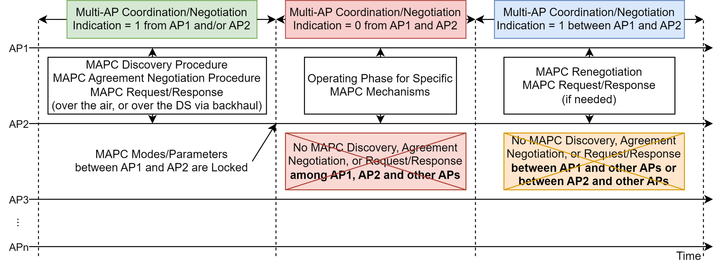
Example
AP1 and AP2 have MAPC enabled, but do not participate in MAPC w/ other APs

Slide 7
Conclusion
This contribution presents multi-AP coordination/negotiation indication for an AP to indicate its intention of participating in multi-AP coordination/negotiation
  An AP may disable multi-AP coordination/negotiation with certain APs for certain reasons.
  APs that receive the indication may take actions accordingly, e.g., do not send MAPC Negotiation/Request or switch to a different channel.
  It helps avoid unnecessary MAPC agreement negotiation and MAPC Request/Response, which helps reduce overhead and simplify network operations.

Slide 8
References
[1] 802.11-24/0209r8, Specification Framework for TGbn, Ross Jian Yu (Huawei)
[2] 802.11-24/2049r5, PDT MAC M-AP Coordination Framework, Arik Klein (Huawei)
[3] IEEE 802.11-2024, September 2024
[4] IEEE 802.11be-2024, September 2024

Slide 9
Straw Polls
SP1: Do you support to define a mechanism in TGbn to indicate whether an AP intends to participate in multi-AP coordination/negotiation?
Note: The indication can be a single bit for general MAPC or multiple bits for different MAPC mechanisms.
Result: Yes: , No: , Abstain:

