Slide 1
Signal Design for Wideband Multi-Carrier OOK
Date: 2025-03-09
Authors:

Slide 2
Abstract
It has been agreed that the (3dB) bandwidth of the AMP DL PPDU in 2.4 GHz is at least 10 MHz for backscattering communication. The transmit spectrum mask is TBD.
Two different approaches for achieving a large bandwidth for a low data rates OOK were described in [1] and [2].
In this contribution, the approach in [3] is used to design a wideband OOK signal with low PAPR
Also, an alternative requirement for the 3 dB BW of 10 MHz is discussed

Slide 3
Outline
Recap of desired signal properties
Methods for obtaining the desired signal properties
Best examples obtained by numerical search
Conclusions
Straw Polls

Slide 4
Recap of desired signal properties - Frequency
Wideband signals are desirable to benefit from frequency diversity and to allow for high TX power in PSD limited regions
We use the term maximum allowable power (MAP) to refer to the maximum transmission power allowed under a PSD limit of 10 dBm/MHz
A signal that achieves higher MAP will also allows for better frequency diversity
When comparing two signal alternatives, the one that allows for larger MAP is considered the better one

Slide 5
Recap of desired signal properties - Time
The signal should have as low PAPR as possible
When comparing two signal alternatives, the one with the smallest PAPR is considered the better one
Note: To measure PAPR, we must consider the signal after LPF needed to fulfill the TX spectrum mask

Slide 6
Search for a suitable ON signal
The selected signal should have the following propoerties (TX mask assumed met)
  The TX power shoud have as high MAP as possible
  The PAPR should be as small as possible
In the search, the following “Frequency-time” metric is used
  FT_metric = MAP (dBm) – PAPR (dB)
  A sequence is considered better if the FT_metric is higher
Note: If a sequence with a good FT_metric is found, but the TX mask is not met (with sufficient margin), this may be easily fixed by (i.e., no need for new search)
  Slightly updating the pulse-shaping filter
  Slightly decreasing the BW of the LPF assumed present to meet the TX spectrum mask

Slide 7
Method for obtaining the desired signal properties
A constant envelope signal is used as the basis to have good PAPR [3]
  A pulse shape is selected (“hand-crafted”) for modulating a single chip
  A spreading sequence is found by numerical search
  The time signal is obtained by applying the pulse shaing to the spreading sequence
The frequency contents of the time signal are found by applying an FFT
The multi-carrier ON signal is generated using an IFFT with a suitable number of bins (that is, some of the FFT coefficients are set to zero) + adding a CP
To be compliant with a standard OFDM transmitter, the IFFT coefficients are quantized to correspond to QAM symbols (1024-QAM)

Slide 8
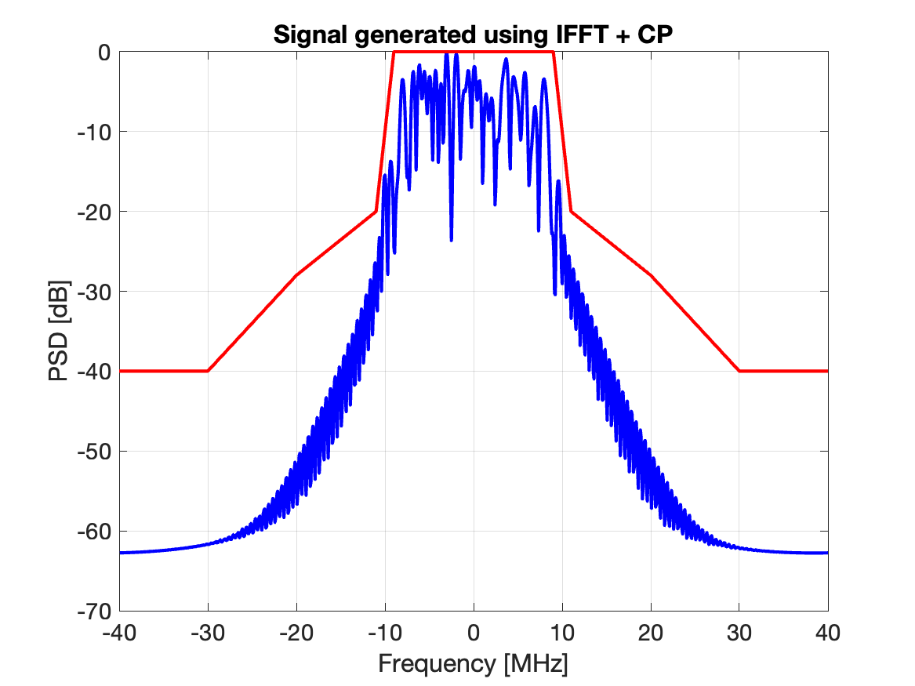
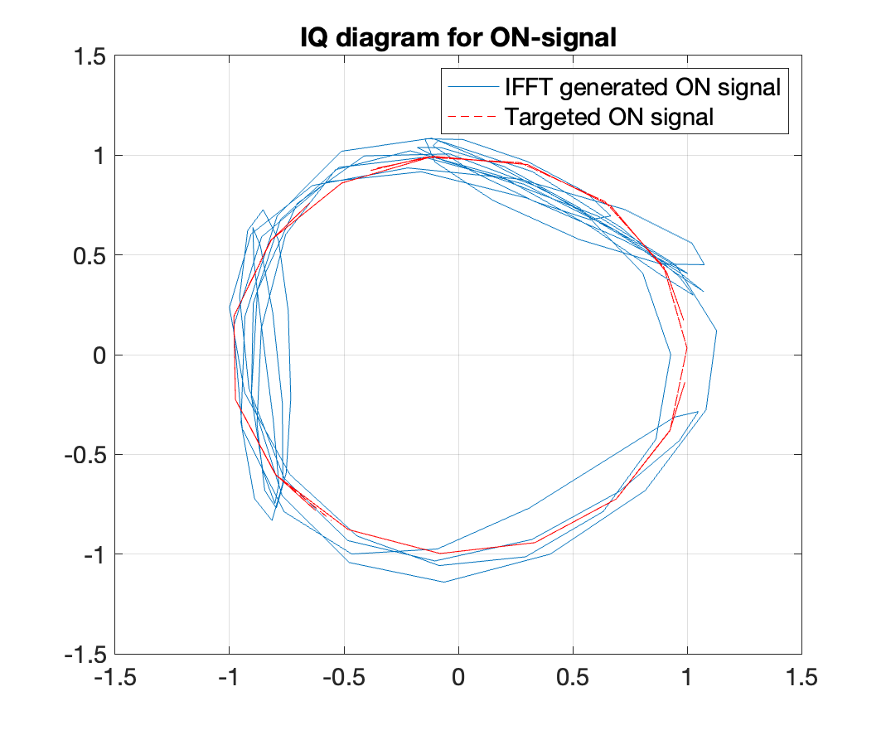
Performance 250kb/s
The best ON-signal according to the ad-hoc metric is shown to the right. The IFFT inputs are in the appendix
The MAP is 20.03dBm and the PAPR is 1.47dB for the ON part
Note: The sequence is randomized for differnet symbols by adding a random phase (0,2pi]

Slide 9
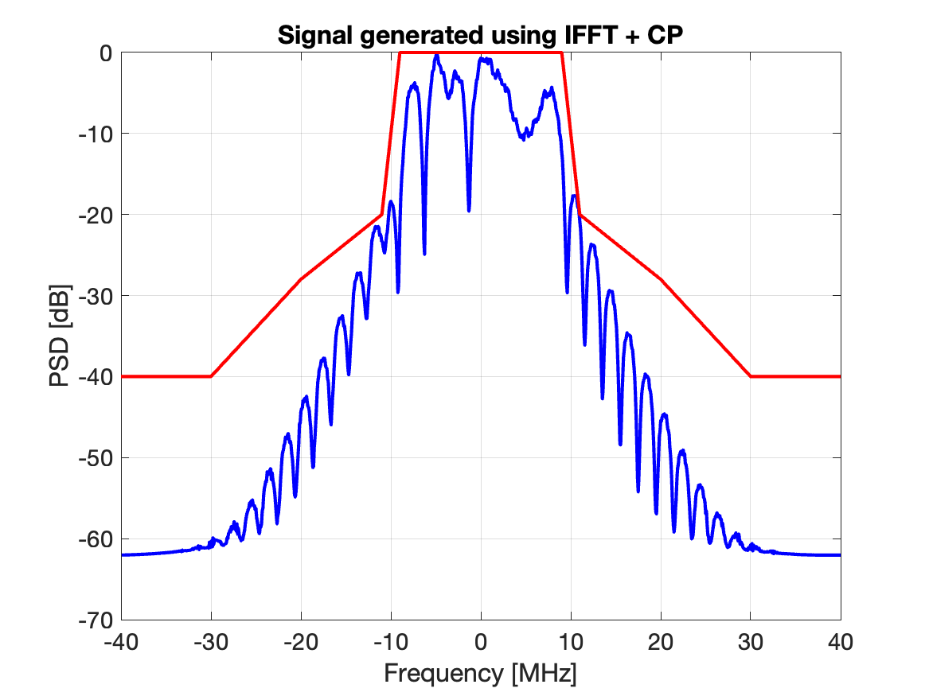
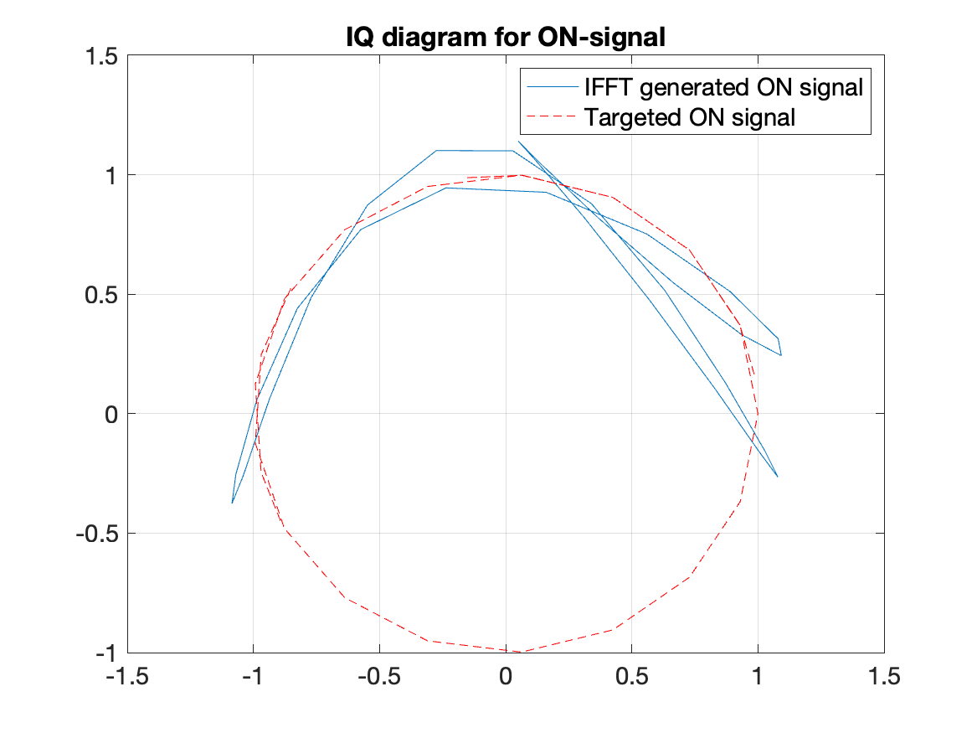
Performance 1Mb/s
The best ON-signal according to the ad-hoc metric is shown to the right. The IFFT inputs are in the appendix
The MAP is 19.23dBm. The PAPR is 1.58dB for the ON part

Slide 10
Discussion of signal metric
With a bit more time spent on signal design, it seems more relevant to requrie that the signal allows for transmitting with a TX power above some threshold value in PSD limited regions (minimum MAP)
It is proposed to change the 3dB BW requriement to something like “The MAP be at least X dBm, X e.g. 18 dBm
It is assumed that how the signal is generated is up to implementation
It is unclear whether it makes sense to standardized PAPR

Slide 11
Conclusions
It is possible to design a multi-carrier OOK signal which has both good frequency and time properties for both 250 kb/s and 1 Mb/s
It is essential to realize that one can select the inputs to the IFFT, which is in contrast to OFDM where this is random data
It is proposed to reconsider the metric used to ensure that the signal is sufficiently wideband. Instead of 3 dB BW of 10 MHz, it is proposed to require that the maximum allowable transmit power in PSD limited regions should be above some thehold, e.g. 18 dBm

Slide 12
References
P. Li et al., “DL Wideband OOK Generation”, IEEE 802.11-25/0050r1.
L. Wilhelmsson et al., “Signal Design for OOK”, IEEE 802.11-25/0051r1.
Miguel Lopez et al., “MC-OOK Symbol Design”, IEEE 802.11-18/0479r2.

Slide 13
Appendix – IFFT inputs
1 Mb/s
S_QAM[-4:3]= [-0.0383 + 0.1149i -0.2680 - 0.4212i 0.0383 - 0.5744i 0.2680 + 0.4212i 0.0383 + 0.6510i 0.7275 - 0.1149i -0.1915 + 0.1915i 0.5744 + 0.0383i ]
250 kb/s
S_QAM[-16:15] = [0.1149 - 0.0383i 0.1915 - 0.0383i 0.1149 + 0.0383i 0.1149 - 0.5744i -0.0383 + 0.1915i 0.4978 - 0.0383i 0.4978 + 0.1915i -0.5744 + 0.1149i -0.2680 + 0.1915i -0.4212 - 0.1915i 0.0383 - 0.2680i 0.6510 - 0.0383i -0.3446 - 0.1915i 0.1149 + 0.7275i 0.0383 + 0.4978i 0.5744 - 0.1149i -0.1915 + 0.5744i 0.2680 + 0.3446i -0.1915 + 0.4212i 0.3446 + 0.1915i 0.0383 - 0.0383i 0.4978 + 0.3446i -0.4212 - 0.4212i -0.4212 - 0.4978i 0.1915 + 0.4212i -0.4978 + 0.2680i 0.0383 - 0.0383i 0.4212 - 0.1149i 0.1915 + 0.2680i 0.1915 - 0.4978i -0.0383 - 0.0383i 0.1149 - 0.0383i]

